Slide 1
MIT DNA & Protein Models Adapt to Covid Times

Slide 2
Prior Work: Benefits of teaching with MIT Tactile Models

Slide 3
Prior Work: Existing Teacher Resources for the MIT Models

Slide 4
Currently Adapting: Hands-on Kit Packages for Partners

Slide 5
Currently Adapting: Lesson Delivery from a Distance
Intro models for CYP protein lesson next

Slide 6
Amino Acid Info Booklets

Slide 7
Amino Acid Info Booklet Instructions

Slide 8
Amino Acid Info Part 1: Building Proteins

Slide 9
Amino Acid Info Hydrophobic Amino Acids

Slide 10
Amino Acid Info: Folding Proteins in Water
Amino Acid Info Booklets

Slide 11
A Short Lesson on the Effects of Genetic Susceptibility on Environmental Health
Using these MIT Edgerton Center protein models here is…
Three Factors That Influence
the Severity of a Person’s
Environmental Health Problem
A Short Lesson on the Effects
of Genetic Susceptibility
On Environmental Health
Special credit goes to my colleague, Amanda Gruhl Mayer, PhD for the CYP variants literature research.
Dr. Mayer was a major contributor to design of this lesson in our “Genes and Health” Booklet

Slide 12
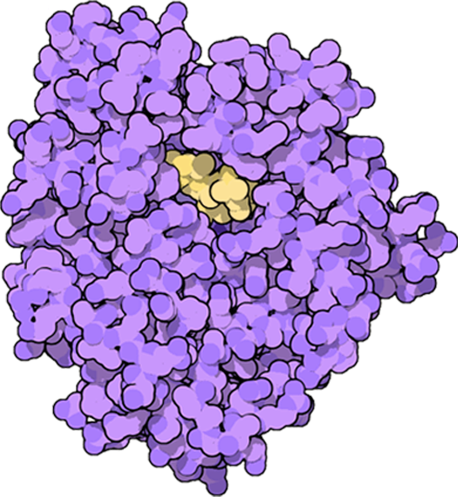
CYP Proteins and Health
Excerpts from MIT Edgerton Center Booklet: “Genes and Health© “
CYP Proteins and Health:
1. What are Cytochrome-P450 (CYP) proteins?
CYP proteins are enzymes that metabolize molecules like drugs, hormones, and toxic compounds:
Drugs Hormones Toxic Compounds
•pain killers •testosterone •pesticides
•antibiotics •estrogen •cigarette smoke
•antidepressants •diesel exhaust
2. How do CYP proteins work?
CYP proteins in the liver add an oxygen atom to drugs, hormones, and toxic compounds to help eliminate them from the body.

Slide 13
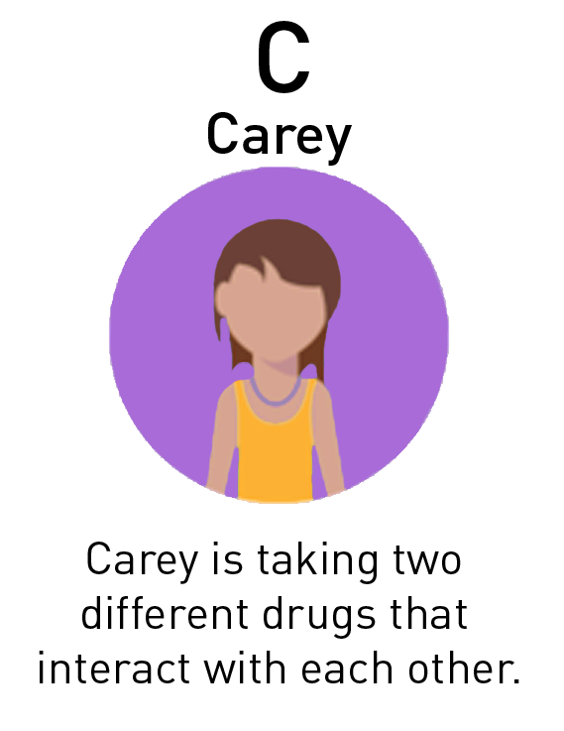
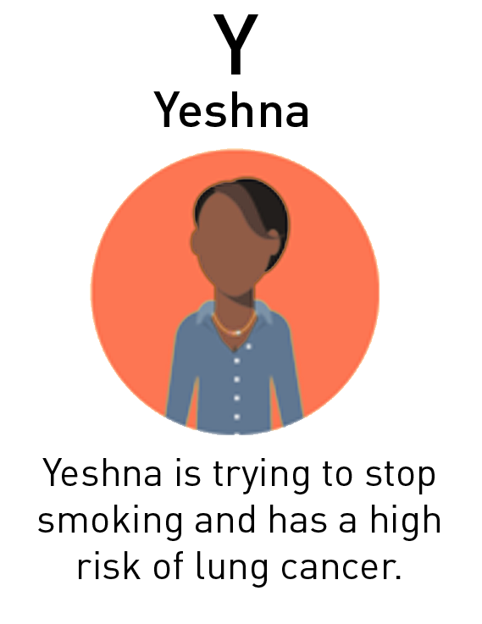
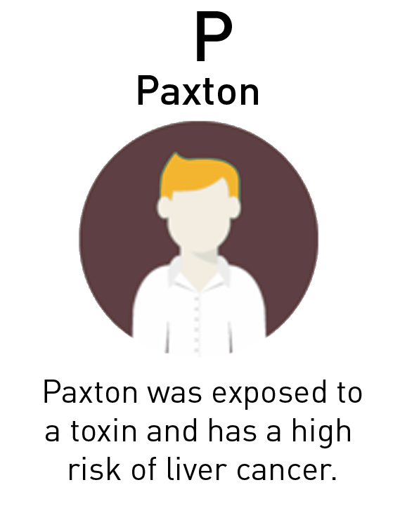
How do CYP Proteins Affect Health?
3. How do CYP proteins affect health?
Differences in the amino acid sequence of CYP proteins can have significant health effects.
Let’s model a CYP protein in three different people:
Paxton quit smoking last year and has a low risk of lung cancer.

Slide 14
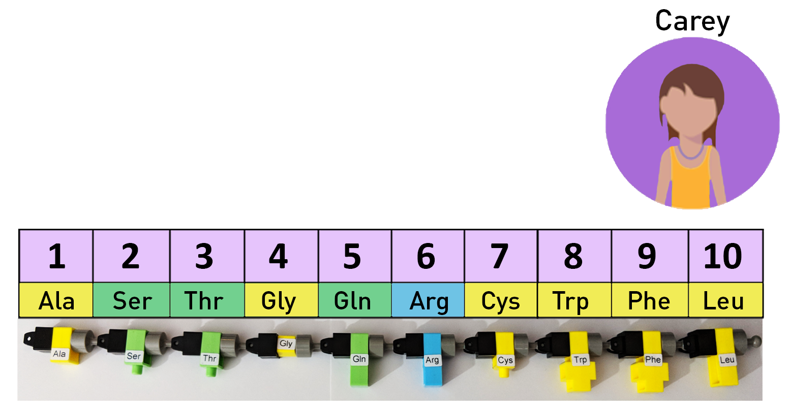
Build the CYP Protein Active Site for Carey
Molecules must be bound in the CYP protein active site before metabolism.
Build the CYP protein active site for Carey.

Slide 15
CYP Protein Active Site Mat for Carey
Find the CYP Protein Active Site Mat for Carey (purple).
Place the built protein chain on the mat.
Different people can have different amino acids, or variants, in their CYP active sites.
Carey has Phe and Arg as variants.
Where is the active site?
The substrate (yellow) is inside the active site in this CYP protein (purple).

Slide 16
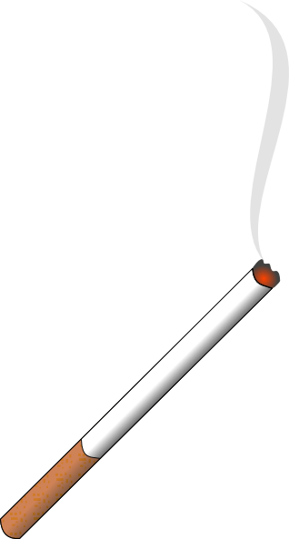
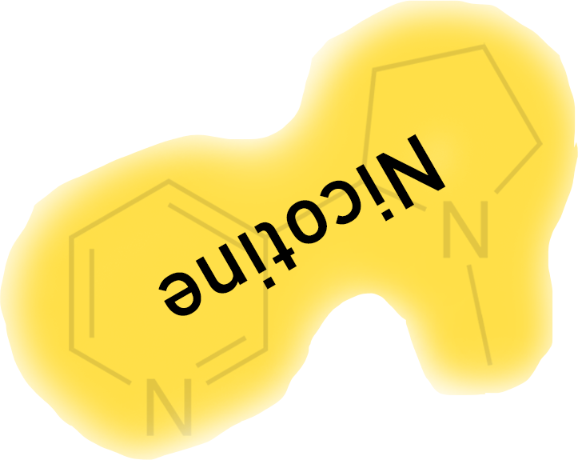
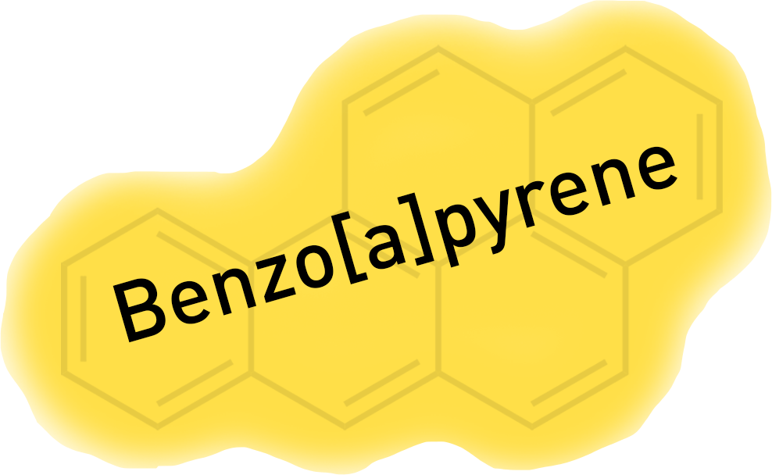
How CYP Metabolized Toxic Compounds
Let’s look at how CYP metabolizes toxic compounds.
Cigarette smoke is an environmental poison that contains many toxic compounds, including nicotine and benzo[a]pyrene.
Nicotine increases the level of dopamine in the brain, increasing feelings of pleasure and well-being. When nicotine leaves the body, a person will crave more.
Benzo[a]pyrene can be metabolized differently by CYP proteins. When the CYP protein adds an oxygen atom to benzo[a]pyrene it can turn into a carcinogen! This sometimes happens with toxic compounds.

Slide 17
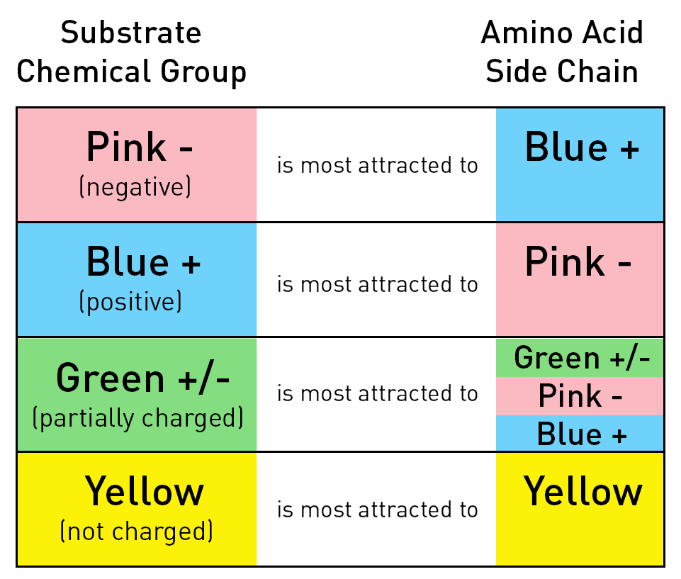
Substrate Chemical Group and Amino Acid Chain for Nicotine - Yeshna
Rotate the nicotine card in Yeshna’s CYP
active site to maximize the attractions
between chemical groups and amino acid side chains.
Where will nicotine bind in the active site?
Substrate
Amino Acid Side Chain
WAIT for student guesses!

Slide 18
Nicotine CYP Protein Active Site – Yeshna
Yellow hydrophobic nicotine is attracted to the large hydrophobic section of amino acids at the top and side.
Nicotine can bind in multiple locations in the active site – it is metabolized very quickly.
CYP protein adds an oxygen atom to nicotine so it can be easily flushed out of the body in the urine.
If nicotine is metabolized quickly, will cigarette cravings increase or decrease?
Answer on next slide

Slide 19
Will Cigarette cravings increase or decrease?
If nicotine is metabolized quickly, will cigarette
cravings increase or decrease?
INCREASE
The nicotine is being metabolized more
quickly and leaving the body sooner.

Slide 20
Substrate Chemical Group and Amino Acid Side Chain - Yeshna
Benzo[a]pyrene is another toxic compound found in cigarette smoke.
Let’s see how CYP metabolizes benzo[a]pyrene differently.
Rotate the benzo[a]pyrene card in
Yeshna’s CYP active site to maximize the
attractions between chemical groups and
amino acid side chains.
Where will benzo[a]pyrene bind in the active site?
Amino Acid Side Chain
Substrate
WAIT for student guesses!

Slide 21
Yeshna CYP Protein Active Site
Yellow hydrophobic benzo[a]pyrene is attracted to large hydrophobic section of amino acids at the top and side.
When the CYP protein adds an oxygen atom to benzo[a]pyrene it turns into a carcinogen!
If benzo[a]pyrene is metabolized quickly, will cancer risk increase or decrease?
Answer on next slide

Slide 22
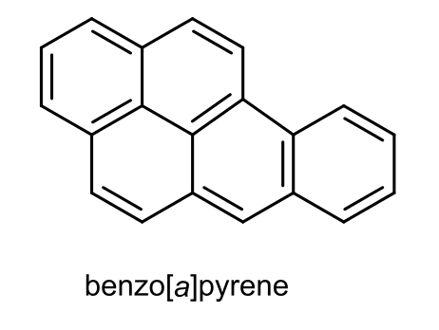
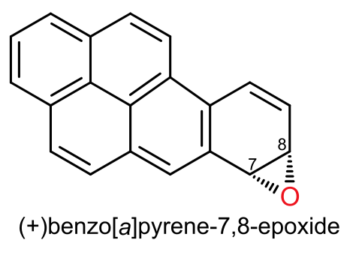
Will cancer risk increase or decrease?
If benzo[a]pyrene is metabolized quickly, will cancer risk increase or decrease?
INCREASE
More benzo[a]pyrene is being made into a carcinogen,
so the cancer risk increases.
Summary of Yeshna next

Slide 23
Yeshna
Yeshna
Metabolizes nicotine very well. The nicotine will leave her body quickly
and increase cigarette cravings.
Metabolizes benzo[a]pyrene very well. She will have more carcinogens in her body.
Paxton next

Slide 24
Paxton
Paxton
Metabolizes nicotine poorly. The nicotine will stay in his body longer
and decrease cigarette cravings.
Metabolizes benzo[a]pyrene
poorly. He will have fewer
carcinogens in his body.
Comparison of Yeshna and Paxton next

Slide 25
Compare Yeshna and Paxton
Compare Yeshna and Paxton.
How do their CYP variants affect their
health with regard to smoking?
YESHNA
will have a harder time quitting smoking and has a higher risk of lung cancer.
PAXTON
will have an easier time quitting smoking and has a lower risk of lung cancer.
SUMMARY:
Yeshna and Paxton have different responses to smoking because of their protein variants.

Slide 26
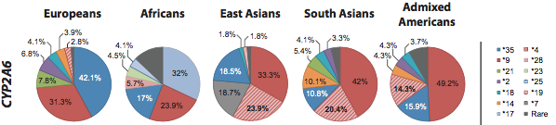
CYP Variants and World Populations
CYP Variants and World Populations
CYP2A6 variants that cause differences in Smoking Desire & Lung Cancer Risk
CYP variant distribution can be incredibly different across populations. These differences in genetic variants can lead to huge disparities in drug reactions, addictive behaviors, and cancer risks.

Slide 27



This CYP Proteins and Health Lesson has been included in the MIT Edgerton Center Booklet "Genes, Proteins, and Health"
This CYP Proteins & Health Lesson has been included in the
MIT Edgerton Center Booklet “GENES, PROTEINS and HEALTH©”
The MIT DNA and Protein Models …
“Teach Abstract Concepts in Concrete Ways©”
          Active and Exploratory in Nature
          Providing for Memorable Learning Experiences

Slide 28
COLLABORATION CREDITS
…and thanks for this opportunity to learn together !
LEAH Knox Scholars Program: A two-year internship program for rising high school juniors and seniors from backgrounds underrepresented in STEM fields (communities of color and low-income backgrounds) in the Greater Boston area providing a foundation
for their future as leaders in the biomedical research field.
Project Collaborators for the 2020 LEAH Knox Scholars Program Summer Biotechnology Lab for First Years:
· MIT Graduate Student Teaching Assistants: Ryan Elbashir; Gabriella S Lopez Perez; Bryanna Isela-Inez Canales; and
Karla Alejandra Montejo
· MIT Biology Dept Instructors: Drs. Mandana Sassanfar and Vanessa Cheung
· Health Resources in Action, Inc. LEAH Program Director: Lisa Aslan. Principle Investigators: Laurie Jo Wallace,
and Lisa Wolff, and with student coordination by Brandon Morgan
LEAH Knox Scholars Program is funded in part by the NIH Grant # R25OD023756-01
2) Environmental Health Sciences Teacher Summer Institute: A long-running teacher professional development program for middle and high school science teachers in the Texas. This week-long series of daily workshops provides teachers with hands-on training and EHS content knowledge. Texas Teachers earn PDE credits.
Project Collaborators: The whole k-12 Team put together a terrific offering of a four day virtual program in amazing time.
  Prof. Robin Fuchs-Young, PhD. Texas A & M University, Principle Investigator
EHS Teacher Summer Institute is funded in part by the NIH Grant # R25ODO20219-01A1
3 ) EMPOWER: Engaging Multi-Discipline Professional Opportunities for Women in Environmental Health:
The EMPOWER summer camp is a partnership with the School of Public Health and College of Education and Human Development, which
aims to provide high school students and teachers with a 2 week virtual research experience.
  Asst. Prof. Christa Young Wright, PhD. , School of Public Health, Georgia State University, Principle Investigator
  GSU Undergraduates participating with MIT collaboration: Mariah Stallworth, Mckeda Knight, Franki Algarin, Tran Nyguyen
  EMPOWER Partner Teacher: Dr. Usha Patke, North Atlanta High School
EMPOWER Program is funded by NIH Grant # R25ES030240-01A1

Slide 29
RESOURCES
https://edgerton.mit.edu/DNA-proteins-sets
Videos for different purposes from the playlist:
YouTube Playlist for all MIT DNA and Protein Set Instructional Videos: (For both educators and students)
https://www.youtube.com/playlist?list=PLMvYhn9sjfL7YXxpN-6ImvzZuWUS7Fdlk
“Teacher to Teacher” Video: Connect the concepts of genes, proteins, and traits
https://www.youtube.com/watch?v=U8eKuOhyzMg&list=PLMvYhn9sjfL7YXxpN-6ImvzZuWUS7Fdlk&index=17&t=0s
“Summarizing the Content” Video: Introduction to Amino Acids:
https://www.youtube.com/watch?v=tXLXDr8QhOI&list=PLMvYhn9sjfL7YXxpN-6ImvzZuWUS7Fdlk&index=2&t=0s
“How To” Videos: Designed to help everyone learn how to build it right.
https://www.youtube.com/watch?v=cuZa_9X1myA&list=PLMvYhn9sjfL7YXxpN-6ImvzZuWUS7Fdlk&index=2
End of file: PEPHKVandiver9-29-20final.pptx

