Slide 1
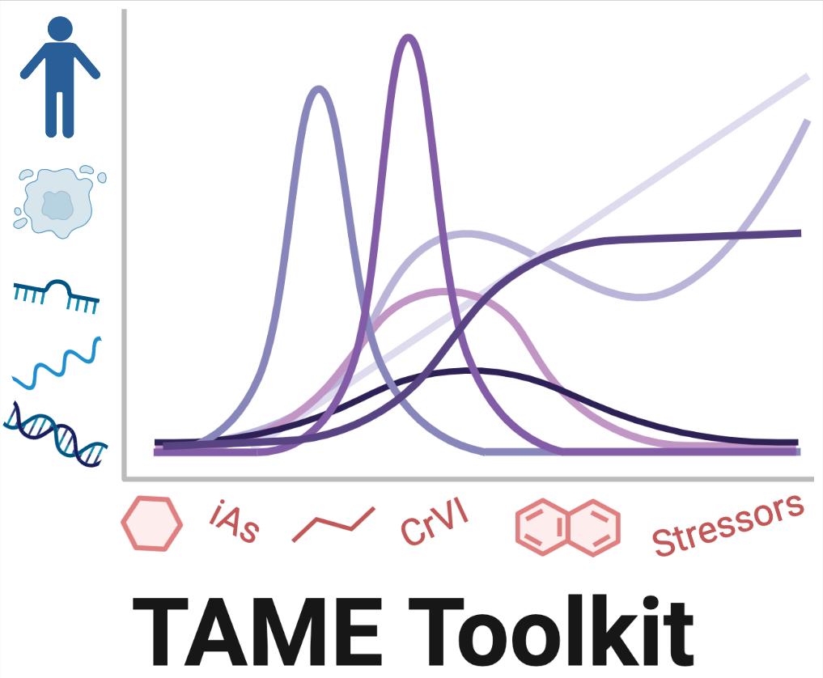
The inTelligence And Machine lEarning (TAME) Toolkit for Introductory Data Science in Environmental Health
Julia E. Rager, PhD, MSEE
Assistant Professor | University of North Carolina at Chapel Hill (UNC)
Department of Environmental Sciences and Engineering (ENVR)
Institute for Environmental Health Solutions (IEHS)
Center for Environmental Medicine and Lung Biology (CEMALB)
Curriculum in Toxicology and Environmental Medicine (CiTEM)
Kyle Roell, PhD
Data Analyst | University of North Carolina at Chapel Hill (UNC)
Department of Environmental Sciences and Engineering (ENVR)
Institute for Environmental Health Solutions (IEHS)

Slide 2
Presentation Schedule
Introduction to TAME and its development – Dr. Julia Rager
Real-time demonstration of how to use TAME – Dr. Kyle Roell
Q&A is encouraged throughout and also at the end

Slide 3
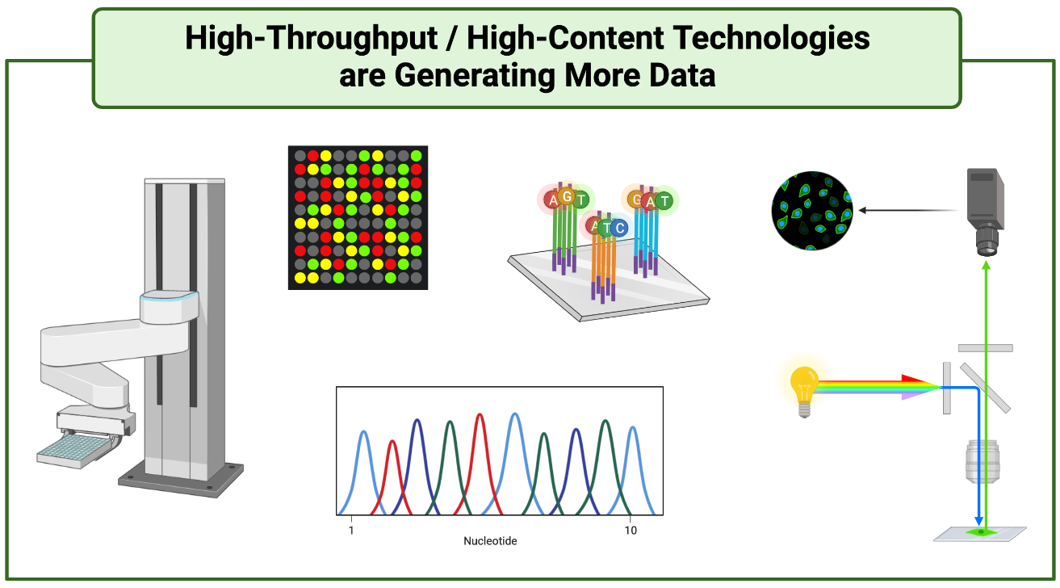
Need for Improved Data Science Training

Slide 4
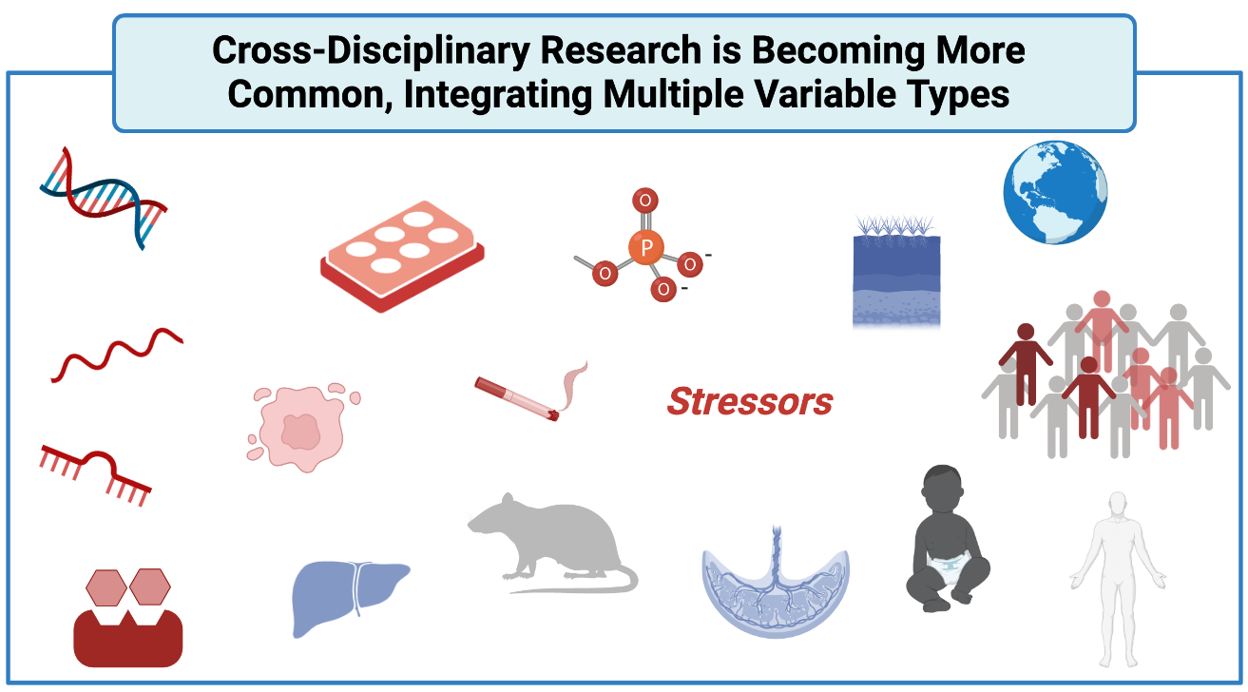
Need for Improved Data Science Training 2
Need for Improved Data Science Training

Slide 5
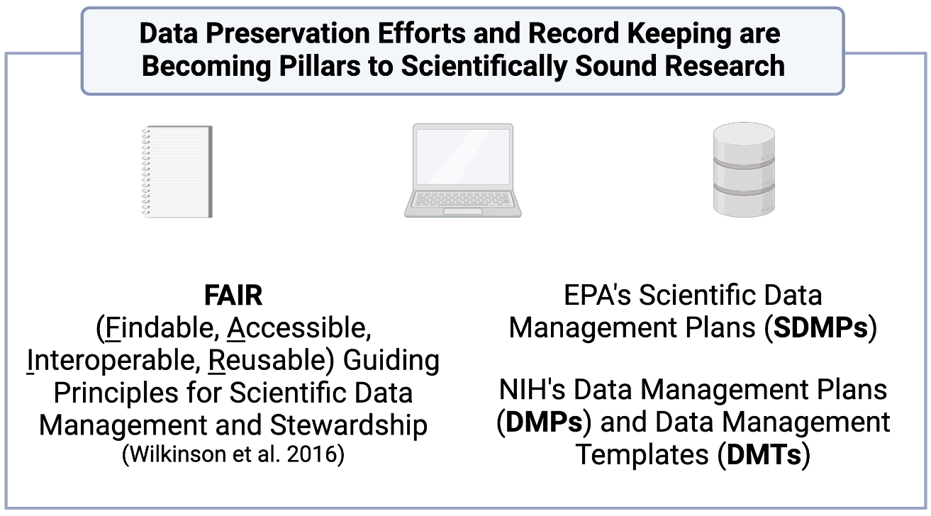
Need for Improved Data Science Training 3
Need for Improved Data Science Training

Slide 6
Need for Improved Data Science Training 4
Need for Improved Data Science Training
How can we make use of these growing resources to better understand environmental stressors???
DATA SCIENCE TRAINING

Slide 7

Data Science Training through TAME Toolkit
Multiple authors share knowledge and translate experiences gathered by multiple authors on data management and analysis methods to address real-world issues in environmental health through carefully developed training modules
This training effort is currently being launched as the inTelligence And Machine lEarning (TAME) Toolkit
Promotes didactic data generation, management, and analysis methods to “TAME” data in environmental health studies
https://uncsrp.github.io/Data-Analysis-Training-Modules/
https://github.com/UNCSRP

Slide 8








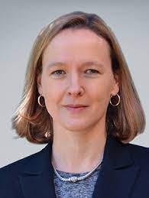

Wonderful Team of TAME Contributors
Headshot not preferred
Kyle Roell
Data Analyst,
UNC-SRP, UNC
Lauren Koval
PhD Candidate,
Ragerlab, UNC
Rebecca Boyles
Data Management Director and Scientist, RTI
Grace Patlewicz
Chemistry and Cheminformatics Scientist,
US EPA
Caroline Ring
Computational Exposure Scientist, US EPA
Cynthia Rider
Mixtures Toxicologist, NIEHS / NTP
Cavin Ward-Caviness
Computational Biologist,
US EPA
David Reif
Professor and NCSU-SRP
Data Management and Analysis Lead, NCSU
Ilona Jaspers
Professor and Curriculum in Environmental Medicine and Toxicology Director, UNC
Rebecca Fry
Professor and Superfund Research Program (UNC-SRP) Director, UNC
Julia Rager
Assistant Professor and UNC-SRP Data Management and Analysis Co-Lead, UNC

Slide 9
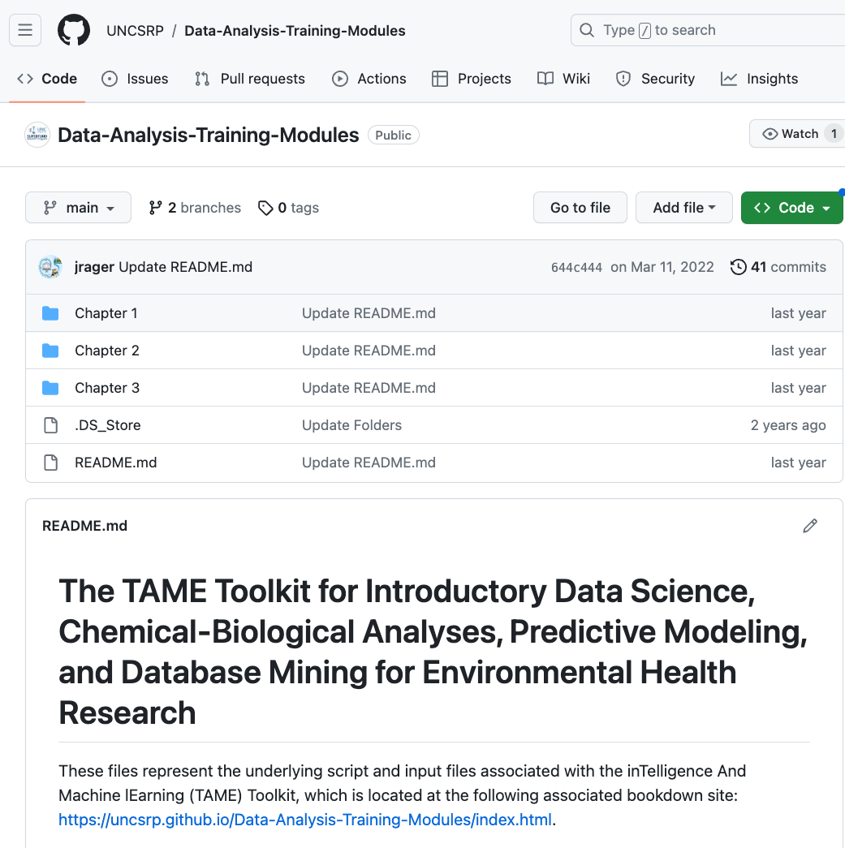
TAME Modules Presented through Bookdown
With underlying script and datasets posted on Github:
https://uncsrp.github.io/Data-Analysis-Training-Modules/
https://github.com/UNCSRP

Slide 10
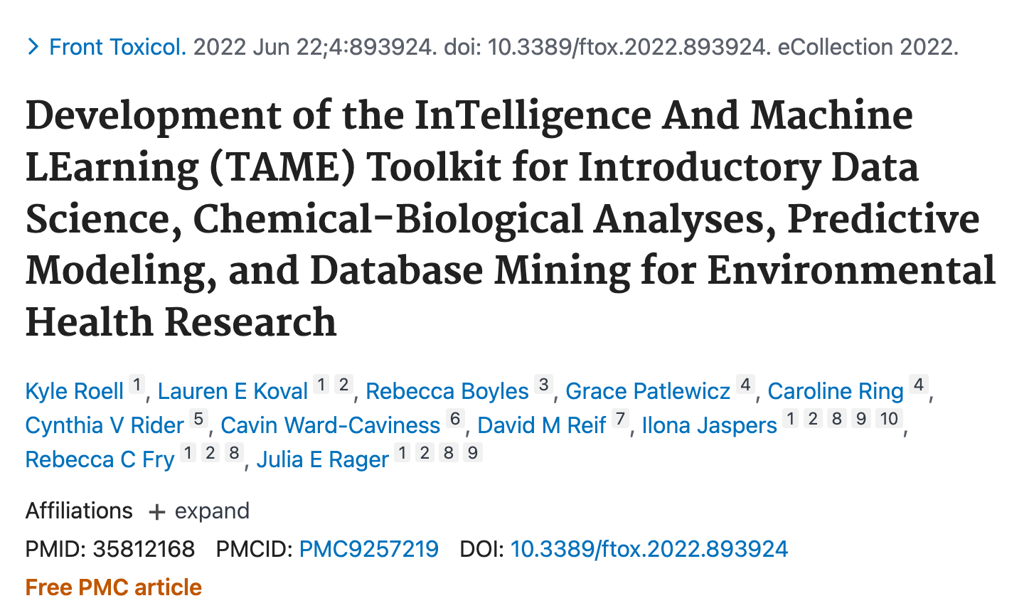
Parent Manuscript

Slide 11
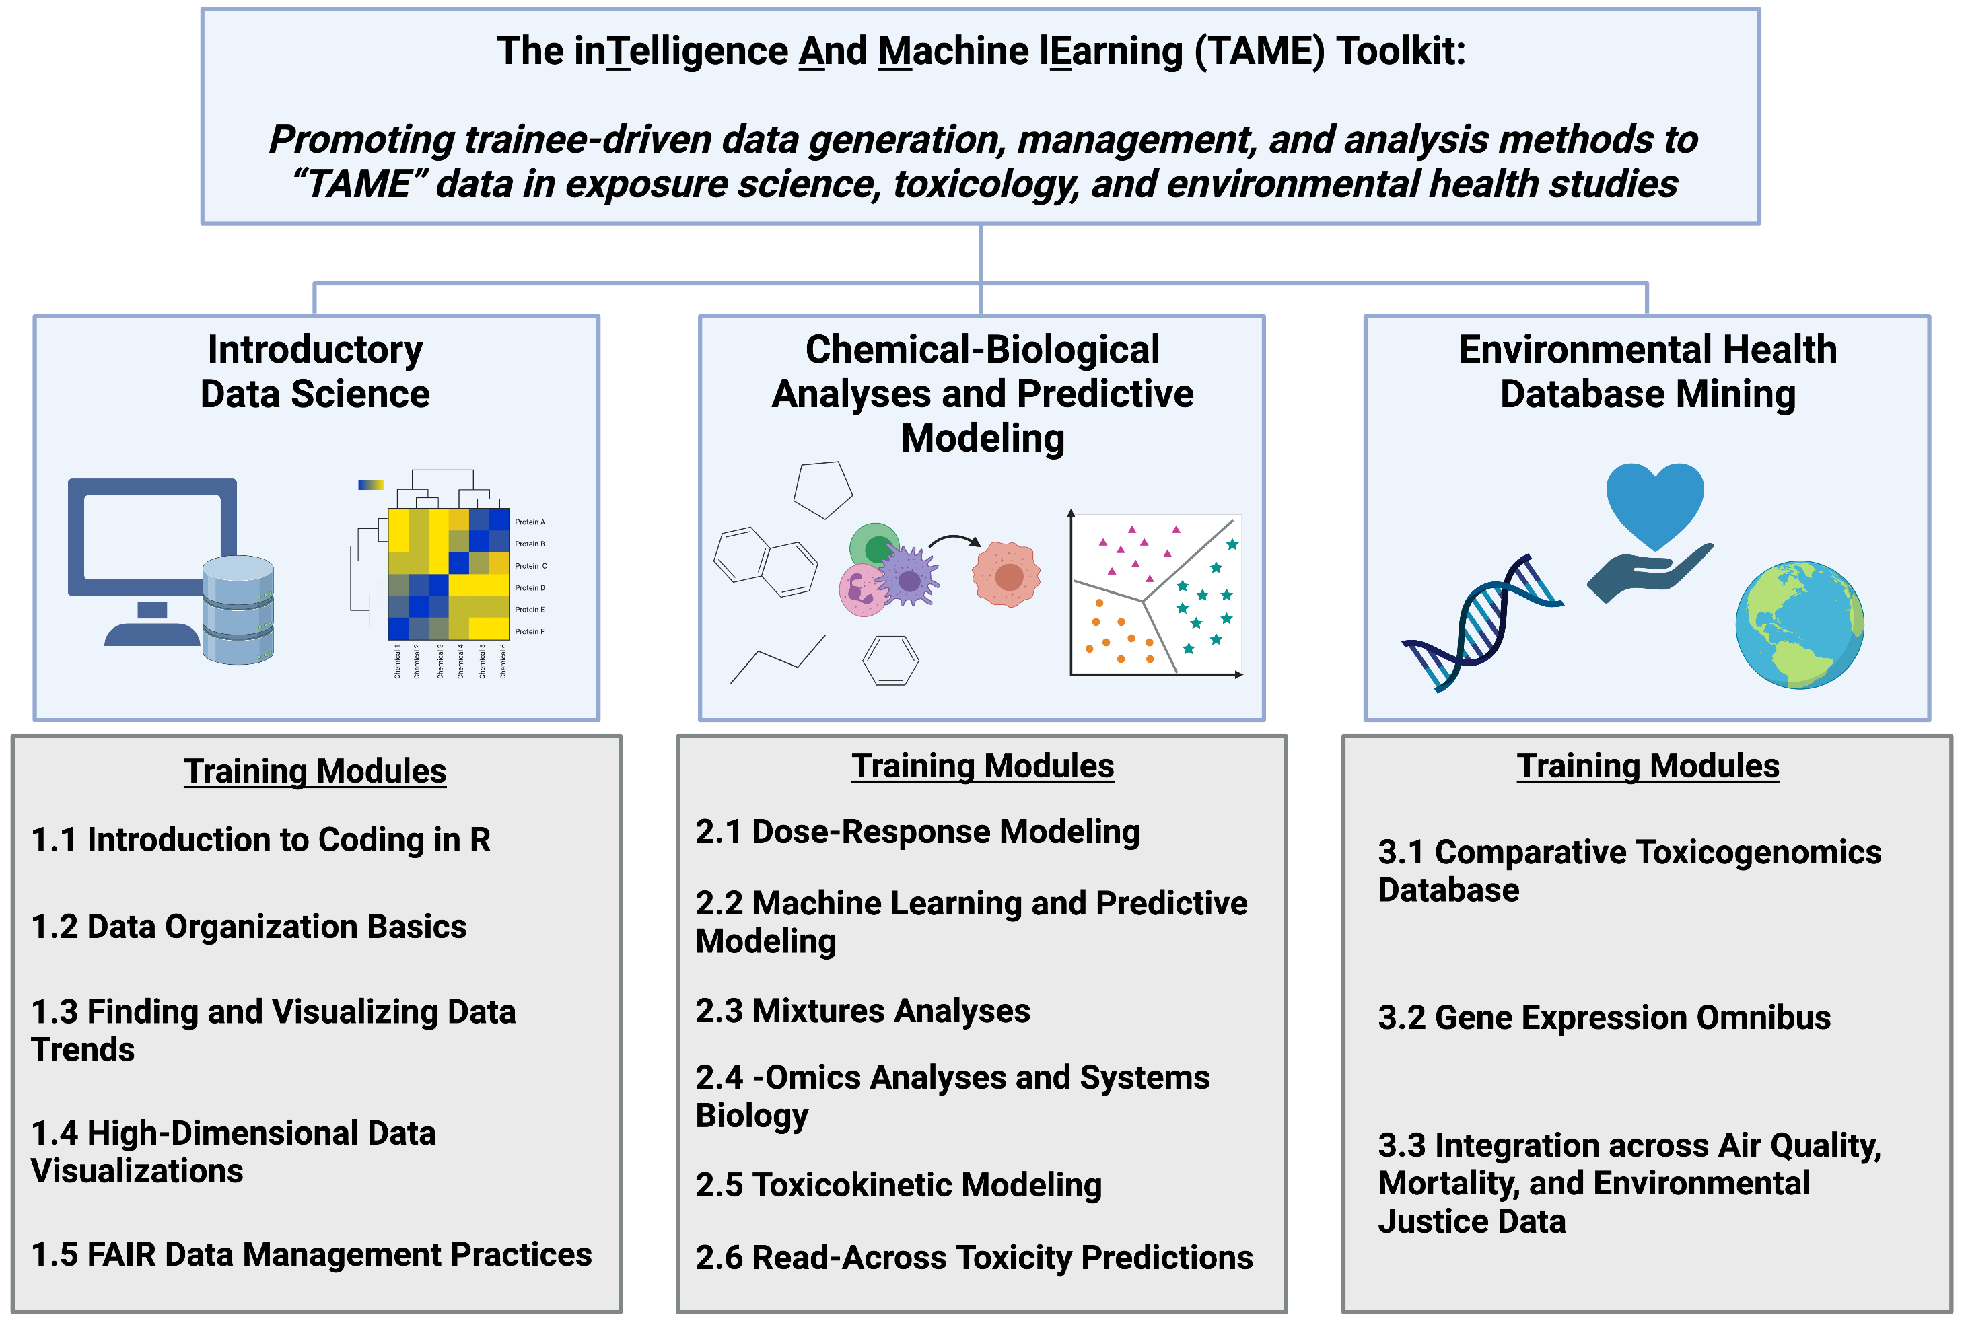
Chapter—Based Content Organization

Slide 12
Content within Each Specific Module
Introduction to the Topic
Introduction to the Training Module
List of Training Module’s Environmental Health Questions
Script Preparations
Scripted Analysis with Applications-based Environmental Health Questions Sprinkled throughout to Keep Participants Engaged
Concluding Remarks and Additional Resources

Slide 13
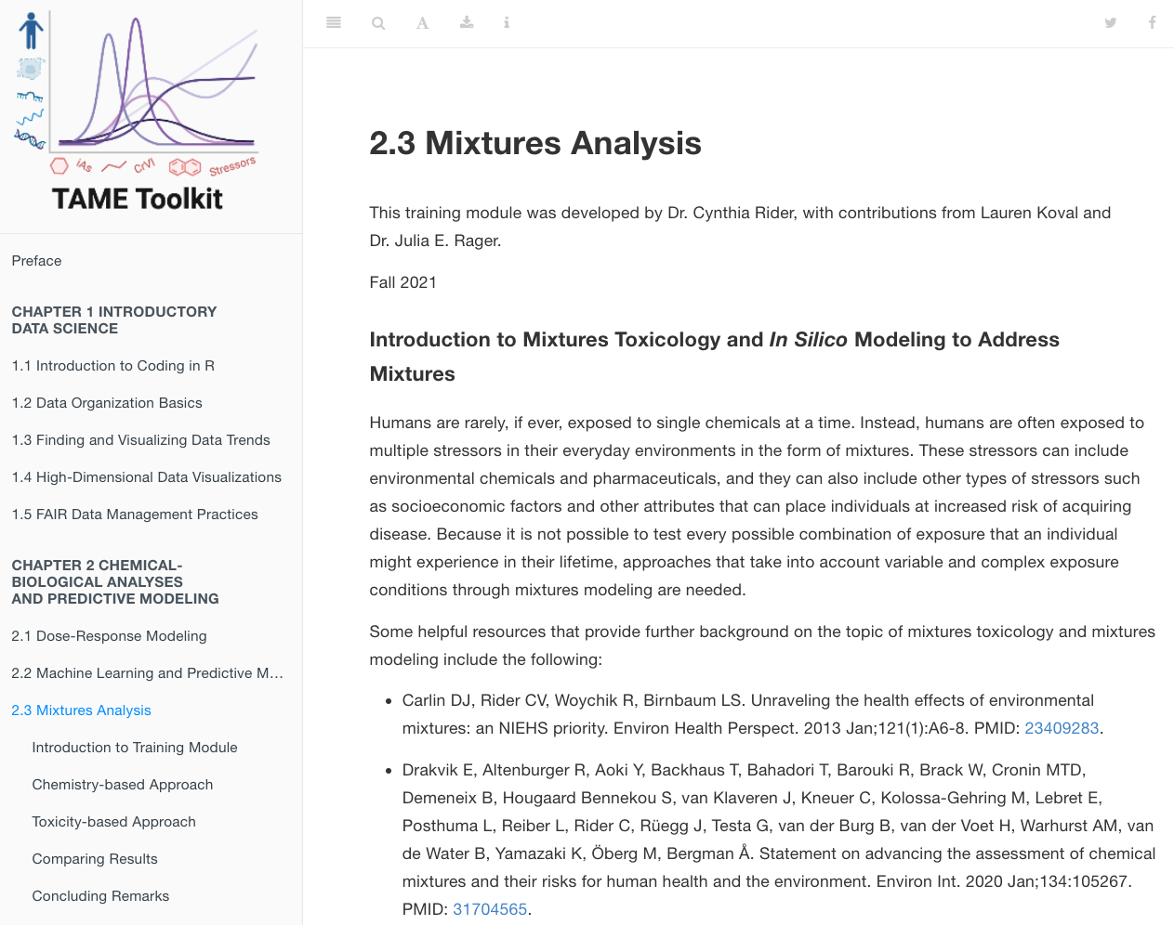
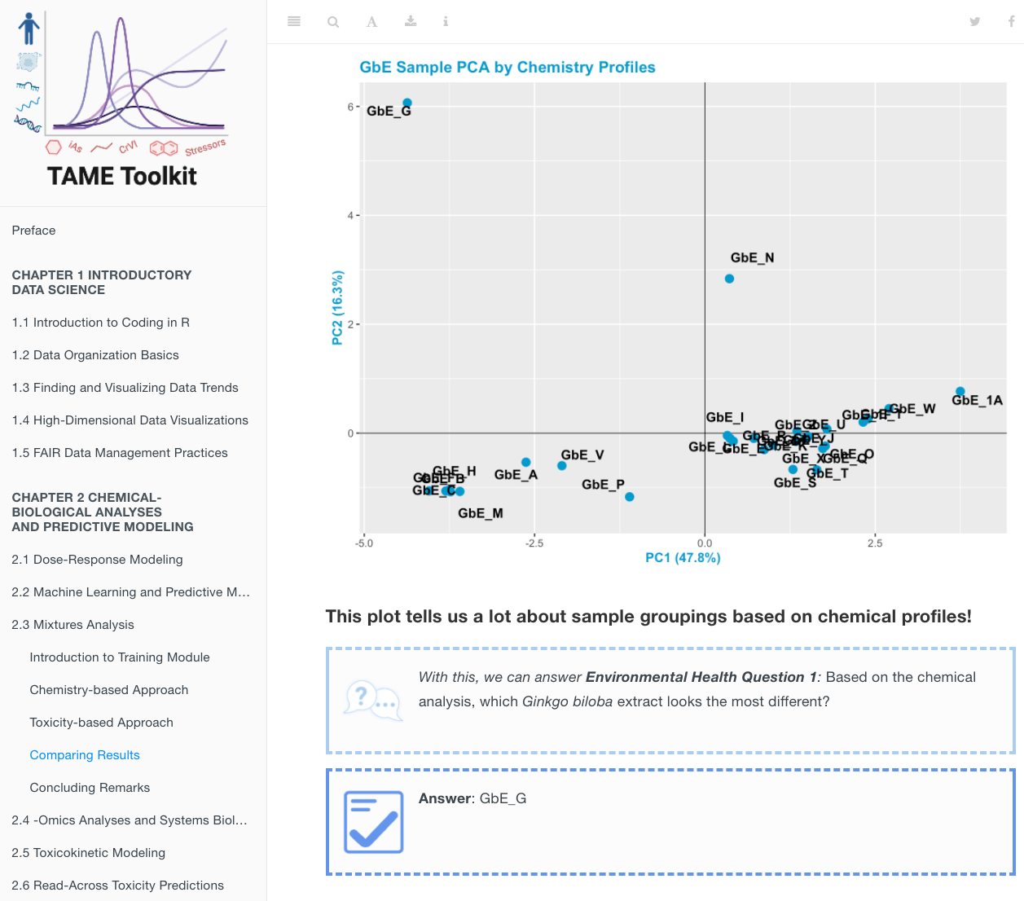
Screenshots in the Mixtures Sufficient Similarity Module

Slide 14

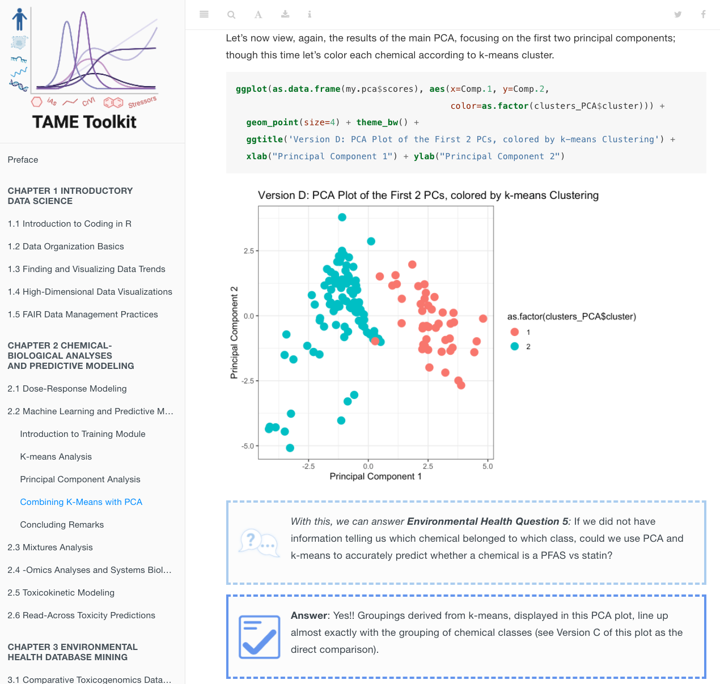
Screenshots in a Machine Learning Module

Slide 15
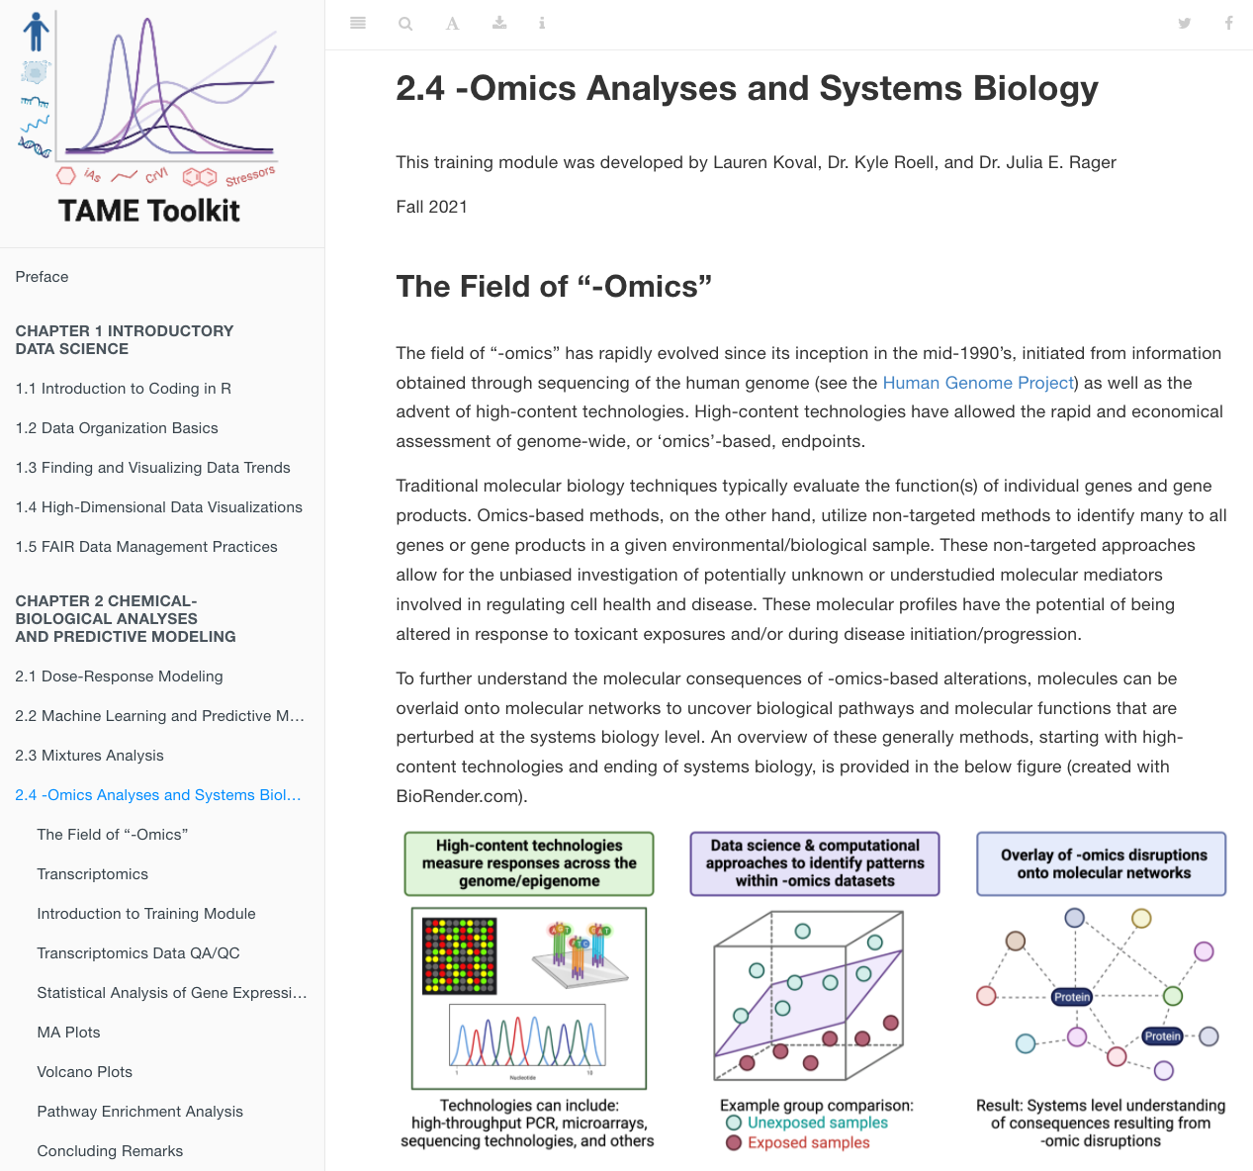
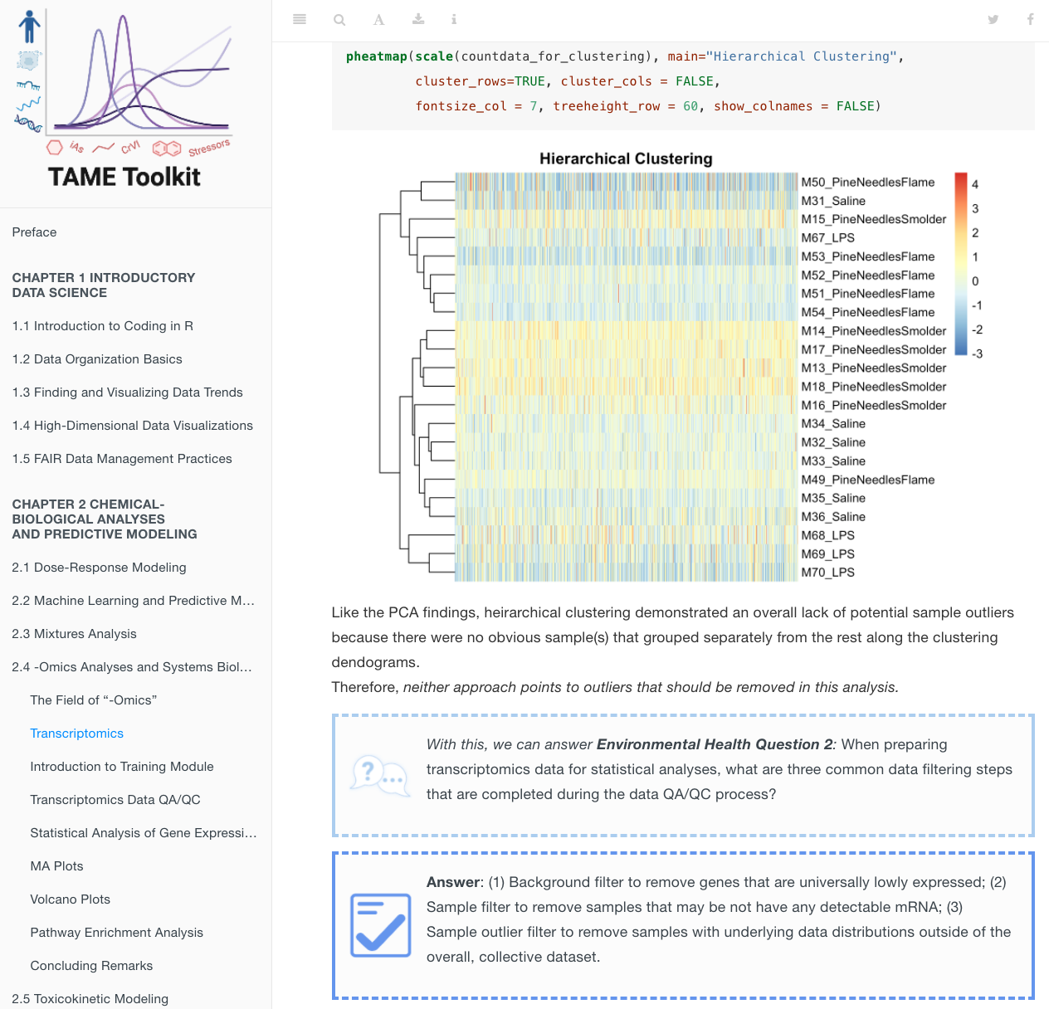
Screenshots in the -Omics Analyses Module

Slide 16
TAME Toolkit Dissemination

Slide 17
Course Materials
Much of this training content was tested through a new course at UNC, ENVR 730: Computational Toxicology and Exposure Science
Included 17 graduate students from:
  Department of Environmental Sciences and Engineering (ENVR)
  Curriculum of Toxicology and Environmental Medicine (CiTEM)
Received the Teaching Innovation Award from the UNC Gillings School of Global Public Health, which is student-nominated!
We are teaching this course again this Fall

Slide 18
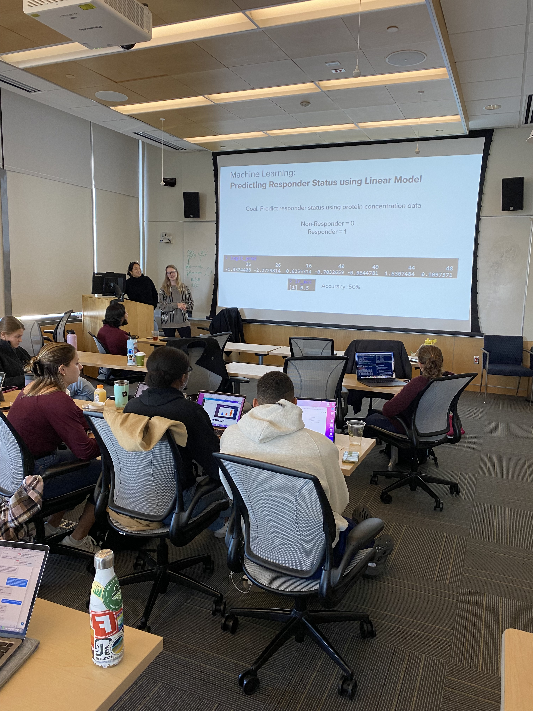
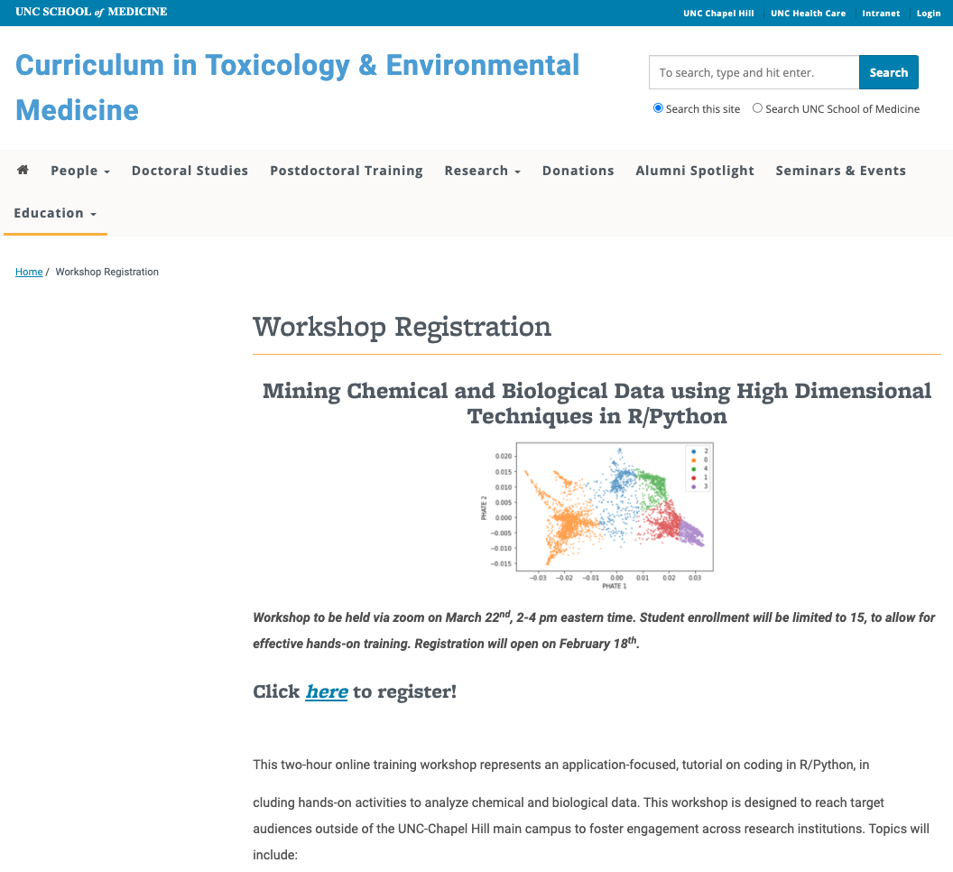
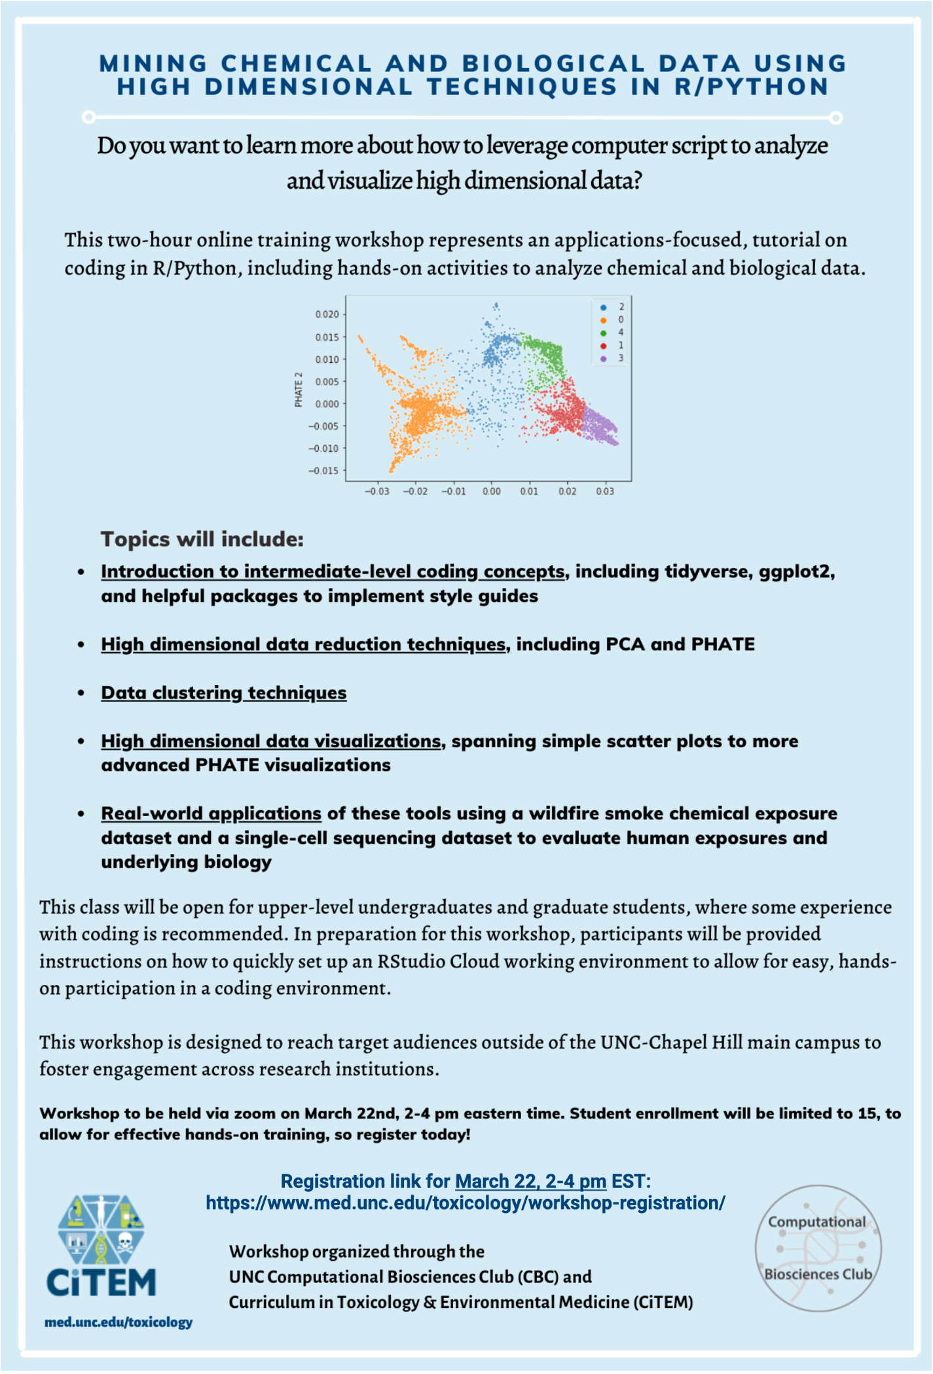
Other Dissemination Efforts
High dimensional data visualization training workshop (virtual, Spring 2022)
PRogramming for Environmental HEalth And Toxicology (PREHEAT) Retreat

Slide 19
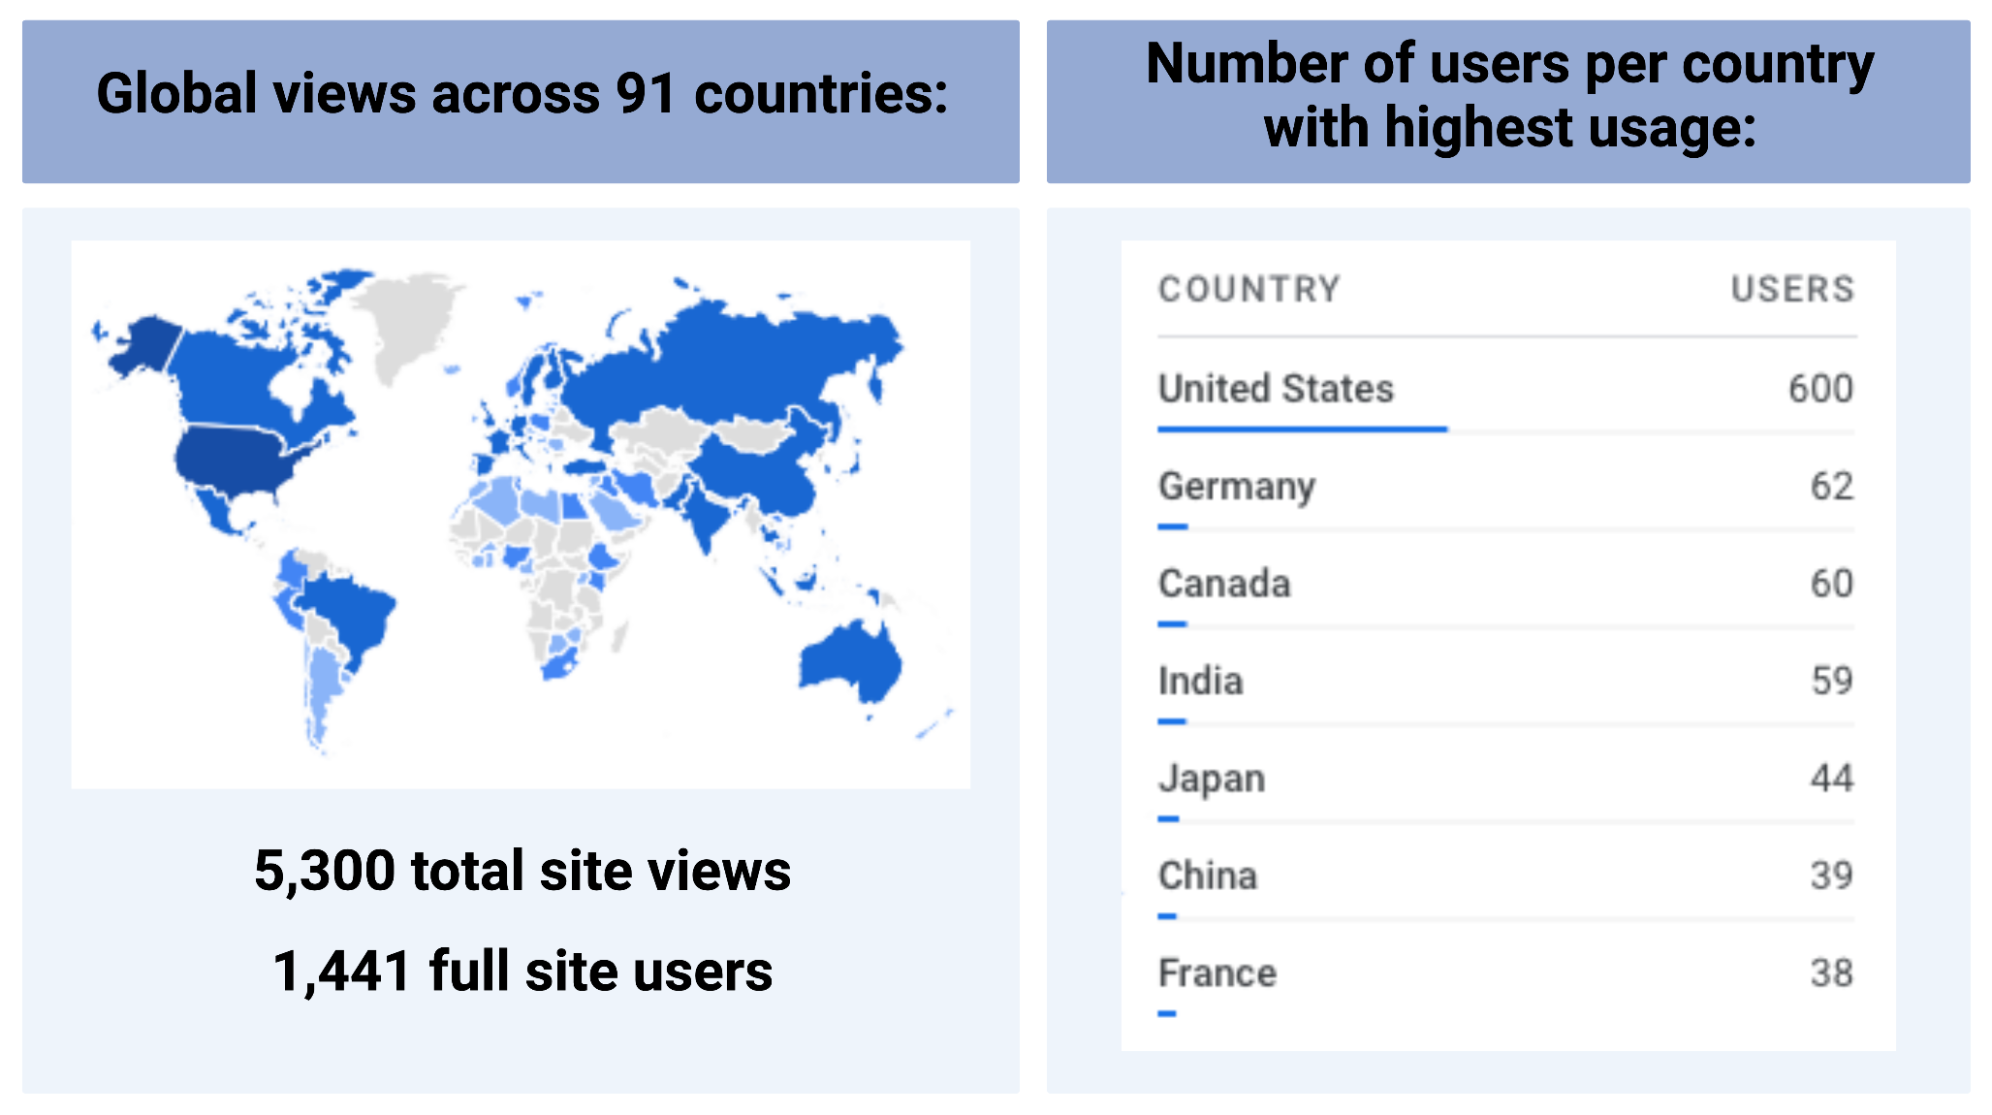
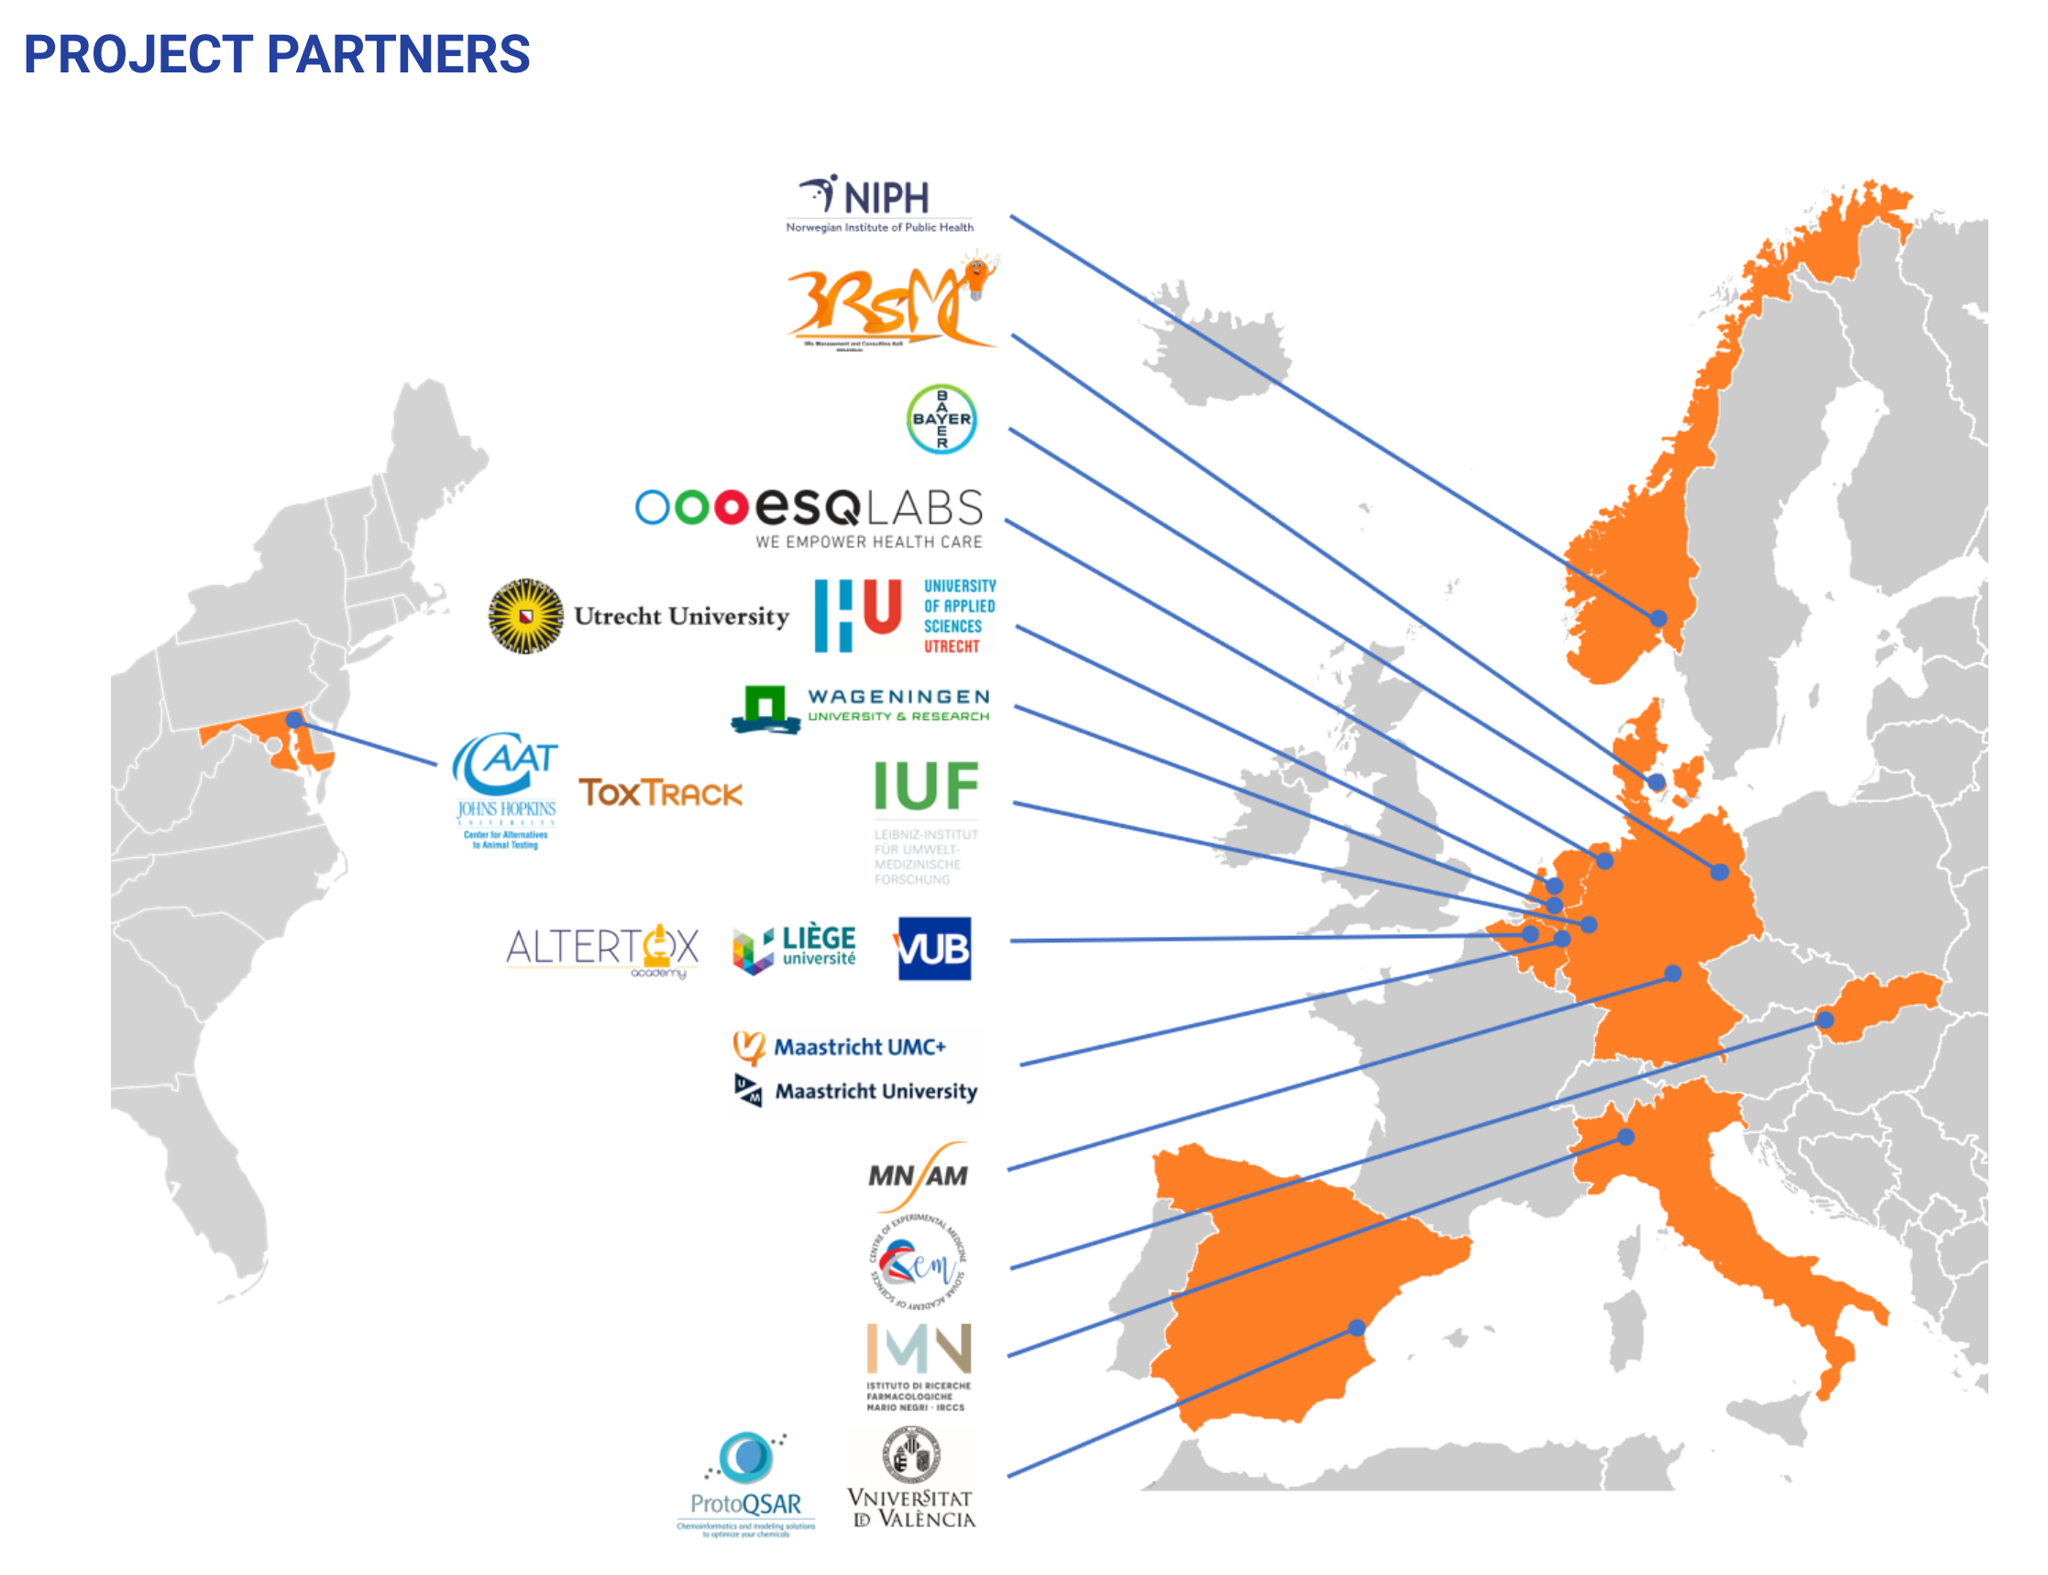
International Engagement
Viewers have accessed the TAME toolkit world-wide
International collaborators
For example, the European Union’s ONTOX project leaders are incorporating TAME materials into their training courses on data analysis and machine learning in toxicology
Google analytics (Sept 2022-current):
https://ontox-project.eu/consortium/

Slide 20
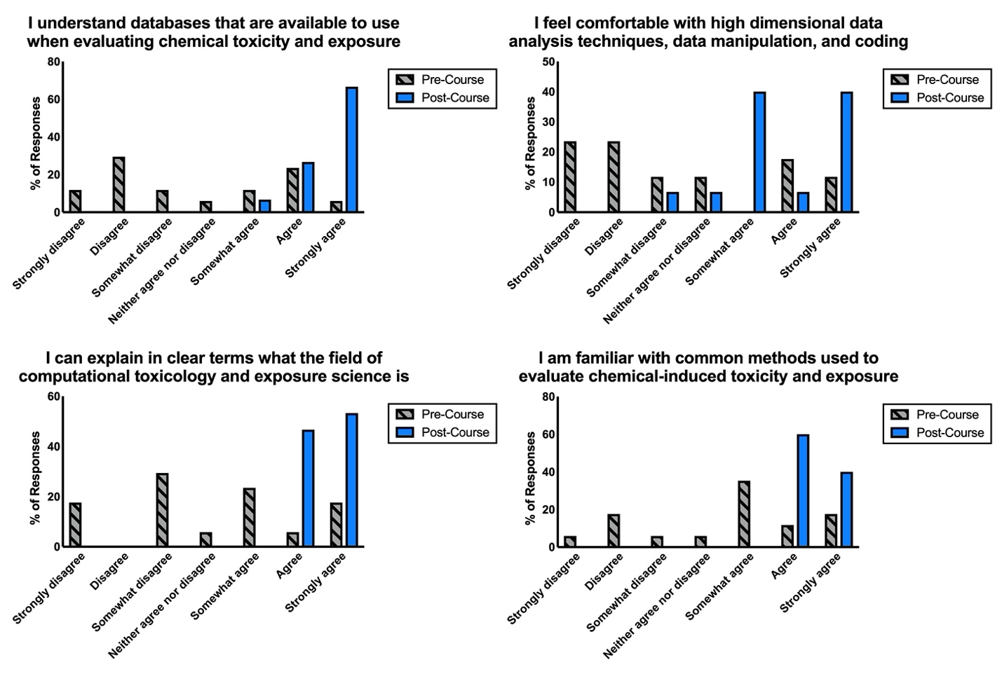
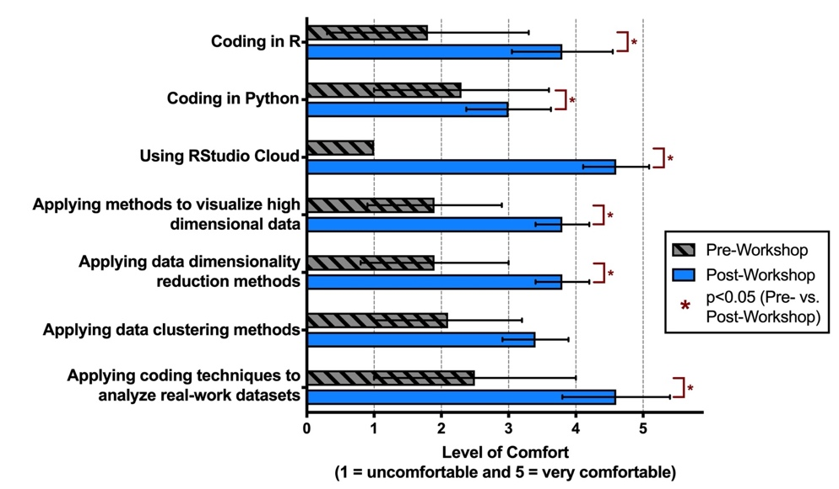
TAME Effectiveness and Feedback
Course Evaluation:
Virtual Workshop Evaluation:
Consistent Feedback across All Dissemination Efforts
Participants want more! More training time, more modules
Training at the intro-level, mid-level, and advanced-level
More basics, including best practices for wet lab data organization and sharing
We are currently in the process of expanding these training materials…

Slide 21
TAME 2.0 Is Underway!
Expanding and reorganizing content into 6 chapters:
  Introduction to Data Science
  Introduction to Coding in R
  Basics of Data Analysis and Visualizations
  Machine Learning and Artificial Intelligence
  Applications in Toxicology and Exposure Science
  Environmental Health Database Mining
Hoping to launch ~December 2023

Slide 22





Collaborations and Funding
Rager lab
Celeste Carberry (PhD cand)
Elise Hickman (post-doc)
Lauren Koval (PhD cand)
Elena McDermott (MSPH)
Alexis Payton (data analyst)
Sarah Miller (PhD cand)
Kai Malone (undergrad)
Raquel Winker (undergrad)
UNC
Stephanie Engel
Ilona Jaspers
Alex Keil
Kun Lu
Tracy Manuck
Meghan Rebuli
Gregory Smith
US EPA
Kathie Dionisio
M Ian Gilmour
Kristin Isaacs
Yong Ho Kim
Grace Patlewicz
Katie Paul-Friedman
Caroline Ring
John Wambaugh
Cavin Ward-Caviness
UNC IEHS / SRP
Rebecca Fry
Audrey Bousquet (res scientist)
Lauren Eaves (res associate)
Hadley Hartwell (lab manager)
Kyle Roell (data analyst)
RTI
Rebecca Boyles
Shaun McCullough
Trainees in italics
NIH / DTT
Scott Auerbach
Stephen Ferguson
Kyle Messier
David Reif
Cynthia Rider
This work was supported by:
NIH / NIEHS
Nicole Niehoff
Matthew Wheeler
Alexis White

Slide 23
Kyle Roell’s Walk Through TAME
Dr. Roell, UNC-SRP lead data analyst

