Slide 1

NICHD COVID-19 Common Data Elements:
NIEHS DR2 Resources Portal and REDCap
Informational Guide

Slide 2
Overview:
This informational guide will demonstrate:
How to search the DR2 Resources Portal for the NICHD COVID-19 Common Data Elements;
upload the NICHD COVID-19 CDEs from the Portal into REDCap;
and import surveys from the REDCap Shared Library and outside sources into your NICHD COVID-19 CDE REDCap project
Basic knowledge of the features and functionality of REDCap is needed. To gain a better understanding of REDCap, go to Project REDCap’s video demonstrations.

Slide 3
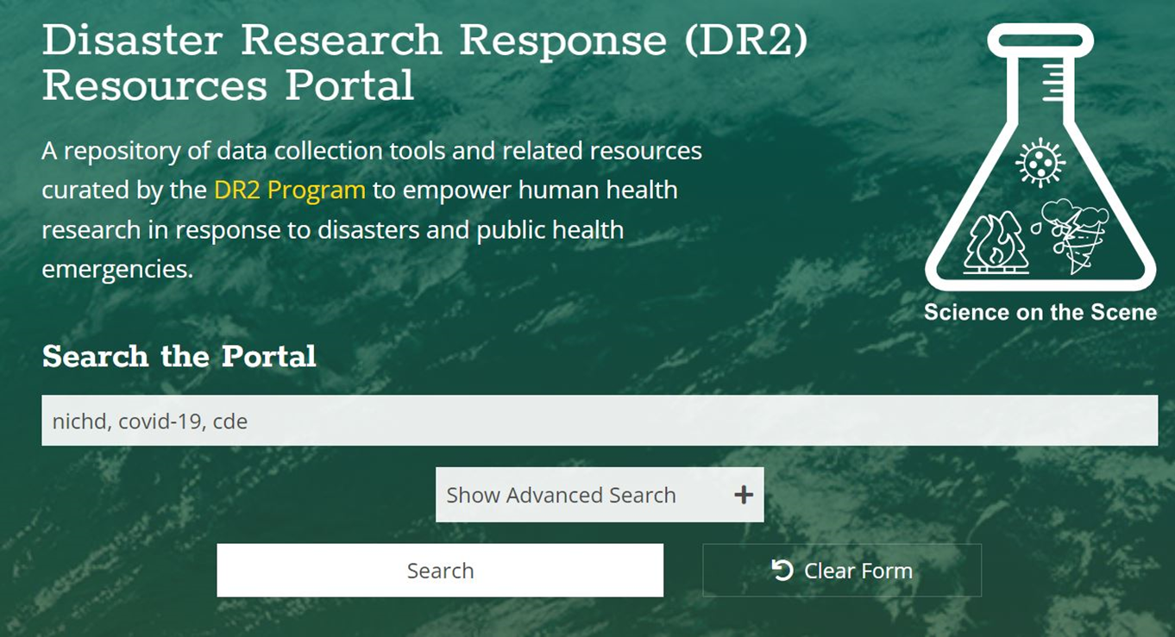
Searching the DR2 Resources Portal for the NICHD COVID-19 CDEs:
Go to the DR2 Resources Portal homepage tools.niehs.nih.gov/dr2/
In the search bar, enter the key terms nichd, covid-19, and cde separated by commas
Click the Search button to see the Search Results page

Slide 4
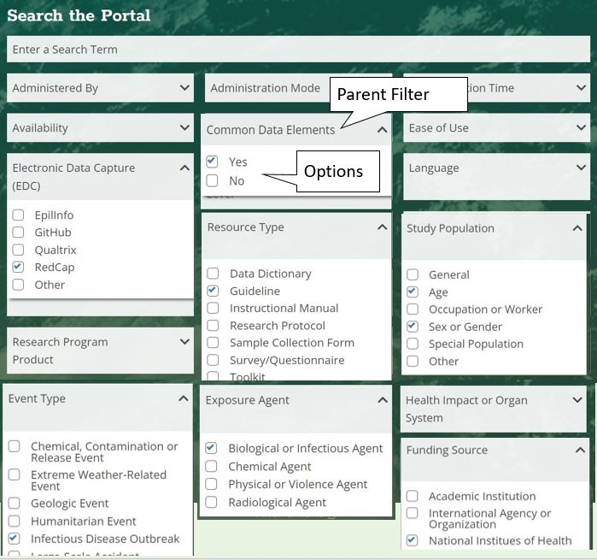
How to search the portal using the Advanced Search filters:
On the portal homepage, click to Show Advanced Search filters
Click the drop down arrow next to the parent filters and select the following options:
Common Data Elements: Yes
Electronic Data Capture (EDC): RedCap
Resource Type: Guideline
Study Population: Age and Sex or Gender
Event Type: Infectious Disease Outbreak
Exposure Agent: Biological or Infectious Agent
Funding Source: National Institutes of Health
Click the Search button located below the advanced search function.

Slide 5
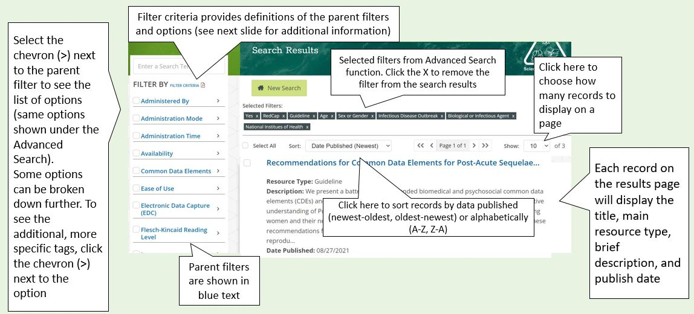
Search Results Page:
Once you’ve entered your search, either by entering key terms in the search bar or selecting filters on the Advanced Search, you will be directed to the Search Results page. From here you can sort through the results using the features below and narrow the search results down further using the Filter By panel on the left hand side of the webpage.

Slide 6
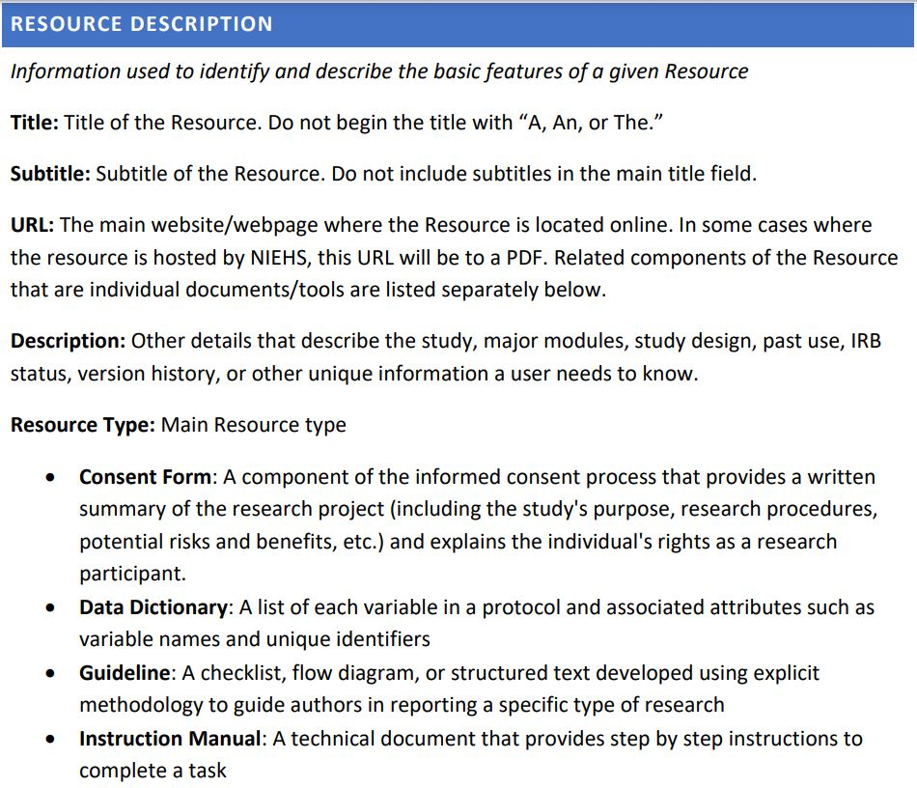
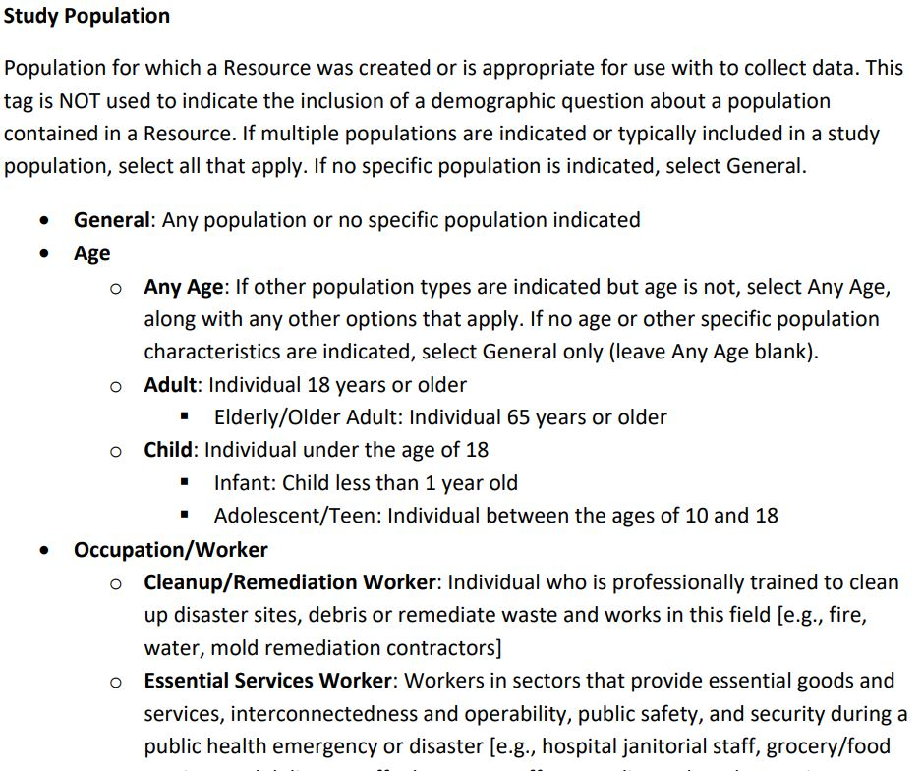
Filter Criteria Guidance:
If you need help making sense of the Search Filters, go to the Filter Criteria document. This document provides brief descriptions of the keyword tags used to curate individual resources within the repository. These descriptions are not formal definitions, but indicators of how tags are defined and used specifically for the purposes of the Portal. All of the tags used to curate a Resource, whether filters or descriptors, are listed in the Resource Details page for each search result.

Slide 7
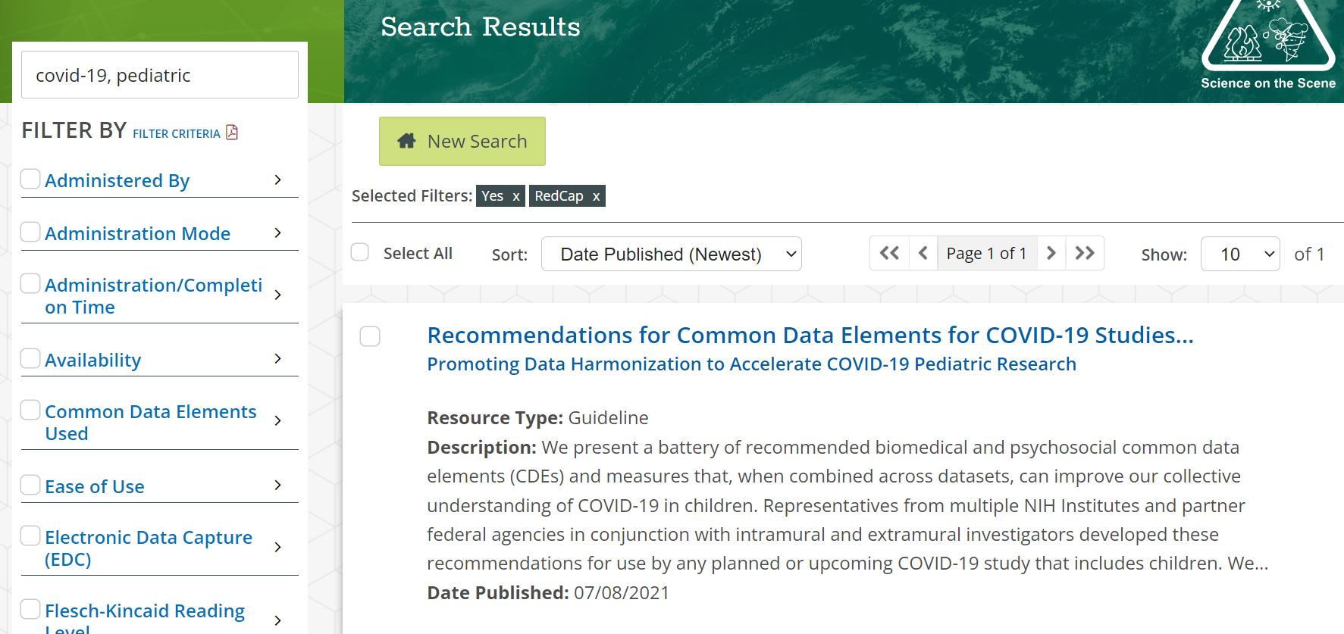
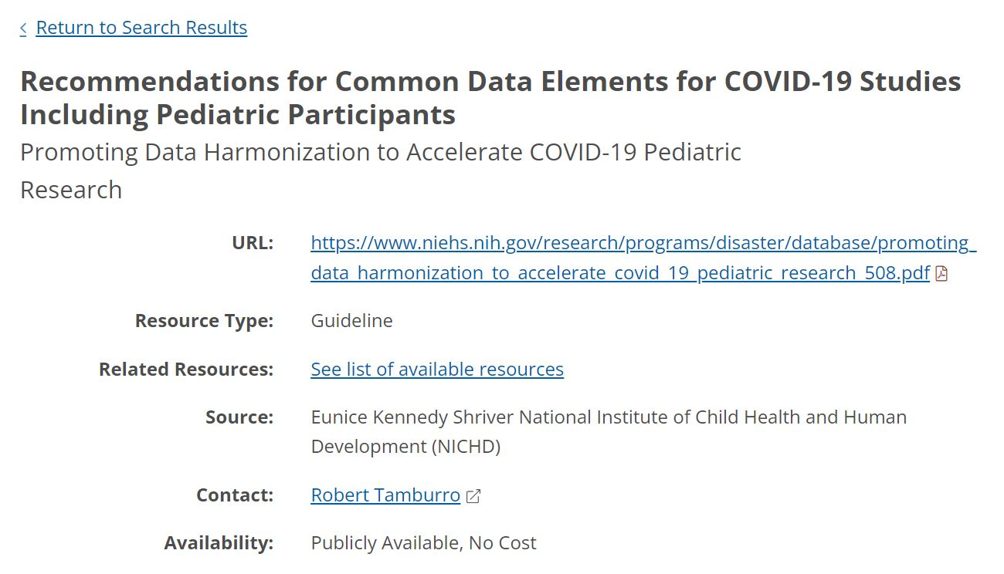
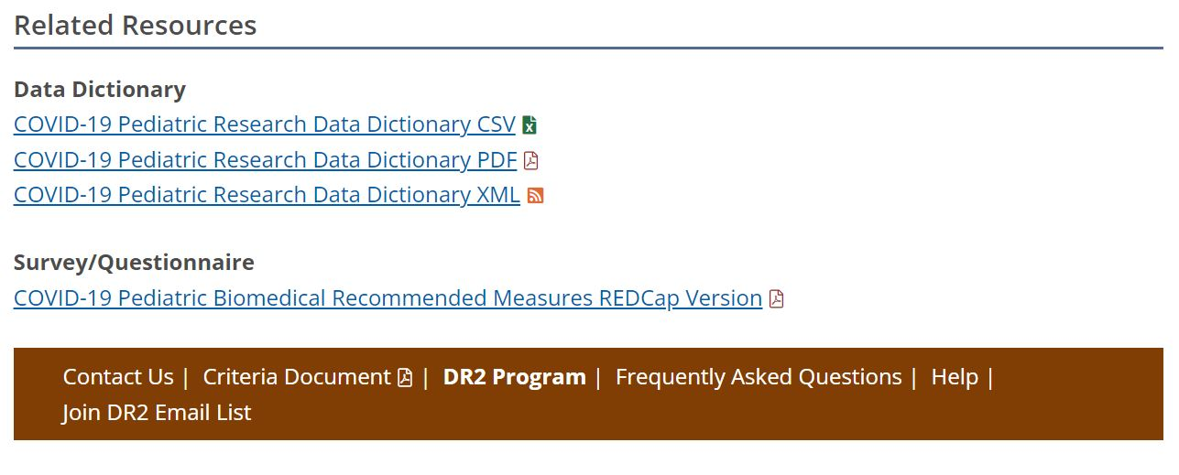

How to find the data dictionary in the record:
Select the record of interest on the Search Results page
Locate the Data Dictionary CSV file within the record *If the data dictionary is not the main resource, go to the Related Resources section by scrolling to the bottom of the page or clicking ‘See list of available resources’ shown in the red box below
Select the Data Dictionary CSV file to download
Once downloaded, save the file on your computer *Make sure to save it in CSV comma delimited format

Slide 8
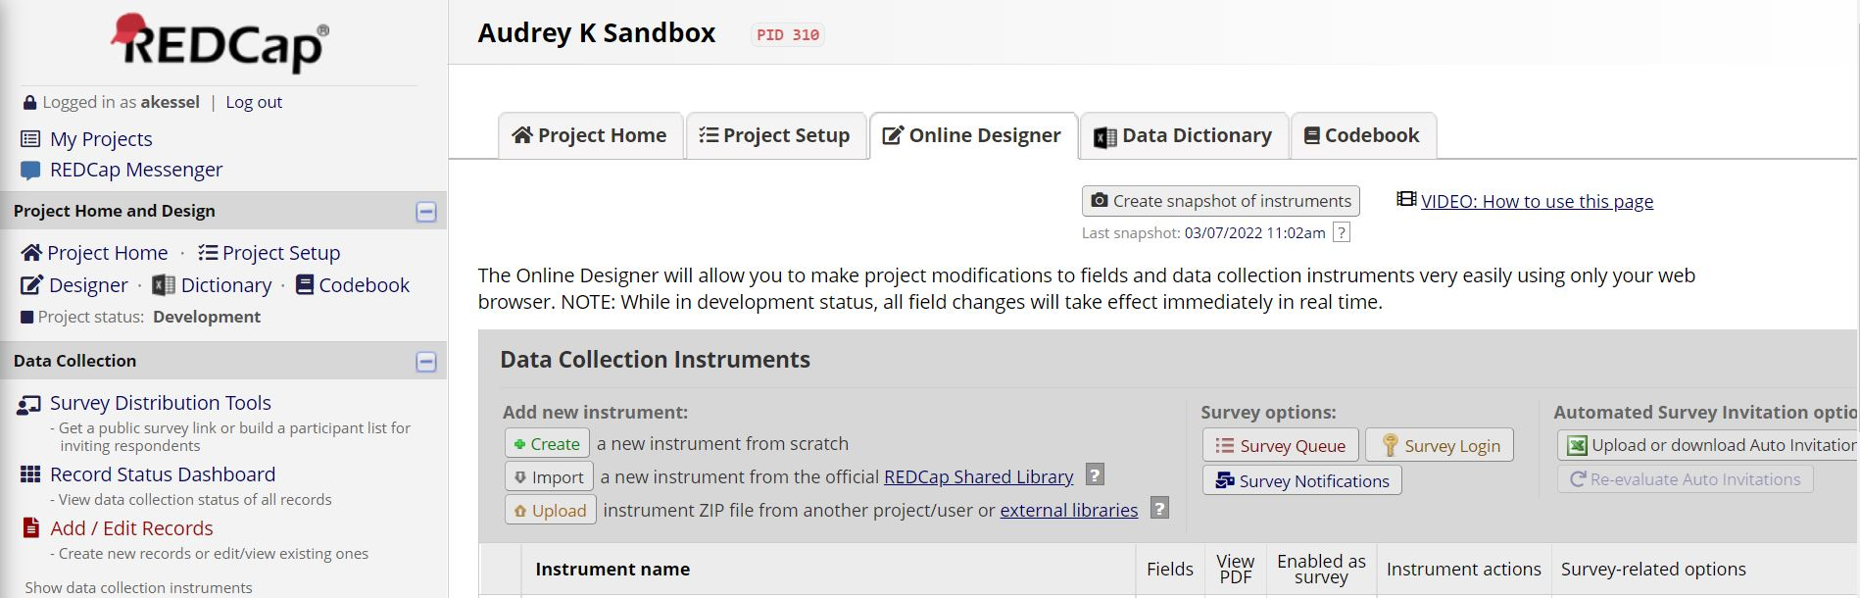
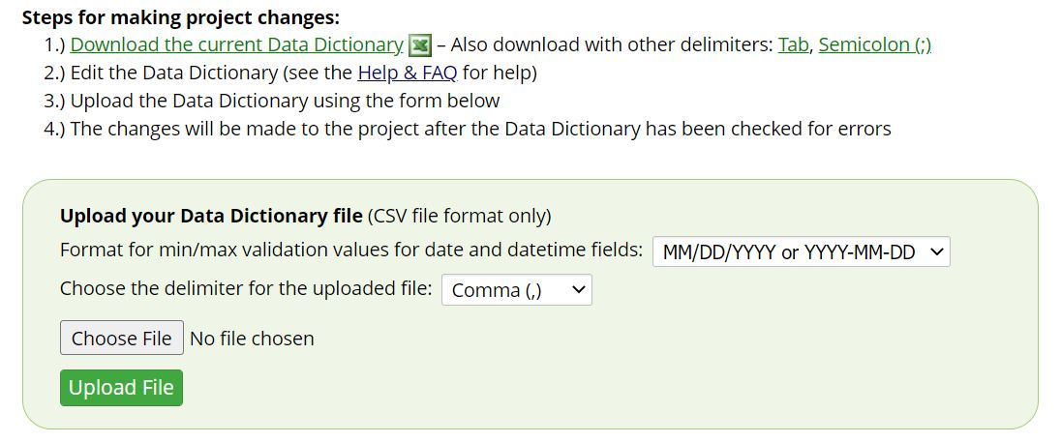
How to upload the data dictionary into your REDCap Project:
Project Name
Login to your REDCap account and select your project or create a new project
Select Dictionary under Project Home and Design
Choose the data dictionary .csv file you previously downloaded and saved from the DR2 Resources Portal
Upload the file

Slide 9
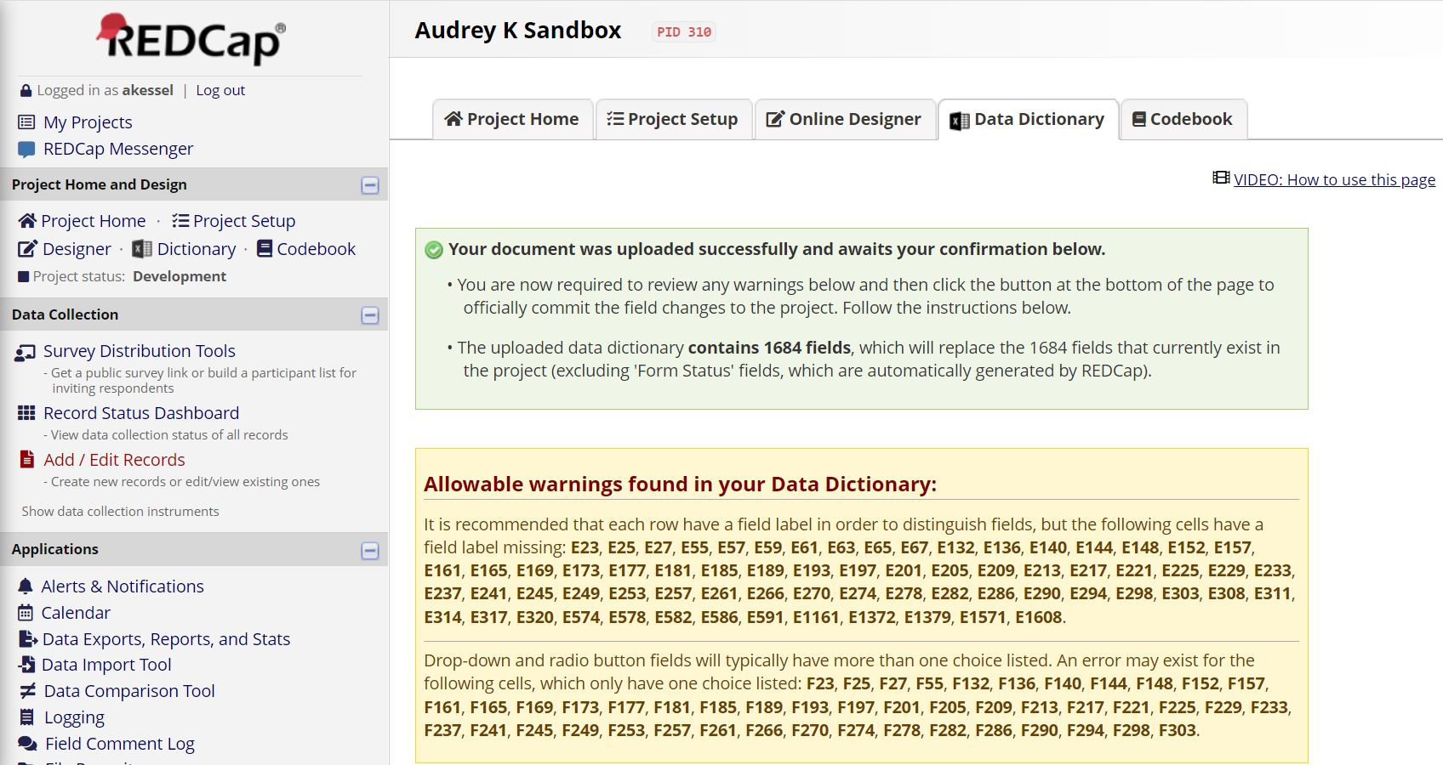
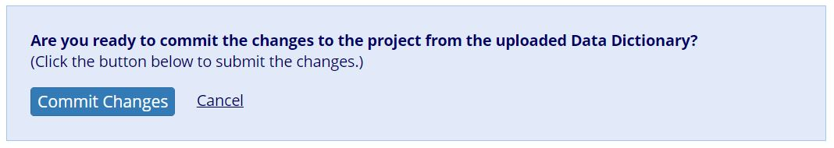
How to upload the data dictionary into your REDCap Project:
Project Name
Review any warnings or errors that may exist in the file and make adjustments as instructed *REDCap will notify you of any warnings and specify which fields have errors
Once you have the green light, commit changes
You will then be prompted to return to the Online Designer
If there are errors in the file, for example, there are two of the same variable names, they will appear here with the cell number in a red box

Slide 10
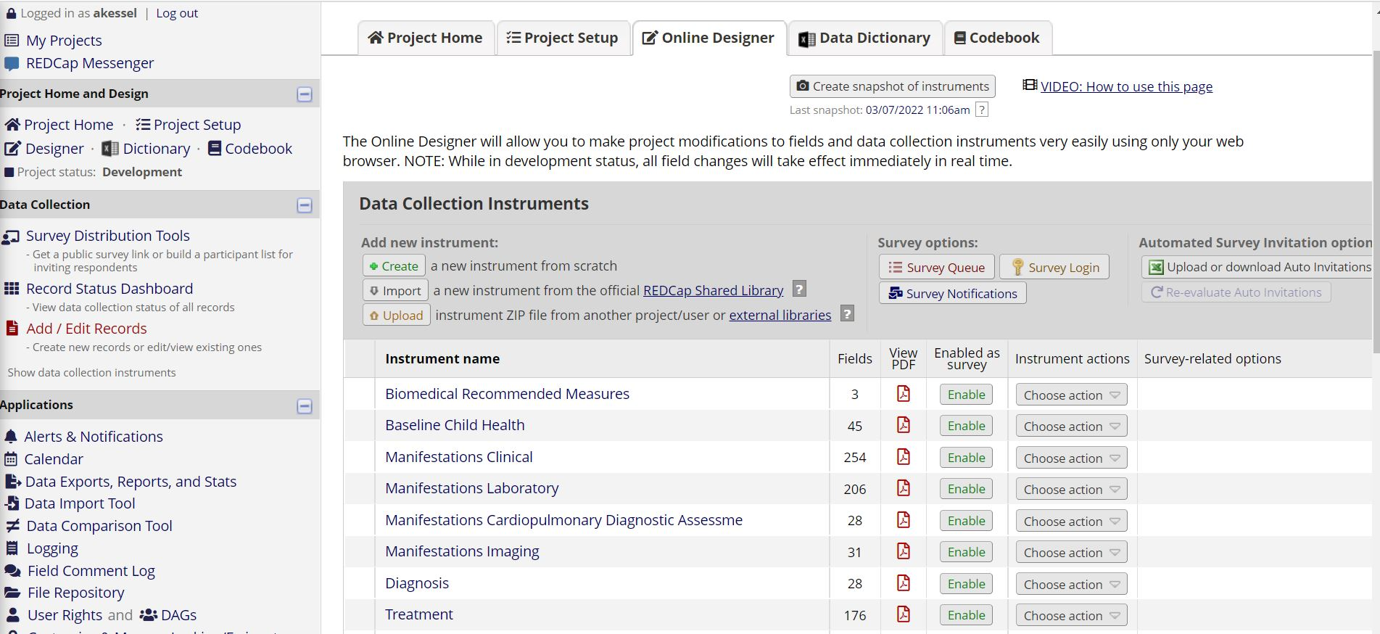
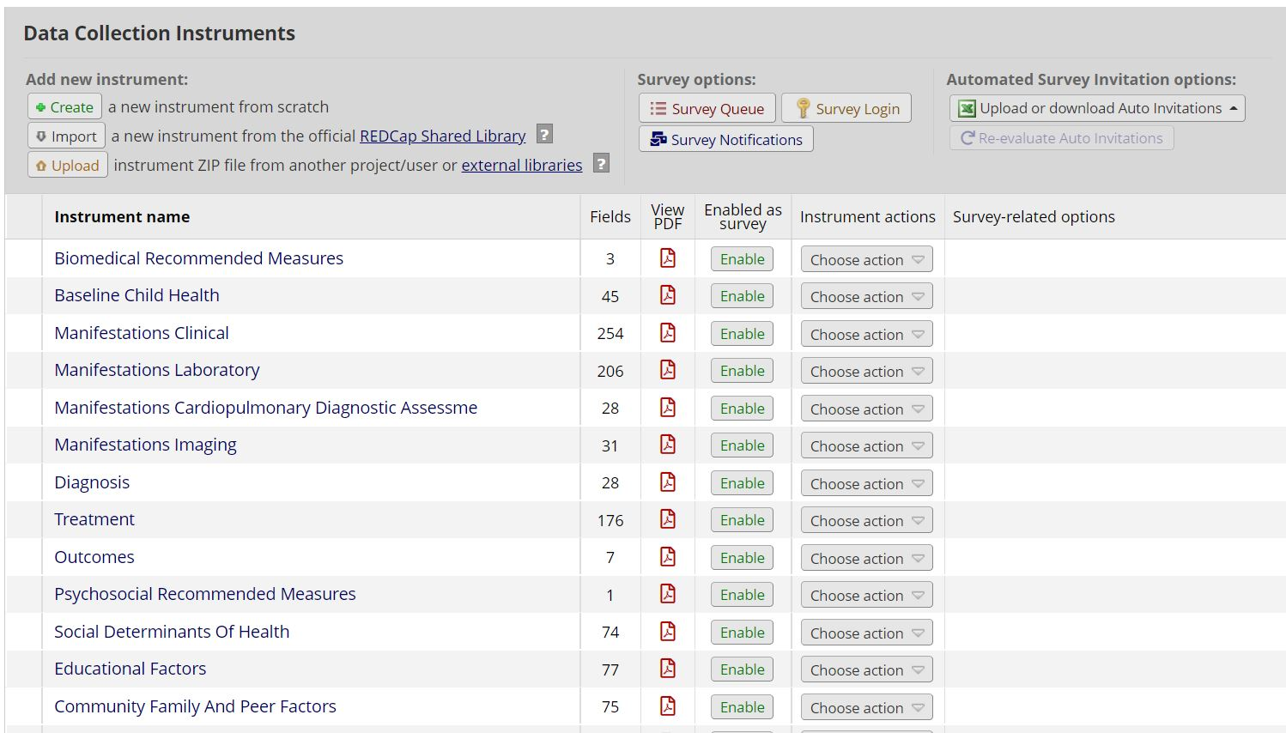
How to upload the data dictionary into your REDCap Project:
Review the instruments in Online Designer
Make revisions to instruments within REDCap to fit the needs of your project

Slide 11
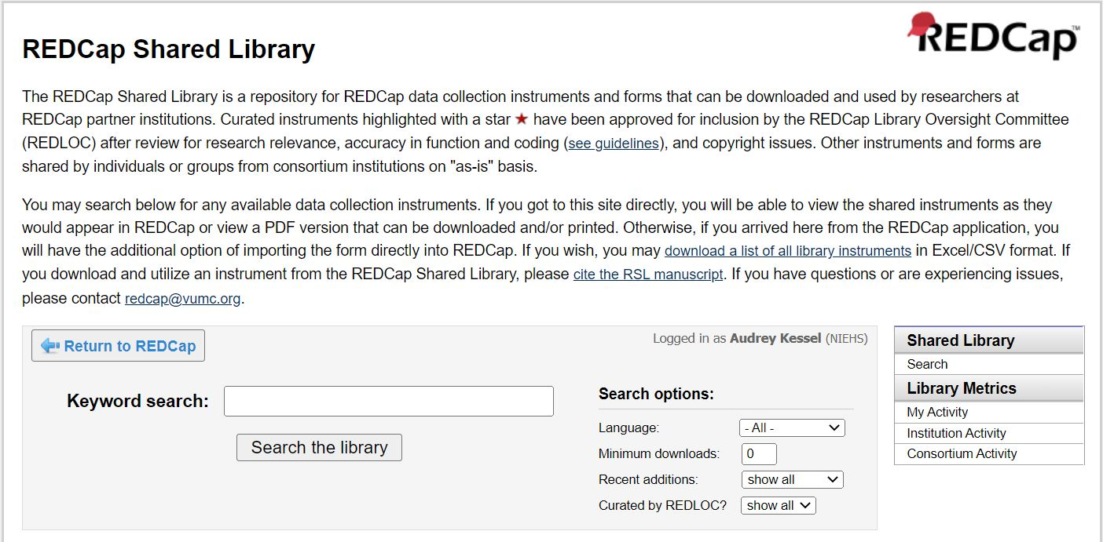
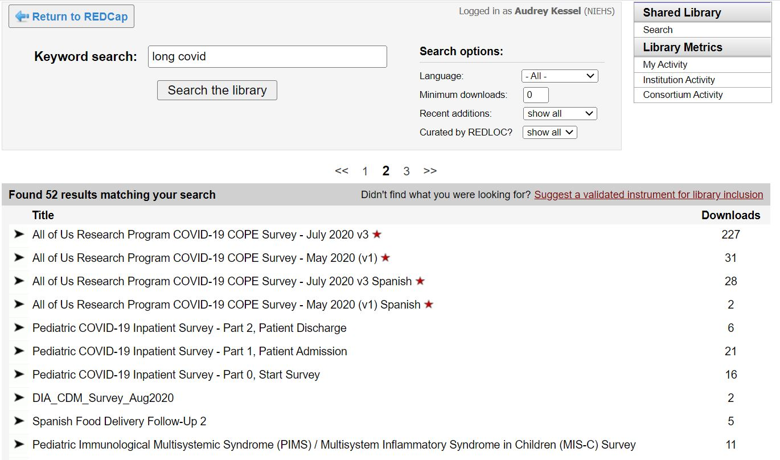
Importing surveys into your REDCap Project through the REDCap Shared Library:
Upload the NICHD COVID-19 CDEs into REDCap using the steps in slides 8-10
In your REDCap project in Online Designer, select Import a new instrument from the official REDCap Shared Library
Search the REDCap Shared Library using keywords
*If looking for a specific survey, you may need the exact name of how it appears in the REDCap Shared Library
Select the instrument you’d like to import

Slide 12
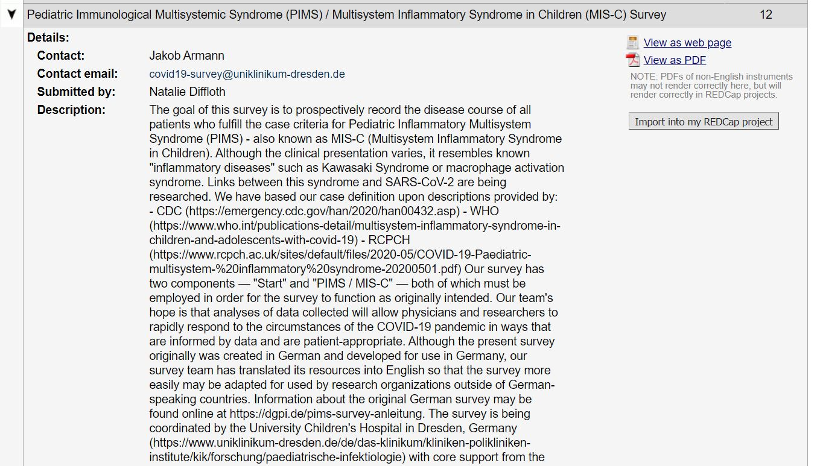
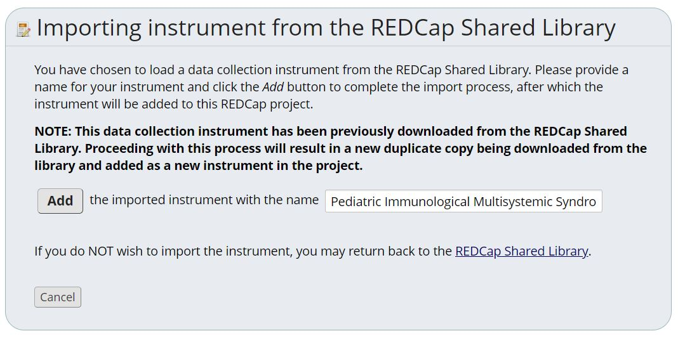
Importing surveys into your REDCap Project through the REDCap Shared Library:
Once you’ve chosen a survey to import, select Import into my REDCap project
Rename the survey or keep as is, then select Add

Slide 13
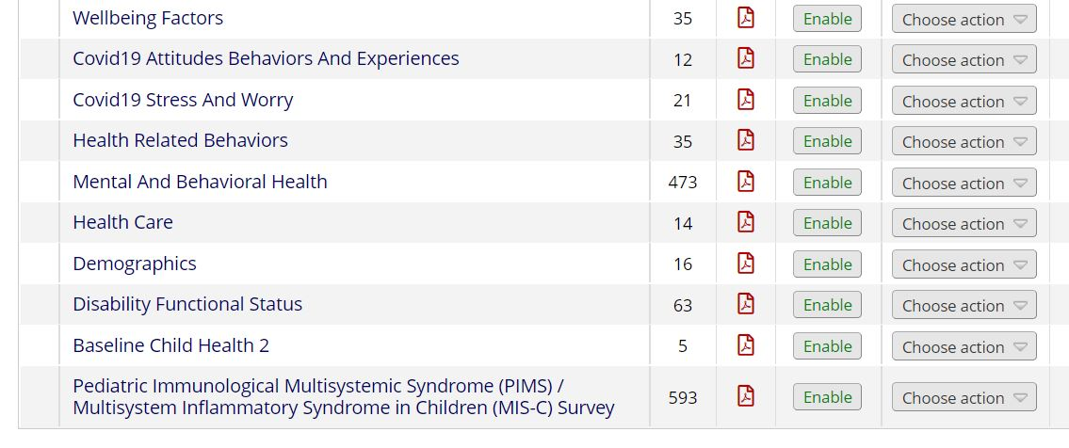
Importing surveys into your REDCap Project through the REDCap Shared Library:
Return to Online Designer. The imported survey will be shown in the list of instruments below the NICHD COVID-19 CDE instruments
Make revisions within REDCap to fit the needs of your project
Repeat steps 1-7 if you’d like to import additional surveys into your RedCap project

Slide 14
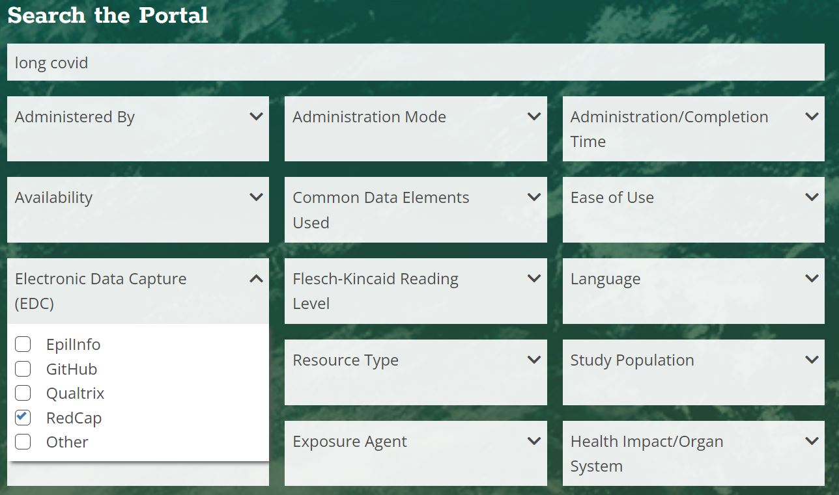
Importing surveys from outside sources into your REDCap Project:
The next few slides demonstrate how to import specific questions or an entire survey into your REDCap project from an outside source (not located in the REDCap Shared Library). You will need the .csv data dictionary file of the survey(s) you are adopting questions from and the .csv data dictionary file of the NICHD COVID-19 CDEs.
For this example, the DR2 Resources Portal was searched for Long COVID tools with RedCap capabilities using the search bar and Advanced Search filters.

Slide 15
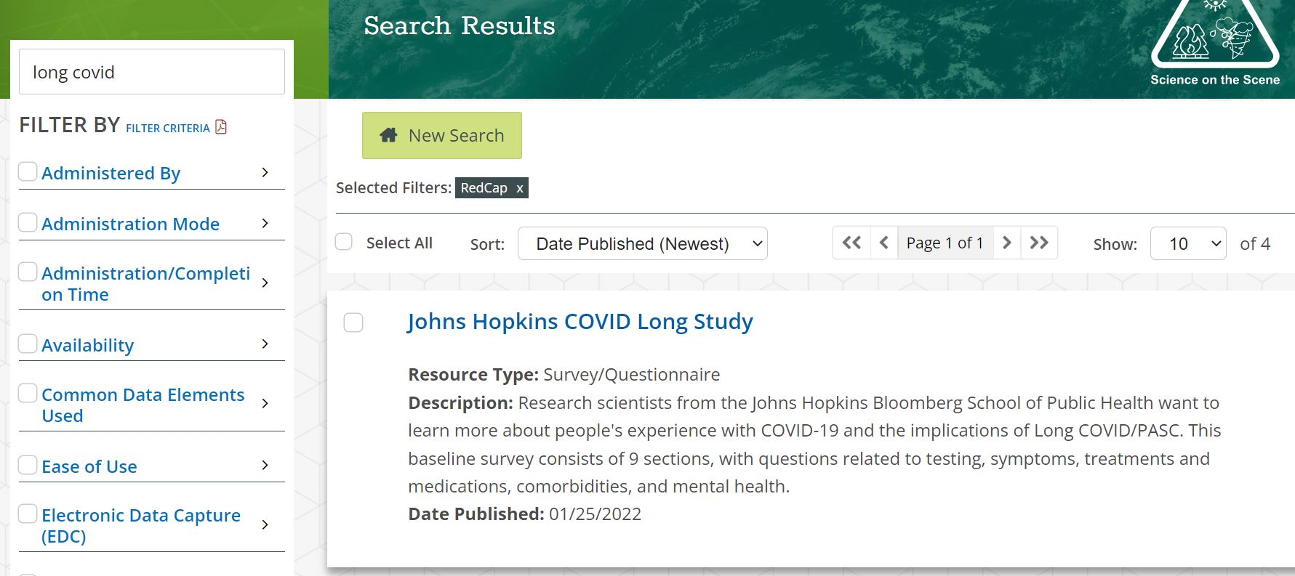
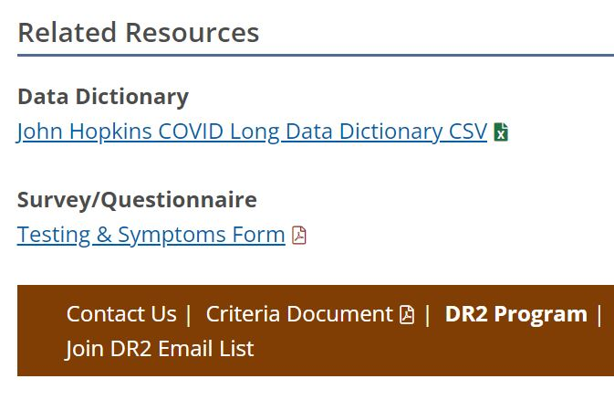
Importing surveys from outside sources into your REDCap Project:
Download the data dictionary .csv file(s) from the outside source(s); in this case the DR2 Resources Portal
Open the following data dictionary .csv files:
  survey(s) you’d like to adopt questions from
  NICHD COVID-19 CDEs

Slide 16
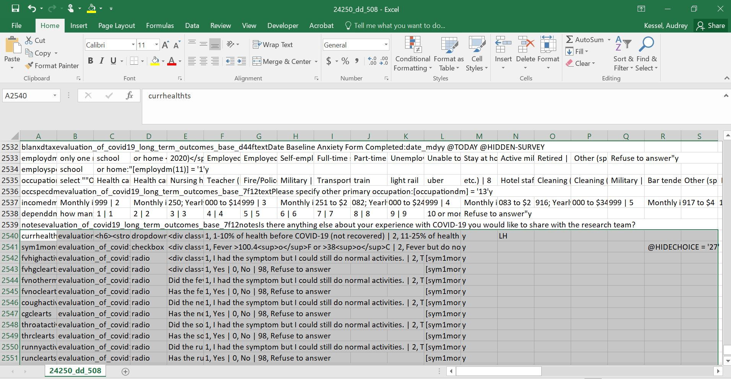
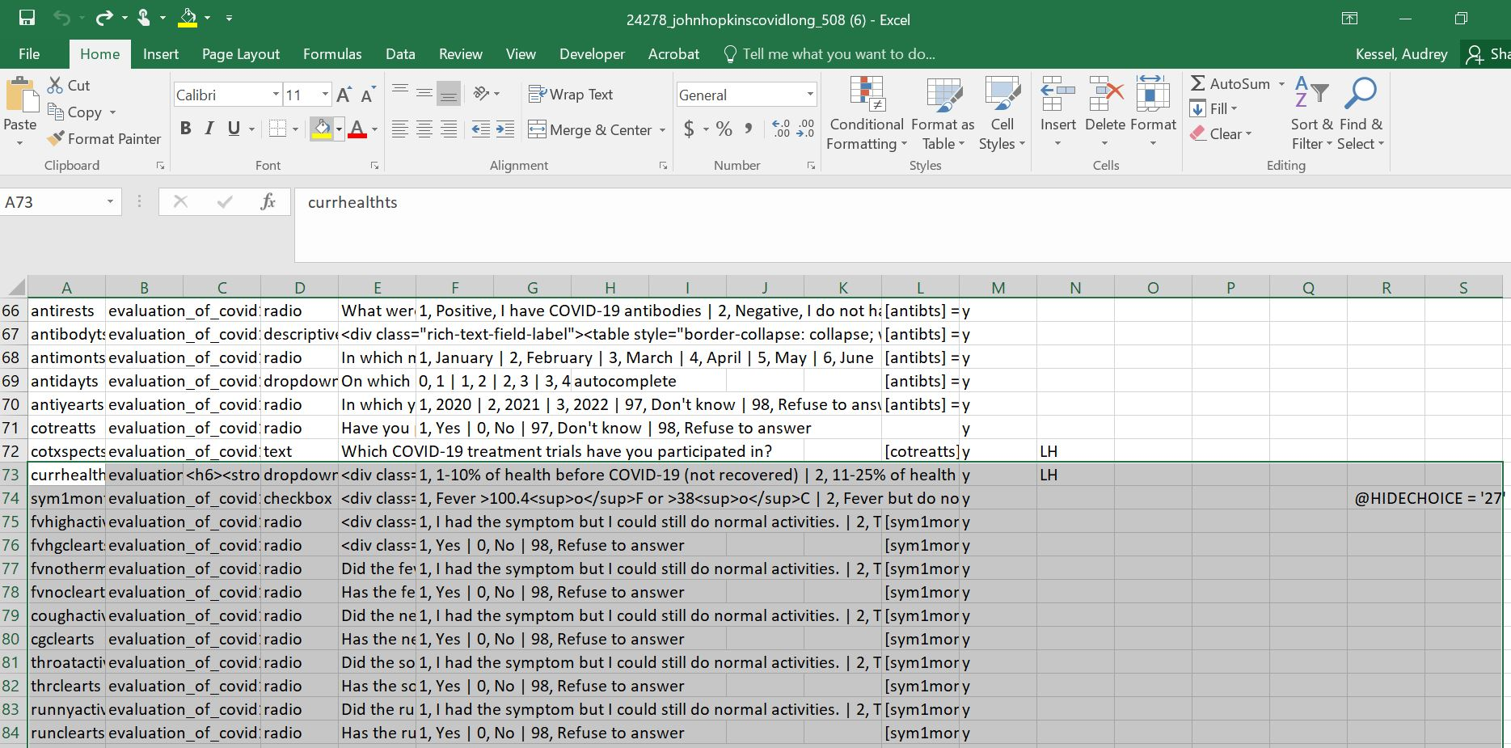
Importing surveys from outside sources into your REDCap Project:
Notice this field note. Check the file to make sure you didn’t leave out any important data/ fields!
Select the field (variable) names of interest, field types, and associated values *If you’d like to import the entire survey, select all data in the file
Copy and paste the selected data from the outside sourced data dictionary into the NICHD COVID-19 CDE Data Dictionary file *Repeat steps 3 and 4 for each survey you’d like to import
*If you know where you’d like the imported set of questions to be placed in the survey, you can paste them into the specific location. They will display in REDCap in the exact location you inserted them. If you’re unsure, the easiest method is to insert them at the end and rearrange them in the Online Designer of REDCap

Slide 17
Importing surveys from outside sources into your REDCap Project:
Project Name
Save the updated NICHD COVID-19 CDE file *make sure to save the file in .csv format
Login to your REDCap account
Select your REDCap Project
Select Dictionary under Project Home and Design
Choose the updated NICHD COVID-19 CDE .csv file with imported survey questions
Upload the file

Slide 18
Importing surveys from outside sources into your REDCap Project:
Project Name
Review any warnings or errors that may exist in the file and make adjustments as instructed *REDCap will notify you of any warnings and specify which fields have errors
Once you have the green light, commit changes
Return to the Online Designer
If there are errors in the file, for example, there are two of the same variable names, they will appear here with the cell number in a red box

Slide 19
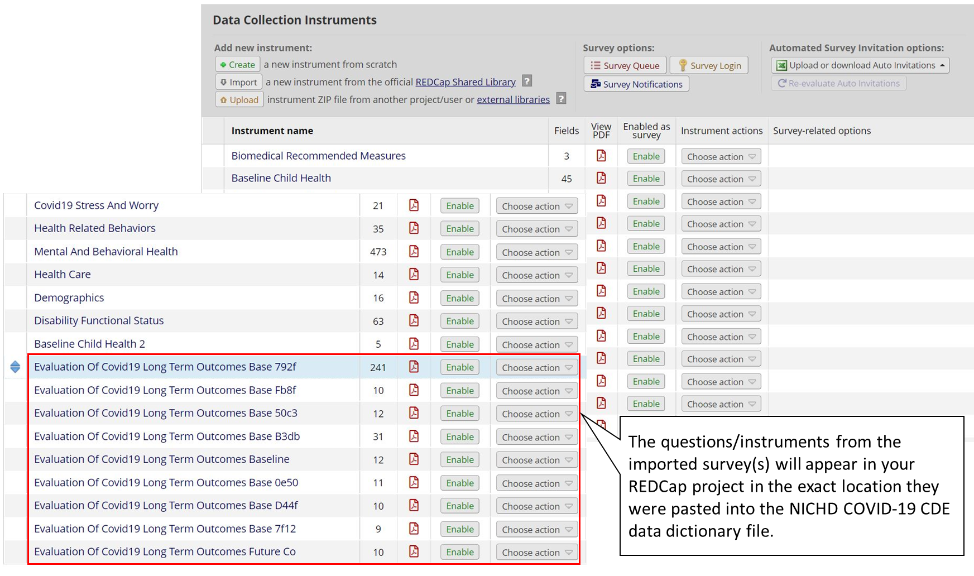
Importing surveys from outside sources into your REDCap Project:
Review the instruments in Online Designer
Make revisions within REDCap to fit the needs of your project

Slide 20
Questions? Contact Us.
Go to DR2 Resources Portal contact page
or
Email the DR2 Inbox directly

