Slide 1
Climate Change
A Human Health Perspective
A Student Exploration of the Global Impacts of Climate
Change on Human Health
Vector-Borne Diseases
National Institute of Environmental Health Sciences

Slide 2
List the impact(s) of a warming climate on human health.
The colors on the map show observed temperature changes over the past 110 years (1901-2012).
IPCC, 2013: Summary for Policymakers. In: Climate Change 2013: The Physical Science Basis.
Notes:
Image credit: IPCC, 2013: Summary for Policymakers. In: Climate Change 2013: The Physical Science Basis. Contribution of Working Group I to the Fifth Assessment Report of the Intergovernmental Panel on Climate Change [Stocker, T.F., D. Qin, G.-K. Plattner, M. Tignor, S.K. Allen, J. Boschung, A. Nauels, Y. Xia, V. Bex and P.M. Midgley (eds.)]. Cambridge University Press, Cambridge, United Kingdom and New York, NY, USA.
http://www.ipcc.ch/pdf/assessment-report/ar5/wg1/WG1AR5_SPM_FINAL.pdf

Slide 3
List the impact(s) of a warming climate on human health.
Heat anomalies are increasing across the board as time progresses. This figure from NOAA data shows documented global temperature anomalies from 1880 to 2018.
Source: NOAA National Centers for Environmental information, Climate at a Glance: Global Time Series, 2018.
Notes:
Of note, global and hemispheric anomalies are show with respect to the 20th century average. Continental anomalies with respect to the 1910 to 2000 average. And coordinate anomalies with respect to the 1981 to 2010 average.
Image credit: NOAA National Centers for Environmental information, Climate at a Glance: Global Time Series, published July 2018, retrieved on August 7, 2018 from https://www.ncdc.noaa.gov/cag/
https://www.ncdc.noaa.gov/cag/global/time-series/globe/land_ocean/all/6/1880-2018

Slide 4
List the impact(s) of a wetter climate on human health and of a drier climate on human health.
Maps of observed precipitation change from 1901 to 2010 and from 1951 to 2010. Trends in annual accumulation were calculated using the same criteria as the previous map.
Source: IPCC, 2013: Summary for Policymakers. In: Climate Change 2013: The Physical Science Basis.
Notes:
Image credit: IPCC, 2013: Summary for Policymakers. In: Climate Change 2013: The Physical Science Basis. Contribution of Working Group I to the Fifth Assessment Report of the Intergovernmental Panel on Climate Change [Stocker, T.F., D. Qin, G.-K. Plattner, M. Tignor, S.K. Allen, J. Boschung, A. Nauels, Y. Xia, V. Bex and P.M. Midgley (eds.)]. Cambridge University Press, Cambridge, United Kingdom and New York, NY, USA.
http://www.ipcc.ch/pdf/assessment-report/ar5/wg1/WG1AR5_SPM_FINAL.pdf

Slide 5
What is a vector?
What is a vector-borne disease?

Slide 6
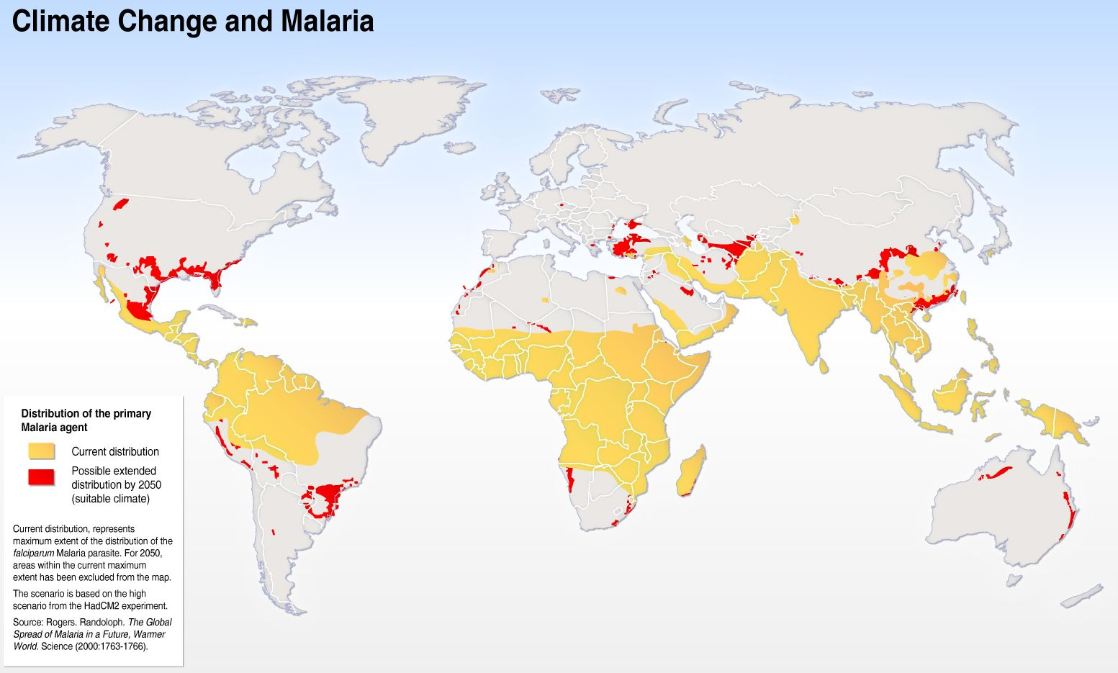
Climate Change and Malaria
Notes:
https://www.google.com/search?q=climate+change+and+malaria&rlz=1C1GCEA_enUS762US762&source=lnms&tbm=isch&sa=X&ved=0ahUKEwiig5Ot0JHXAhUJ5YMKHct-ArEQ_AUICygC&biw=1920&bih=974#imgrc=ajsyRNBsYxfqBM:

Slide 7
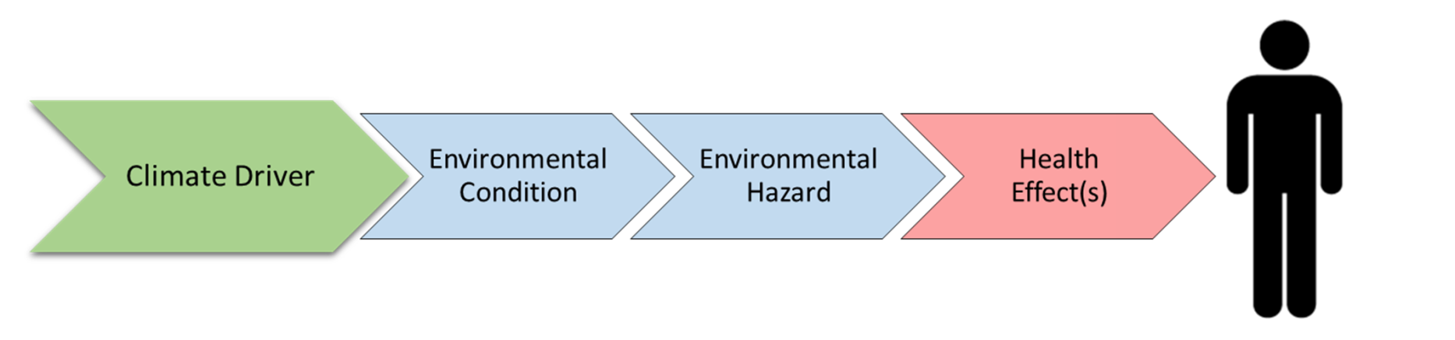
Visual Model | Cause-effect
The climate driver is the specific climate change that leads to an environmental condition.
The environmental condition is what arises in response to a specific climate change.
An environmental hazard is what will directly lead to a negative health effect.

Slide 8


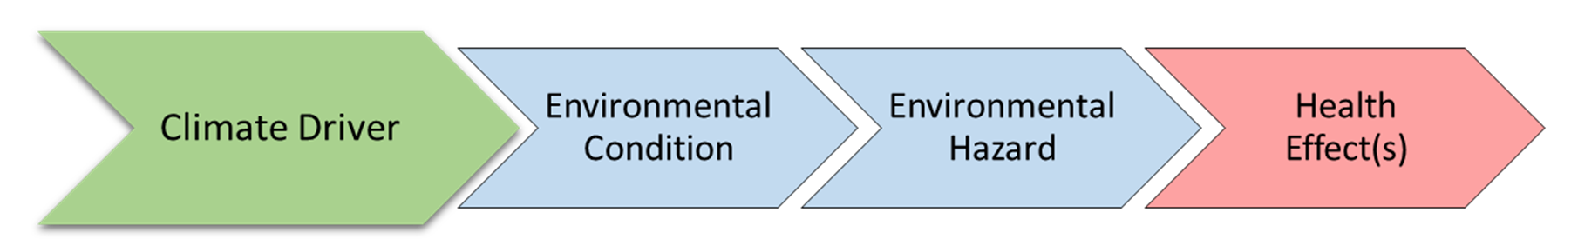
Visual Model | Cause-effect
Exposure pathway

Slide 9

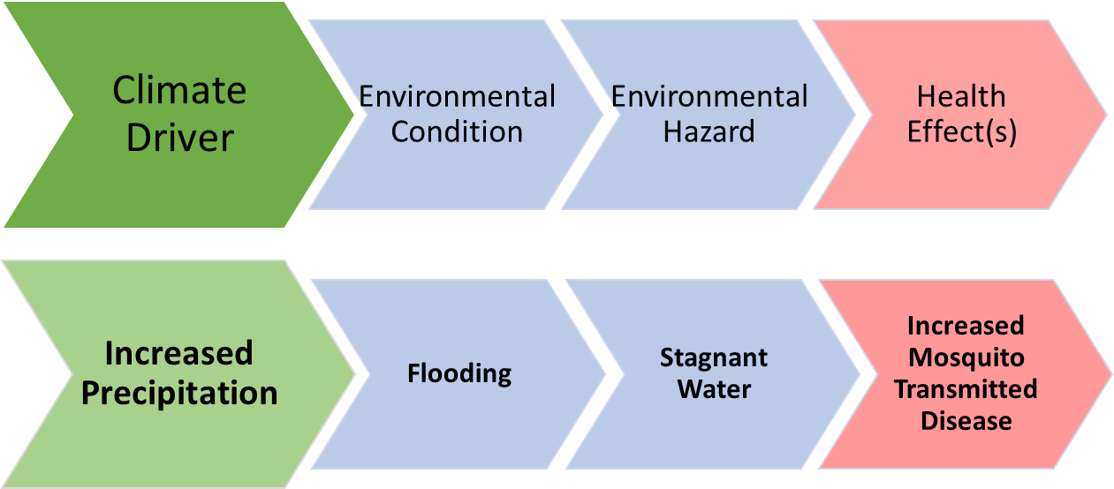

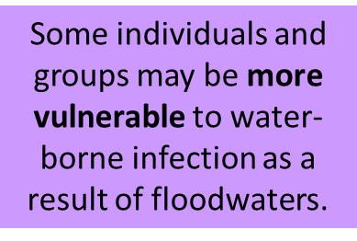
Flooding
Photo Credit: Ch. 4: Impacts of Extreme Events on Human Health. The Impacts of Climate Change on Human Health in the United States: A Scientific Assessment. U.S. Global Change Research Program
Some individuals and groups may be more vulnerable to vector-borne diseases as a result of floodwaters.
Notes:
Image credit: https://s3.amazonaws.com/climatehealth2016/low/ClimateHealth2016_04_Extremes_small.pdf

Slide 10
Directions
READ your assigned impact section:
Temperature, storm and radiation-related impacts
  Chapter 11 Sections 4.1 – 4.3
Vector-borne and other infectious diseases
  Chapter 11 Section 5.1
Food and water-borne diseases
  Chapter 11 Section 5.2
Air quality
  Chapter 11 Section 5.3
Nutrition and occupational health
  Chapter 11 Sections 6.1 – 6.2
Mental health and violence/conflict
  Chapter 11 Sections 6.3 –6.4

Slide 11
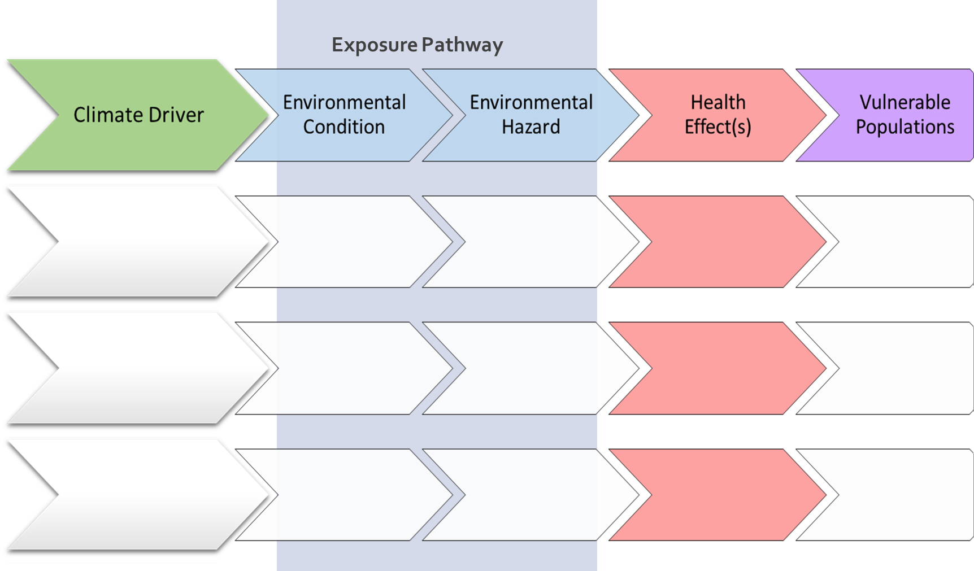
Student Graphic Organizer
Notes:
PPT of student graphic organizer; students may not be able to complete all rows.

Slide 12
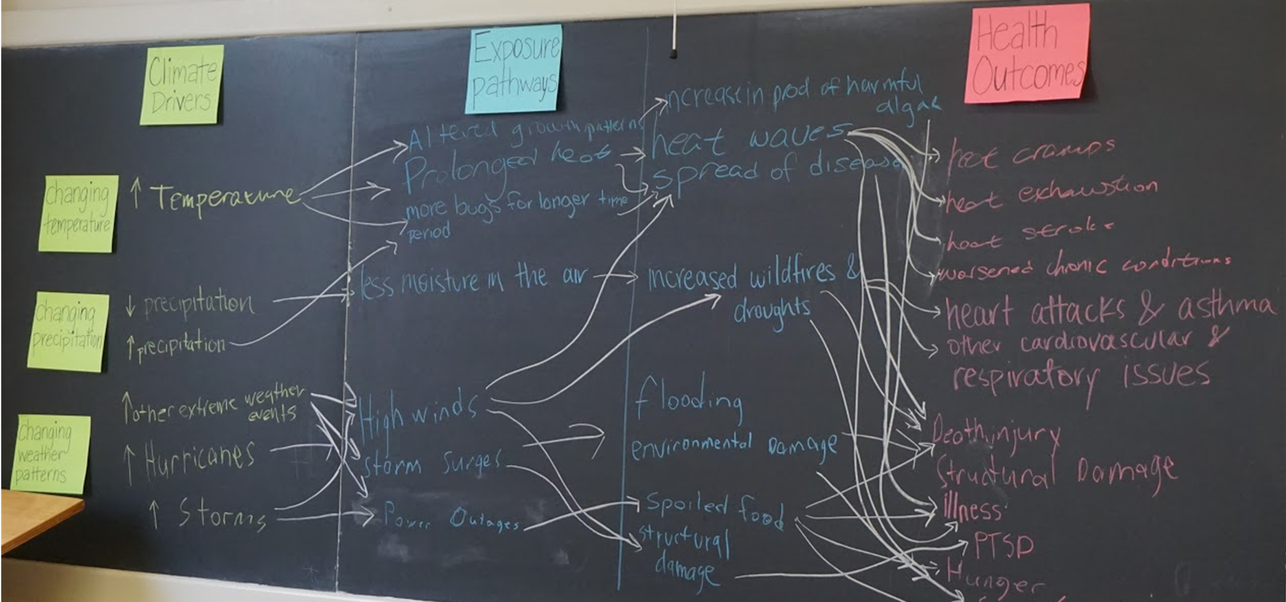
Climate change flow chart
Notes:
This lesson promotes systems thinking necessary to understand how climate change impacts human health.

Slide 13
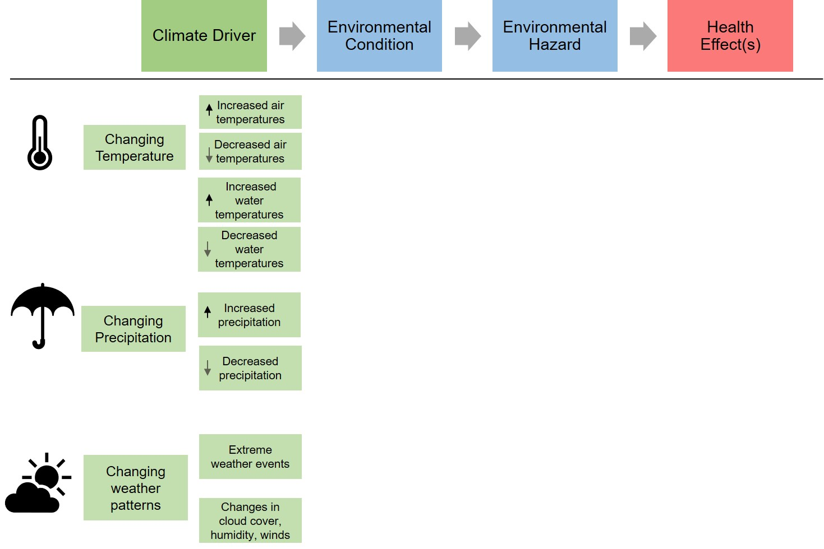
Climate Drivers and Health Outcomes

Slide 14
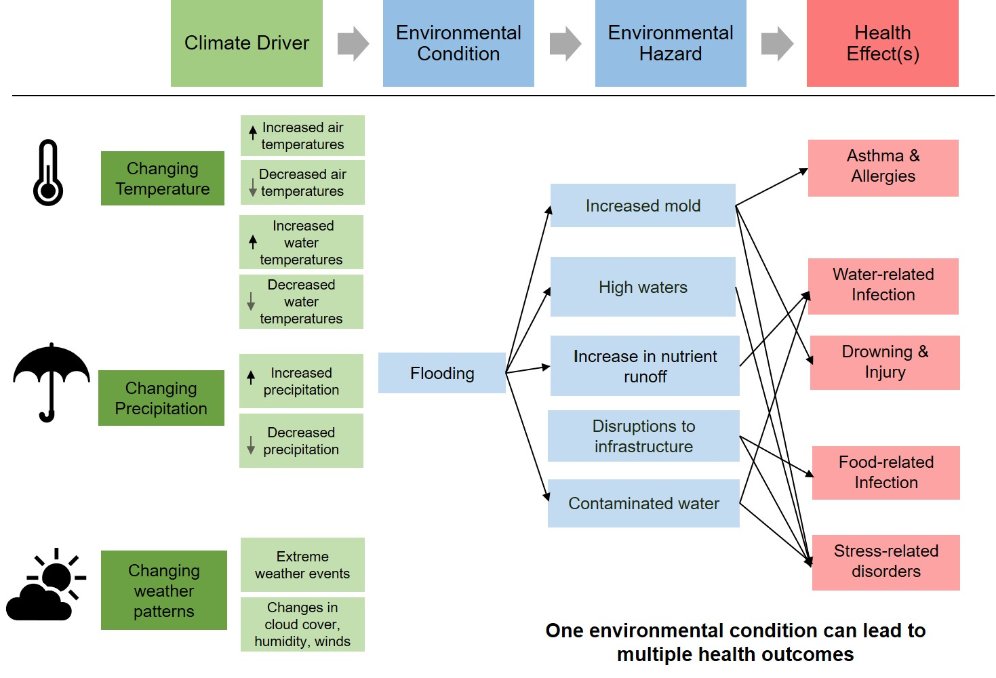
Climate Drivers and Health Outcomes

Slide 15
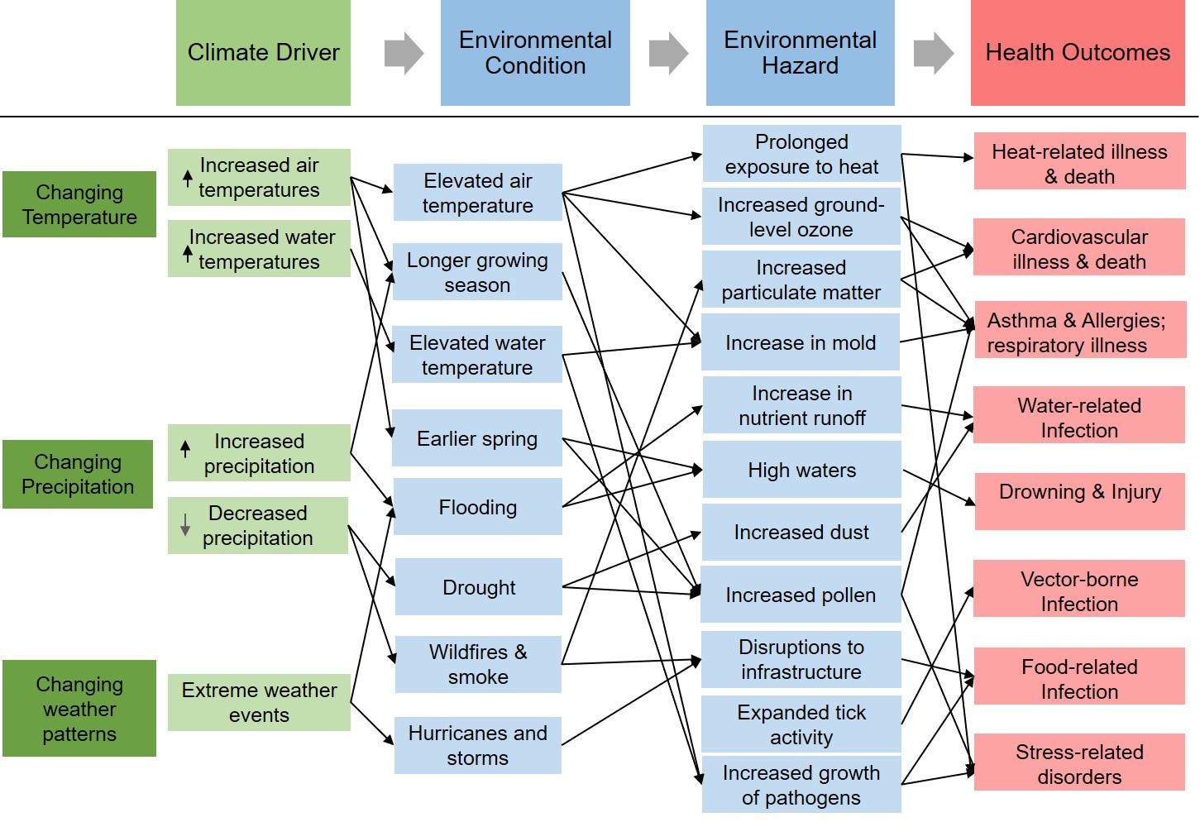
Climate Drivers and Health Outcomes

Slide 16

Climate change and Human Health Effects
Climate Change
Human Health Effects
Temperature
Vector borne infection
Cardiovascular and respiratory illness
Heat related illness and death
Precipitation
Water-related infection
Humidity
Weather-related injury and death
Mental health and Stress-related disorders
Weather patterns
Food-related infection
Notes:
Visual model to summarize activity.

Slide 17
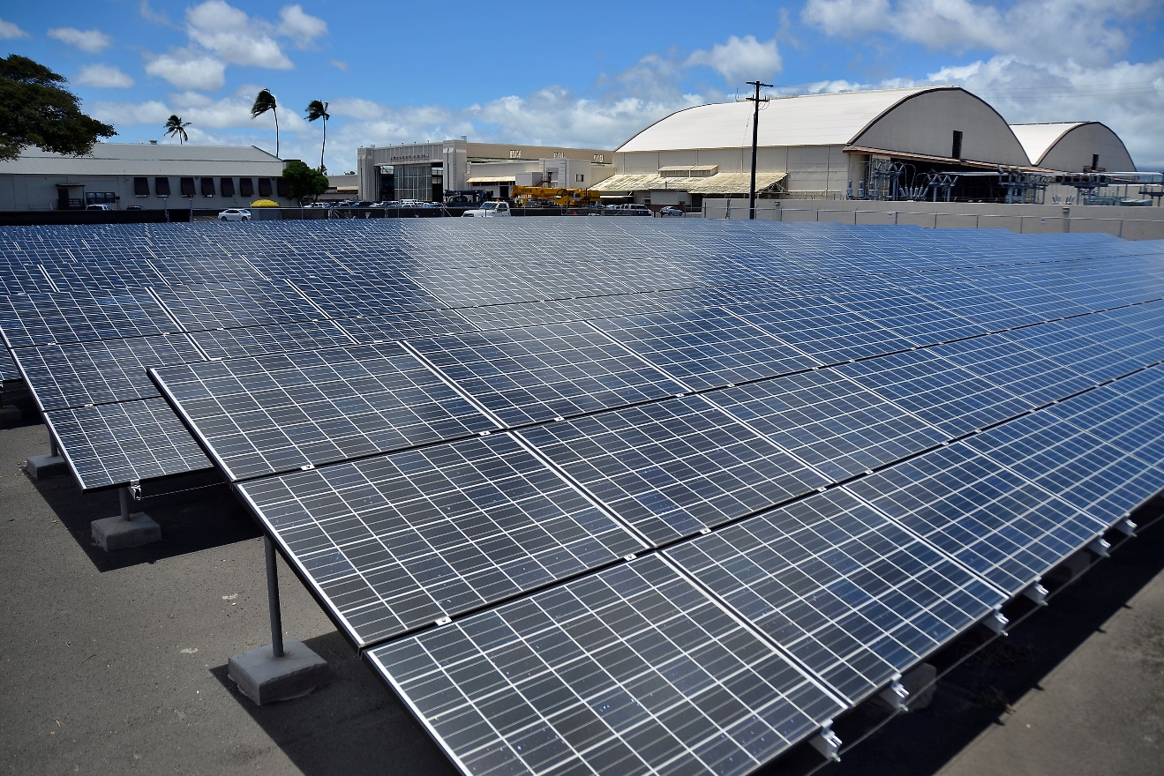
Mitigation strategies
Actions we can take to reduce the severity of climate change by reducing greenhouse gas emissions.
Photo Credit: Official Navy Page from United States of AmericaMC2 Daniel Barker/U.S. Navy (Solar panels.) [Public domain], via Wikimedia Commons
Notes:
By Official Navy Page from United States of AmericaMC2 Daniel Barker/U.S. Navy (Solar panels.) [Public domain], via Wikimedia Commons
https://upload.wikimedia.org/wikipedia/commons/5/57/Flickr_-_Official_U.S._Navy_Imagery_-_Solar_panels..jpg

Slide 18
Mitigation can make a difference
Source: IPCC, 2013: Summary for Policymakers. In: Climate Change 2013: The Physical Science Basis..
Notes:
Above figure explained: Representative Concentration Pathways (RCPs) are four greenhouse gas concentration trajectories adopted by the IPCC for its fifth Assessment Report (AR5) in 2014. The pathways are used for climate modeling and research. They describe four possible climate futures, all of which are considered possible, depending on how much greenhouse gas is emitted in the years to come. The four RCPs (RCP 2.5, RCP 4.5, RCP 6 and RCP 8.5) each represent the amount greenhouse gas concentration involved in the scenario. RCP 2.6 assumes that global annual greenhouse gas emissions peak between 2010-2020 with emission declining substantially thereafter. Emissions in RCP 4.5 peak around 2040, then decline. In RCP 6, emissions peak around 2080 and then decline. In RCP 8.5 they continue to rise throughout the 21st century.
Image credit: IPCC, 2013: Summary for Policymakers. In: Climate Change 2013: The Physical Science Basis. Contribution of Working Group I to the Fifth Assessment Report of the Intergovernmental Panel on Climate Change [Stocker, T.F., D. Qin, G.-K. Plattner, M. Tignor, S.K. Allen, J. Boschung, A. Nauels, Y. Xia, V. Bex and P.M. Midgley (eds.)]. Cambridge University Press, Cambridge, United Kingdom and New York, NY, USA.
http://www.ipcc.ch/pdf/assessment-report/ar5/wg1/WG1AR5_SPM_FINAL.pdf

Slide 19
Mitigation can make a difference
Source: IPCC, 2013: Summary for Policymakers. In: Climate Change 2013: The Physical Science Basis.
Notes:
Above figure explained: Representative Concentration Pathways (RCPs) are four greenhouse gas concentration trajectories adopted by the IPCC for its fifth Assessment Report (AR5) in 2014. The pathways are used for climate modeling and research. They describe four possible climate futures, all of which are considered possible, depending on how much greenhouse gas is emitted in the years to come. The four RCPs (RCP 2.5, RCP 4.5, RCP 6 and RCP 8.5) each represent the amount greenhouse gas concentration involved in the scenario. RCP 2.6 assumes that global annual greenhouse gas emissions peak between 2010-2020 with emission declining substantially thereafter. Emissions in RCP 4.5 peak around 2040, then decline. In RCP 6, emissions peak around 2080 and then decline. In RCP 8.5 they continue to rise throughout the 21st century.
Image credit: IPCC, 2013: Summary for Policymakers. In: Climate Change 2013: The Physical Science Basis. Contribution of Working Group I to the Fifth Assessment Report of the Intergovernmental Panel on Climate Change [Stocker, T.F., D. Qin, G.-K. Plattner, M. Tignor, S.K. Allen, J. Boschung, A. Nauels, Y. Xia, V. Bex and P.M. Midgley (eds.)]. Cambridge University Press, Cambridge, United Kingdom and New York, NY, USA.
http://www.ipcc.ch/pdf/assessment-report/ar5/wg1/WG1AR5_SPM_FINAL.pdf

Slide 20
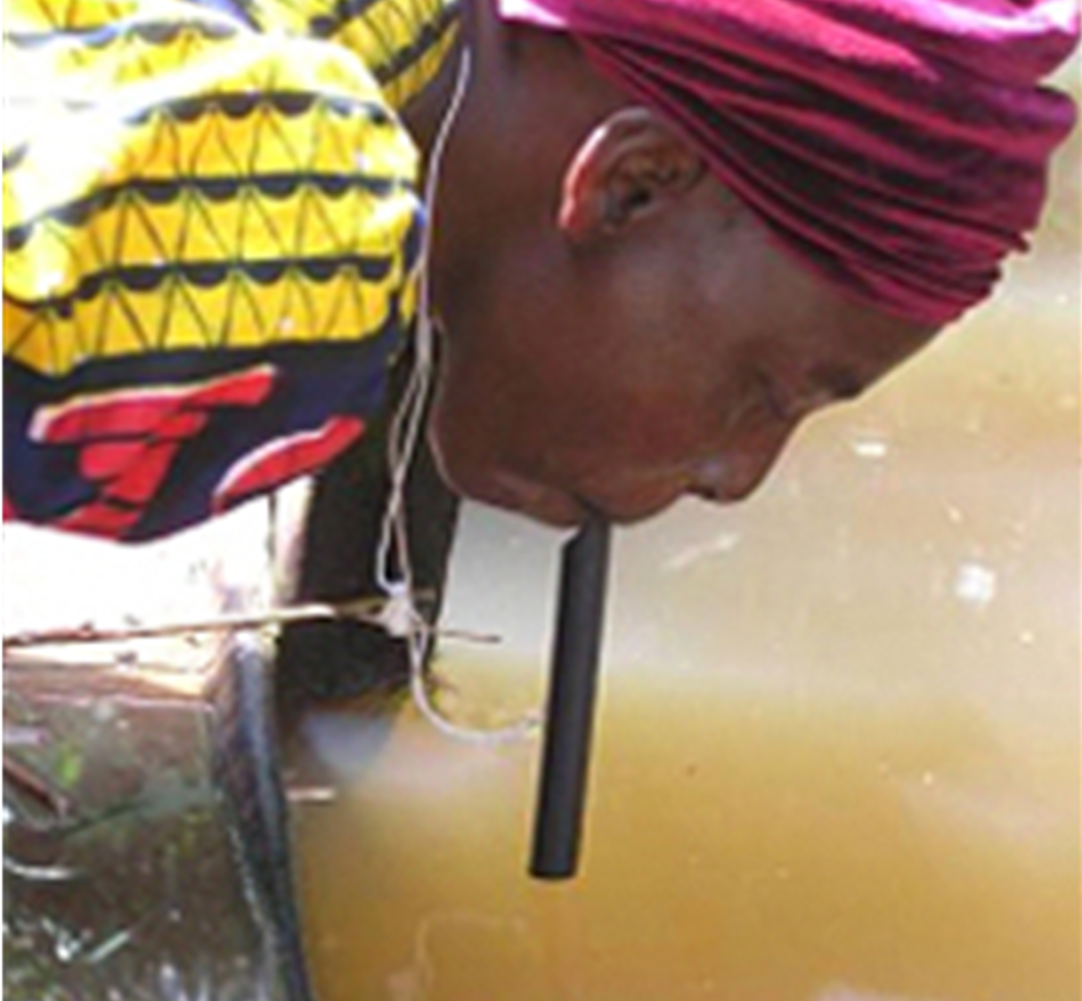
Adaptation strategies
Actions we can take to reduce our risk/vulnerability to climate impacts.
Photo Credit: CDC, Prevention & Control (2017).
Notes:
http://www.cdc.gov/parasites/guineaworm/prevent.html

