Slide 1
A Student Exploration of the Global Impacts of Climate
Change on Human Health
Climate Change| A Human Health Perspective

Slide 2
List the impact(s) of a warming climate on human health.
The colors on the map show observed temperature changes over the past 110 years (1901-2012).
Source: IPCC, 2013: Summary for Policymakers. In: Climate Change 2013: The Physical Science Basis.
Notes:
Image credit: IPCC, 2013: Summary for Policymakers. In: Climate Change 2013: The Physical Science Basis. Contribution of Working Group I to the Fifth Assessment Report of the Intergovernmental Panel on Climate Change [Stocker, T.F., D. Qin, G.-K. Plattner, M. Tignor, S.K. Allen, J. Boschung, A. Nauels, Y. Xia, V. Bex and P.M. Midgley (eds.)]. Cambridge University Press, Cambridge, United Kingdom and New York, NY, USA.
http://www.ipcc.ch/pdf/assessment-report/ar5/wg1/WG1AR5_SPM_FINAL.pdf

Slide 3
List the impact(s) of a wetter climate on human health and of a drier climate on human health.
Maps of observed precipitation change from 1901 to 2010 and from 1951 to 2010. Trends in annual accumulation were calculated using the same criteria as the previous map.
Source: IPCC, 2013: Summary for Policymakers. In: Climate Change 2013: The Physical Science Basis.
Notes:
Image credit: IPCC, 2013: Summary for Policymakers. In: Climate Change 2013: The Physical Science Basis. Contribution of Working Group I to the Fifth Assessment Report of the Intergovernmental Panel on Climate Change [Stocker, T.F., D. Qin, G.-K. Plattner, M. Tignor, S.K. Allen, J. Boschung, A. Nauels, Y. Xia, V. Bex and P.M. Midgley (eds.)]. Cambridge University Press, Cambridge, United Kingdom and New York, NY, USA.
http://www.ipcc.ch/pdf/assessment-report/ar5/wg1/WG1AR5_SPM_FINAL.pdf

Slide 4
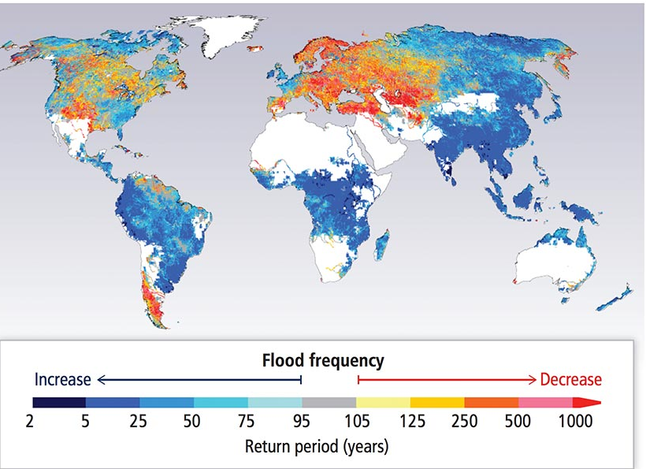
Flooding Frequency
Source: IPCC 2014, 5AR Chapter 3: Freshwater Resources, Pg. 248.

Slide 5
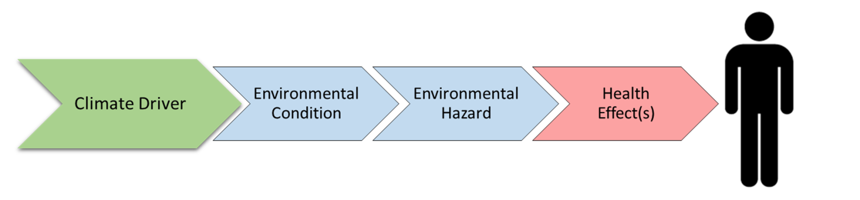
Visual Model | Cause-effect
The climate driver is the specific climate change that leads to an environmental condition.
The environmental condition is what arises in response to a specific climate change.
An environmental hazard is what will directly lead to a negative health effect.
5

Slide 6

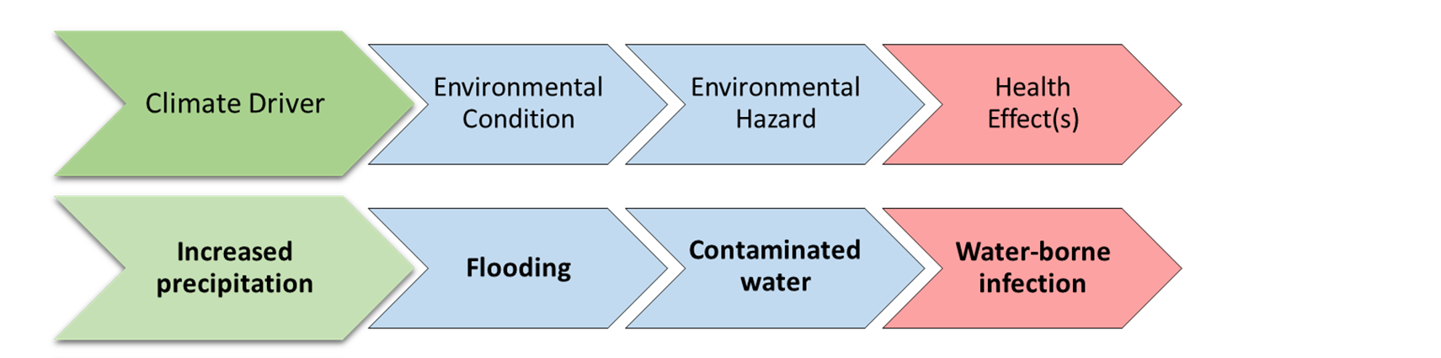

Flooding
Photo Credit: Ch. 4: Impacts of Extreme Events on Human Health. The Impacts of Climate Change on Human Health in the United States: A Scientific Assessment. U.S. Global Change Research Program
Some individuals and groups may be more vulnerable to water-borne infection as a result of floodwaters.
Notes:
Image credit: https://s3.amazonaws.com/climatehealth2016/low/ClimateHealth2016_04_Extremes_small.pdf

Slide 7
Directions
READ your assigned impact section:
Temperature, storm and radiation-related impacts
  Chapter 11 Sections 4.1 – 4.3
Vector-borne and other infectious diseases
  Chapter 11 Section 5.1
Food and water-borne diseases
  Chapter 11 Section 5.2
Air quality
  Chapter 11 Section 5.3
Nutrition and occupational health
  Chapter 11 Sections 6.1 – 6.2
Mental health and violence/conflict
  Chapter 11 Sections 6.3 –6.4

Slide 8
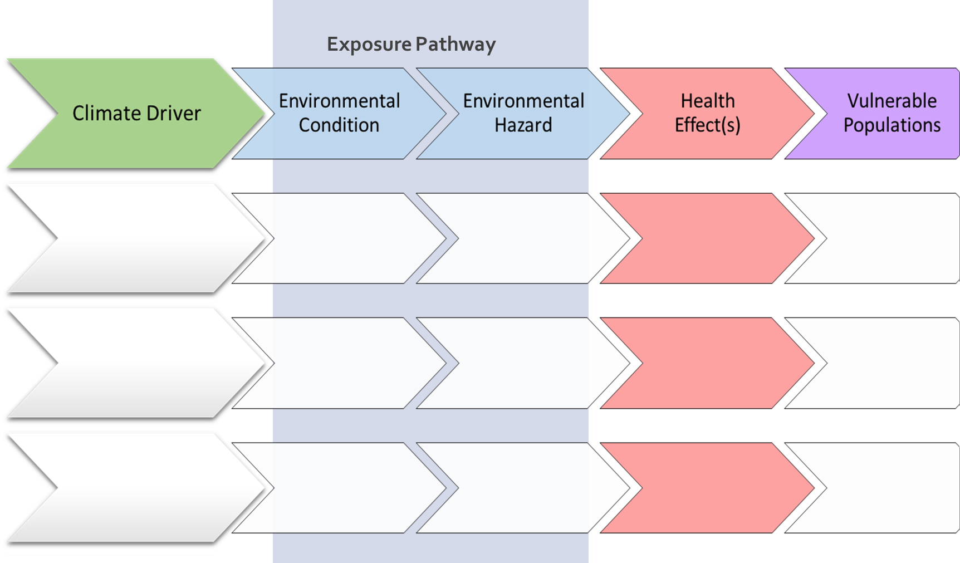
Graphic Organizer
Notes:
PPT of student graphic organizer; students may not be able to complete all rows.

Slide 9
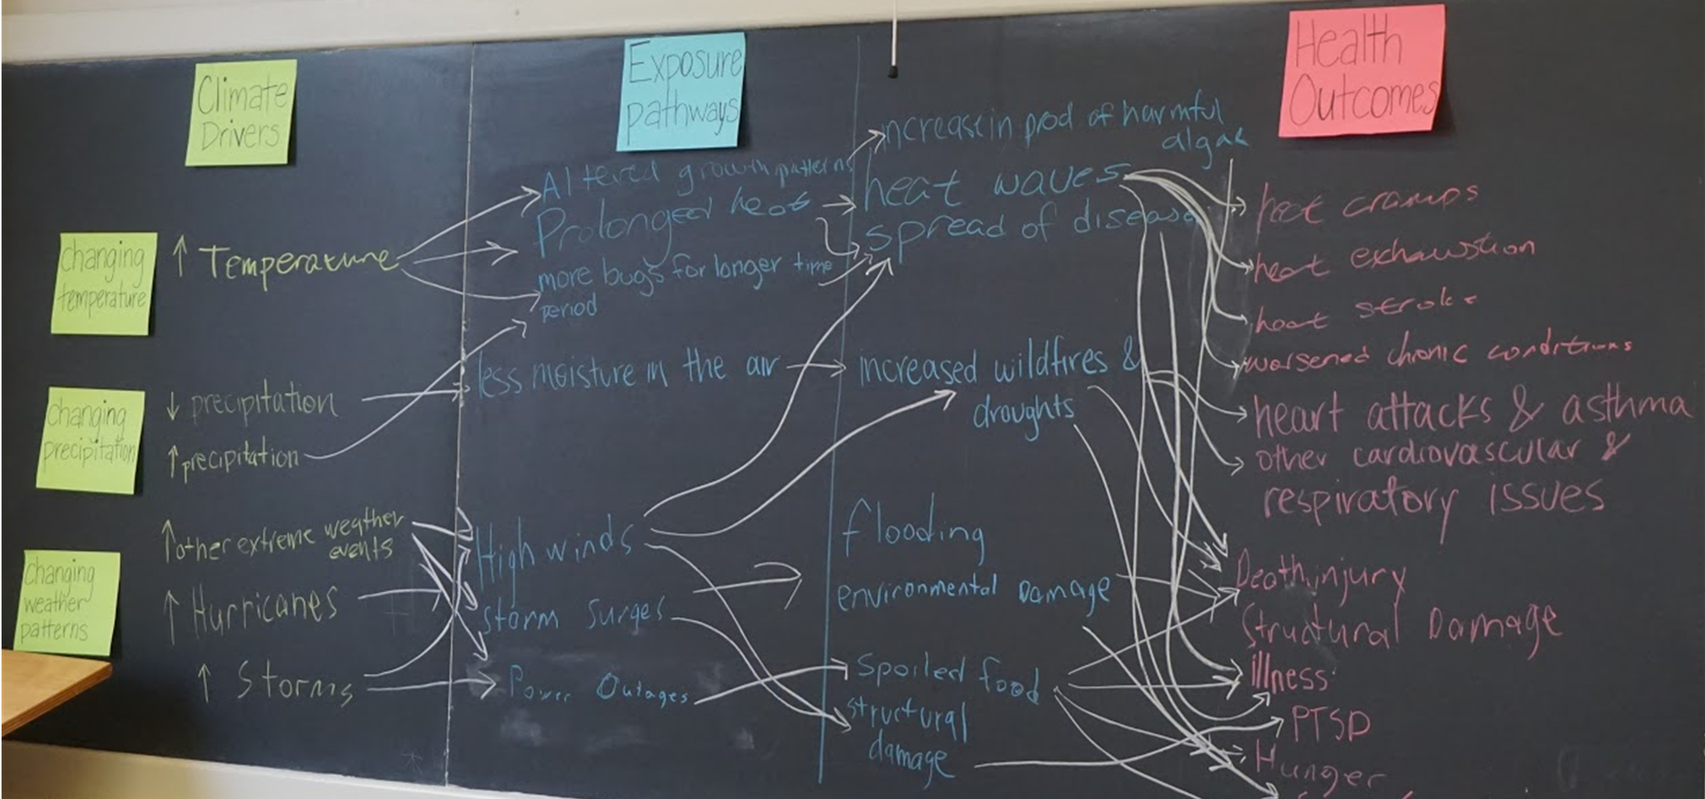
Climate change flow chart
Notes:
This lesson promotes systems thinking necessary to understand how climate change impacts human health.

Slide 10
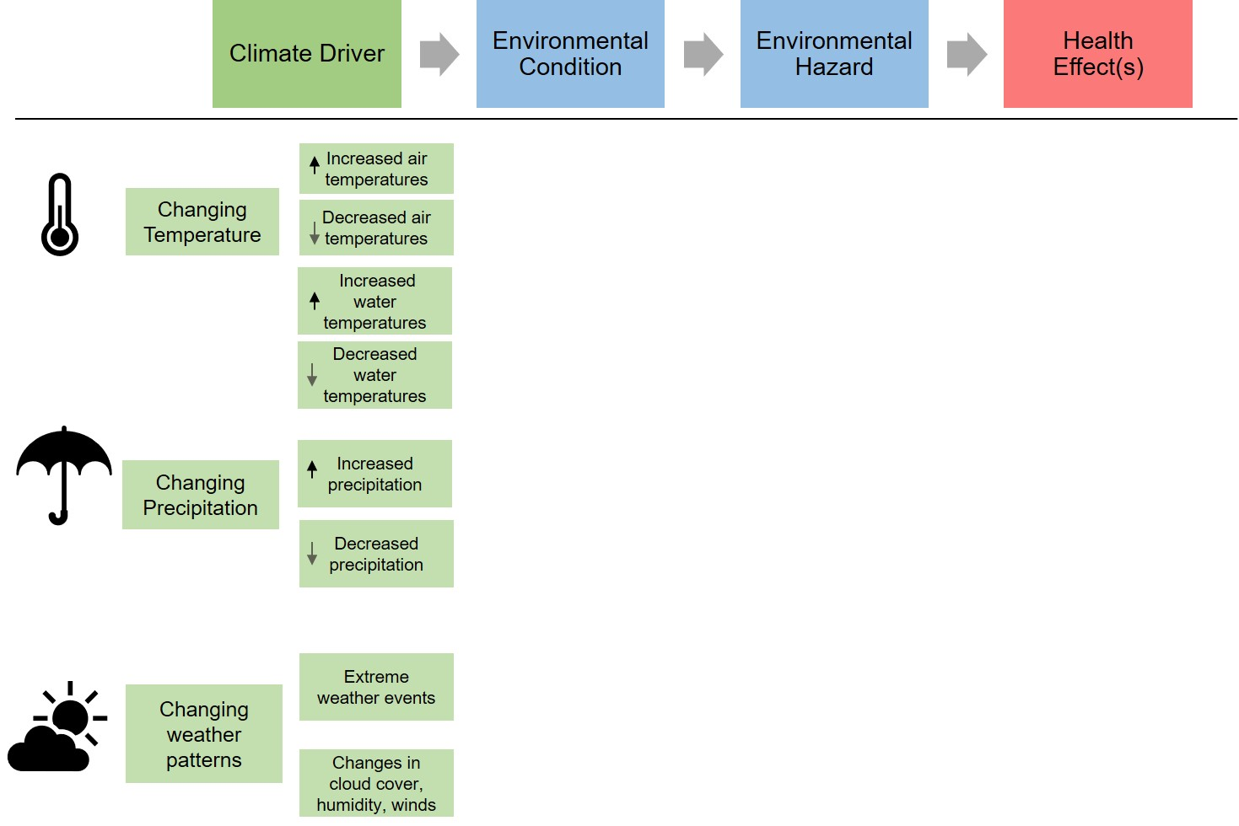
Climate Drivers and Health Outcomes

Slide 11
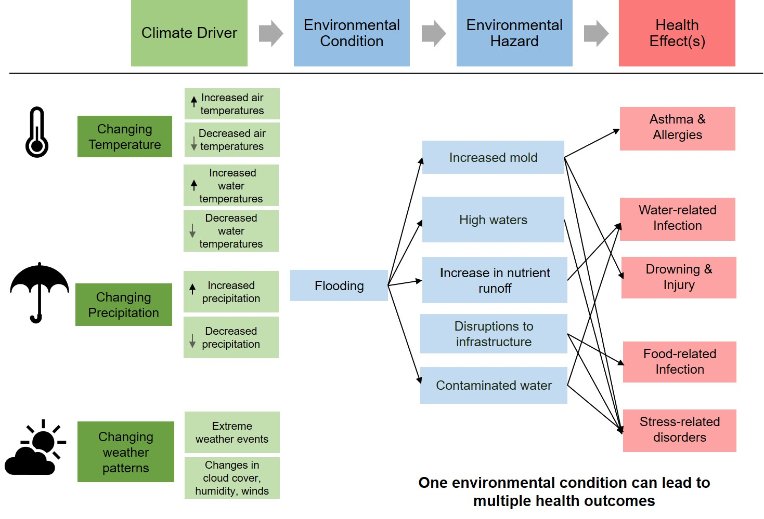
Climate Drivers and Health Outcomes

Slide 12
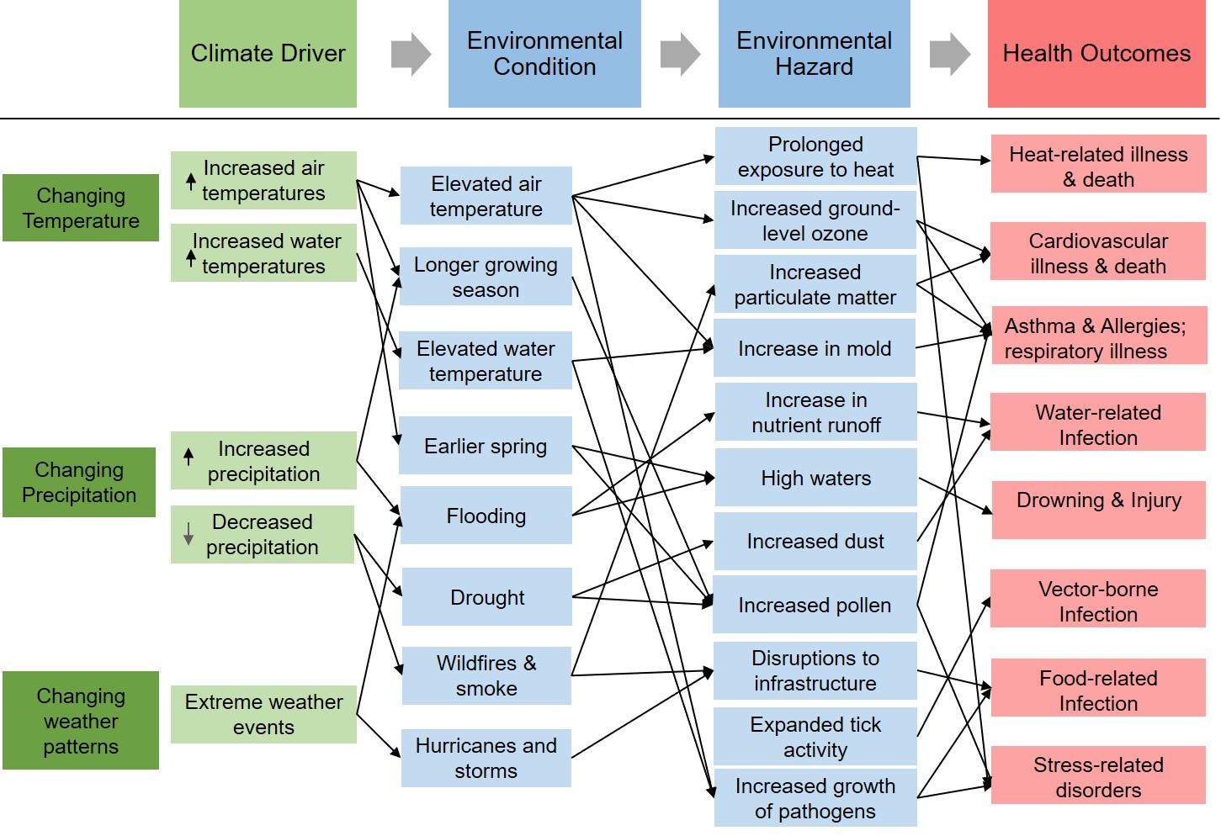
Climate Drivers and Health Outcomes

Slide 13

Climate Change and Human Health Effects
Climate Change
Human Health Effects
Temperature
Vector borne infection
Cardiovascular and respiratory illness
Heat related illness and death
Precipitation
Water-related infection
Humidity
Weather-related injury and death
Mental health and Stress-related disorders
Weather patterns
Food-related infection
Notes:
Visual model to summarize activity.

Slide 14
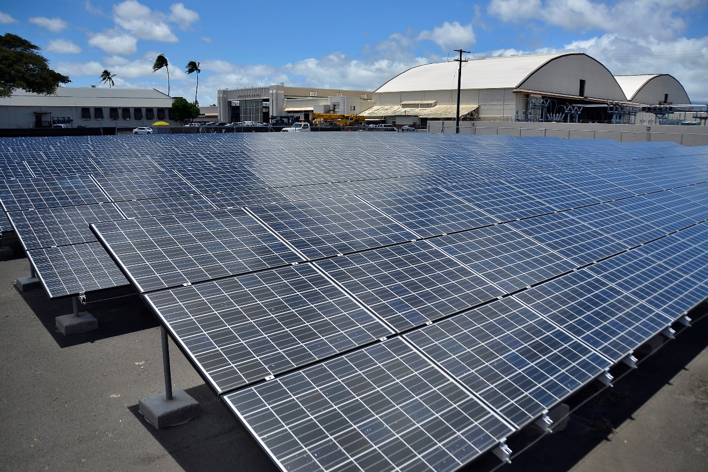
Mitigation strategies
Actions we can take to reduce the severity of climate change by reducing greenhouse gas emissions.
Photo Credit: Official Navy Page from United States of AmericaMC2 Daniel Barker/U.S. Navy (Solar panels.) [Public domain], via Wikimedia Commons
Notes:
By Official Navy Page from United States of AmericaMC2 Daniel Barker/U.S. Navy (Solar panels.) [Public domain], via Wikimedia Commons
https://upload.wikimedia.org/wikipedia/commons/5/57/Flickr_-_Official_U.S._Navy_Imagery_-_Solar_panels..jpg

Slide 15
Mitigation can make a difference
Source: IPCC, 2013: Summary for Policymakers. In: Climate Change 2013: The Physical Science Basis.
Notes:
Above figure explained: Representative Concentration Pathways (RCPs) are four greenhouse gas concentration trajectories adopted by the IPCC for its fifth Assessment Report (AR5) in 2014. The pathways are used for climate modeling and research. They describe four possible climate futures, all of which are considered possible, depending on how much greenhouse gas is emitted in the years to come. The four RCPs (RCP 2.5, RCP 4.5, RCP 6 and RCP 8.5) each represent the amount greenhouse gas concentration involved in the scenario. RCP 2.6 assumes that global annual greenhouse gas emissions peak between 2010-2020 with emission declining substantially thereafter. Emissions in RCP 4.5 peak around 2040, then decline. In RCP 6, emissions peak around 2080 and then decline. In RCP 8.5 they continue to rise throughout the 21st century. Fewer greenhouse gas emissions are represented by RCP 2.5 and average surface temperature changes are less than under RCP 6 or 8.5 which reflect increased emissions.
Image credit: IPCC, 2013: Summary for Policymakers. In: Climate Change 2013: The Physical Science Basis. Contribution of Working Group I to the Fifth Assessment Report of the Intergovernmental Panel on Climate Change [Stocker, T.F., D. Qin, G.-K. Plattner, M. Tignor, S.K. Allen, J. Boschung, A. Nauels, Y. Xia, V. Bex and P.M. Midgley (eds.)]. Cambridge University Press, Cambridge, United Kingdom and New York, NY, USA.
http://www.ipcc.ch/pdf/assessment-report/ar5/wg1/WG1AR5_SPM_FINAL.pdf

Slide 16
Mitigation can make a difference
Source: IPCC, 2013: Summary for Policymakers. In: Climate Change 2013: The Physical Science Basis.
Notes:
Above figure explained: Representative Concentration Pathways (RCPs) are four greenhouse gas concentration trajectories adopted by the IPCC for its fifth Assessment Report (AR5) in 2014. The pathways are used for climate modeling and research. They describe four possible climate futures, all of which are considered possible, depending on how much greenhouse gas is emitted in the years to come. The four RCPs (RCP 2.5, RCP 4.5, RCP 6 and RCP 8.5) each represent the amount greenhouse gas concentration involved in the scenario. RCP 2.6 assumes that global annual greenhouse gas emissions peak between 2010-2020 with emission declining substantially thereafter. Emissions in RCP 4.5 peak around 2040, then decline. In RCP 6, emissions peak around 2080 and then decline. In RCP 8.5 they continue to rise throughout the 21st century.
Image credit: IPCC, 2013: Summary for Policymakers. In: Climate Change 2013: The Physical Science Basis. Contribution of Working Group I to the Fifth Assessment Report of the Intergovernmental Panel on Climate Change [Stocker, T.F., D. Qin, G.-K. Plattner, M. Tignor, S.K. Allen, J. Boschung, A. Nauels, Y. Xia, V. Bex and P.M. Midgley (eds.)]. Cambridge University Press, Cambridge, United Kingdom and New York, NY, USA.
http://www.ipcc.ch/pdf/assessment-report/ar5/wg1/WG1AR5_SPM_FINAL.pdf

Slide 17
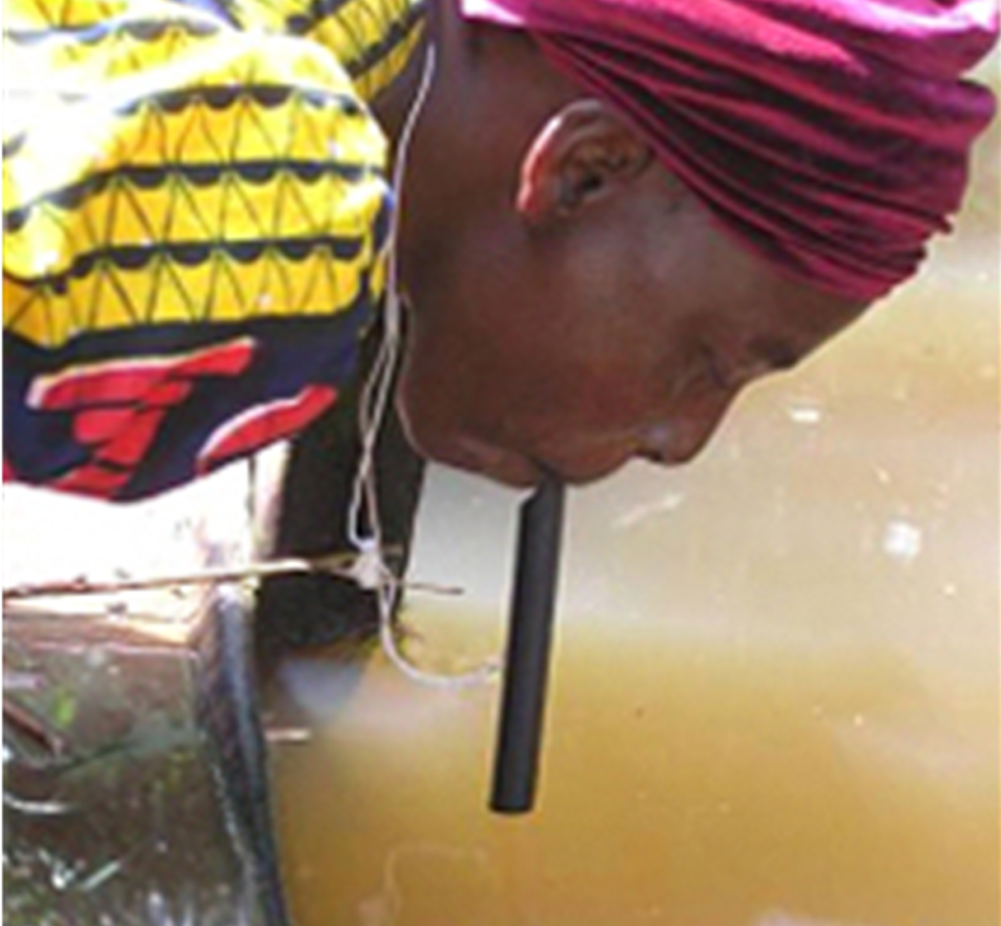
Adaptation strategies
Actions we can take to reduce our risk/vulnerability to climate impacts.
Photo Credit: CDC, Prevention & Control (2017).
Notes:
http://www.cdc.gov/parasites/guineaworm/prevent.html

