Slide 1
A Clinical Healthcare Student Exploration of the Global Impacts of Climate Change on Human Health
Climate Change| A Human Health Perspective

Slide 2
List the impact(s) of a warming climate on human health.
The colors on the map show observed temperature changes over the past 110 years (1901-2012).
Source: IPCC, 2013: Summary for Policymakers. In: Climate Change 2013: The Physical Science Basis.
Notes:
Image credit: IPCC, 2013: Summary for Policymakers. In: Climate Change 2013: The Physical Science Basis. Contribution of Working Group I to the Fifth Assessment Report of the Intergovernmental Panel on Climate Change [Stocker, T.F., D. Qin, G.-K. Plattner, M. Tignor, S.K. Allen, J. Boschung, A. Nauels, Y. Xia, V. Bex and P.M. Midgley (eds.)]. Cambridge University Press, Cambridge, United Kingdom and New York, NY, USA.
http://www.ipcc.ch/pdf/assessment-report/ar5/wg1/WG1AR5_SPM_FINAL.pdf

Slide 3
List the impact(s) of a wetter climate on human health and of a drier climate on human health.
Maps of observed precipitation change from 1901 to 2010 and from 1951 to 2010. Trends in annual accumulation were calculated using the same criteria as the previous map.
Source: IPCC, 2013: Summary for Policymakers. In: Climate Change 2013: The Physical Science Basis.
Notes:
Image credit: IPCC, 2013: Summary for Policymakers. In: Climate Change 2013: The Physical Science Basis. Contribution of Working Group I to the Fifth Assessment Report of the Intergovernmental Panel on Climate Change [Stocker, T.F., D. Qin, G.-K. Plattner, M. Tignor, S.K. Allen, J. Boschung, A. Nauels, Y. Xia, V. Bex and P.M. Midgley (eds.)]. Cambridge University Press, Cambridge, United Kingdom and New York, NY, USA.
http://www.ipcc.ch/pdf/assessment-report/ar5/wg1/WG1AR5_SPM_FINAL.pdf

Slide 4
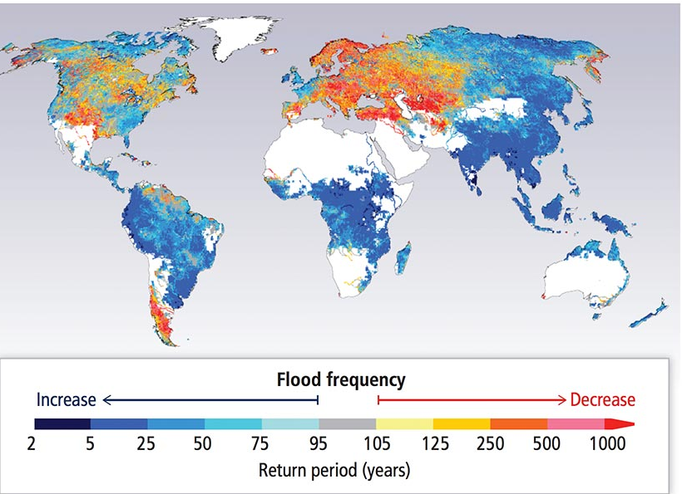
Flooding Frequency
Source: IPCC 2014, 5AR Chapter 3: Freshwater Resources, Pg. 248.

Slide 5
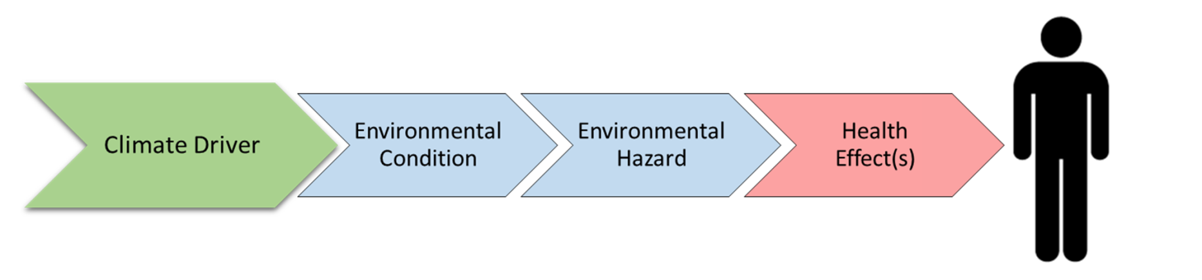

Visual Model | Cause-effect
The climate driver is the specific climate change that leads to an environmental condition.
The environmental condition is what arises in response to a specific climate change.
An environmental hazard is what will directly lead to a negative health effect.

Slide 6


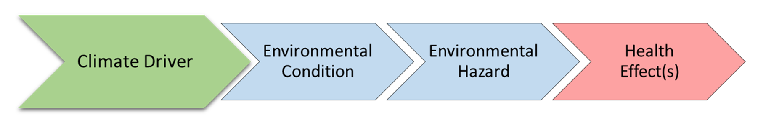
Visual Model | Cause-effect
Exposure pathway

Slide 7

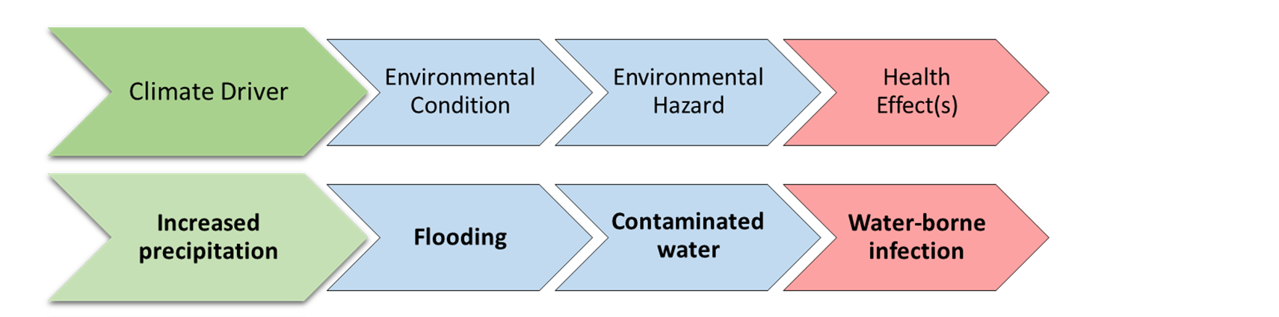

Flooding
Photo Credit: Ch. 4: Impacts of Extreme Events on Human Health. The Impacts of Climate Change on Human Health in the United States: A Scientific Assessment. U.S. Global Change Research Program
Some individuals and groups may be more vulnerable to water-borne infection as a result of floodwaters.
Notes:
Image credit: https://s3.amazonaws.com/climatehealth2016/low/ClimateHealth2016_04_Extremes_small.pdf

Slide 8
Climate Drivers and Impacts
Source: Executive Summary. The Impacts of Climate Change on Human Health in the United States: A Scientific Assessment. U.S. Global Change Research Program.(2016)
Notes:
Crimmins, A., J. Balbus, J.L. Gamble, C.B. Beard, J.E. Bell, D. Dodgen, R.J. Eisen, N. Fann, M.D. Hawkins, S.C. Herring, L. Jantarasami, D.M. Mills, S. Saha, M.C. Sarofim, J. Trtanj, and L. Ziska, 2016: Executive Summary. The Impacts of Climate Change on Human Health in the United States: A Scientific Assessment. U.S. Global Change Research Program, Washington, DC, page 1–24. http://dx.doi.org/10.7930/J00P0WXS

Slide 9
Climate Drivers and Impacts
Source: Executive Summary. The Impacts of Climate Change on Human Health in the United States: A Scientific Assessment. U.S. Global Change Research Program.
Notes:
Crimmins, A., J. Balbus, J.L. Gamble, C.B. Beard, J.E. Bell, D. Dodgen, R.J. Eisen, N. Fann, M.D. Hawkins, S.C. Herring, L. Jantarasami, D.M. Mills, S. Saha, M.C. Sarofim, J. Trtanj, and L. Ziska, 2016: Executive Summary. The Impacts of Climate Change on Human Health in the United States: A Scientific Assessment. U.S. Global Change Research Program, Washington, DC, page 1–24. http://dx.doi.org/10.7930/J00P0WXS

Slide 10
Directions
READ your assigned impact section:
Temperature, storm and radiation-related impacts
  Chapter 11 Sections 4.1 – 4.3
Vector-borne and other infectious diseases
  Chapter 11 Section 5.1
Food and water-borne diseases
  Chapter 11 Section 5.2
Air quality
  Chapter 11 Section 5.3
Nutrition and occupational health
  Chapter 11 Sections 6.1 – 6.2
Mental health and violence/conflict
  Chapter 11 Sections 6.3 –6.4

Slide 11
Take into consideration…
Are there any vulnerable populations who might be disproportionately affected by certain exposure pathways?
Photo credit: 'Collecting water’ by UNAMID, flikr
Notes:
Specific groups of people are at higher risk for distress and other adverse mental health consequences from exposure to climate-related or weather-related disasters. These groups include children, elderly, women, people with preexisting mental illness, the economically disadvantages, homeless and first responders. Communities that rely on the natural environment for sustenance and livelihood, as well as populations living in areas most susceptible to specific climate change events, are also at increased risk. (health2016.globalchange.gov)
Photo credit: 'Collecting water' by UNAMID, flikr

Slide 12
Graphic Organizer
Climate Driver
Environmental Condition
Environmental Hazard
Health Effect(s)
Clinical Implications
Vulnerable Populations
Exposure Pathway
Notes:
PPT of student graphic organizer; students may not be able to complete all rows.

Slide 13
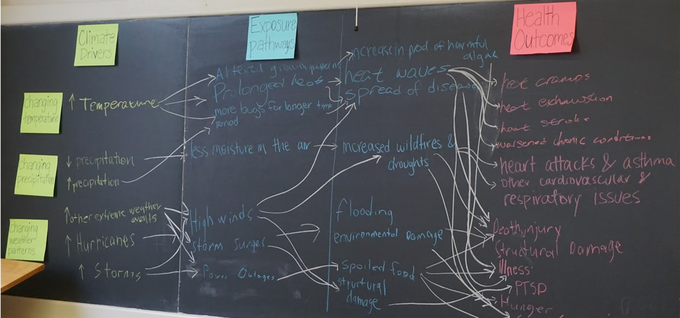
Climate change flow chart
Notes:
This lesson promotes systems thinking necessary to understand how climate change impacts human health.

Slide 14
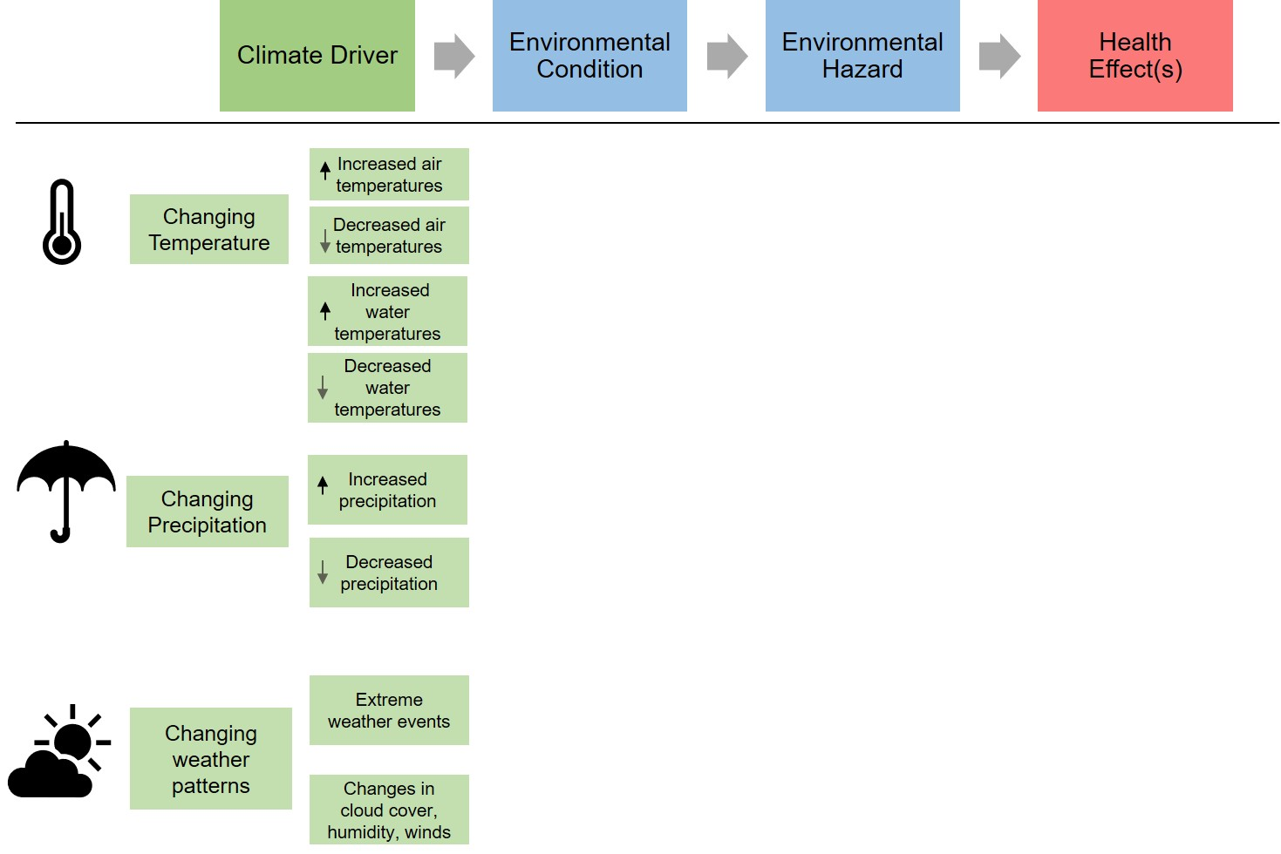
Climate Drivers and Health Outcomes

Slide 15
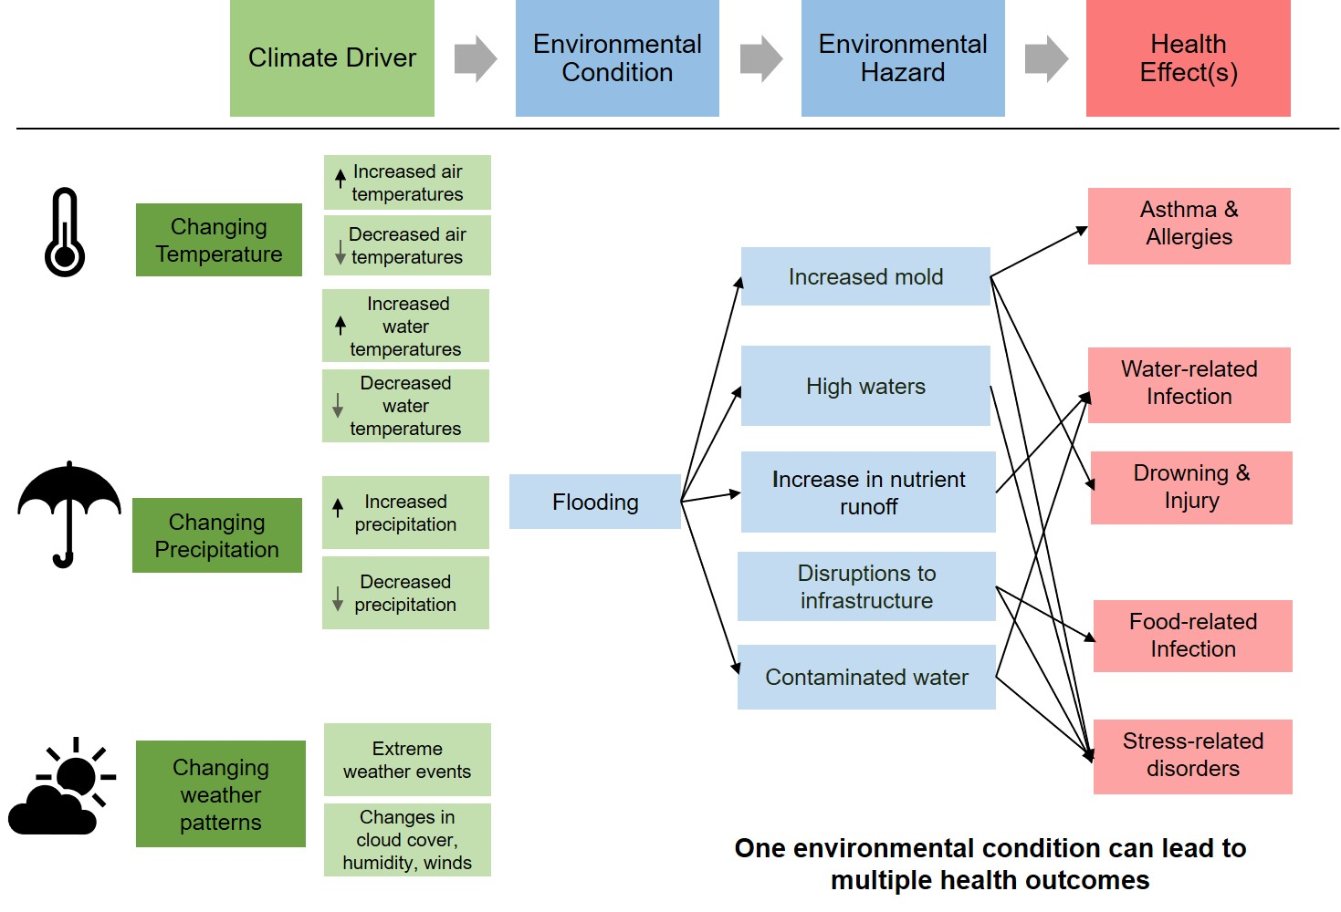
Climate Drivers and Health Outcomes

Slide 16
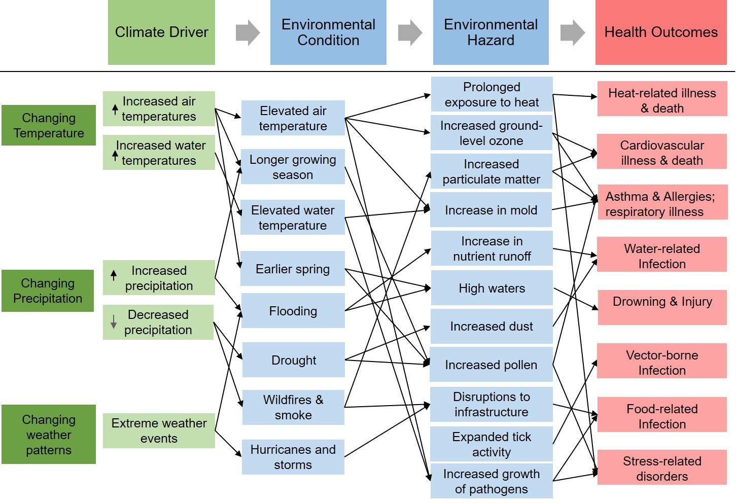
Climate Drivers and Health Outcomes

Slide 17

Climate change and Human Health Effects
Climate Change
Human Health Effects
Temperature
Vector borne infection
Cardiovascular and respiratory illness
Heat related illness and death
Precipitation
Water-related infection
Humidity
Weather-related injury and death
Mental health and Stress-related disorders
Weather patterns
Food-related infection
Notes:
Visual model to summarize activity.

Slide 18
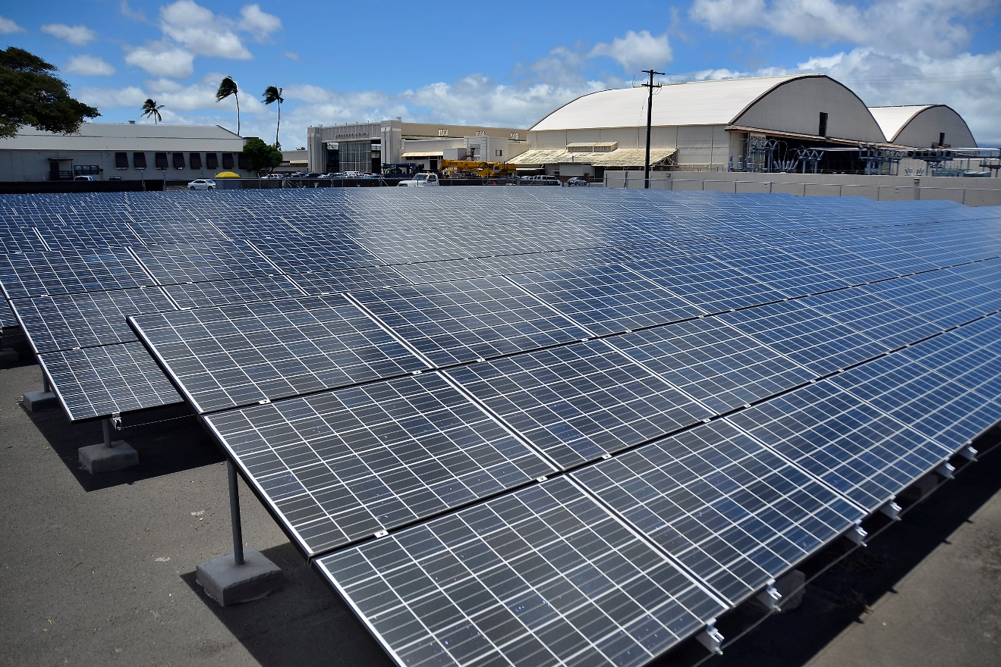
Mitigation strategies
Actions we can take to reduce the severity of climate change by reducing greenhouse gas emissions.
Photo Credit: Official Navy Page from United States of AmericaMC2 Daniel Barker/U.S. Navy (Solar panels.) [Public domain], via Wikimedia Commons
Notes:
By Official Navy Page from United States of AmericaMC2 Daniel Barker/U.S. Navy (Solar panels.) [Public domain], via Wikimedia Commons
https://upload.wikimedia.org/wikipedia/commons/5/57/Flickr_-_Official_U.S._Navy_Imagery_-_Solar_panels..jpg

Slide 19
Mitigation can make a difference
Source: IPCC, 2013: Summary for Policymakers. In: Climate Change 2013: The Physical Science Basis..
Notes:
Above figure explained: Representative Concentration Pathways (RCPs) are four greenhouse gas concentration trajectories adopted by the IPCC for its fifth Assessment Report (AR5) in 2014. The pathways are used for climate modeling and research. They describe four possible climate futures, all of which are considered possible, depending on how much greenhouse gas is emitted in the years to come. The four RCPs (RCP 2.5, RCP 4.5, RCP 6 and RCP 8.5) each represent the amount greenhouse gas concentration involved in the scenario. RCP 2.6 assumes that global annual greenhouse gas emissions peak between 2010-2020 with emission declining substantially thereafter. Emissions in RCP 4.5 peak around 2040, then decline. In RCP 6, emissions peak around 2080 and then decline. In RCP 8.5 they continue to rise throughout the 21st century.
Image credit: IPCC, 2013: Summary for Policymakers. In: Climate Change 2013: The Physical Science Basis. Contribution of Working Group I to the Fifth Assessment Report of the Intergovernmental Panel on Climate Change [Stocker, T.F., D. Qin, G.-K. Plattner, M. Tignor, S.K. Allen, J. Boschung, A. Nauels, Y. Xia, V. Bex and P.M. Midgley (eds.)]. Cambridge University Press, Cambridge, United Kingdom and New York, NY, USA.
http://www.ipcc.ch/pdf/assessment-report/ar5/wg1/WG1AR5_SPM_FINAL.pdf

Slide 20
Mitigation can make a difference
Source: IPCC, 2013: Summary for Policymakers. In: Climate Change 2013: The Physical Science Basis.
Notes:
Above figure explained: Representative Concentration Pathways (RCPs) are four greenhouse gas concentration trajectories adopted by the IPCC for its fifth Assessment Report (AR5) in 2014. The pathways are used for climate modeling and research. They describe four possible climate futures, all of which are considered possible, depending on how much greenhouse gas is emitted in the years to come. The four RCPs (RCP 2.5, RCP 4.5, RCP 6 and RCP 8.5) each represent the amount greenhouse gas concentration involved in the scenario. RCP 2.6 assumes that global annual greenhouse gas emissions peak between 2010-2020 with emission declining substantially thereafter. Emissions in RCP 4.5 peak around 2040, then decline. In RCP 6, emissions peak around 2080 and then decline. In RCP 8.5 they continue to rise throughout the 21st century.
Image credit: IPCC, 2013: Summary for Policymakers. In: Climate Change 2013: The Physical Science Basis. Contribution of Working Group I to the Fifth Assessment Report of the Intergovernmental Panel on Climate Change [Stocker, T.F., D. Qin, G.-K. Plattner, M. Tignor, S.K. Allen, J. Boschung, A. Nauels, Y. Xia, V. Bex and P.M. Midgley (eds.)]. Cambridge University Press, Cambridge, United Kingdom and New York, NY, USA.
http://www.ipcc.ch/pdf/assessment-report/ar5/wg1/WG1AR5_SPM_FINAL.pdf

Slide 21
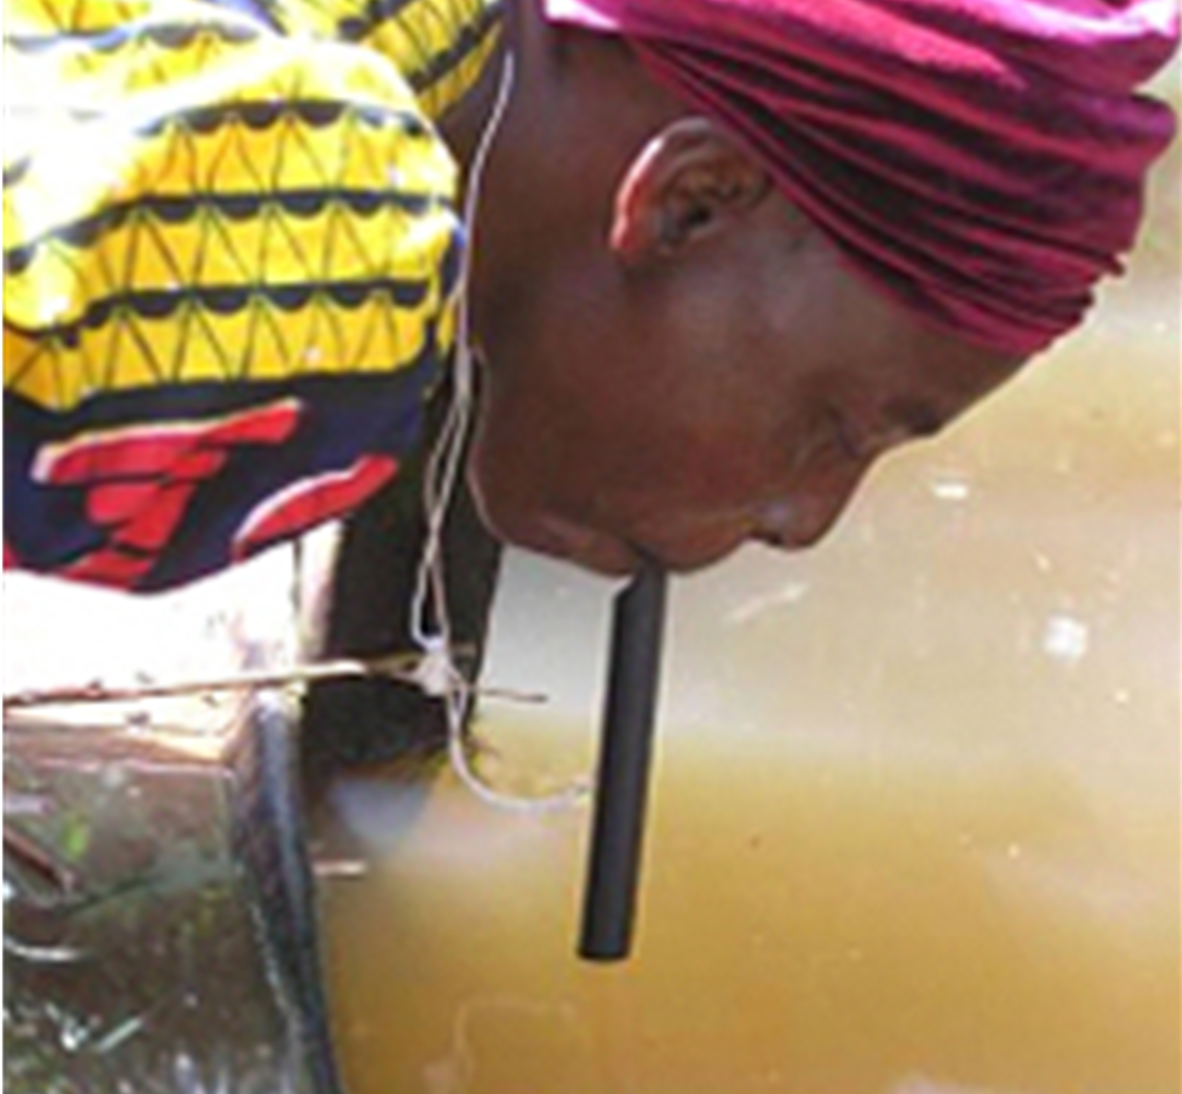
Adaptation strategies
Actions we can take to reduce our risk/vulnerability to climate impacts.
Photo Credit: CDC, Prevention & Control (2017).
Notes:
http://www.cdc.gov/parasites/guineaworm/prevent.html

Slide 22
Pathways by which Climate Change affects health
Source: IPCC, 2014 Chapter 11: Impacts, Adaptation, and Vulnerability.
Notes:
Figure 11-1 | Conceptual diagram showing three primary exposure pathways by which climate change affects health: directly through weather variables such as heat and storms; indirectly through natural systems such as disease vectors; and pathways heavily mediated through human systems such as undernutrition. The green box indicates the moderating influences of local environmental conditions on how climate change exposure pathways are manifest in a particular population. The gray box indicates that the extent to which the three categories of exposure translate to actual health burden is moderated by such factors as background public health and socioeconomic conditions, and adaptation measures. The green arrows at the bottom indicate that there may be feedback mechanisms, positive or negative, between societal infrastructure, public health, and adaptation measures and climate change itself. As discussed later in the chapter, for example, some measures to improve health also reduce emissions of climate-altering pollutants, thus reducing the extent and/or pace of climate change as well as improving local health (courtesy of E. Garcia, UC Berkeley). The examples are indicative.
http://www.ipcc.ch/pdf/assessment-report/ar5/wg2/WGIIAR5-Chap11_FINAL.pdf

Slide 23
Assessment of the health impacts from Climate Change
Qualitative assessment of the health impacts from climate change, with and without adaptation measures.
The width of the slices gives an indication of the attributable burden for each health impact, and the light blue area indicates the proportion that could be avoided through strong adaptation measures. Assessment is shown for the period 2080–2100, in which vigorous mitigation efforts could potentially avoid part of the 4°C or higher global temperature increase that would otherwise be expected from current emissions trends (WHO Climate and Health Global Overview)
Source: WHO 2015, Climate and Health Country Profiles-A Global Overview, pg. 11.
Notes:
http://apps.who.int/iris/bitstream/handle/10665/208855/WHO_FWC_PHE_EPE_15.01_eng.pdf;jsessionid=A5DA4475662EF22C3A7964B3668857CF?sequence=1

Slide 24
Clinical Case Studies| Climate Change and Health

Slide 25
Extreme Heat
Key points
Climate change poses unique risks to a rapidly growing demographic of elderly patients. Clinicians, hospitals, policy makers and financial planners must prepare for these current and future needs.
Integrating weather modeling and public health intervention to address vulnerable populations may ease the burden of heat stress on individuals and the health care system.
Resources are needed to address environmental disparities and provide protective measures against heat related illness in the inner city.
Rapid warming as well as rapid development are occurring in the developing world. To keep populations safe-guarded against the negative effects of extreme heat, innovative cooling solutions are necessary.
Elderly populations are particularly vulnerable to heat stress, a factor that should be incorporated into routine care.

Slide 26
Heat Extremes and Elders
Source: IPCC, 2014 Chapter 11: Impacts, Adaptation, and Vulnerability.
Notes:
Figure 11-2 | Increasingly frequent heat extremes will combine with rapidly growing numbers of older people living in cities— who are particularly vulnerable to extreme heat. Countries are shaded according to the expected proportional increase in urban populations aged over 65 by the year 2050. Bar graphs show how frequently the maximum daily temperature that would have occurred only once in 20 years in the late 20th century is expected to occur in the mid-21st century, with lower numbers indicating more frequent events. Results are shown for three different Special Report on Emission Scenarios (SRES) scenarios (blue = B1; green = A1B, red = A2), as described in the IPCC Special Report on Emissions Scenarios, and based on 12 global climate models participating in the third phase of the Coupled Model Intercomparison Project (CMIP3). Colored boxes show the range in which 50% of the model projections are contained, and whiskers show the maximum and minimum projections from all models (WHO and W MO, 2012).
http://www.ipcc.ch/pdf/assessment-report/ar5/wg2/WGIIAR5-Chap11_FINAL.pdf

Slide 27
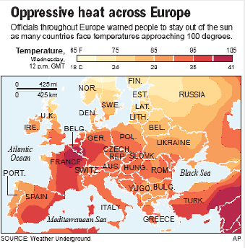
Heat Wave in Europe 2003
Casualties
France: 14,082
Germany: 7,000
Spain: 4,200
Italy: 4,000
UK: 2,045
Netherlands: 1,400
Portugal: 1,300
Belgium: 150
Source: Yale Climate Connections, New Analysis of ‘03 Fatal Paris Heat Wave (2015).
Notes:
CLINICAL CORRELATES: PAGE 3
http://www.unisdr.org/files/1145_ewheatwave.en.pdf
Picture: https://www.yaleclimateconnections.org/2015/08/new-analysis-of-2003-fatal-paris-heat-wave/

Slide 28
Outdoor Air Quality
Key Points
Deteriorating air quality threatens the health of vulnerable pediatric patients, especially among those living in low-income environments.
Ozone not only compounds global warming but also causes measurable negative health effects during periods of acute increase.
Ambient fine particulate matter, produced as a byproduct of fossil fuel combustion, significantly negatively impacts human health which in turn impacts health-care system usage.

Slide 29
Air Pollution and Deaths
Source: WHO 2015, Climate and Health Country Profiles-A Global Overview.
Notes:
ALRI = acute lower respiratory infections, IHD = ischemic heart disease, COPD = chronic obstructive pulmonary disease
http://apps.who.int/iris/bitstream/handle/10665/208855/WHO_FWC_PHE_EPE_15.01_eng.pdf;jsessionid=A5DA4475662EF22C3A7964B3668857CF?sequence=1

Slide 30
Flooding
Key Points
System-wide evaluation of public and “safety net” hospitals is needed to prepare for natural disasters.
Extreme precipitation events unleash toxic man-made compounds as well as infectious pathogens into drinking and recreational waters, posing significant risks to human health.
Contained industrial wastes are susceptible to being unleashed during extreme weather and flooding leading to release of toxins that have the potential to enter the food chain and adversely affect human health.

Slide 31
Flooding and Environmental Contamination

Slide 32
Vector-Borne Diseases
Key Points
Malaria early warning systems combine case surveillance with long-range climate modeling to allow clinicians and policy makers to proactively prepare for outbreaks and allocate resources.
Surveillance programs for West Nile are soon to be sensitive enough to predict outbreaks of disease. Clinicians and public health officials must increase their cooperation and communication to bring this knowledge to meaningful place in clinical practice.
The impacts of climate change on the geographic distribution of resources may result in mass human movement. Clinicians and public health officials must be alert to the possibility of infectious diseases appearing in unexpected places.
The manifestation of disease from climate sensitive zoonotic pathogens is influenced by the baseline health of communities and individuals which may in turn be threatened by climate change.

Slide 33
Vector-borne diseases
Source: IPCC, 2014 Chapter 11: Impacts, Adaptation, and Vulnerability.
Notes:
Table 11-1 | The association between different climatic drivers and the global prevalence and geographic distribution of selected vector-borne diseases observed over the period 2008-2012. Among the vector-borne diseases shown here, only dengue fever was associated with climate variables at both the global and local levels (high confidence), while malaria and hemorrhagic fever with renal syndrome showed a positive association at the local level (high confidence).
http://www.ipcc.ch/pdf/assessment-report/ar5/wg2/WGIIAR5-Chap11_FINAL.pdf

Slide 34
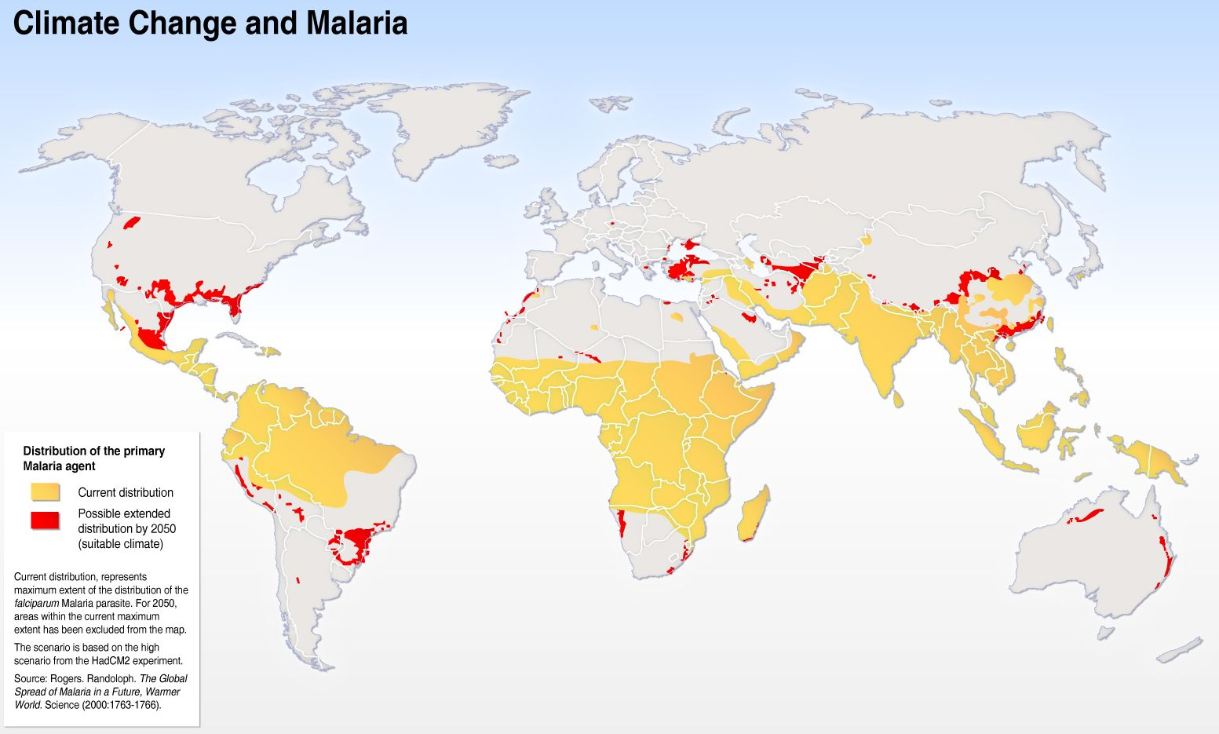
Climate Change and Malaria
Source: Google Images
Notes:
https://www.google.com/search?q=climate+change+and+malaria&rlz=1C1GCEA_enUS762US762&source=lnms&tbm=isch&sa=X&ved=0ahUKEwiig5Ot0JHXAhUJ5YMKHct-ArEQ_AUICygC&biw=1920&bih=974#imgrc=ajsyRNBsYxfqBM:

Slide 35
Water-Related Infection
Key Points
Cryptosporidium is a common climate-sensitive disease that health care providers must be aware of in order to prevent complications among vulnerable patients.
Access to safe water is a difficult milestone to achieve, define and assess. It is requisite to achieve modern health standards and may be threatened by changing climates.
Harmful algae blooms pose significant risks to communities and health care systems. Strong public health monitoring is needed to trace these impacts and create notification pathways within the health care system and within communities.

Slide 36
Water-Related Infection
Effect of rising temperatures on the area in which transmission of Schistosomiasis japonica may occur. Green area denotes the range of schistosomiasis in China in 2000. The blue area shows the additional area suitable for disease transmission in 2050.
Source: IPCC, 2014 Chapter 11: Impacts, Adaptation, and Vulnerability.
Notes:
Figure 11-4 | Effect of rising temperatures on the area in which transmission of Schistosomiasis japonica may occur. Green area denotes the range of schistosomiasis in China in 2000. The blue area shows the additional area suitable for disease transmission in 2050. Based on a biology-driven model including parasite (Schistosoma japonicum) and snail intermediate host (Oncomelania hupensis) and assuming average temperatures in China in mid-winter (January) increase by 1.6°C in 2050, compared with 2000 (adapted from Zhou et al., 2008).
http://www.ipcc.ch/pdf/assessment-report/ar5/wg2/WGIIAR5-Chap11_FINAL.pdf

Slide 37
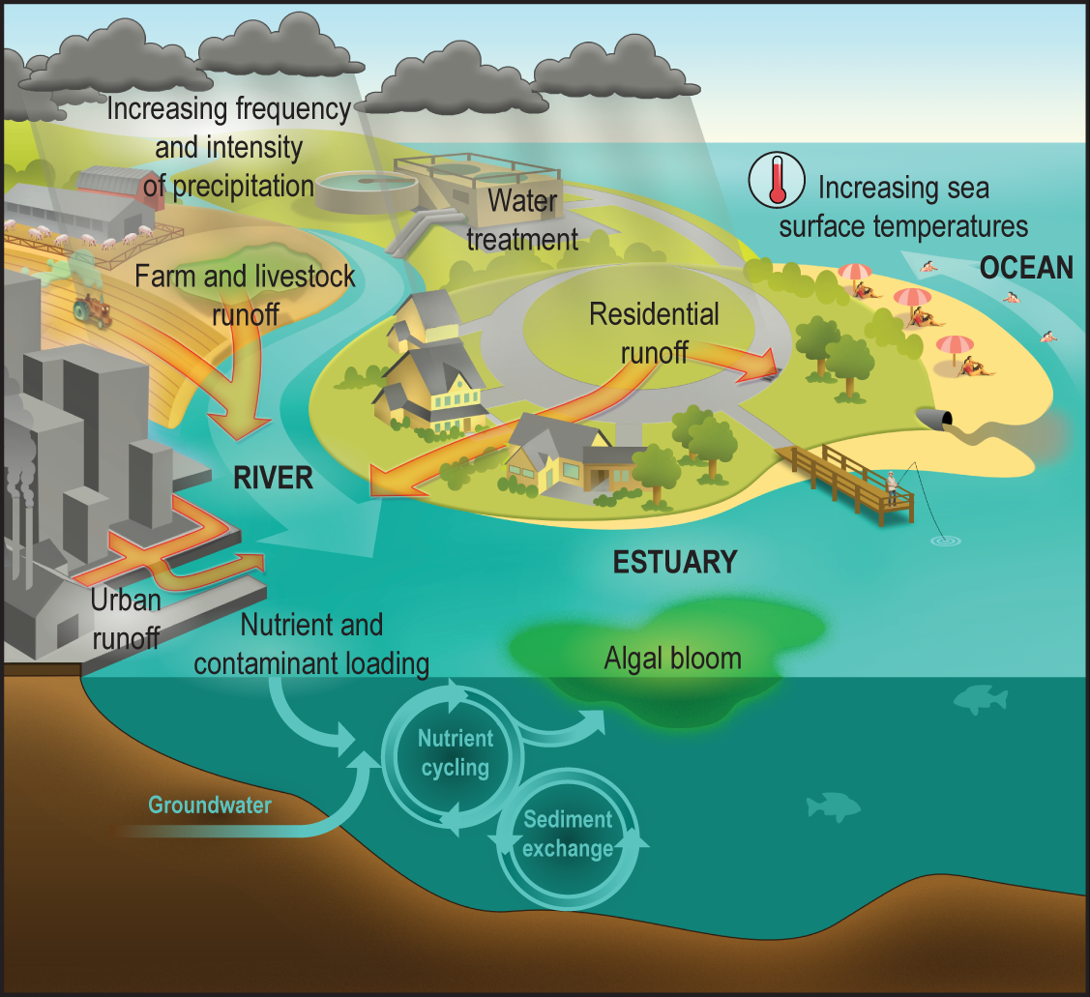
Climate Change, Water Quantity and Quality, and Human Exposure to Water-Related Illness
Source: USGCRP, 2016: The Impacts of Climate Change on Human Health in the United States: A Scientific Assessment.
Notes:
CLINICAL CORRELATES PAGE 9

Slide 38
Food and Nutrition
Key Points
Helminth infections are a prevalent climate sensitive illness that has wide-reaching implications for human health and nutrition.
Climate change leads to food insecurity, more reliance on industrialized food production and the use of chemicals with unknown and known detrimental effects on human health.
Evidence-based approaches should be used to assess and address the health impacts of food security among vulnerable populations.
Health effects of chronic undernutrition manifest in a myriad of ways, ranging from physical to cognitive, and are likely to intensify in the future as a result of climate change.
Ciguatera poisoning is a climate sensitive cause of bio-poisoning that clinicians must be aware of.
Global climate change is affecting food availability and lifestyle choices, thus shifting the prevalence of diseases worldwide

Slide 39
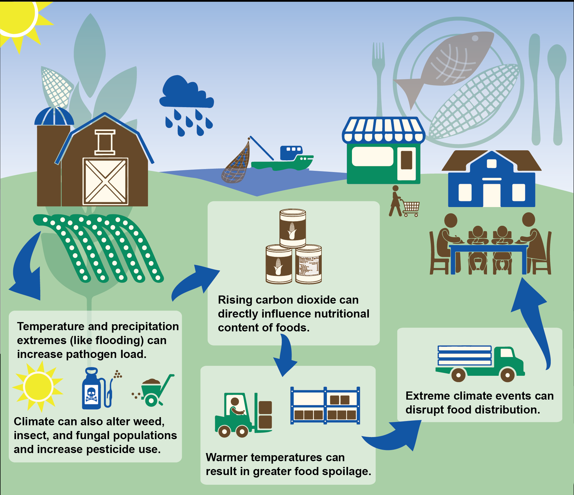
Interactions of Rising CO2 and Climate Change on Food Safety and Nutrition
Source: USGCRP, 2016: The Impacts of Climate Change on Human Health in the United States: A Scientific Assessment.
Notes:
https://health2016.globalchange.gov/food-safety-nutrition-and-distribution

Slide 40
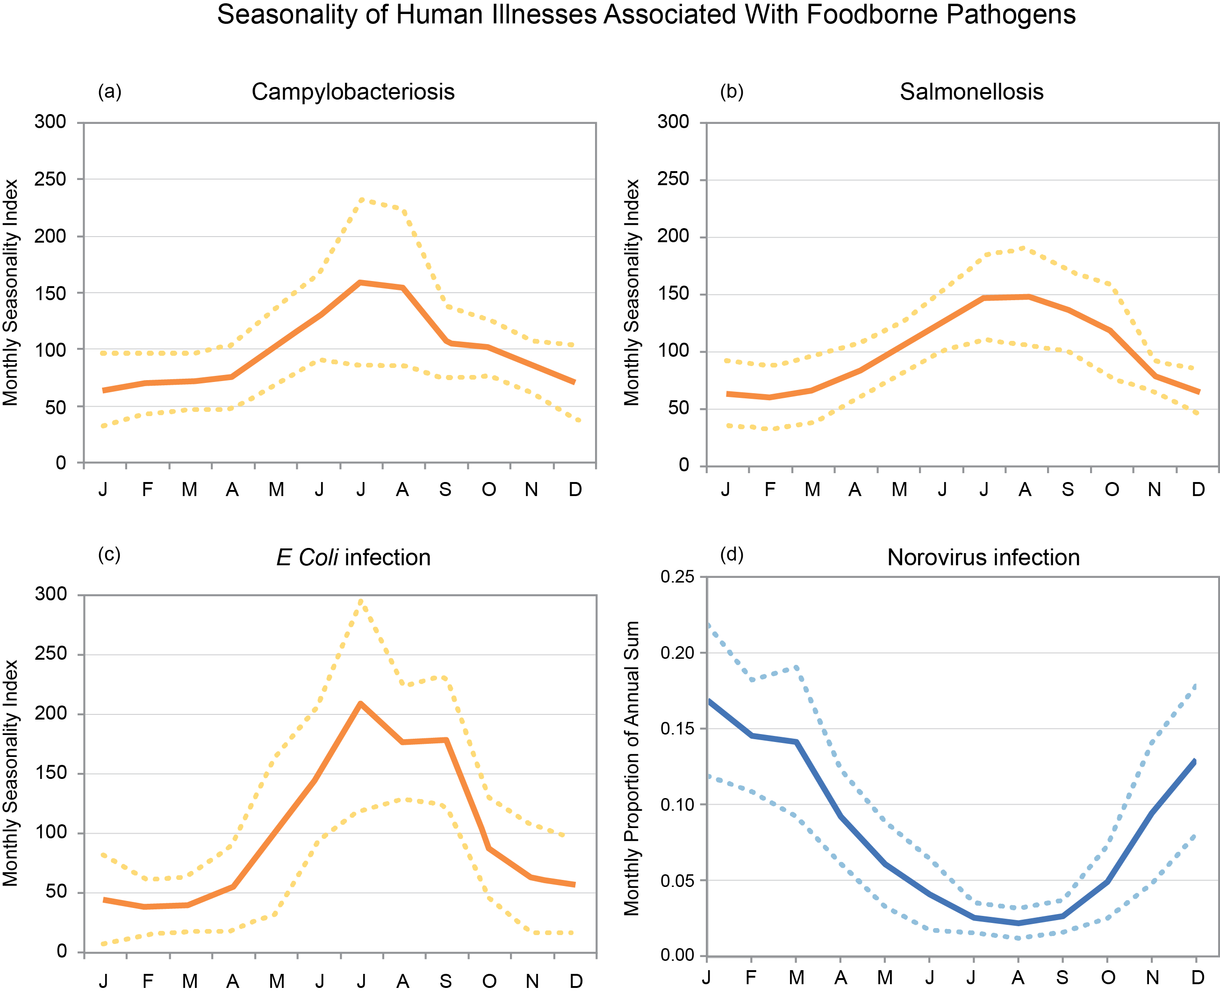
Human Illness and Foodborne Pathogens
Source: USGCRP, 2016: The Impacts of Climate Change on Human Health in the United States: A Scientific Assessment.
Notes:
https://health2016.globalchange.gov/food-safety-nutrition-and-distribution

Slide 41
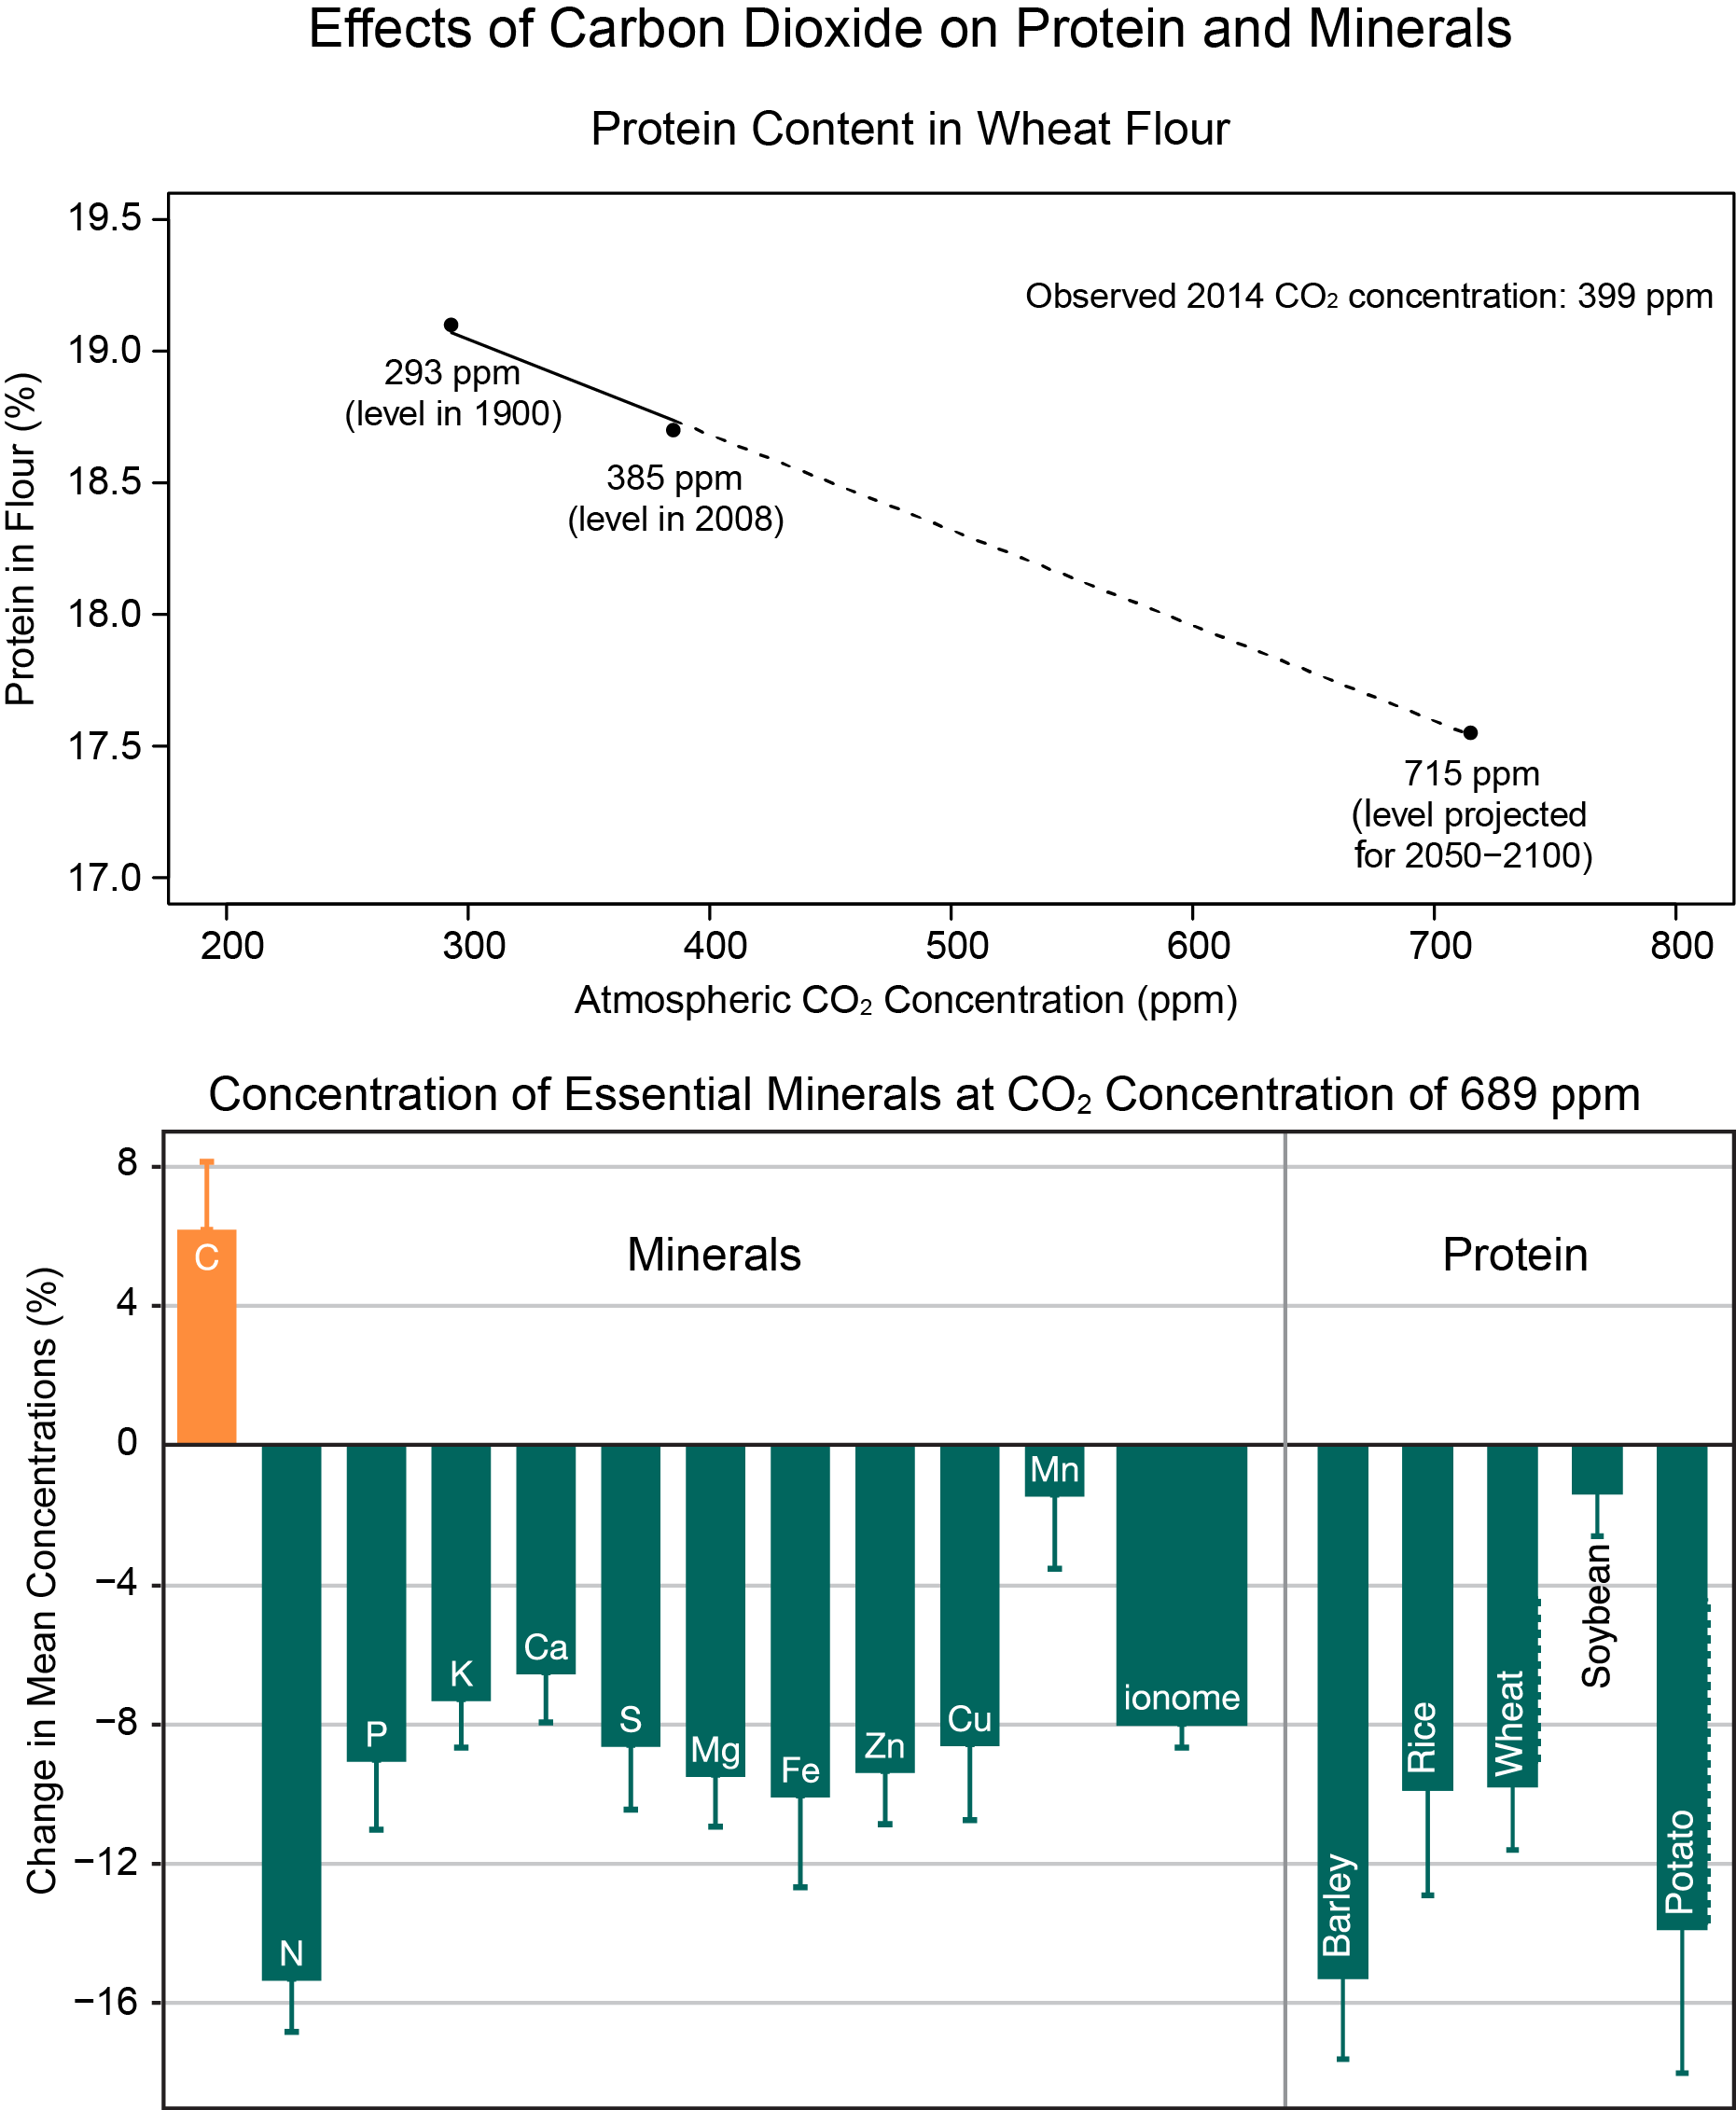
Effects of Carbon Dioxide on Proteins and Minerals
Source: USGCRP, 2016: The Impacts of Climate Change on Human Health in the United States: A Scientific Assessment.
Notes:
https://health2016.globalchange.gov/food-safety-nutrition-and-distribution

Slide 42
Mental Health and Well-being
Key Points
Mental health care plays a crucial role in disaster recovery and the dearth of providers domestically and globally means the care will be distributed among all specialties of medicine.
Climate change has the potential to result in widespread physical and psychological trauma. Thus, clinicians must be well versed in properly diagnosing and treating stress syndromes.
Climate change causes real and perceived threats of food scarcity, job insecurity, natural disasters and more. Stress has wide-reaching effects on health that clinicians must be able to promptly and accurately diagnose and treat.
Mitigation of climate-related disasters must consider the psychological effects that trauma has on communities. Clinicians and other community leaders can serve as leaders in rehabilitation efforts.

Slide 43
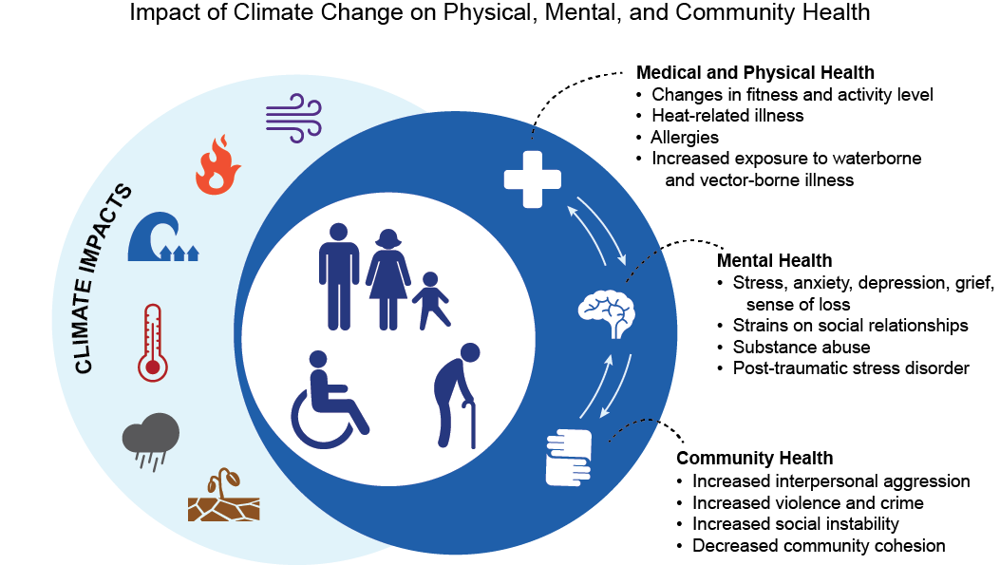
Impact of Climate Change on Physical, Mental and Community Health
Source: USGCRP, 2016: The Impacts of Climate Change on Human Health in the United States: A Scientific Assessment.

