Slide 1

Translating data for people and machines:
How to improve metadata reporting through better data dictionaries
Jeanette A Stingone PhD MPH
Assistant Professor, Department of Epidemiology
EHLC Seminar Series - 2023

Slide 2
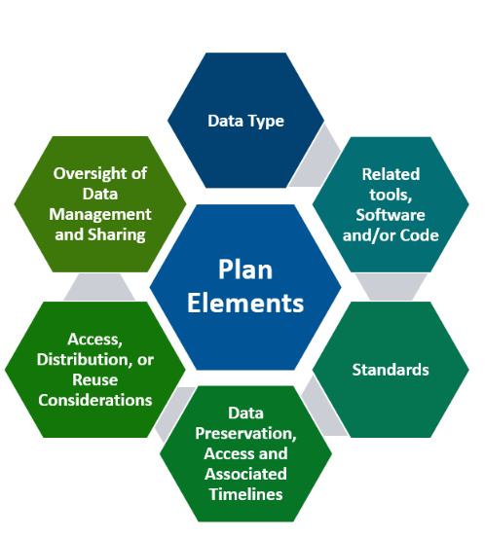
Why we are here…Data Sharing is our New Reality
DMS plans are now required for our research
Data Sharing (at appropriate levels) is becoming the new norm within biomedical and scientific fields
We need to shift how we think about recording and representing our scientific data
Source: NIH

Slide 3

Preparing for this webinar…..

Slide 4
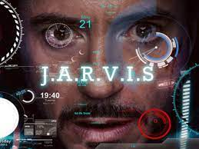
Don’t you want to be Iron-Man! Building the Data Ecosystem of the Future
Hey JARVIS…. Can you tell me how many children under 18 with measurements on phthalates and lung function are within this data repository?
Hey JARVIS…. Can you find all of the existing data on pesticide exposure and child development funded by NIH in the last 15 years?
Hey JARVIS…. Can you harmonize data across these ten cohorts so I can conduct a pooled analysis?

Slide 5
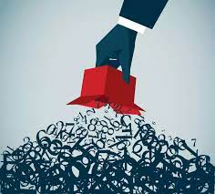
Won’t achieve our goals if we just “dump the data”

Slide 6
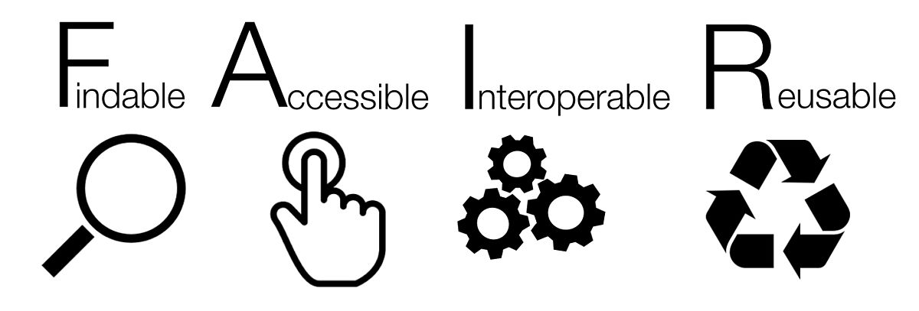
Learning to Play FAIR

Slide 7
MetaData: Major Component of being “FAIR”
What is metadata?.....Information about your data
Examples of how metadata is connected to FAIR
Findable: Where is your data located?
Accessible: What protocols can be used to retrieve the data?
Interoperable: What “languages” or vocabularies are used to represent your data and metadata?
Reuseable: Do I have enough information about your data in order to meaningfully reuse it?

Slide 8
Data Dictionaries
Centralized repository of information about data such as meaning, relationships to other data, origin usage and format. -IBM Dictionary of Computing
Commonly used to accompany existing digital datasets/data resources
Can also be created to represent the data generated from a specific collection scenario
Not much standardization in format or content
Often used internally…new person in the lab gets caught up, but often there’s human back-up

Slide 9
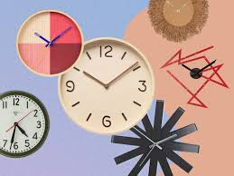
Need for Community Consensus
Motivating Problem
  How do we construct high-quality data dictionaries to get us to the data ecosystems needed for meaningful AI?
Proposal
  Acknowledge how we typically create data dictionaries currently
  Work as a community to Identify needed elements and formats
  Consider readability for both humans and machines
  Identify gaps in available tools and create new ones

Slide 10
Think about your own research studies…
Who made the data dictionary to accompany the data you are currently working with?
When was it made? How often is it updated?
What elements does it include?
What software was used to create it?
What format is it stored in?

Slide 11
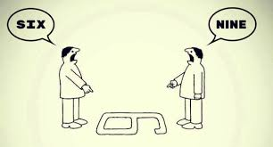
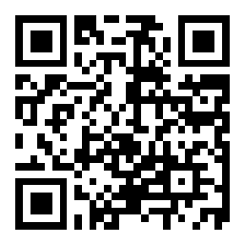
Now….Think about what you want when someone sends you a dataset
https://app.sli.do/event/7WC1jE7RG46FytjPqHvxx2
www.slido.com Meeting # 1417181
Poll expires 8/10

Slide 12
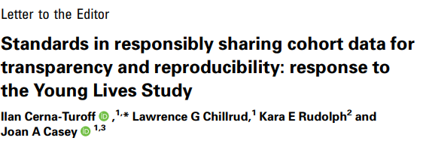
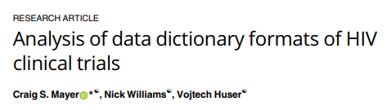
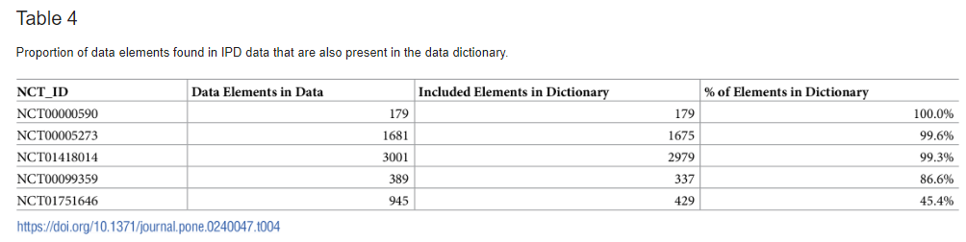
Research shows Data Dictionaries are often lacking

Slide 13
Needed Elements and Formats

Slide 14
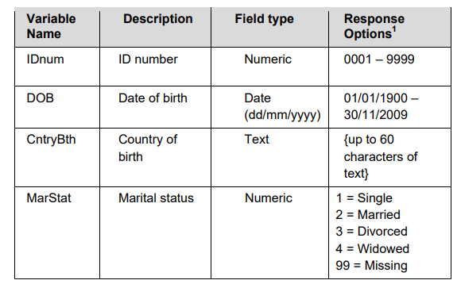
Guidance Currently Given
“A data dictionary should include, at a minimum:
• Variable names;
• Variable descriptions or labels;
• Variable types; and
• Response options and codes used to represent the response options”

Slide 15
Data Dictionaries describe our data, but how well?
Example 1: Pregnancy Study
Example 2: Childhood Asthma Study
Variable | Description | Coding | Type
Id | Individual id | Na | Numeric
pctbfat | Measures from dxa | na | Numeric
Bmi | Body mass index | na | Numeric
Age | Self-reported questionnaire | na | Numeric
Ethnicity | Self-reported questionnaire | 1 White 2 Black 3 Asian 4 Hawaiian/PI 5 AI/AN 6 Other | Categorical
Variable | Description | Coding | Type
Avisits_2months_doctor | Number of asthma-related clinic visits | Na | Numeric
Dust_derf1 | Dust mite allergen in bedroom dust | na | Numeric
Msp_pm10 | Stationary pm10 measurement | Na | Numeric
Vital_bmi_type | Participant BMI Category | 0 underweight 1 healthy weight 2 overweight 3 obese | Ordinal

Slide 16
How can we improve?
FULLY DESCRIBE DATA
Who, What, Where, When, How
Structured data is better; free-text should be clear
Use standardized terms in descriptions
  Helpful for people and machines
Varname | Description | Type | Units | Comments
Phy_act | Physical activity reported |  | Hours/ week
Vest_pm10 | Vest Measurement of PM10 | numeric | mcg/m3 | used psl air monitor-12 hours, conducted at baseline visit; ……..

Slide 17
Add details as structured columns
Instead of…
Varname | Description | Type | Units | Comments
Phy_act | Physical activity reported |  | Hours/ week
Vest_pm10 | Vest Measurement of PM10 | numeric | mcg/m3 | used psl air monitor-12 hours, conducted at baseline visit; ……..
How about…
Varname | Description | Type | Units | Time Period | Measurement Instrument
Phy_act | Physical activity of moderate level reported by participant’s mother during pregnancy | integer | Hours/ week | Average week in first trimester | Pregnancy physical activity questionnaire (PPQA)
Vest_pm25 | Measurement of PM_{2.5} using personal air monitor in participant’s vest | numeric | mcg/m3 | 12 hour measurement at baseline visit | TSI SidePak AM510

Slide 18
Potential Elements
Variable Name
Variable Description
Type of Data
Time Period of Collection
Measurement/Assessment Instrument
Units
Coding
Derived Variable (Yes/No)
Entity the Variable Describes
Valid Values (Min/Max)
Part of a Skip Pattern
Relationship to Other Variable
What should we be reporting? What information is needed
to ensure reusability when there’s no one around to ask?

Slide 19
Some Communities Already have Minimum Information Criteria which can Inform Elements of Data Dictionaries
Good examples: MIAME (Minimum Information about a Microarray Experiment)
MINSEQE (Minimum Information about a Next-generation Sequencing Experiment)
Key Elements of MIAME
Raw data for each assay (e.g., CEL or FASTQ files)
Final processed (normalized) data for the set of assays in the study (e.g., the gene expression data count matrix used to draw the conclusions in the study)
Essential sample annotation (e.g., tissue, sex and age) and the experimental factors and their values (e.g., compound and dose in a dose response study)
Experimental design including sample data relationships (e.g., which raw data file relates to which sample, which assays are technical, which are biological replicates)
Sufficient annotation of the array or sequence features examines (e.g., gene identifiers, genomic coordinates)
Essential laboratory and data processing protocols (e.g., what normalization method has been used to obtain the final processed data)

Slide 20
Formats for Data Dictionaries
Common Types
Spreadsheet Files (.xlsx, .csv, etc)
Tables in Word Processing Files (.doc)
PDF
Types for Machine-Readability
JSON-LD
XML
Consider human AND machine readability
Data Repositories often have their own formatting requirements

Slide 21
“Language” for Data Dictionaries
Currently
No standard variable names
Often using non-standard terminologies in descriptions
Often using non-standard terminologies to represent data types
(e.g. numeric, continuous, number, etc)
Potential Improvements
Use terms from controlled vocabularies in text descriptions
Use common data elements during data collection
Agree on terminologies to represent data types
Annotate with ontology or other controlled terms in structured fields

Slide 22
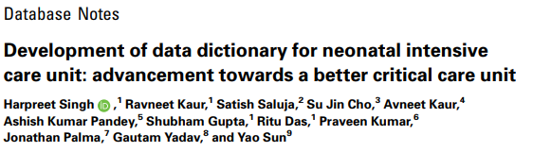
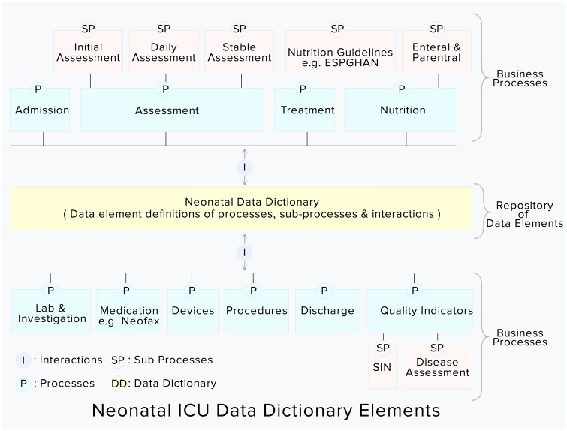
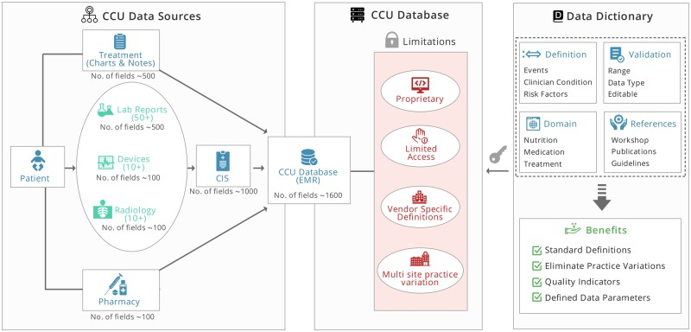
Groups have created standard Data Dictionaries Describing Data Generation/Collection in Specific Scenarios

Slide 23
What Tools Currently Exist for Creating Data Dictionaries?
Poll expires 8/10

Slide 24
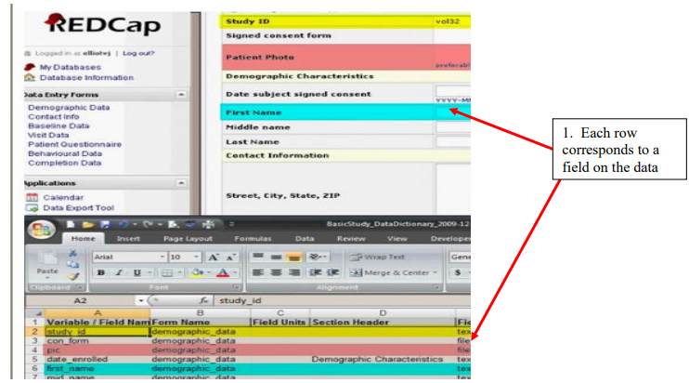
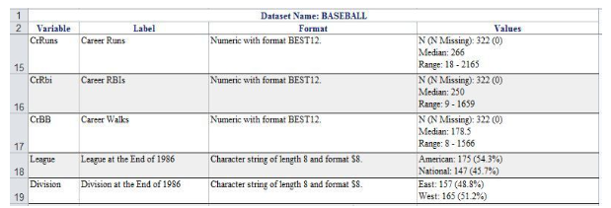
Data Dictionaries Produced by Data Collection/Management Tools
RedCap Data Dictionary
SAS Proc Contents OR Proc SQL & Proc Format OR Available Macros
Source: Macro DATA SPECS
Source: mcw.edu

Slide 25
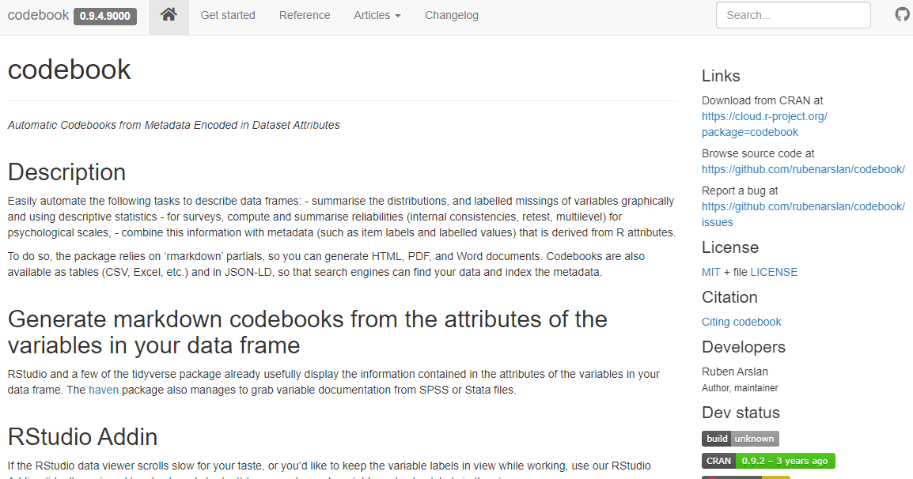
R Codebook

Slide 26
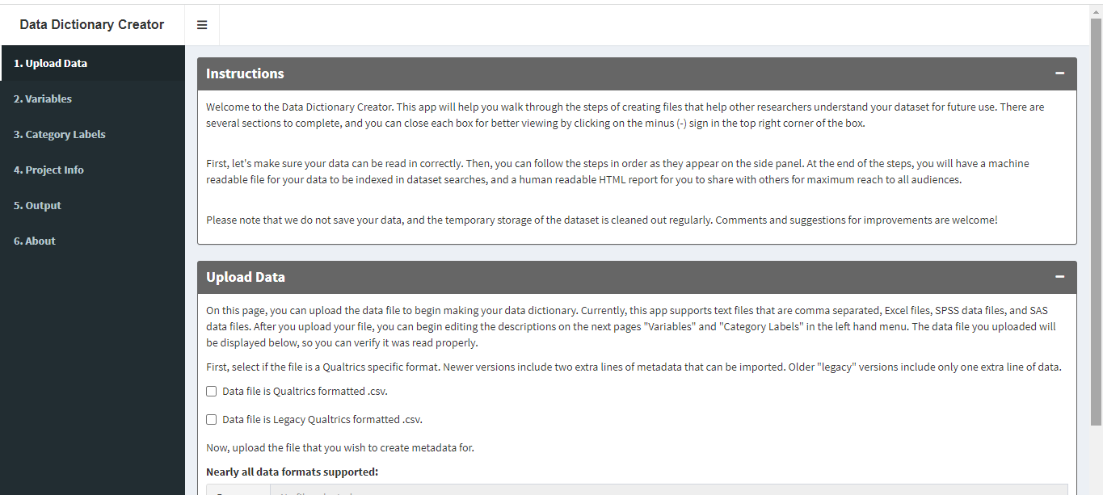
Data Dictionary Creator (Thanks to Charles Schmitt!)
From the Society for the Improvement of Psychological Sciences (SIPS) 2018 meeting by Lisa De Bruine, Erin Buchanan, and Alicia Moher.

Slide 27
SEMANTIC DATA DICTIONARY: Template for Translating Human DDs to Machine-Readable Knowledge Graphs
Features and human descriptions
from Data Dictionary
About
Who?
What is the
implicit object?
What?
Rashid SM et al The semantic data dictionary: an approach for describing and annotating data Data Intelligence 2020; 2:443-486 doi: https://doi.org/10.1162/dint_a_00058 PMC7583433
https://tetherless-world.github.io/sdd/

Slide 28
What Tools Do We Need?
I’ll start….
Language Standards
Common Template that Include Essential and Recommended Elements
Suggested/Automated Mapping to Controlled Vocabularies
Prospective Tools Rather than Relying on Annotation of Existing Datasets
Poll expires 8/10

Slide 29
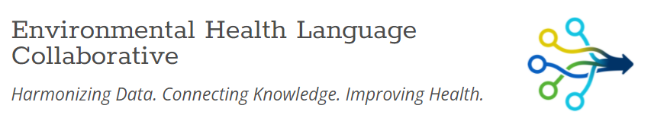
Join us!
https://www.niehs.nih.gov/research/programs/ehlc/index.cfm
EHLC@icf.com
Acknowledgements
Environmental Health Language Collaborative
EHLC Data Harmonization Use Case Working Group
EHLC Use Case Champions
NIEHS Office of Data Science
ICF
HHEAR Data Center
Susan Teitelbaum PhD
Sofia Bengoa MPH
James Masters PhD
Patricia Kovatch
Nancy Mervish PhD
Deborah McGuinness PhD
Paulo Pinheiro PhD
Funding
NIH/NIEHS ES027022
NIH/NIEHS ES026555

