Slide 1
Accessible artificial intelligence for data science
Jason H. Moore, PhD, FACMI, FIAHSI, FASA
Chair, Department of Computational Biomedicine
Director, Center for Artificial Intelligence Research and Education
Cedars-Sinai Medical Center
Los Angeles, CA
jason.moore@csmc.edu

Slide 2
NIEHS Areas of Scientific Focus
Environmental Factor - July 2022: New initiatives to transform research highlighted at Council meeting (nih.gov)

Slide 3
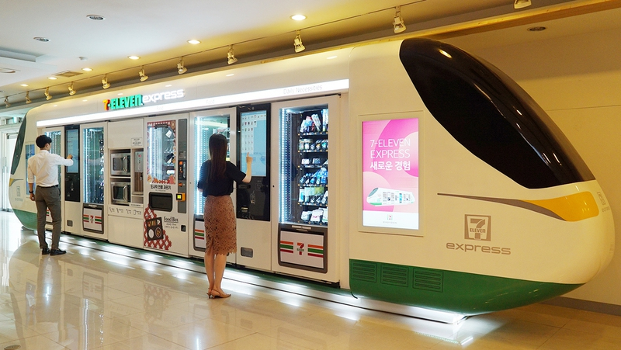
Learning Health Systems
Easy Data
Access
Easy Data
Cleaning
Easy Data
Analytics
Easy Model
Evaluation
Easy Model
Deployment

Slide 4
The practice of machine learning is hard!

Slide 5
Machine learning is hard!

Slide 6
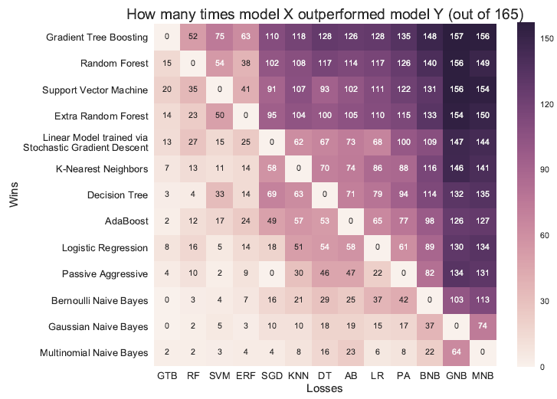
Machine learning is hard!

Slide 7
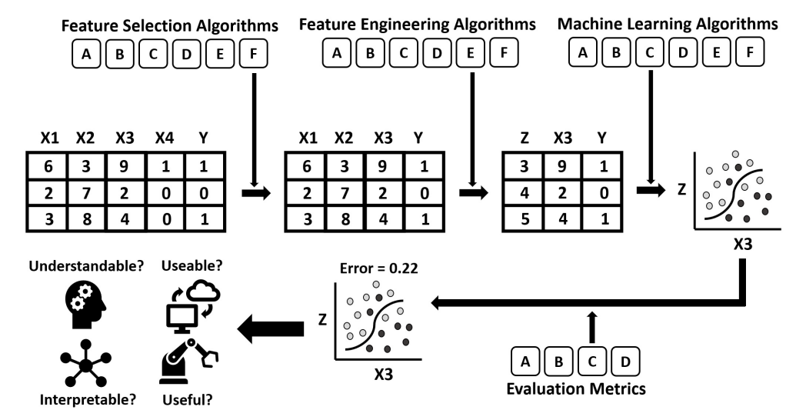
Building machine learning pipelines is harder

Slide 8
Deployment can be even harder
IT
UI/UX
Clinical workflow
Trust
Fairness
Ethics
ROI
Auditing
Legal
Updates

Slide 9
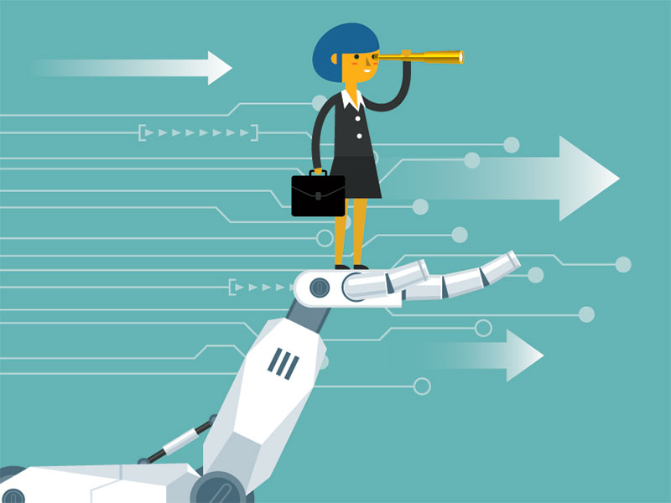
GOAL: Democratize AI and machine learning so everyone can benefit Necessary for a learning health system

Slide 10
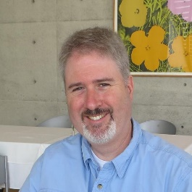
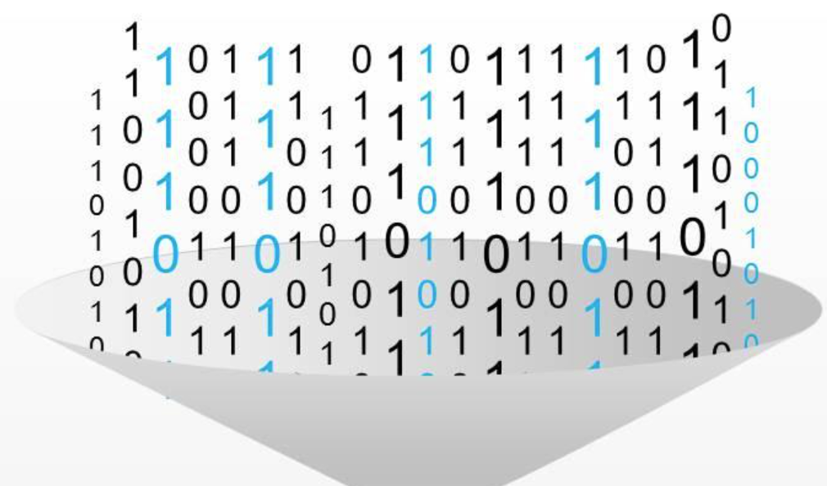
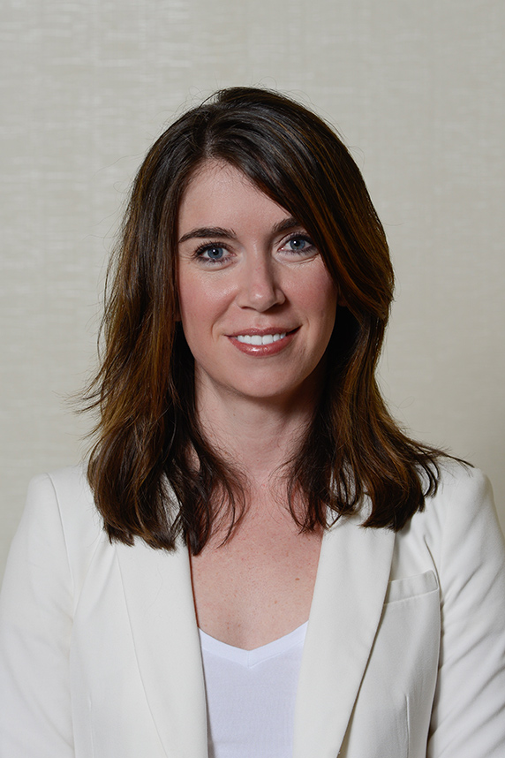
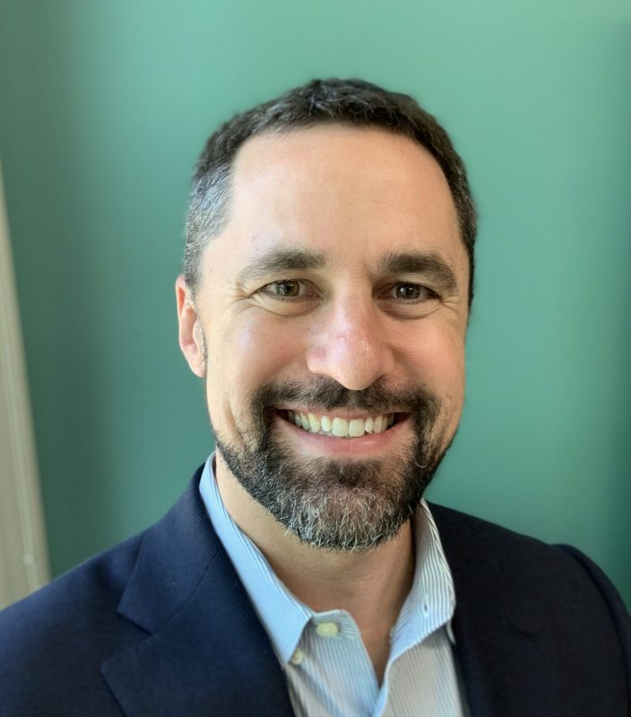
How do humans build machine learning pipelines?
RF
Importance
DT
Polynomial
NN
PCA
LR

Slide 11
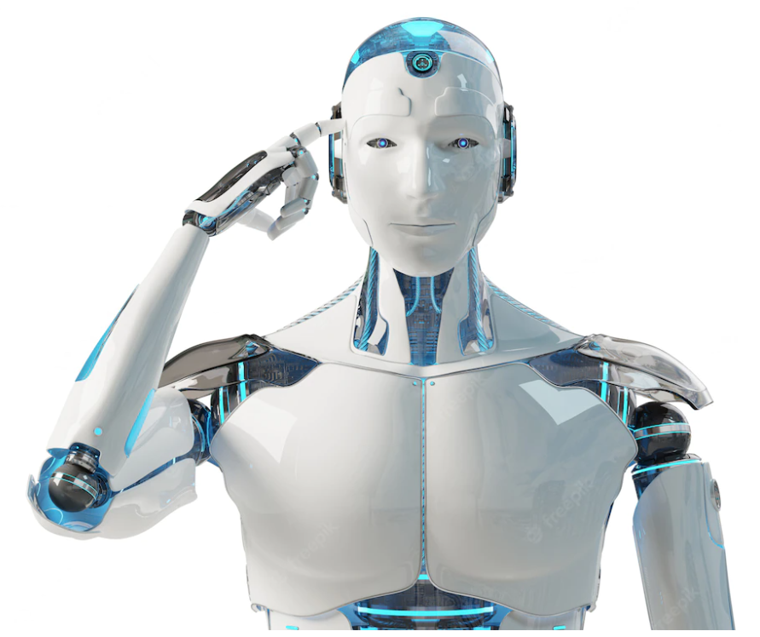
Can we get a computer to do this?
RF
Importance
DT
Polynomial
NN
PCA
LR

Slide 12
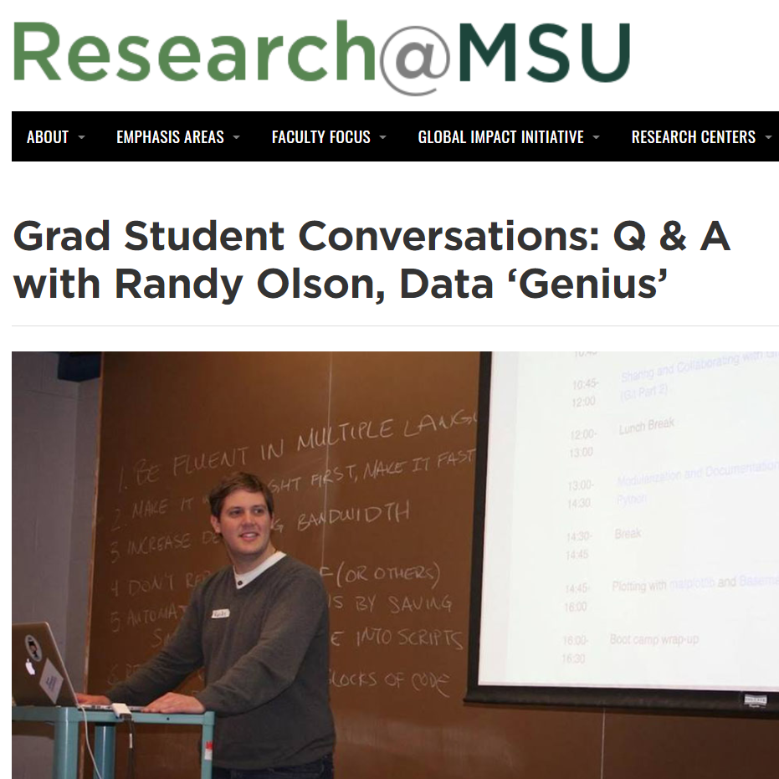
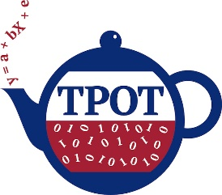
Tree-based pipeline optimization tool (TPOT)
Automating data science

Slide 13
We were two years ahead of Google

Slide 14
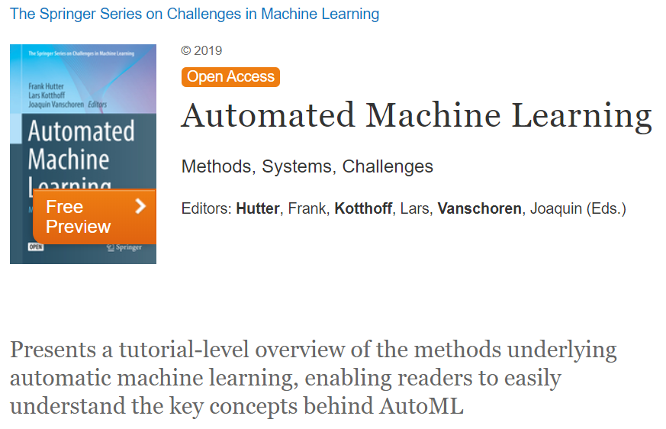
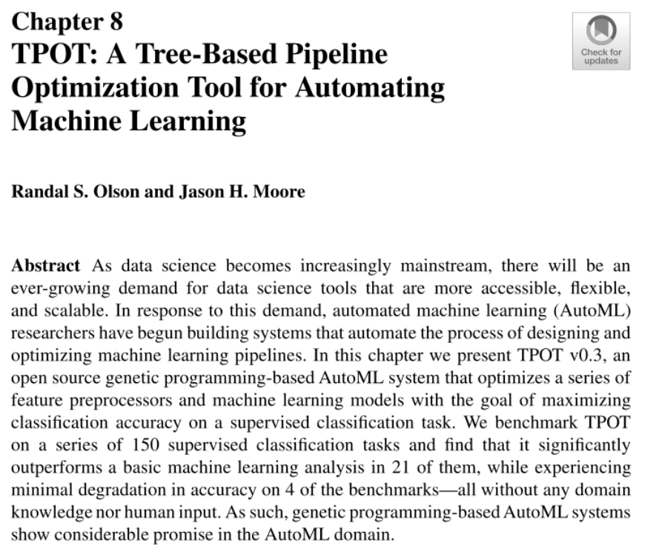
The first book on automated machine learning (AutoML)

Slide 15
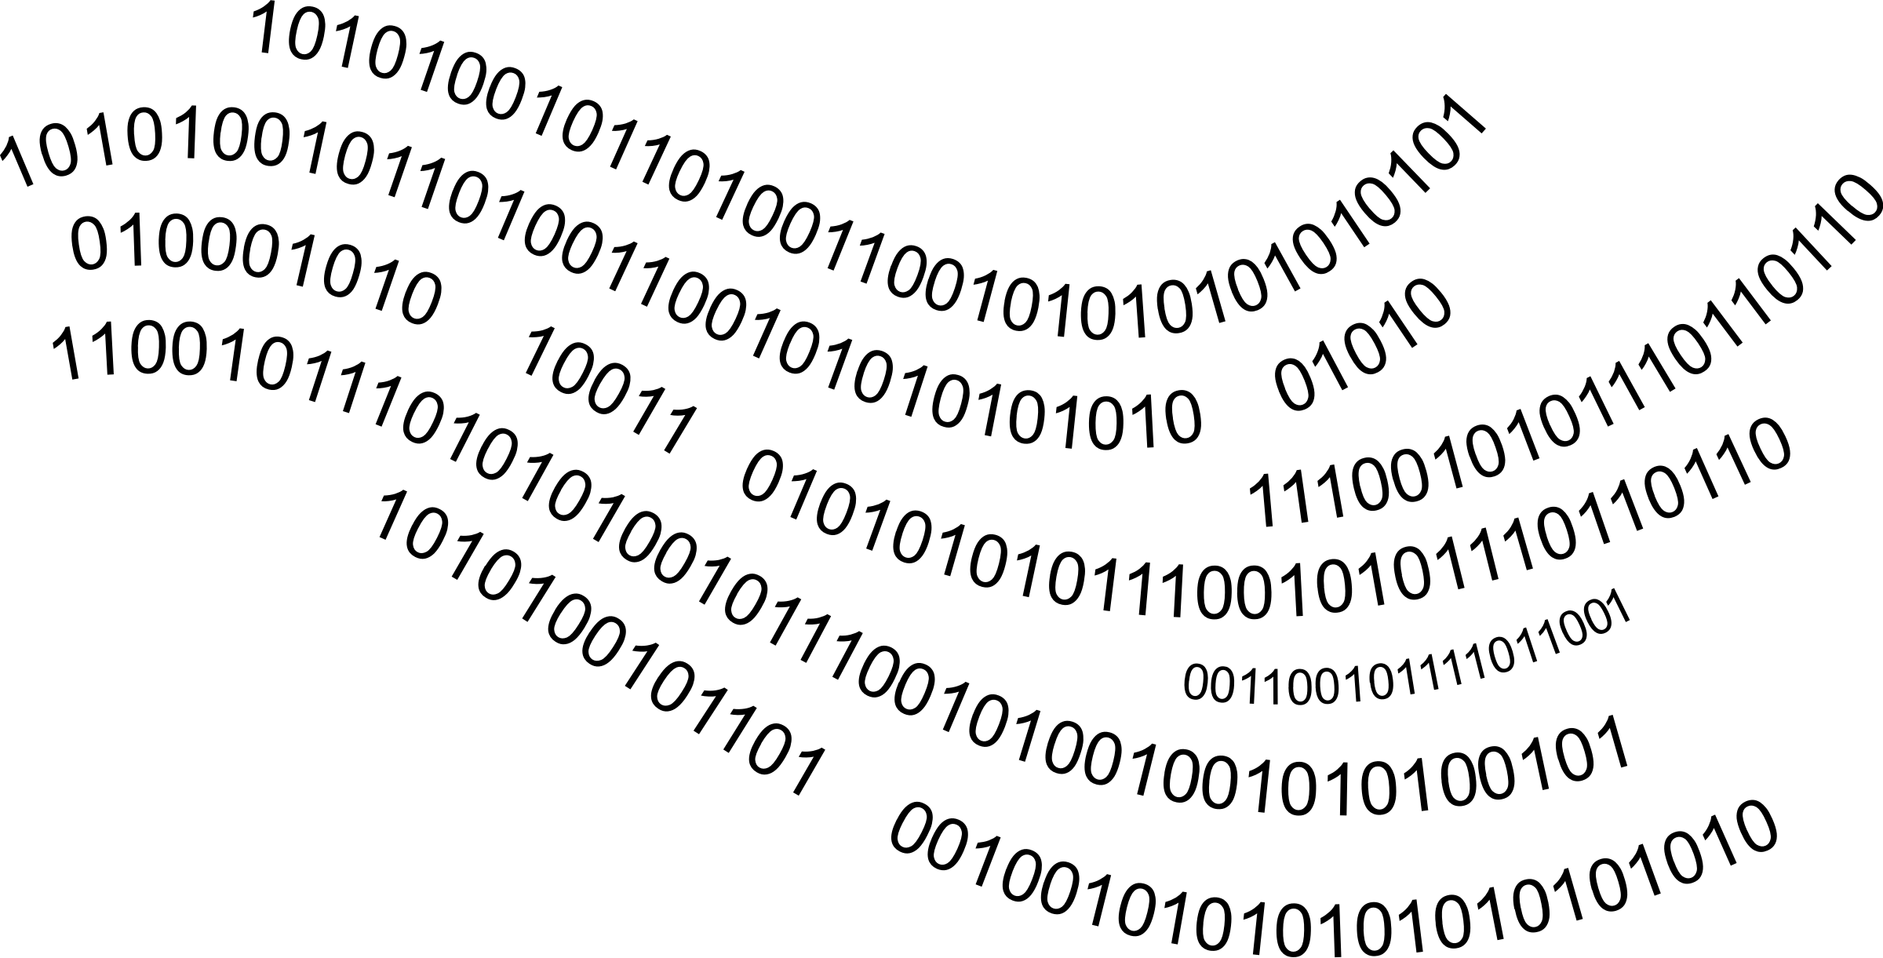
Aliro AI for automated machine learning (AutoML)

Slide 16
Step 1 – Machine learning code base
XGBoost
RandFor
NeuralNet
KNN
LogReg
DecTree

Slide 17
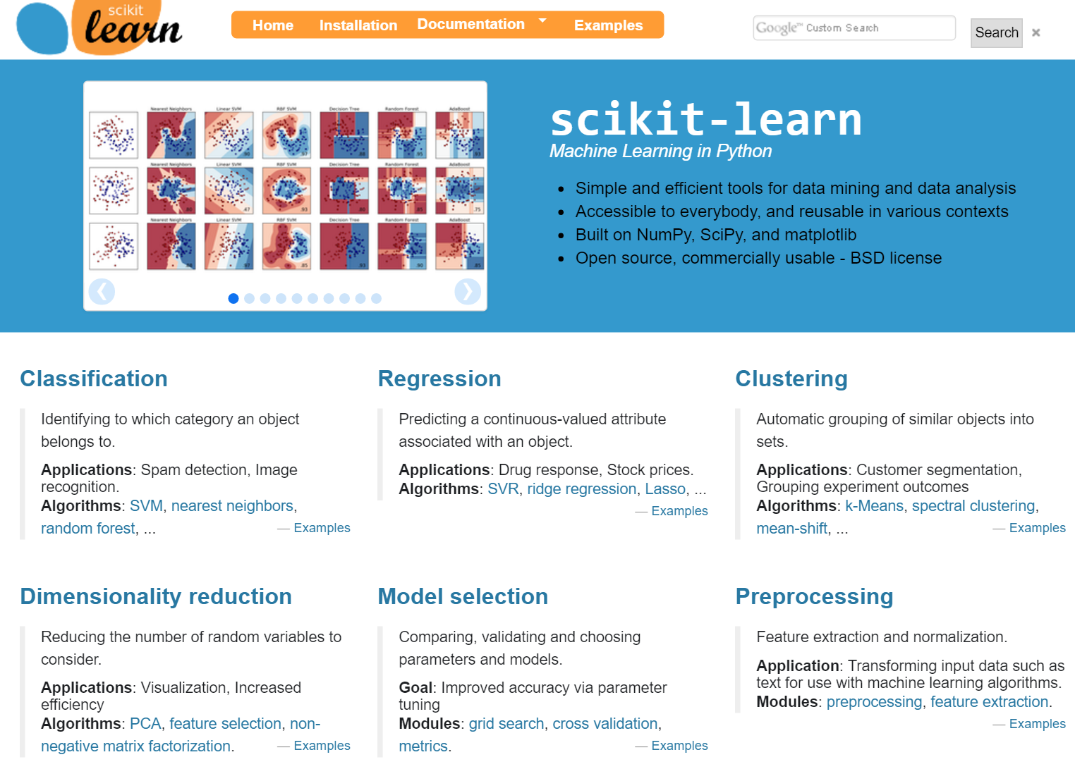
Machine learning is hard!

Slide 18
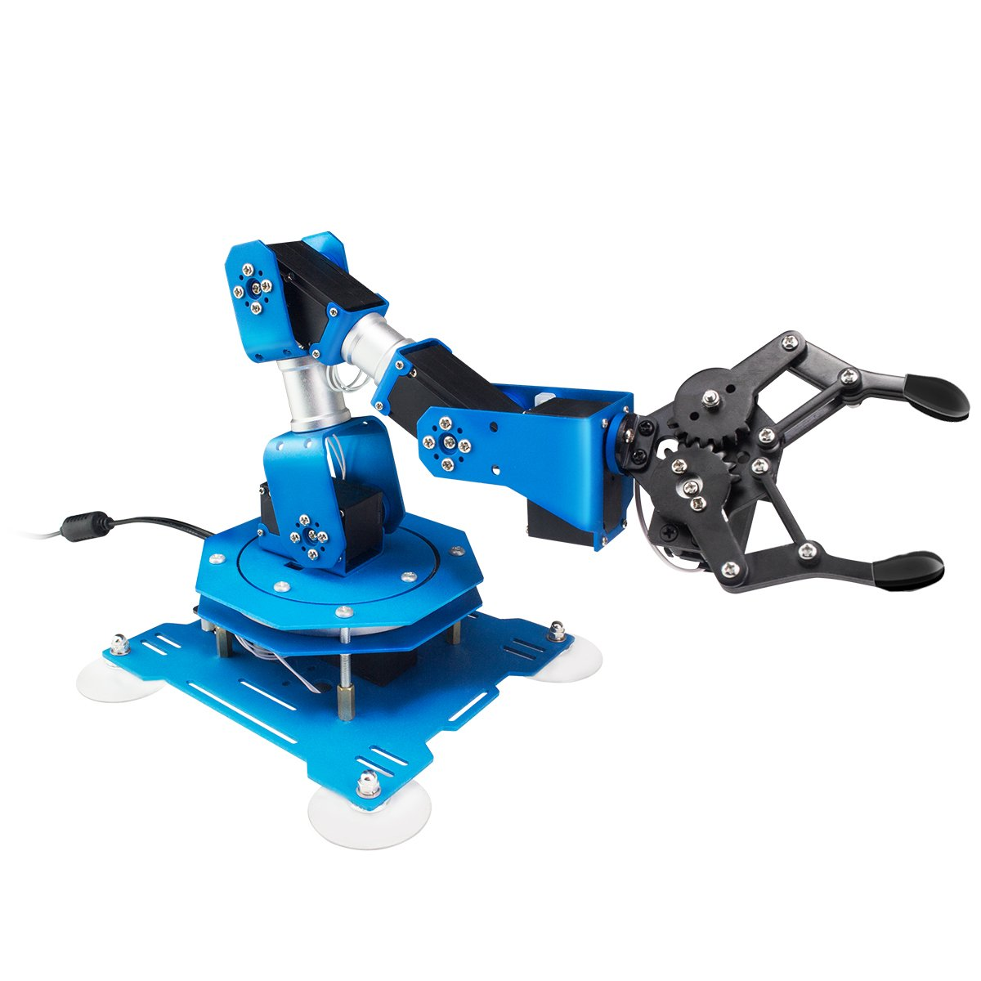
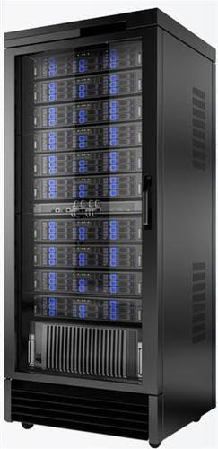
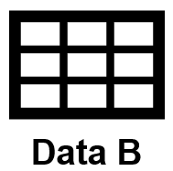
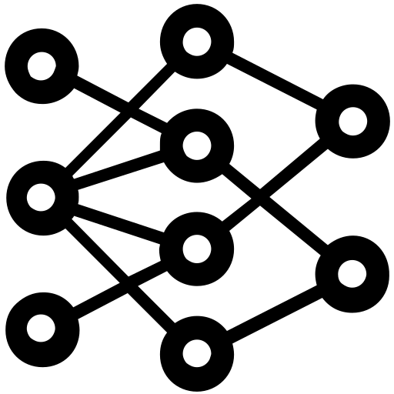
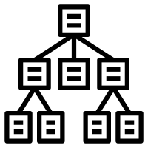
Step 2 – Controller

Slide 19
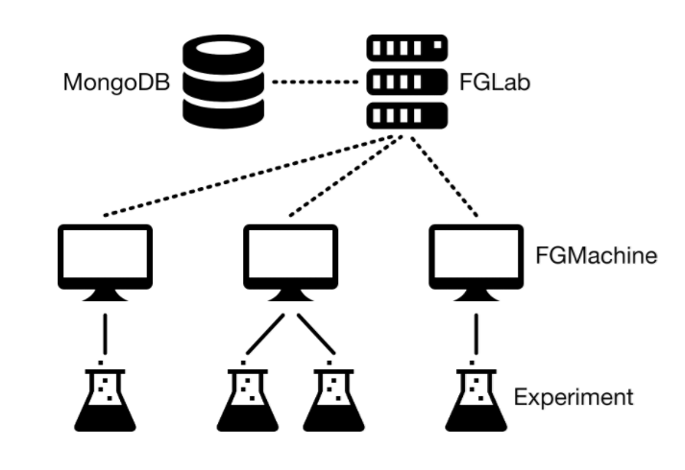
Future Gadget Lab

Slide 20
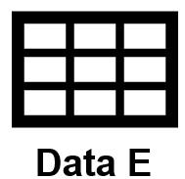
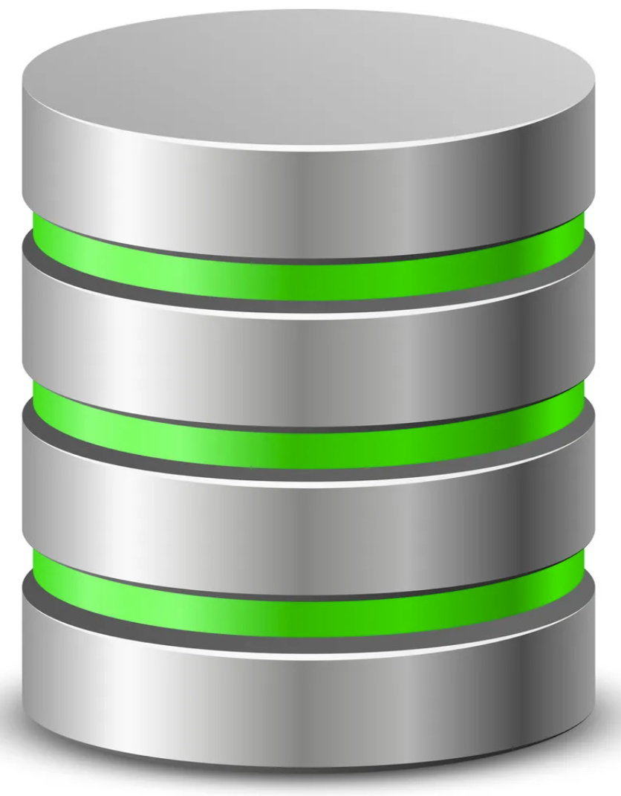
Step 3 – Database (i.e. the AI memory)

Slide 21
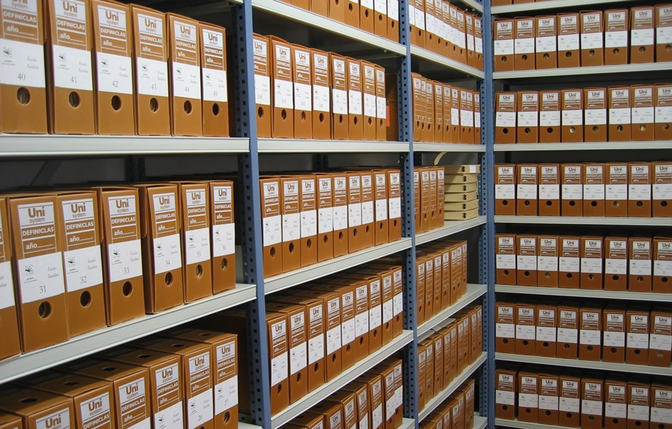
MongoDB Document Store

Slide 22
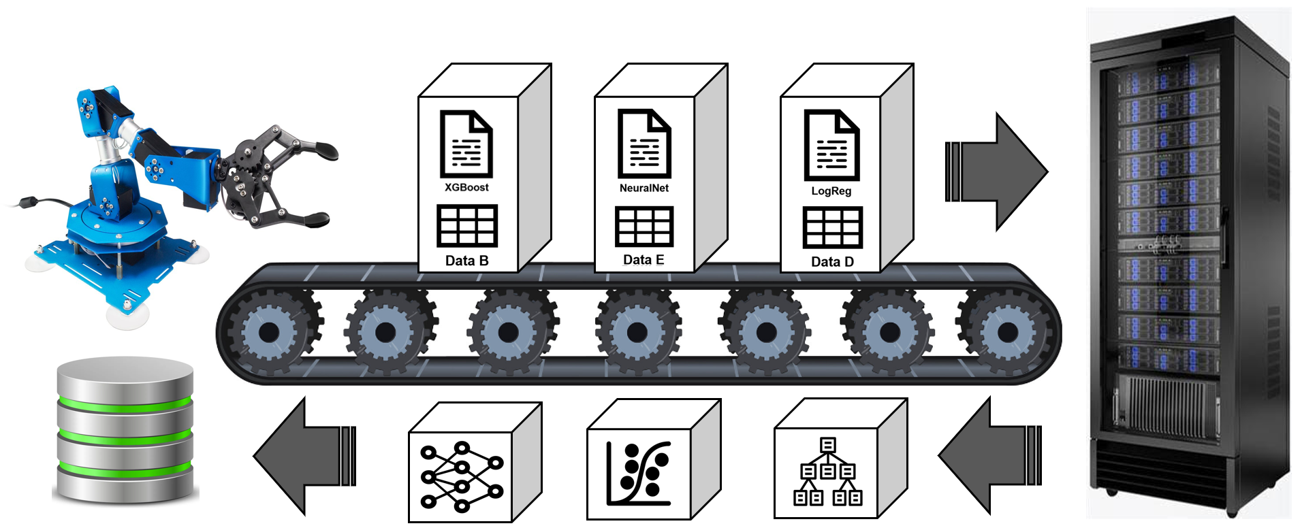
Step 4 – AI (i.e. something that learns from experience)

Slide 23
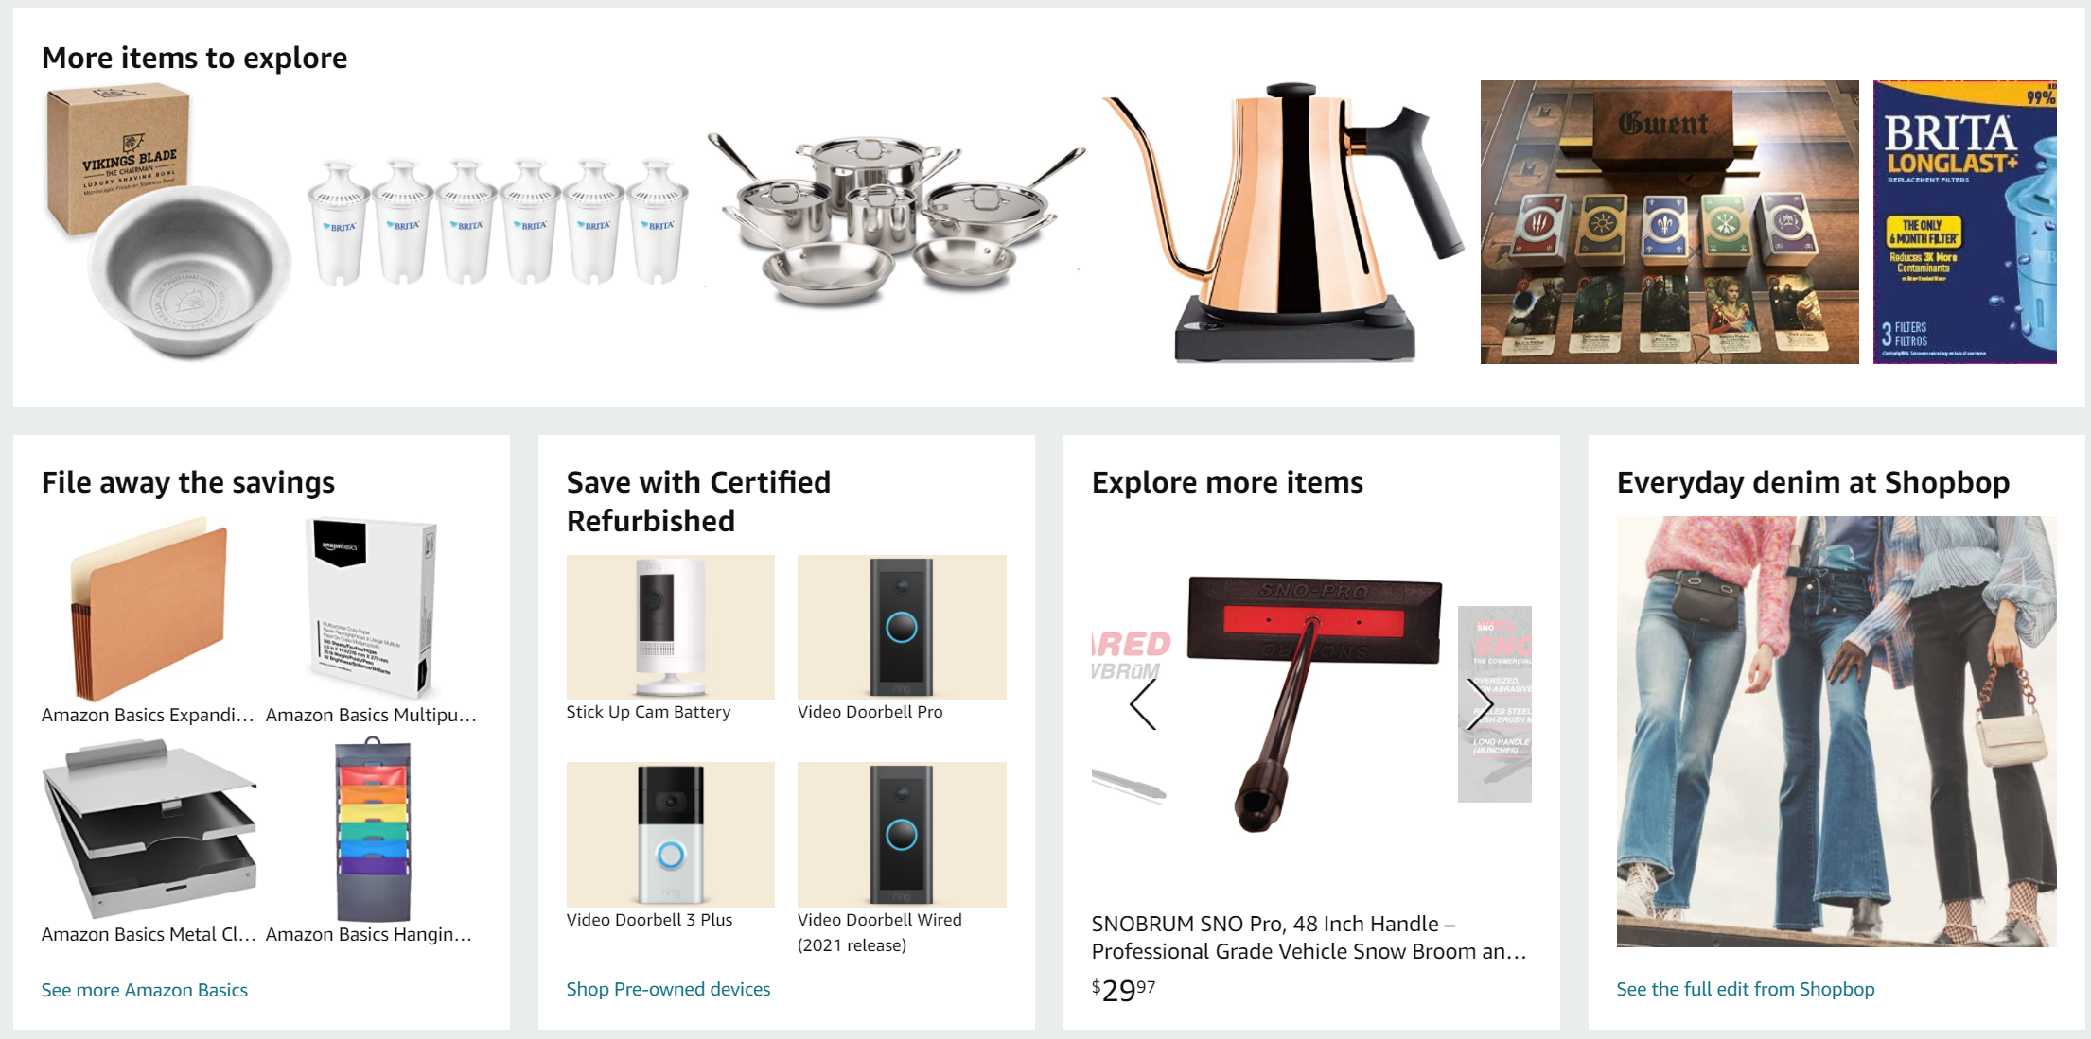
AI Recommender System

Slide 24
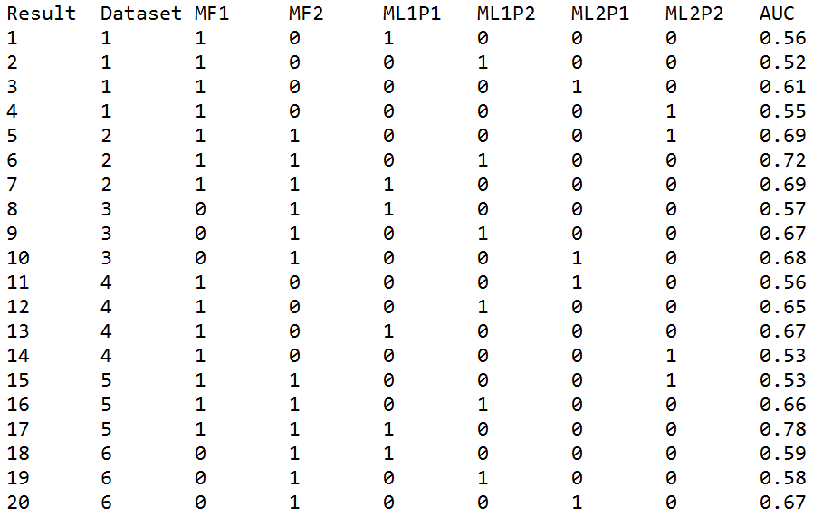
Recommender System

Slide 25
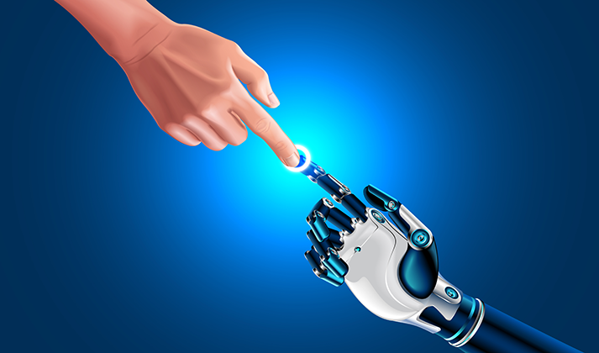
Step 5 – Human-Computer Interaction

Slide 26
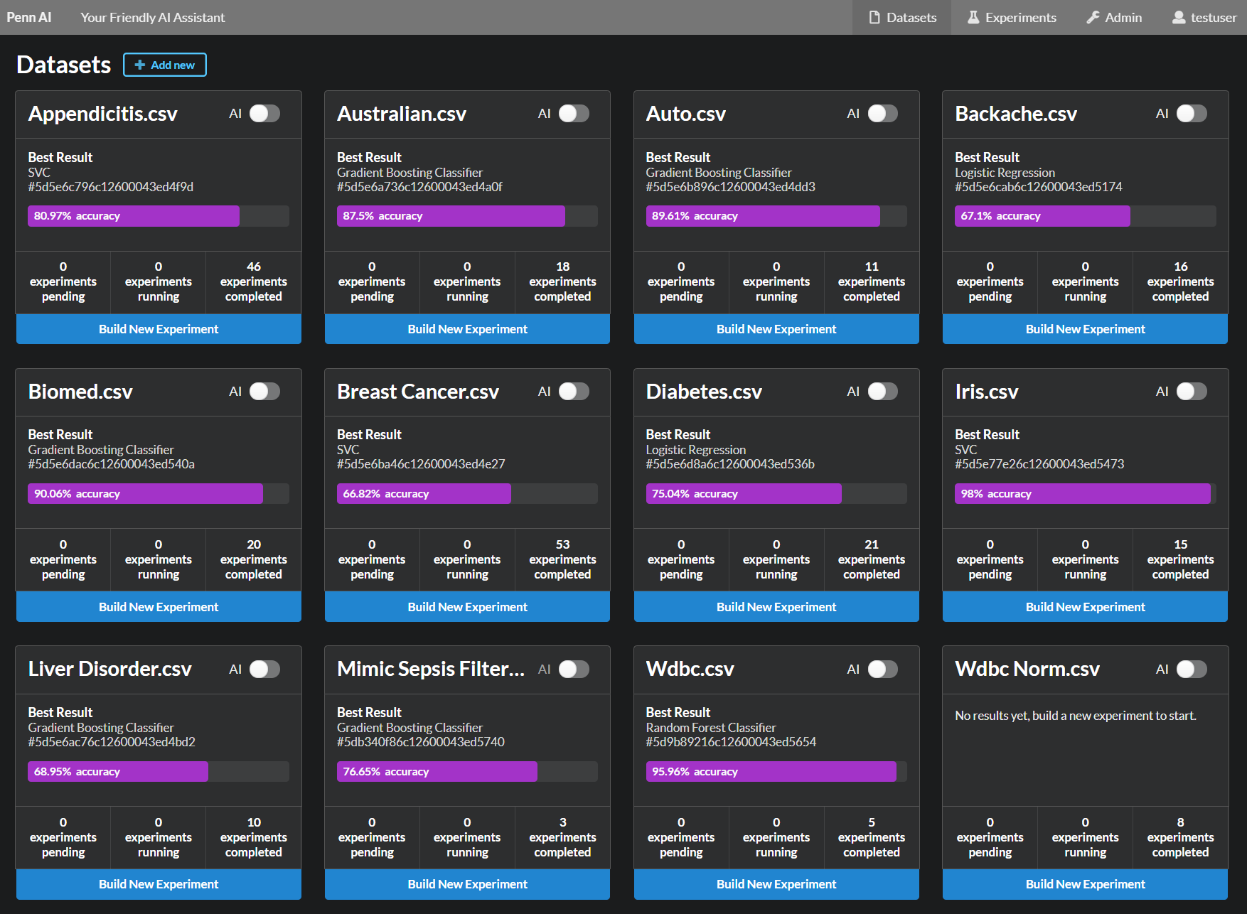
3. Ensembling or stacking
Aliro – Your Friendly AI Assistant

Slide 27
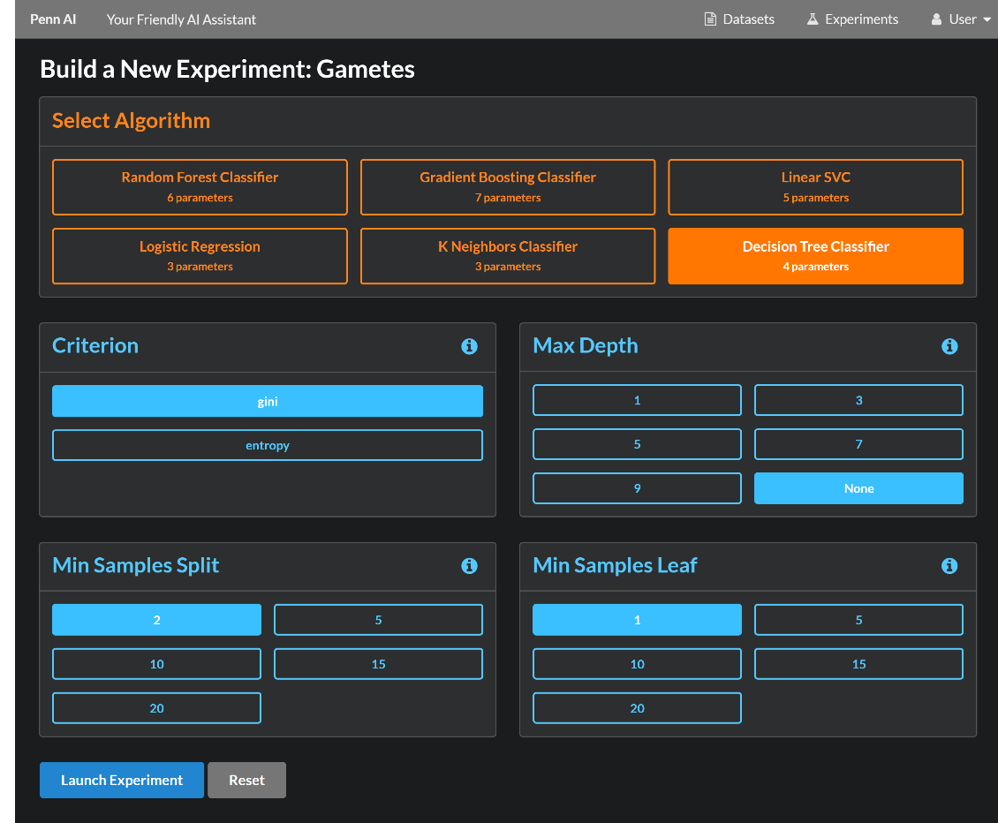
3. Ensembling or stacking
Aliro – Your Friendly AI Assistant

Slide 28
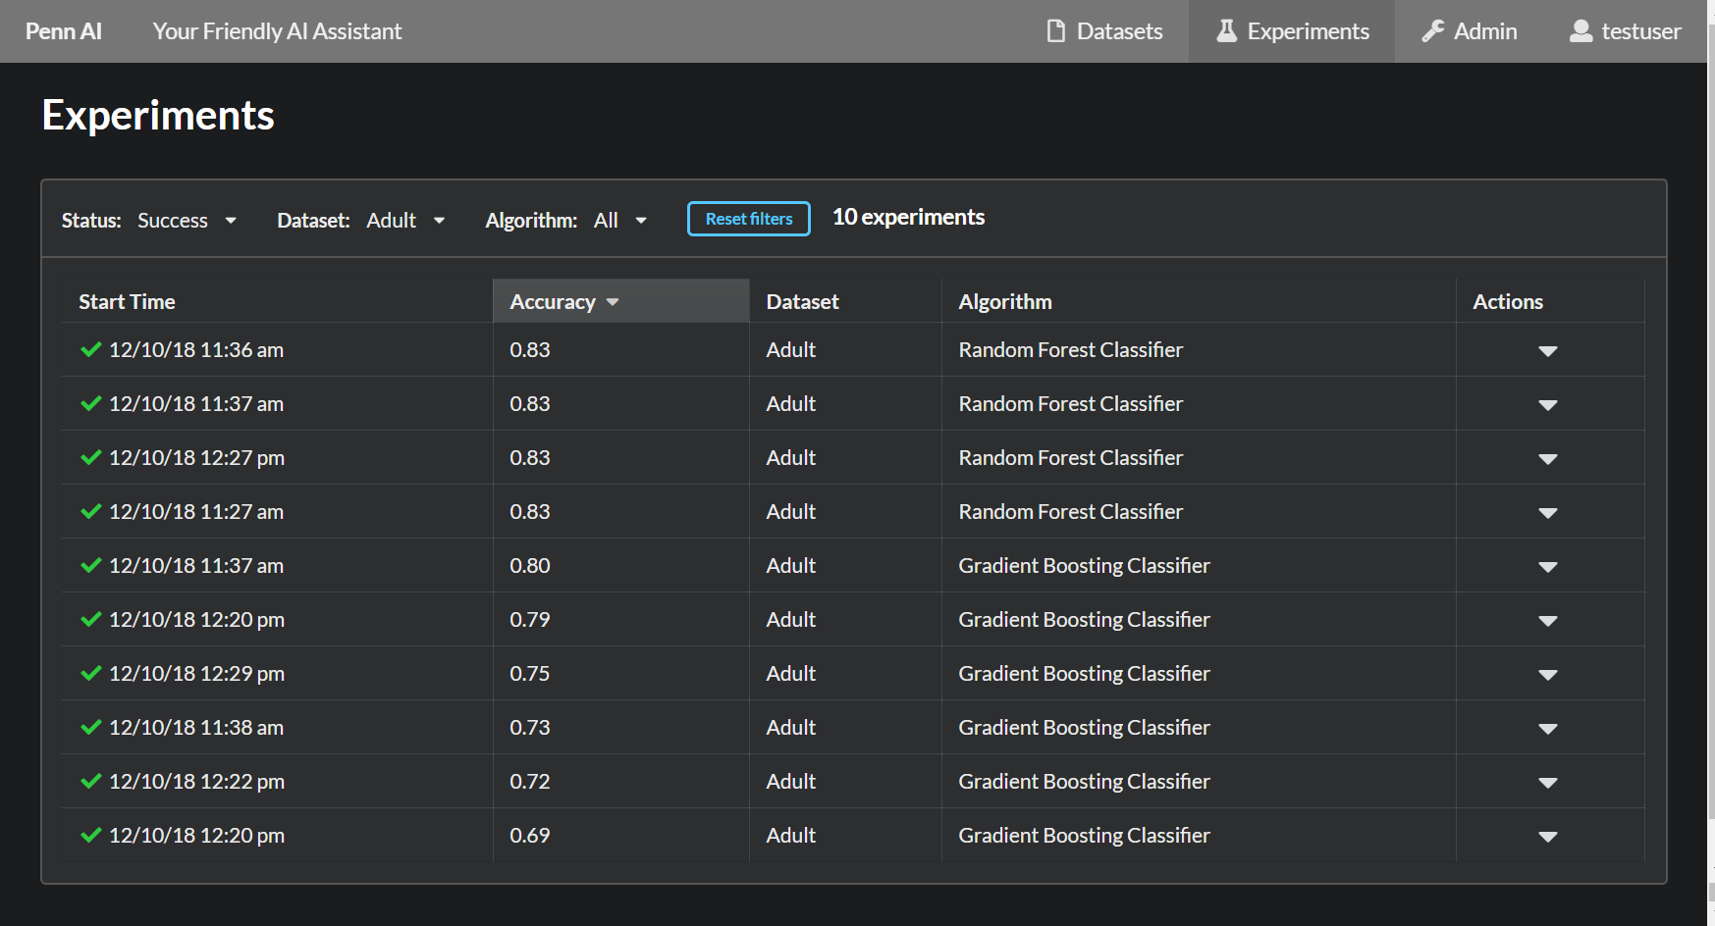
3. Ensembling or stacking
Aliro – Your Friendly AI Assistant

Slide 29
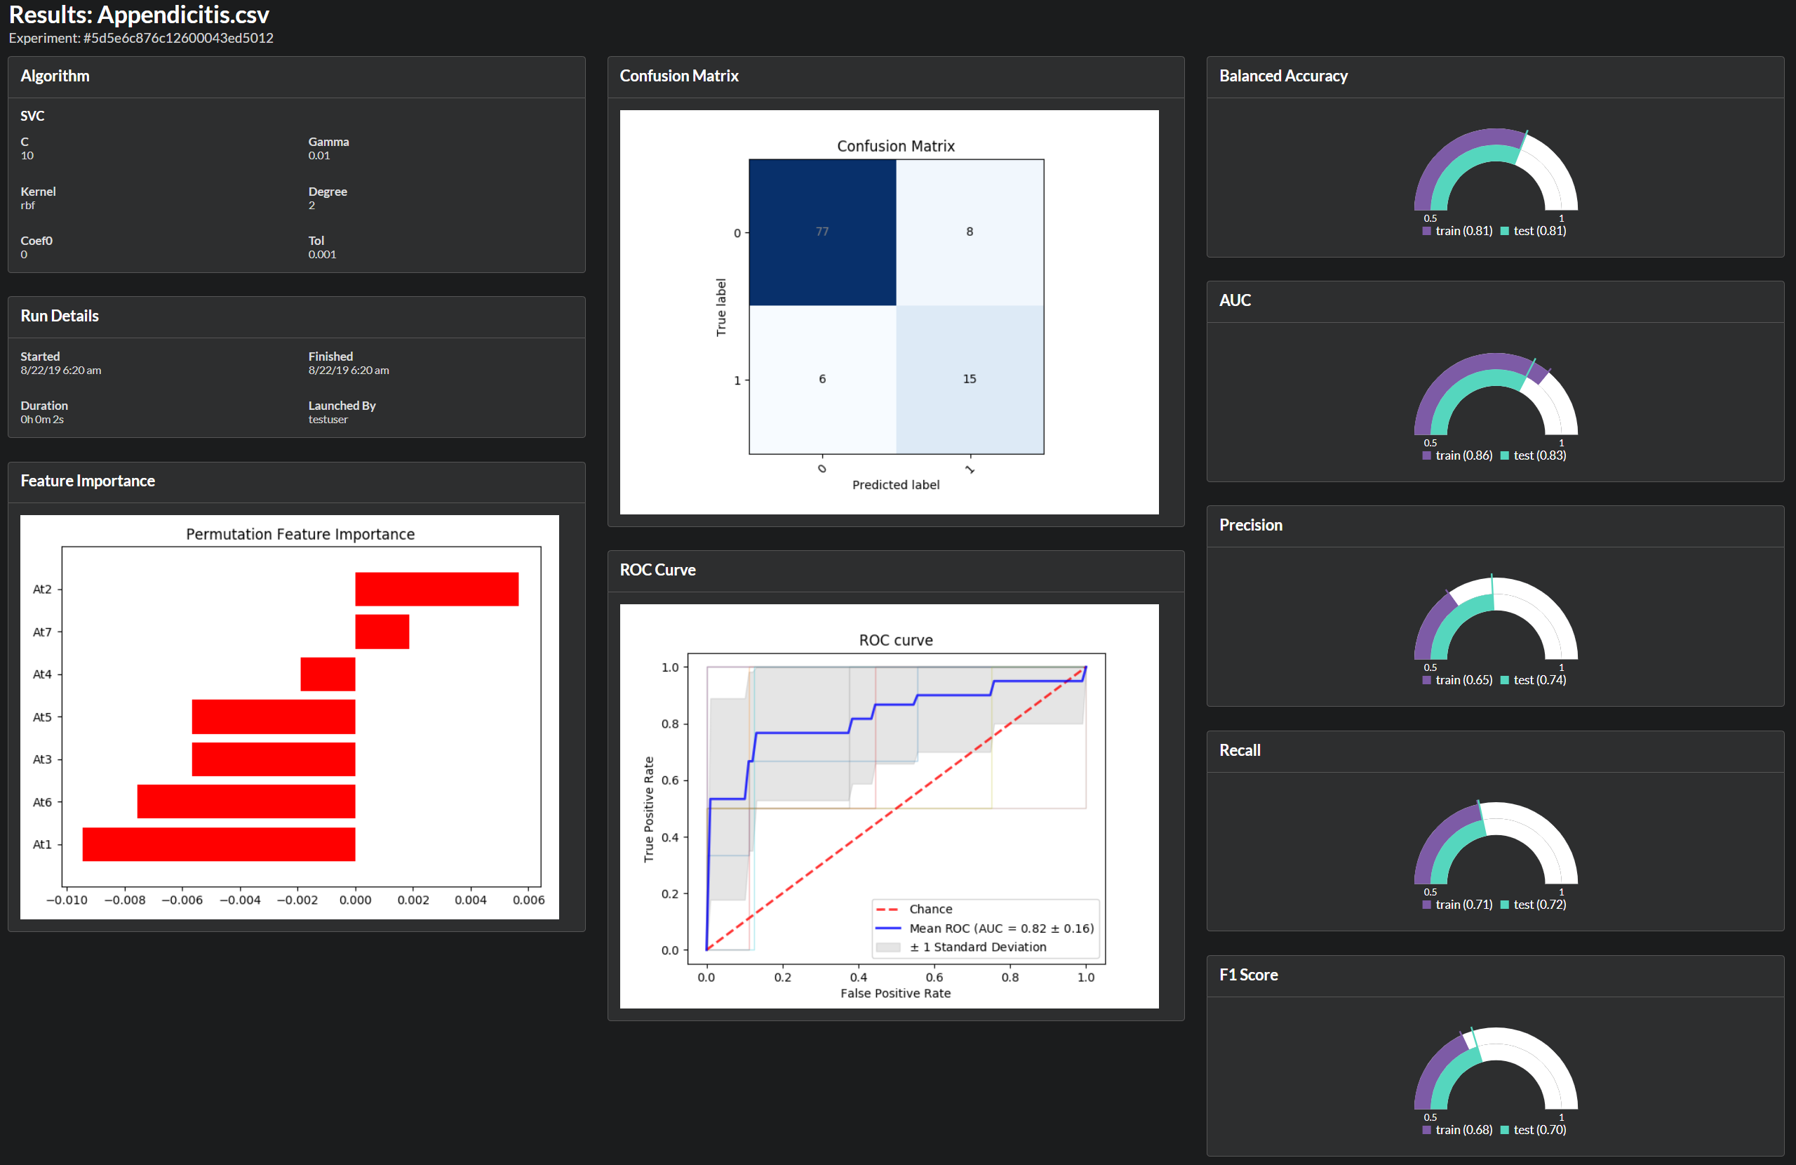
3. Ensembling or stacking

Slide 30
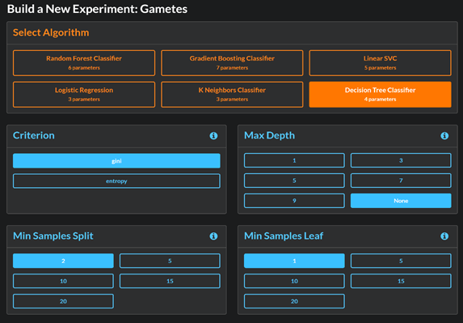
Aliro AI

Slide 31
Learning Health Systems
Easy Data
Access
Easy Data
Cleaning
Easy Data
Analytics
Easy Model
Evaluation
Easy Model
Deployment

Slide 32
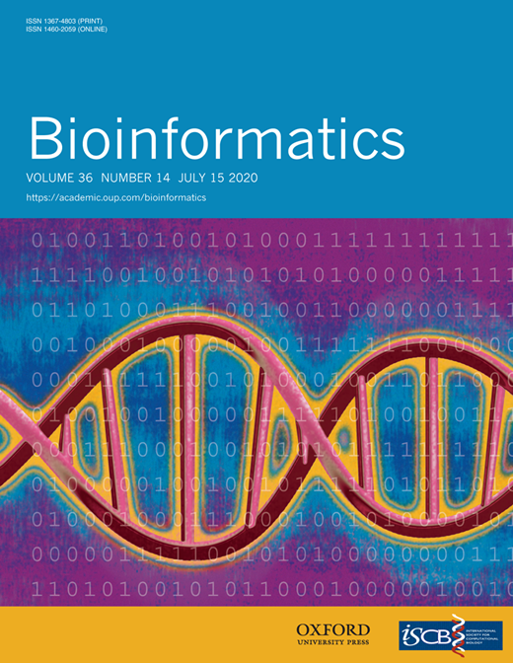
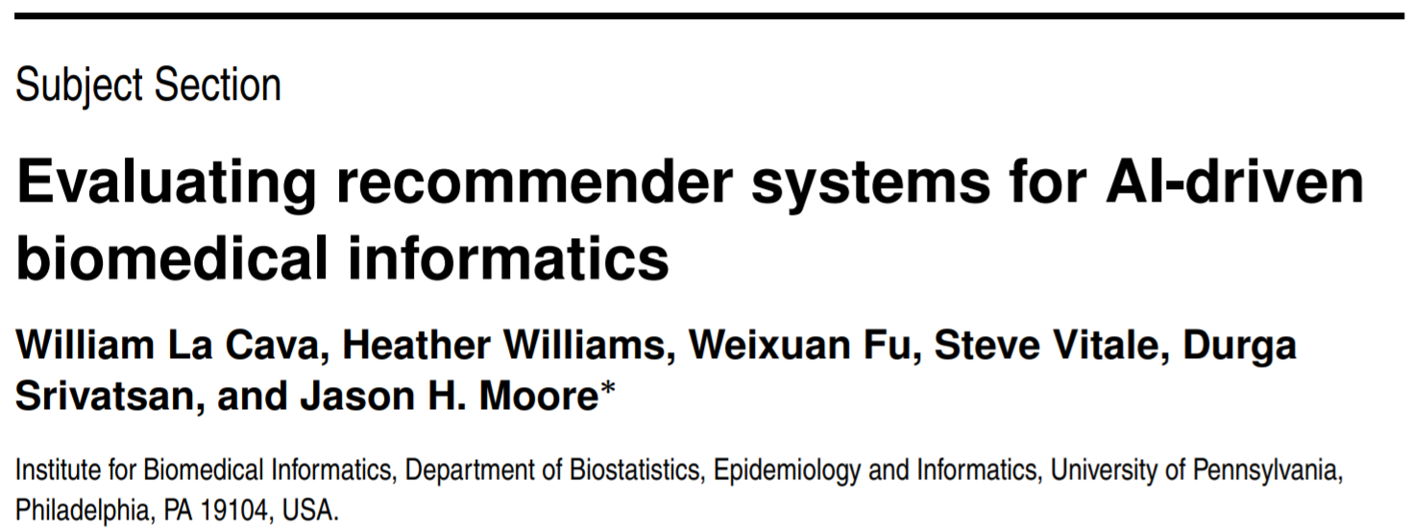
4. Feature transformation

Slide 33
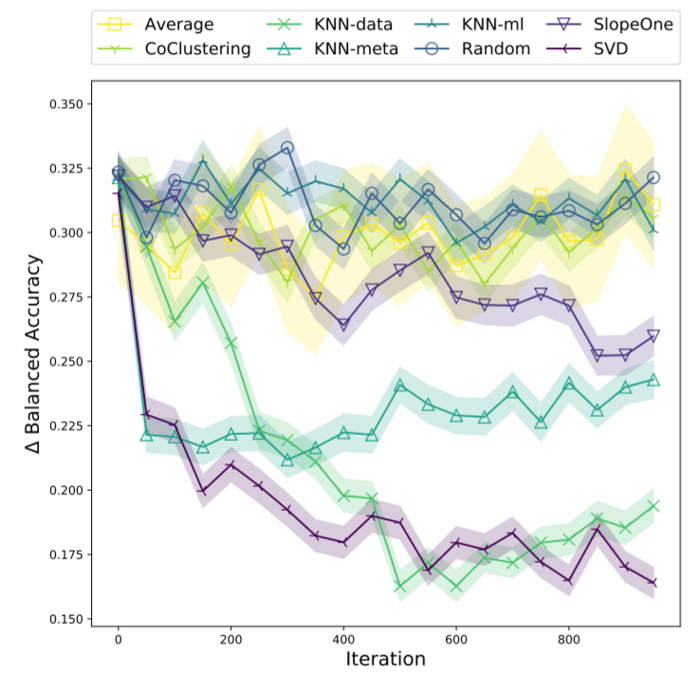
4. Feature transformation

Slide 34
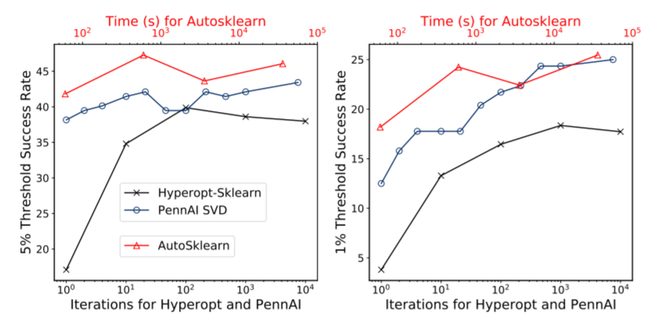
4. Feature transformation
Hyperopt-Sklearn
Aliro
AutoSklearn

Slide 35
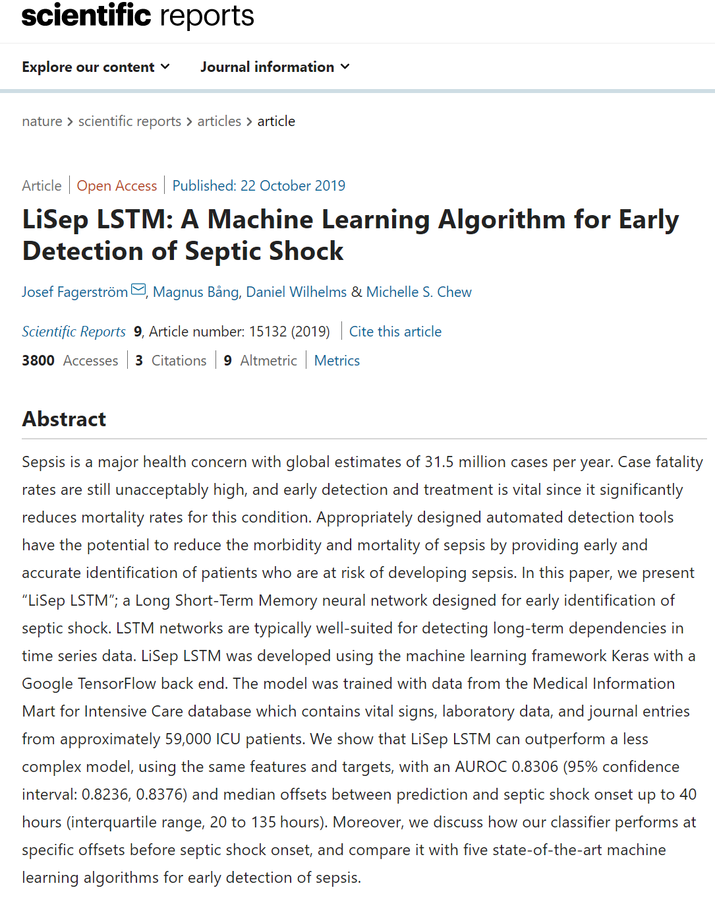
4. Feature transformation

Slide 36
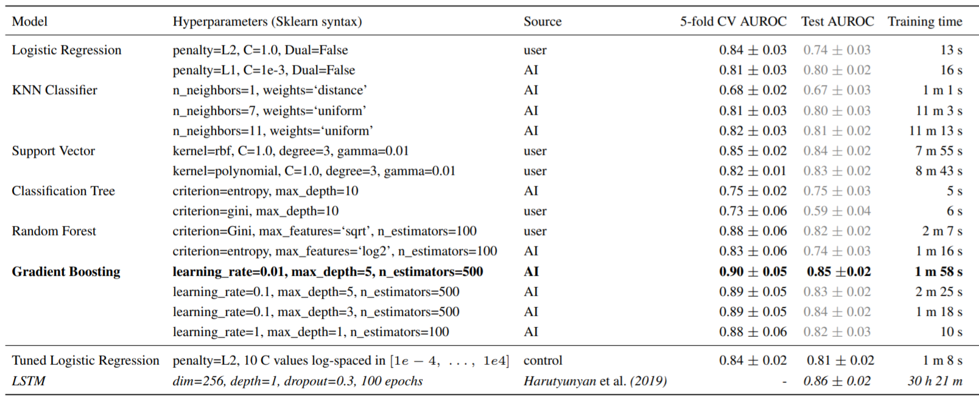
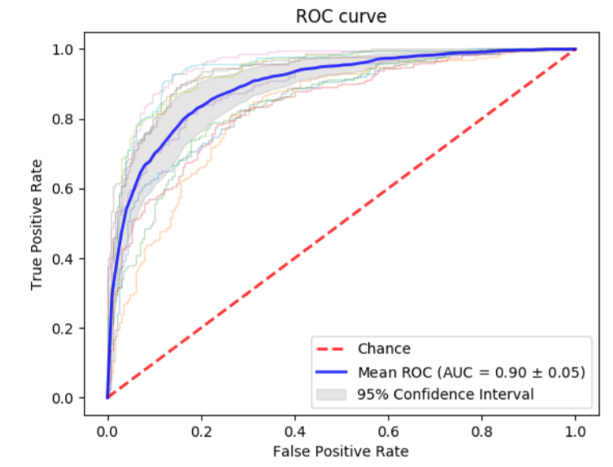
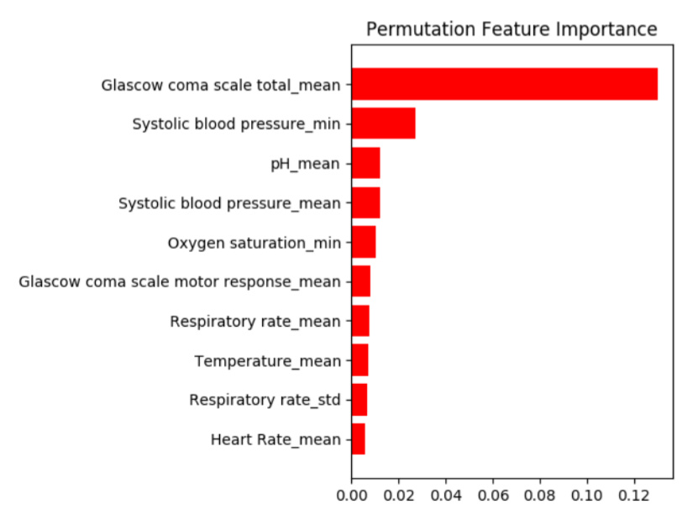
4. Feature transformation

Slide 37
Aliro AI is open source
https://github.com/EpistasisLab/aliro

Slide 38
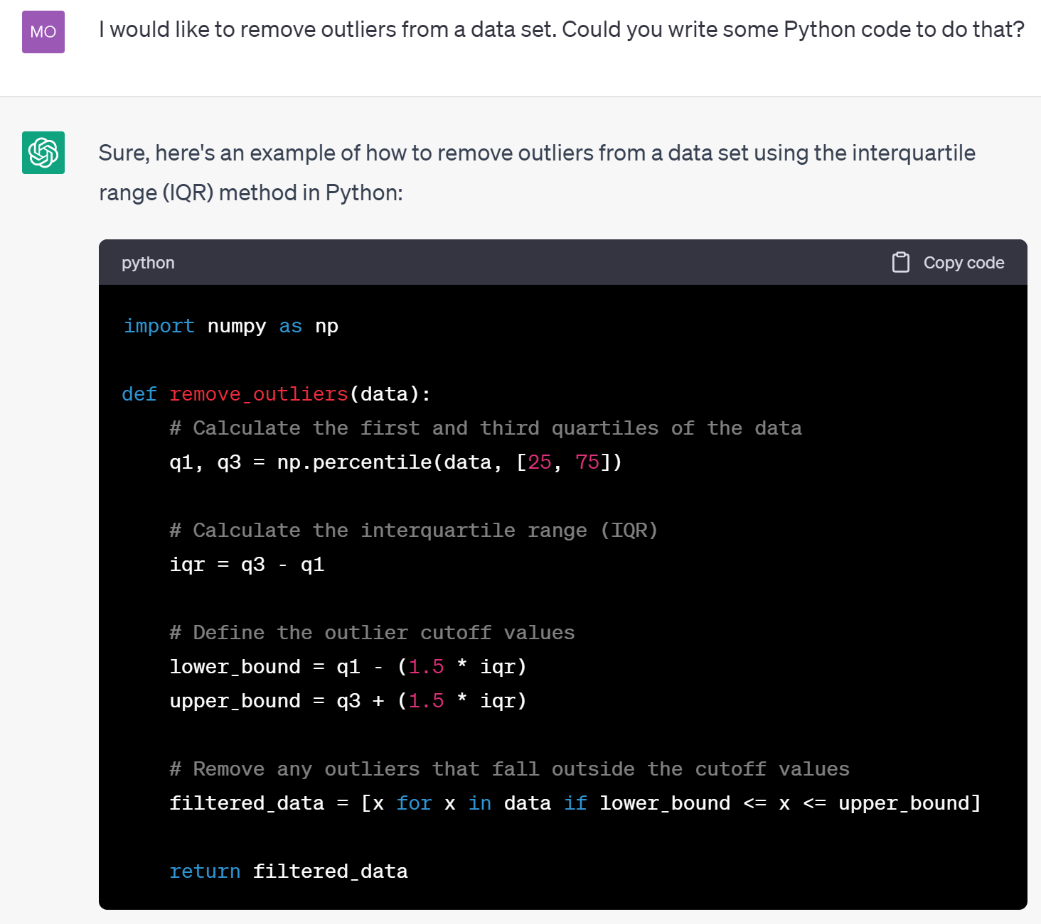
4. Feature transformation
Aliro + ChatGPT

Slide 39
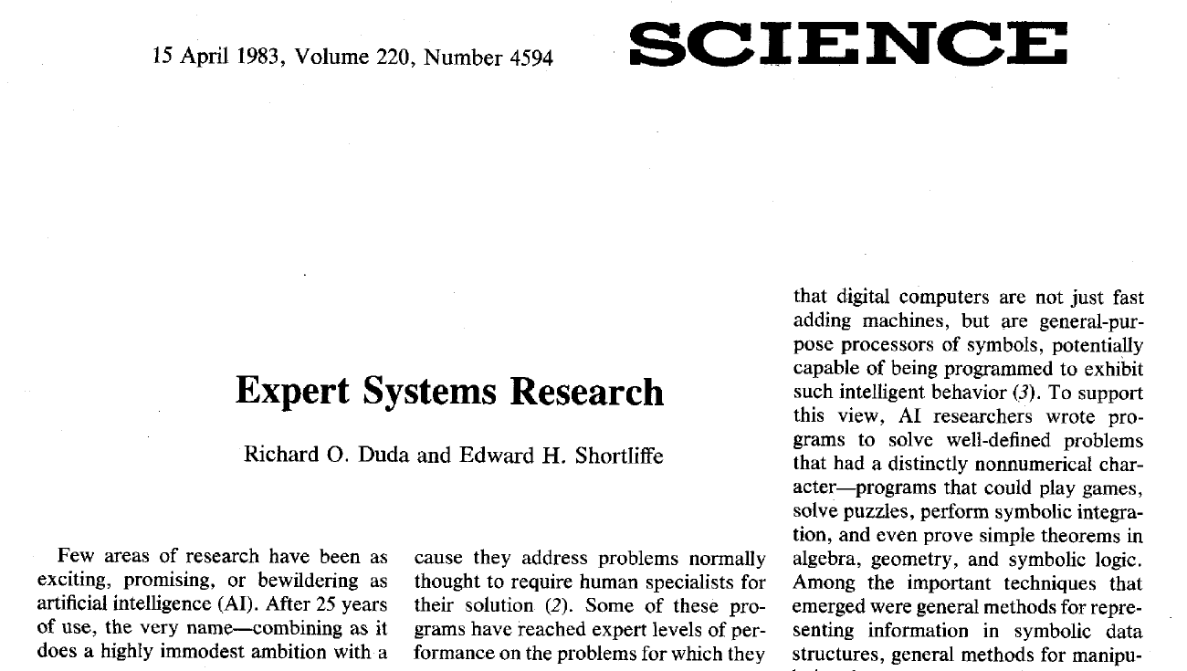
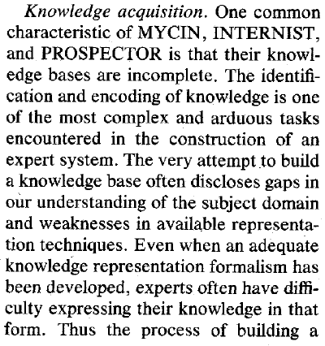
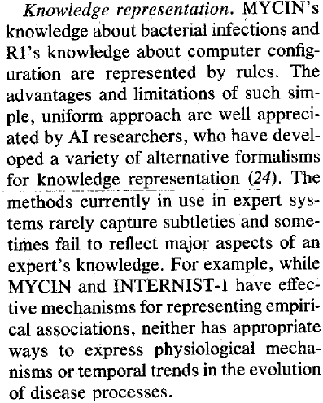
Question – How to integrate expert knowledge in an AI?

Slide 40
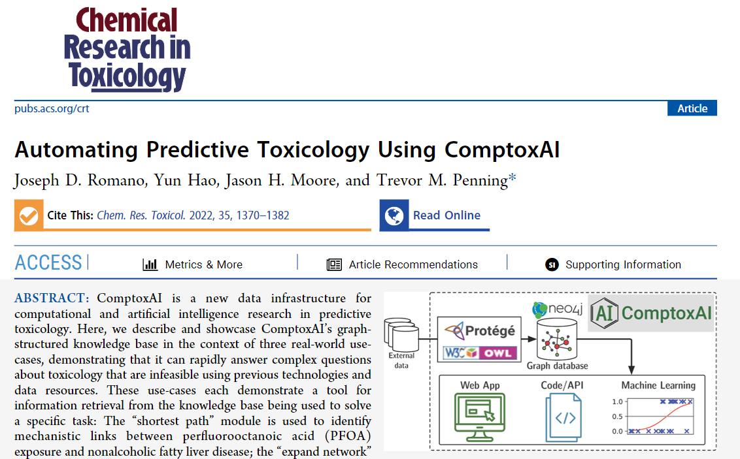
Computational Toxicology Knowledgebase (Comptox.AI)

Slide 41
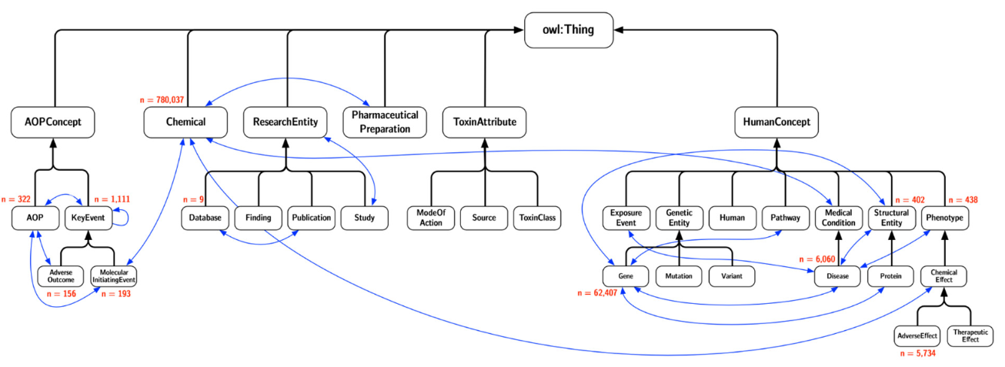
Computational Toxicology Knowledgebase (Comptox.AI)

Slide 42
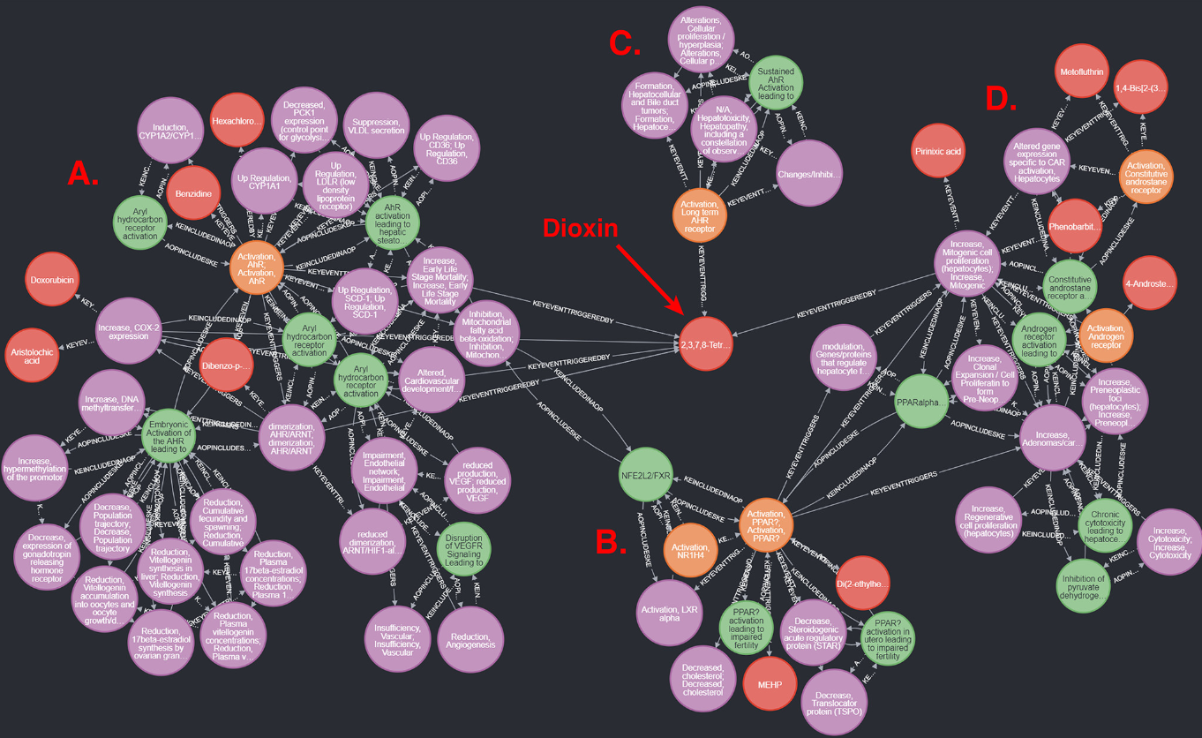
Computational Toxicology Knowledgebase (Comptox.AI)

Slide 43
RESEARCH GOAL: Knowledge-aware AutoML

Slide 44
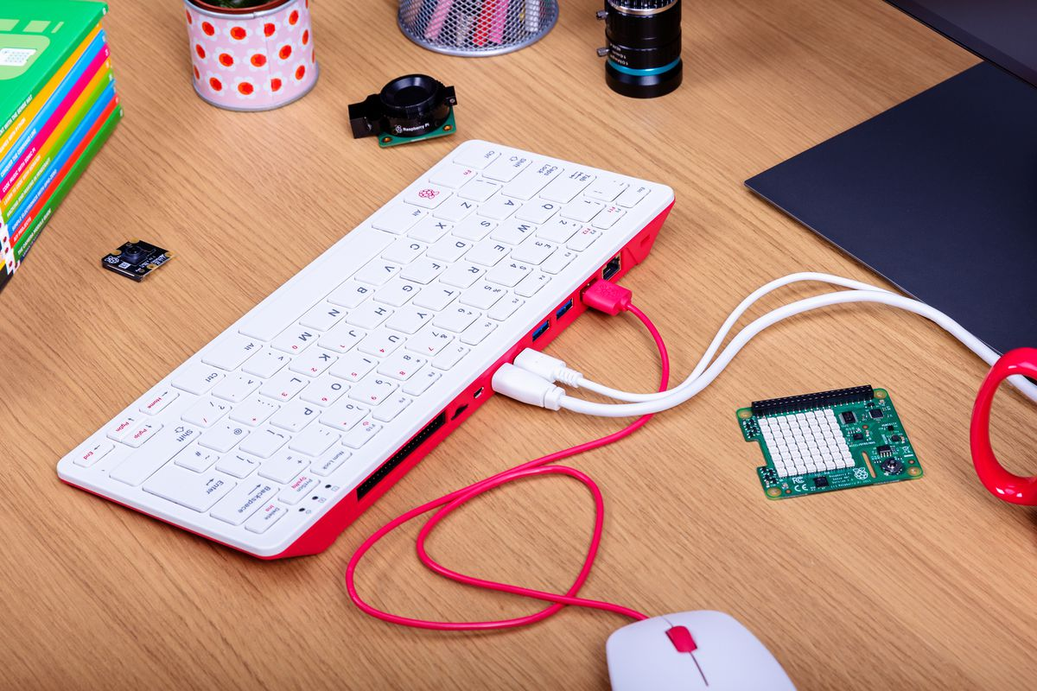
4. Feature transformation
$100
Aliro-ED

Slide 45
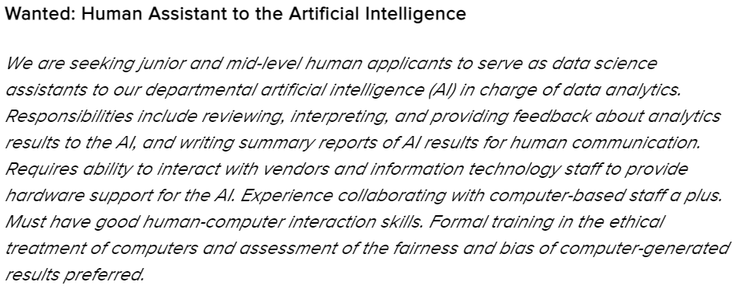
4. Feature transformation

Slide 46
4. Feature transformation

Slide 47
4. Feature transformation
Our Growing AI Ecosystem

Slide 48
Acknowledgements
AliroAI: Miguel Hernandez, Nick Matsumoto, Jay Moran, Paul Wang
R01 LM010098, U01 AG066833
jason.moore@csmc.edu
https://github.com/epistasislab/aliro
https://github.com/epistasislab/tpot2
https://comptox.ai
https://epistasis.org

Slide 49
Questions?

