Slide 1
Climate Change
A Human Health Perspective
A Student Exploration of the Impacts of Climate
Change on Human Health in the United States
National Institute of Environmental Health Sciences

Slide 2
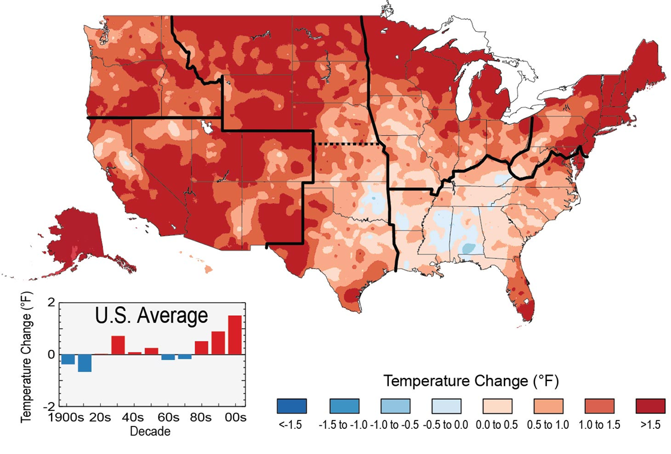
List the impact(s) of a warming climate on human health.
The colors on the map show temperature changes over the past 22 years (1991-2012) compared to the 1901-1960 average for the contiguous U.S., and to the 1951-1980 average for Alaska and Hawai'i.
Notes:
Image credit: http://nca2014.globalchange.gov/highlights/report-findings/widespread-impacts
The colors on the map show temperature changes over the past 22 years (1991-2012) compared to the 1901-1960 average for the contiguous U.S., and to the 1951-1980 average for Alaska and Hawai'i. The bars on the graph show the average temperature changes by decade for 1901-2012 (relative to the 1901-1960 average). The far right bar (2000s decade) includes 2011 and 2012. The period from 2001 to 2012 was warmer than any previous decade in every region. (Figure source: NOAA NCDC / CICS-NC).

Slide 3
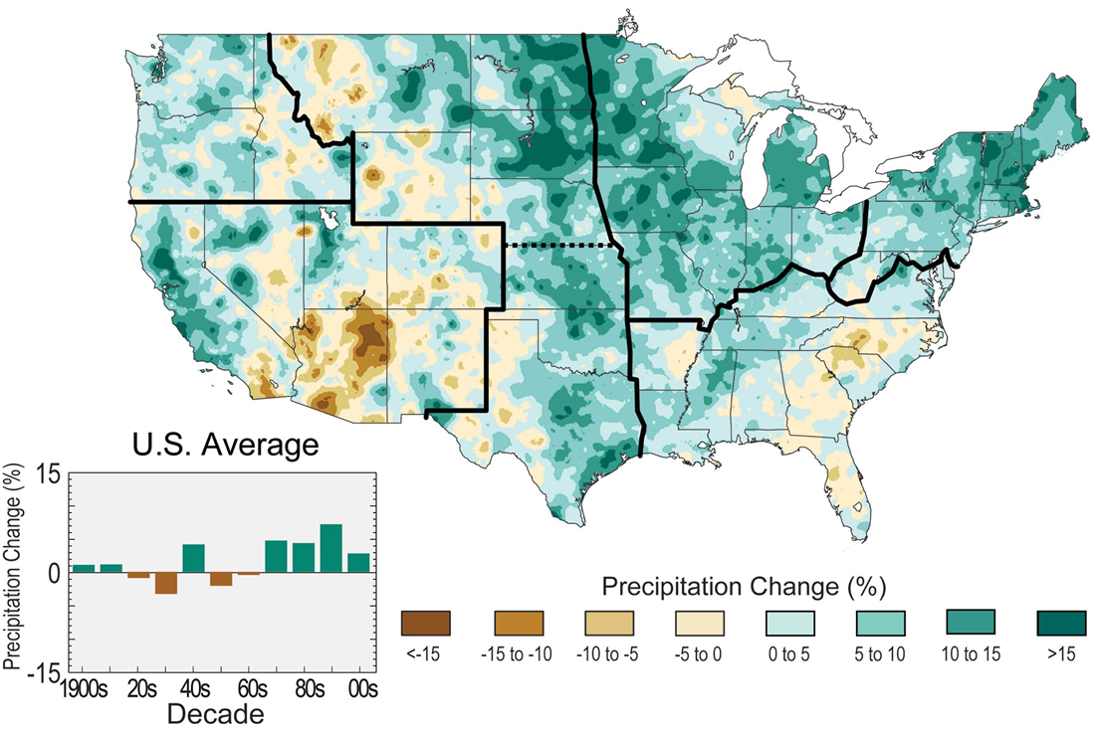
List the impact(s) of a wetter climate on human health and of a drier climate on human health.
The colors on the map show annual total precipitation changes for 1991-2012 compared to the 1901-1960 average, and show wetter conditions in most areas.
Notes:
Image Credit: http://nca2014.globalchange.gov/highlights/report-findings/our-changing-climate
The colors on the map show annual total precipitation changes for 1991-2012 compared to the 1901-1960 average, and show wetter conditions in most areas. The bars on the graph show average precipitation differences by decade for 1901-2012 (relative to the 1901-1960 average). The far right bar is for 2001-2012. (Figure source: NOAA NCDC / CICS-NC).

Slide 4
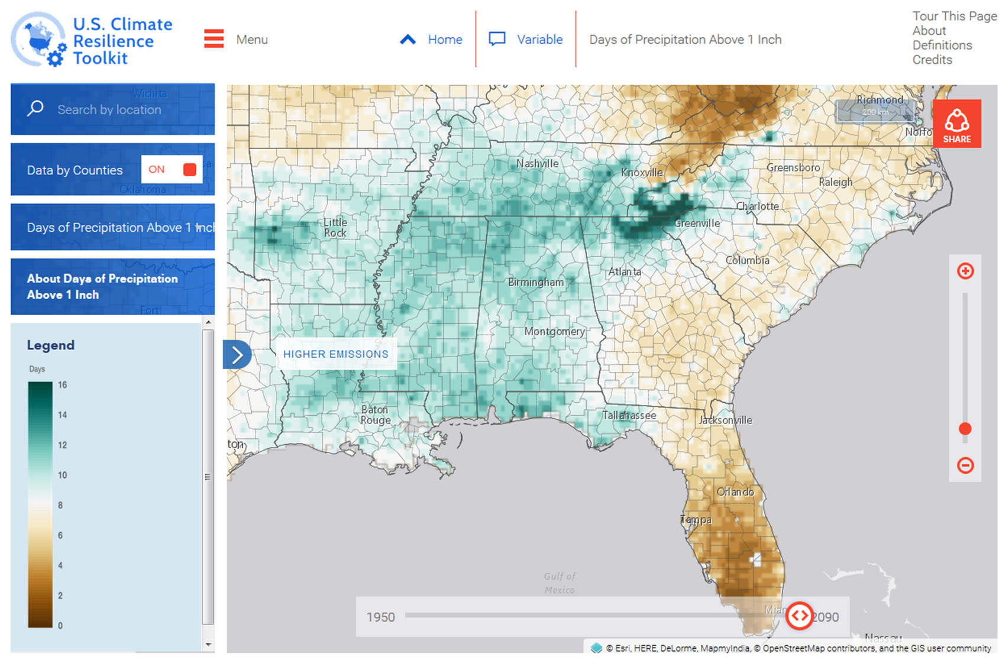
US Climate Resilience Toolkit
To be used on slides where the header is not desired.
Notes:
https://toolkit.climate.gov/climate-explorer2

Slide 5

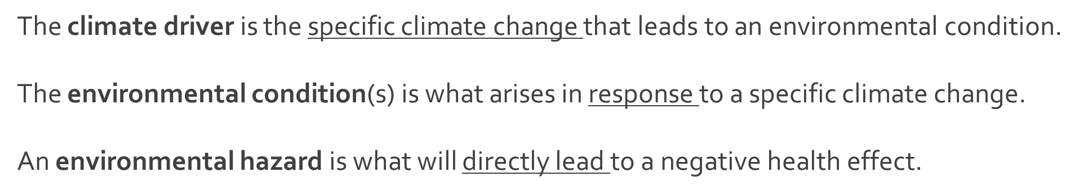
Visual Model | Cause-effect

Slide 6


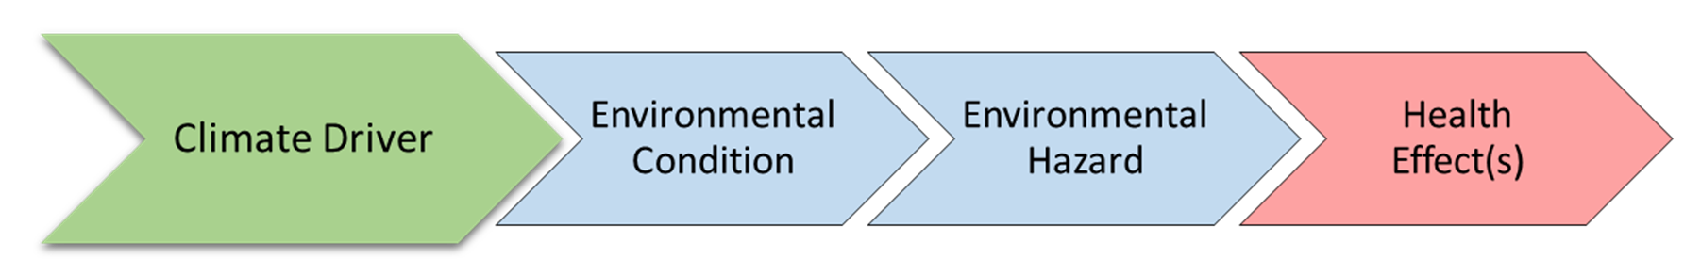
Visual Model | Cause-effect
Exposure pathway

Slide 7

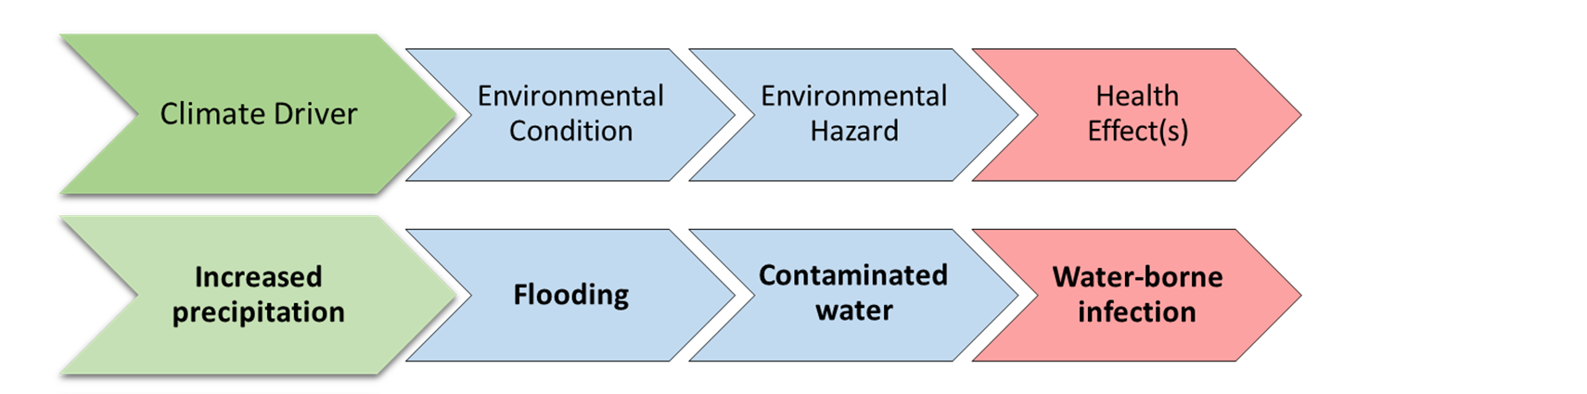

Flooding
Some individuals and groups may be more vulnerable to water-borne infection as a result of floodwaters.
Notes:
Image credit: https://s3.amazonaws.com/climatehealth2016/low/ClimateHealth2016_04_Extremes_small.pdf

Slide 8

Directions
READ your assigned impact section:
Group 1 – Temperature-related impacts (chapter 2)
Group 2 – Air Quality impacts (chapter 3)
Group 3 – Impacts from extreme events (chapter 4)
Group 4 – Vector-borne disease impacts (chapter 5)
Group 5 – Water-related impacts (chapter 6)
Group 6 – Impacts to food (chapter 7)
Group 7 – Impacts to mental health (chapter 8)

Slide 9
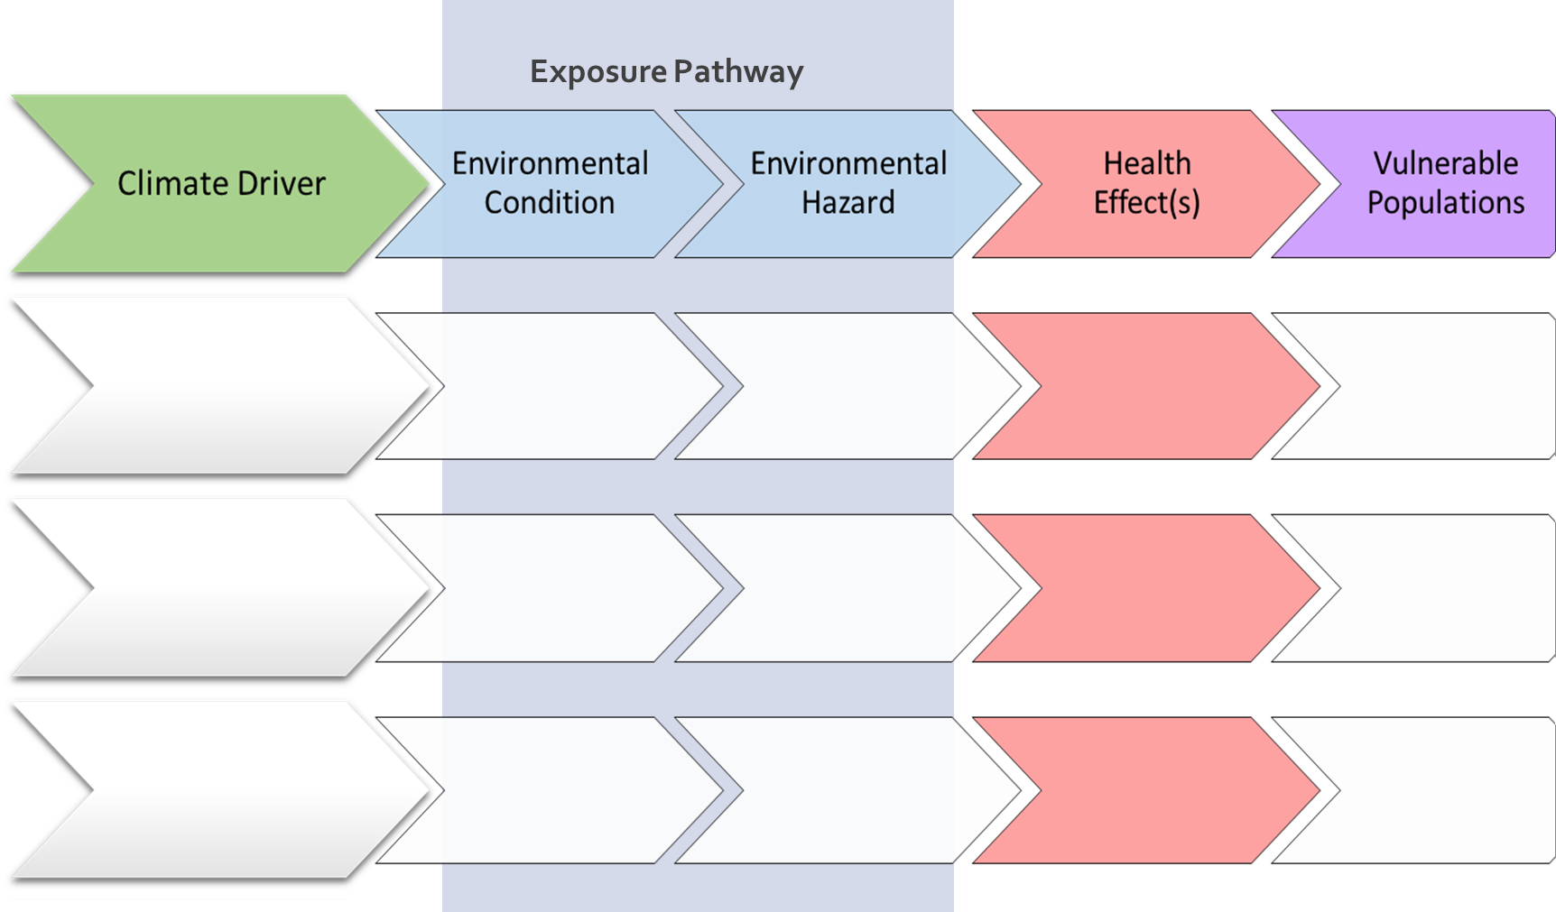
Student Graphic Organizer
Notes:
PPT of student graphic organizer; students may not be able to complete all rows.

Slide 10
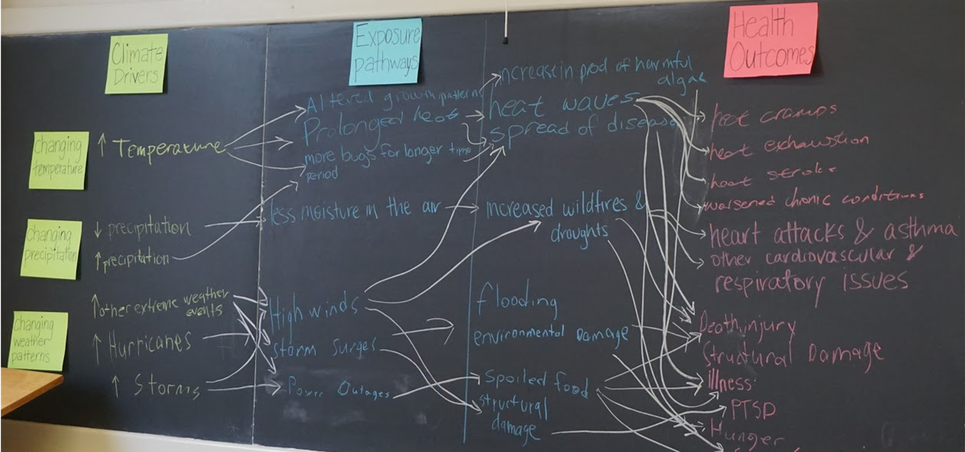
Climate change flow chart
Notes:
This lesson promotes systems thinking necessary to understand how climate change impacts human health.

Slide 11



Exposure pathway worksheet
Climate Driver
Exposure pathway
Health Outcomes
Increased AIR temperatures
Environmental Condition
Hazard
Decreased AIR temperatures
Changing Temperature
Increased WATER temperatures
Decreased WATER temperatures
Increased precipitation
Changing Precipitation
Decreased precipitation
Extreme weather events
Changing weather patterns
Changes in cloud cover, humidity, winds
Notes:
This could be printed as a worksheet for students to complete during explanation phase.

Slide 12
One Environmental Condition can lead to multiple health outcomes
Climate Driver
Exposure pathway
Health Outcomes
Increased AIR temperatures
Environmental Condition
Hazard
Decreased AIR temperatures
Changing Temperature
Increased WATER temperatures
Increased mold
Asthma & Allergies
Decreased WATER temperatures
High waters
Increase in nutrient runoff
Water-related Infection
Increased precipitation
Flooding
Changing Precipitation
Drowning & Injury
Decreased precipitation
Disruptions to infrastructure
Contaminated water
Food-related Infection
Extreme weather events
Changing weather patterns
One environmental condition can lead to multiple health outcomes
Stress-related disorders
Changes in cloud cover, humidity, winds
Notes:
One environmental condition can lead to multiple health outcomes

Slide 13
Sample model
Climate Driver
Exposure pathway
Health Outcomes
Prolonged exposure to heat
Heat-related illness and death
Elevated air temperature
Increased ground-level ozone
Increased AIR temperatures
Longer growing season
Increased particulate matter
Cardiovascular illness & death
Changing Temperature
Increased WATER temperatures
Increase in mold
Elevated water temperature
Asthma & Allergies; respiratory illness
Increase in nutrient runoff
Earlier spring
Increased precipitation
Water-related Infection
Changing Precipitation
Flooding
High waters
Drowning & Injury
Decreased precipitation
Increased dust
Drought
Increased pollen
Vector-borne Infection
Wildfires & smoke
Disruptions to infrastructure
Food-related Infection
Changing weather patterns
Extreme weather events
Hurricanes and storms
Expanded tick activity
Stress-related disorders
Increased growth of pathogens
Notes:
Sample model.

Slide 14

Climate Change| A Human Health Perspective
Climate Change
Δ Temperature
Human Health Effects
Δ Precipitation
Cardiovascular and respiratory illness
Heat related illness and death
Vector borne infection
Δ Humidity
Mental health and Stress-related disorders
Water-related infection
Weather-related injury and death
Food-related infection
Δ Weather patterns
Notes:
Visual model to summarize activity.

Slide 15
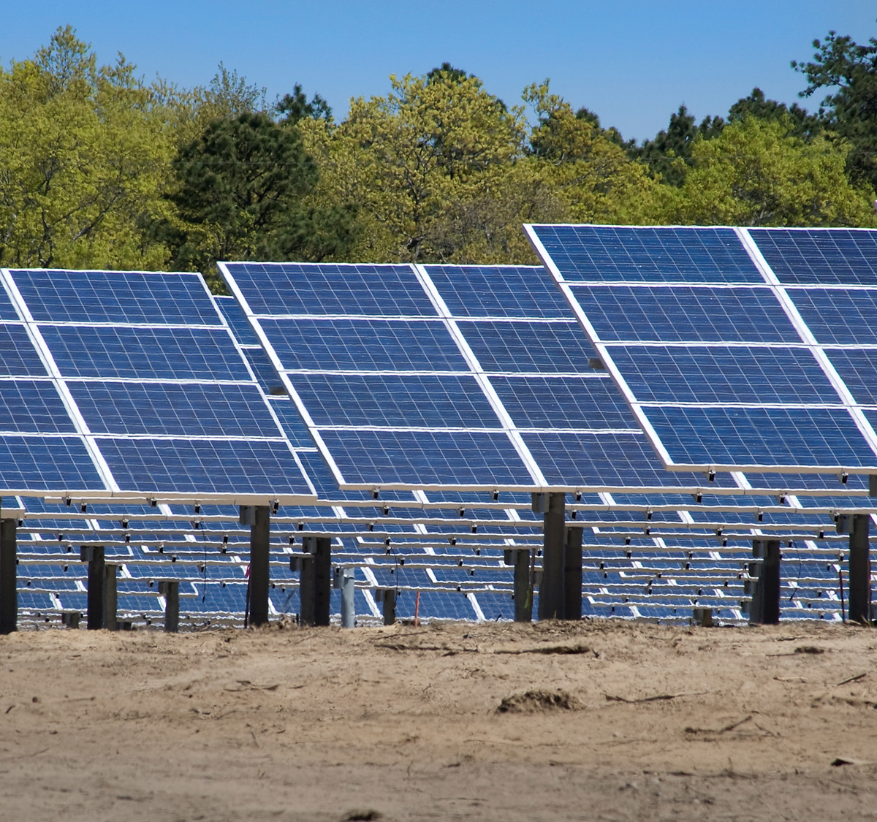
Mitigation strategies
Actions we can take to reduce the severity of climate change by reducing greenhouse gas emissions.
Notes:
https://www.bnl.gov/newsroom/news.php?a=11509

Slide 16
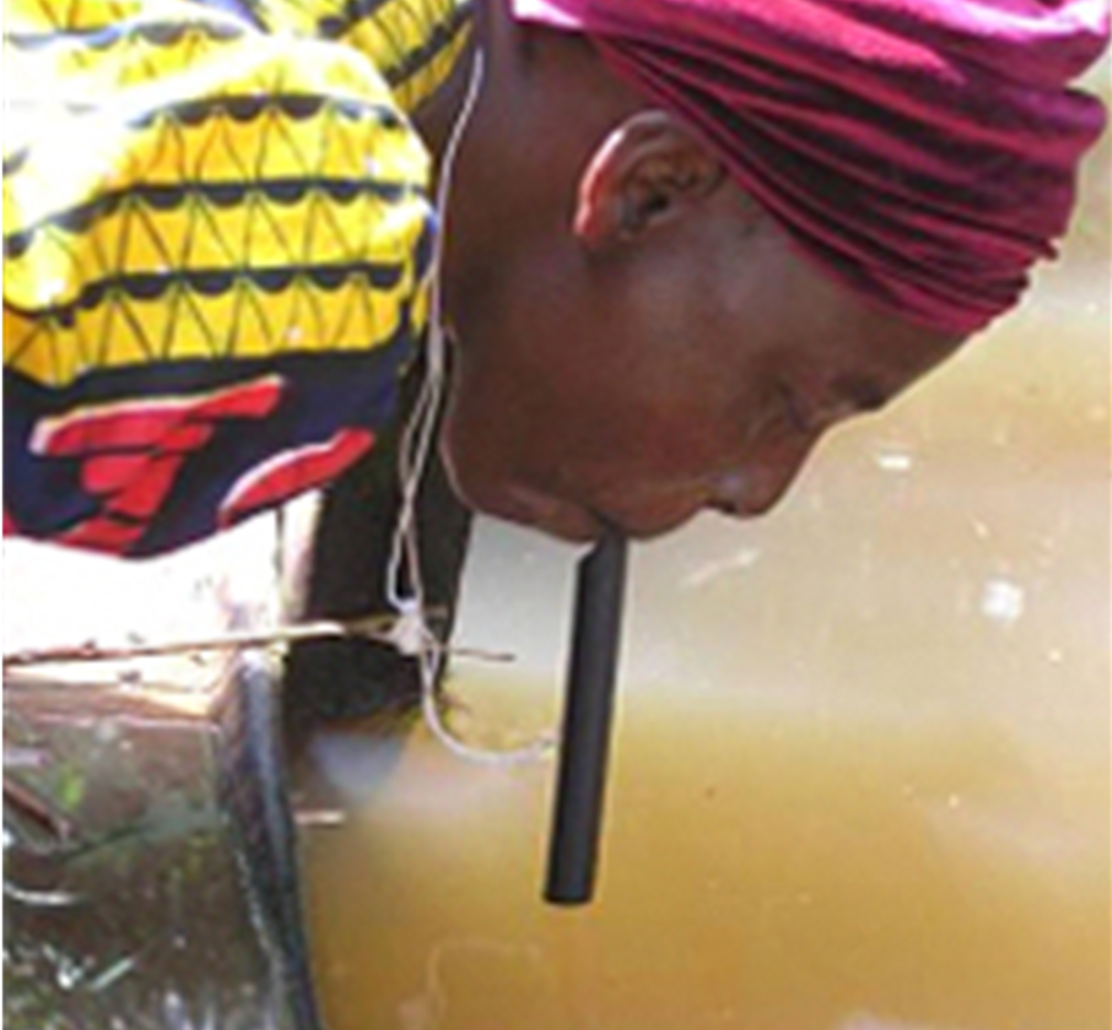
Adaptation strategies
Actions we can take to reduce our risk/vulnerability to climate impacts.
Notes:
http://www.cdc.gov/parasites/guineaworm/prevent.html

