Slide 1






NICHD and niehs present:
Training and REDCap Demonstration for the Implementation of NICHD’s common data element (CDE) Recommendations for COVID-19 Research in Pediatric, Pregnant, and Lactating Populations Published Through the NIEHS Disaster Research Response (dr2) Portal
November 1st, 2022
2:30 – 3:30 pm EST
PURPOSE
LOGISTICS
Understand the aim of NIH’s Pregnancy and Pediatric CDEs related to COVID-19/Post-Acute Sequelae of SARS-CoV-2 Infection (PASC) and how they were developed
Activities Include:
Live demonstration on DR2 and REDCap
Q&A with DR2 and CDE representatives
Become familiar with accessing CDEs via the Disaster Research Response Program (DR2) Website and REDCap
Registration:
Click Here for the Zoom Registration Attendee Link
Webinar ID: 960 3266 2934
Passcode: 440012
Inquiries To:
Areej Haroon, Deloitte
Email: arharoon@deloitte.com
Call to action for future use
WEBINAR WILL BEGIN IN: 15:00

Slide 2
Training and REDCap Demonstration for the Implementation of NICHD's CDE Recommendations for COVID-19 Research in Pediatric, Pregnant, and Lactating Populations Published Through the NIEHS Disaster Research Response (DR2) Portal

Slide 3
Agenda
1
Development of Pregnancy and Pediatric CDEs for COVID-19 and Post-Acute Sequelae of SARS-CoV-2 Infection (PASC)
2
Overview of NIH CDE Report Structure and Modifications
3
Accessing CDEs via the Disaster Research Response Program (DR2) Website and REDCap
4
Call to Action, Q&A, and Closing

Slide 4



Today’s Learning Objectives
 | Review the importance of data harmonization and the critical role of CDEs
 | Understand the aim of the NIH’s recommended Pregnancy and Pediatric COVID-19 and PASC CDE initiatives and how recommendations were developed
 | Become familiar with accessing the recommended CDEs on the DR2 platform

Slide 5

Diana W. Bianchi, M.D. Quote
“Common data elements are critical for providing consistency in the way we collect, describe, and analyze research data. Our hope is that these common elements are central to future COVID-19 studies.”
- Diana W. Bianchi, M.D. NICHD Director

Slide 6
Development of Pregnancy and Pediatric CDEs for COVID-19 and Post-Acute Sequelae of SARS-CoV-2 Infection (PASC)

Slide 7
COVID-19 Data Harmonization: NIH’s Deliberate Process
In the 2020-2021 timeframe, NIH led the development of biomedical, psychosocial, and biospecimen CDEs to promote data harmonization in pregnancy and pediatric research.
    Planned for data harmonization and future analyses combining datasets to address key research questions
    Used a modified Delphi approach to build consensus for data harmonization
    Engaged in a deliberate process from March 2020 to June 2021 that included the refinement and addition of CDEs, which reflect the increased scientific knowledge of SARS‑CoV‑2 and Post-Acute Sequelae of SARS-CoV-2 Infection disease manifestation, variants, and vaccine efforts

Slide 8



















Assembled Working Groups Comprised of Subject Matter Experts
NIH’s COVID-19 CDEs encompass the collective contributions of NIH ICO representatives, federal partners, NIH extramural and intramural investigators, and non-NIH funded studies from the relevant research community.
    90+ stakeholders in five working groups (WGs) across NIH, NIH-supported COVID-19 research studies, and three Federal agencies
    Participating NIH Institutes, Centers, and Offices (ICOs) included: NIEHS, NHLBI, NIAID, NICHD, NIDA, NIDDK, NIMH, NINDS, NLM, and OD
Global Network
GCSNeuroCOVID

Slide 9





Five Working Groups Contributed to Pregnancy and Pediatrics COVID-19 and PASC CDE Development
CDE Development
Pregnancy Working Groups
Biomedical
Psychosocial
Pediatric Working Groups
Biomedical
Psychosocial
Biospecimen

Slide 10
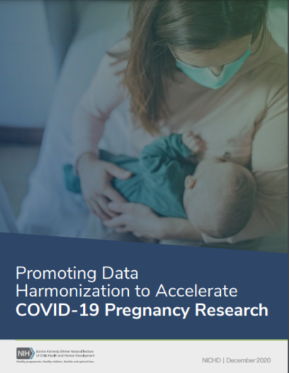
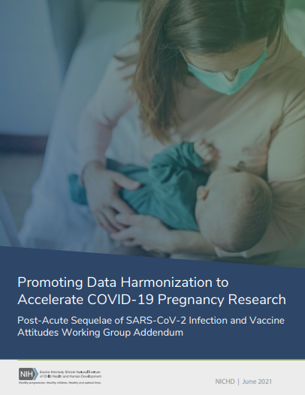
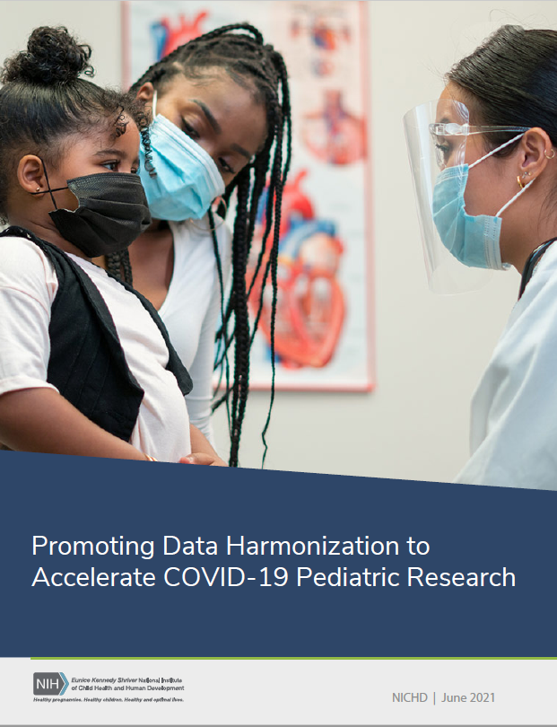
Pregnancy and Pediatrics CDE Reports
Recommended biomedical, psychosocial, and biospecimen CDEs are captured in three reports on the Disaster Research Response (DR2) Program website.
    COVID-19 Pregnancy Research Report
COVID-19 Pregnancy Research PASC and Vaccine Attitudes Addendum Report
    COVID-19 Pediatrics Research Report

Slide 11
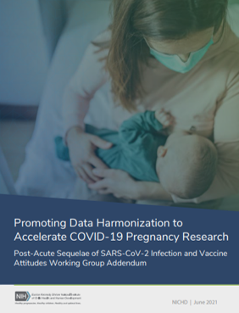
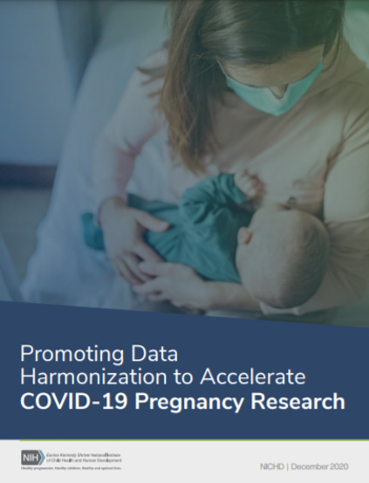

NICHD Common Data Elements: DR2 Web Analytics
Combined, our NICHD CDEs have received 1,377 views and 498 downloads since their publish date.
 | Report | Publication Date | Last Updated | Page Views since Publication | Downloads
 | COVID-19 Pregnancy Research Report | March 30, 2021 | August 2022 | 497 | 66
 | COVID-19 Pregnancy Research PASC and Vaccine Attitudes Addendum Report | November 29, 2021 | August 2022 | 329 | 123
 | COVID-19 Pediatrics Research Report | November 24, 2021 | August 2022 | 551 | 309
*Downloads and page views include multiple instances from the same user

Slide 12
Overview of CDE Structure

Slide 13
Tier 1 & Tier 2 Recommendations
TIER 1
All COVID-19 Studies
Baseline CDEs for any study related to COVID-19 and/or PASC that may include either:
Pregnant participants, postpartum participants, or participants of reproductive age
Pediatric populations
TIER 2
Population-Specific Studies
More detailed CDEs for any study related to COVID-19 and/or PASC that focus on either:
Pregnant participants, postpartum participants, or participants of reproductive age
Pediatric populations
Note: Tier 2 CDEs may pose additional participant or investigator burden that may not be feasible for all studies.

Slide 14
Subject Area, Domains, Concepts, & Elements
CDE Structure
Example
Subject Area
The overarching content areas (i.e., biomedical, psychosocial, biospecimen) comprised of domain groupings
Psychosocial
Domain
A categorical grouping of concepts within the biomedical, psychosocial, biospecimen subject areas
Socioeconomic Status
Concept
The construct that CDEs are designed to measure
Household Crowding
CDE
A standardized, precisely defined question that is paired with a set of specific allowable responses
How many total people (adults and children) currently live in your household, including yourself?

Slide 15
Pregnancy CDE Domains
WGs recommended data elements across biomedical, psychosocial, and biospecimen domains.
13 Biomedical and Psychosocial COVID-19 Domains
Biomedical
  Baseline Maternal/Pregnancy Characteristics
  Maternal COVID-19 Treatment
  Maternal Outcomes
  Obstetric/Pregnancy Outcomes
  Neonatal Characteristics
  Neonatal COVID-19 Testing
  Early Neonatal Outcomes
Psychosocial
  Socioeconomic Status, Housing, and Emergent Financial Strain
  Medical Care
  Impact on Parenting
  Stressful Life Events
  Maternal Mental Health
  Health Related Behaviors
10 Biomedical and Psychosocial PASC and Vaccine Attitudes Domains
Biomedical
  COVID-19 Vaccination History
  Vaccine Attitudes
  Postpartum
  Family Planning
Psychosocial
  Pregnancy and Postpartum Function
  Infant Care Practices
  Childcare and Education
  Attribution of Symptoms
  Domestic Violence
  Access to Care
4 Biospecimen COVID-19 and PASC Domains
Biospecimen
  Biospecimens (Neonate)
  Biospecimens (Maternal)
  Extended Specimen Collection (Maternal)
  Maternal

Slide 16
Pediatrics CDE Domains
WGs recommended data elements across biomedical, psychosocial, and biospecimen domains.
8 Biomedical COVID-19 and PASC Domains
Biomedical
  Baseline Child Health
  Manifestations: Clinical
  Manifestations: Laboratory
  Manifestations: Cardiopulmonary Diagnostic Assessment
  Manifestations: Imaging
  Diagnosis
  Treatment
  Outcomes
10 Psychosocial COVID-19 and PASC Domains
Psychosocial
  Community, Family, and Peer Factors
  Social Media/Screen Time
  Well-being Factors
  COVID-19 Stress and Worry
  COVID-19 Attitudes, Behaviors, and Experiences
  Health-related Behaviors
  Mental and Behavioral Health
  Health Care
3 Shared COVID-19 and PASC Domains
Shared Biomedical and Psychosocial
  Demographics
  Disability/Functional Status
  Underlying Health Conditions/Health History Prior to Pandemic

Slide 17


Modifications
As our understanding changes, further CDEs and/or modifications to existing recommended measures may be needed.
Changing question stem of non-validated CDEs while maintaining the current purpose of the question
Adding in a response item due to increasing knowledge of disease manifestation when answer choices are not formatted in a Likert scale
Changing question stem of CDEs that are part of a validated measure
Making substantive changes to question stem and/or altering the purpose of the question
Changing the timeframe referenced in the question
Removing a specific response item

Slide 18
Examples of CDE Amendments as our Understanding of the Current Pandemic Continues to Evolve
Sample Pregnancy Biomedical CDE
Sample Pregnancy Psychosocial CDE
Mark Yes/No/Unknown to denote if the patient received any of the following COVID-19 treatments
In the past 7 days, I have been able to laugh and see the funny things:
Oseltamivir
Hydroxychloroquine/chloroquine therapy
Remdesivir
Azithromycin
Convalescent Plasma
[New Treatment Option]
As much as I always could
Not quite so much now
Definitely not so much now
Not at all Other
Removing the time frame or changing it from “7 days” to “few days,” “14 days,” etc.
Removing “Not at all,” an existing answer item
Adding “Other” as a response option when the answers are presented in a Likert Scale
Changing the question stem in a way that removes the purpose. For example, “In the past 7 days, I have connected with family and friends:”
Adding a response item as treatment options for COVID-19 evolve
Changing the question stem to “Did the patient receive any of the listed COVID-19 treatments?”

Slide 19
Accessing CDEs via the Disaster Research Response Program (DR2) Website and REDCap

Slide 20



DR2 Hosts NIH COVID-19 Data Collection/Survey Instruments
The Disaster Research Response (DR2) Program provides training, funding, and a resource portal of tools to empower research in response to disasters and public health emergencies
ACCESS
Access rapidly evolving survey items by researchers
> 145 COVID-19 surveys currently online
New electronic intake processes, search engines, metadata, and comparison tools
COMPARE
Compare across datasets and studies, further data integration, and collaborations
> 15,000 new users
APPLY
Apply to NIH funding opportunities recommending the use of DR2 COVID-19 CDE collections

Slide 21

CDEs Live on DR2 via REDCap
Several NIH institutes (including NICHD), CDC, and more than a dozen state health departments in the U.S. are using REDCap for COVID-19 symptom tracking and monitoring
ACCESS
    REDCap is a web-based data-entry and collection application
CAPTURE
It is used to capture data for clinical research and create databases and projects
Databases employ easy-to-use instruments (e.g., surveys, forms) as research capture tools
SECURE
REDCap is designed to store highly sensitive information
Health Insurance Portability and Accountability Act (HIPAA) compliant

Slide 22


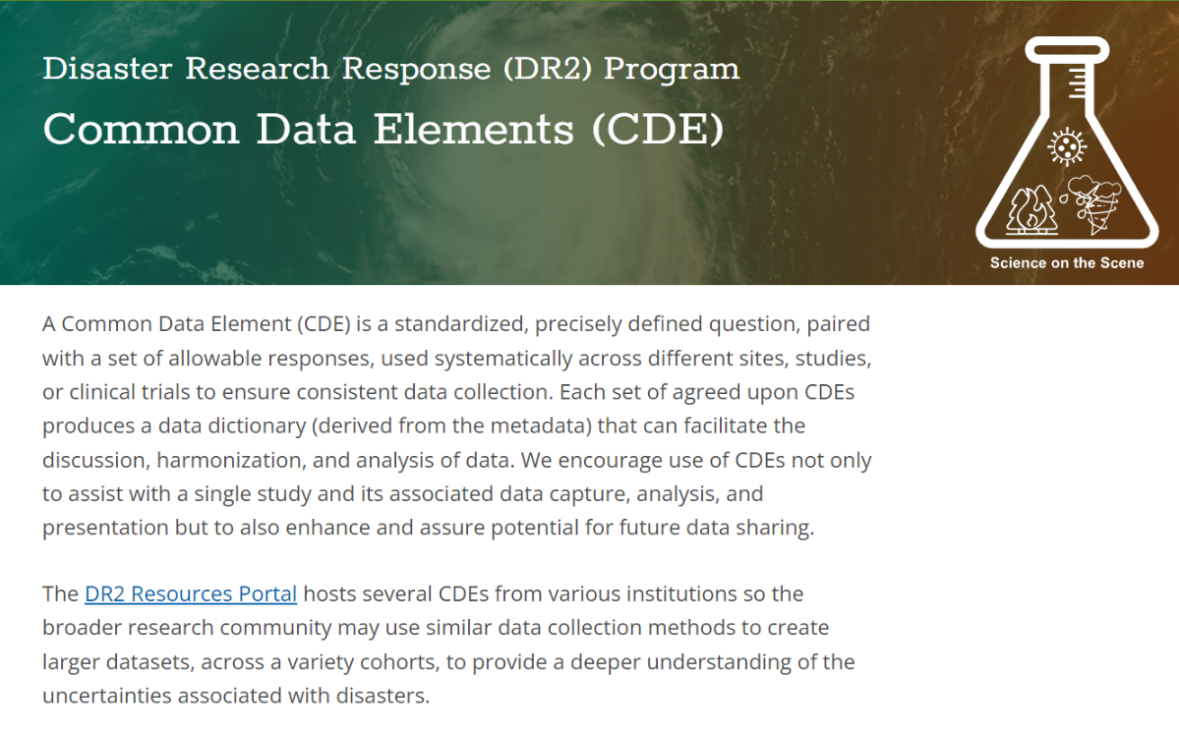
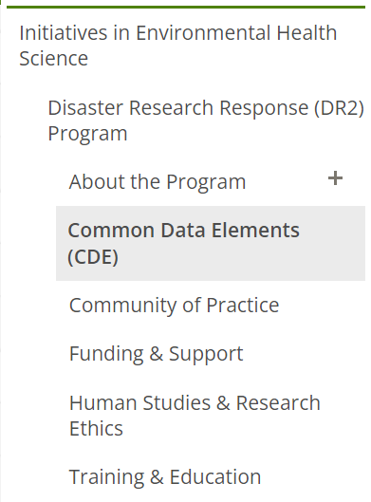
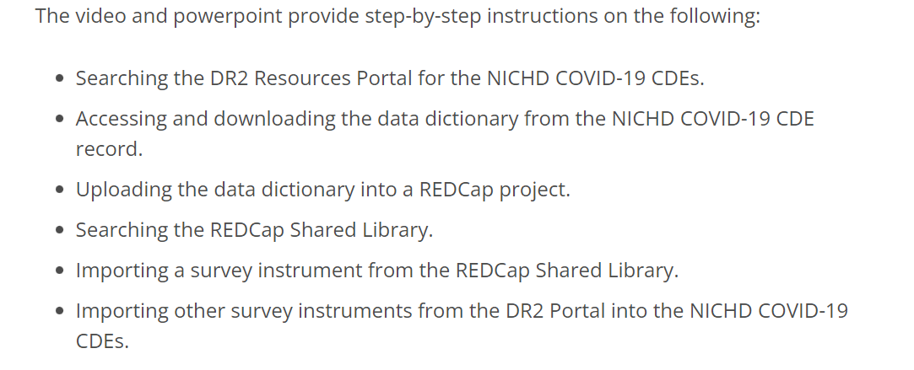
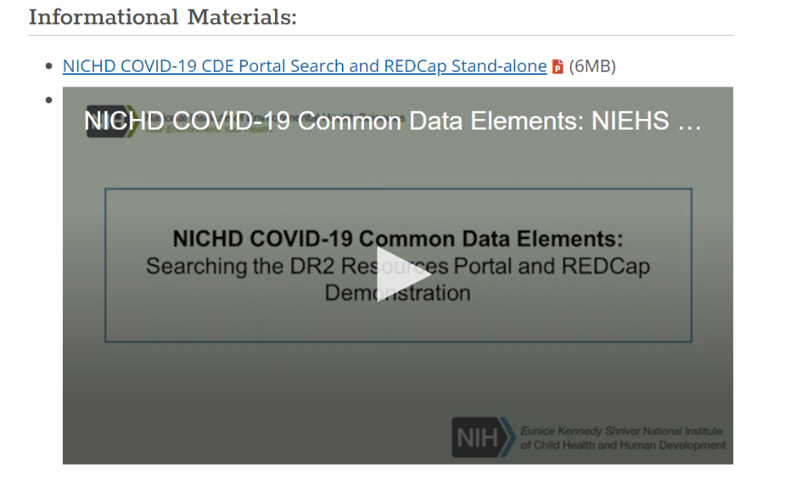
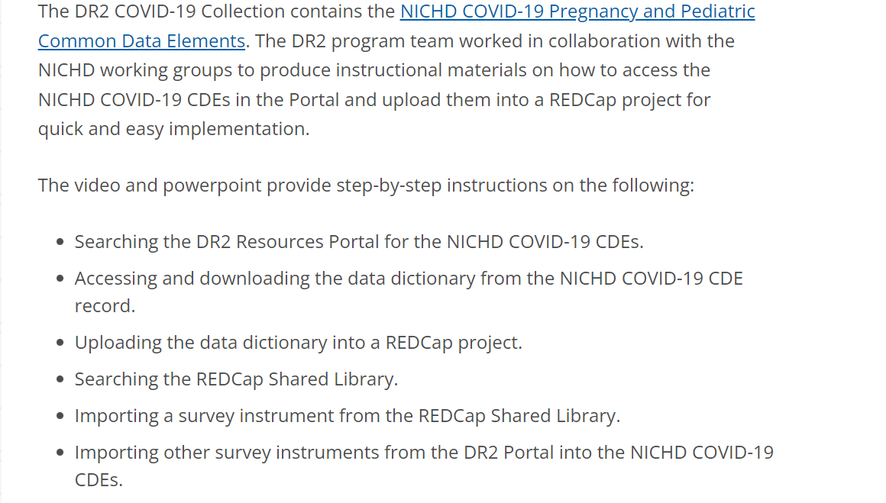
DEMO: DR2

Slide 23
Call to Action

Slide 24
A Call to Action
Review
  Review the full set of recommended pregnancy and pediatrics CDEs:
    Promoting Data Harmonization to Accelerate COVID-19 Pregnancy Research
    Post-Acute Sequelae of SARS-CoV-2 Infection and Vaccine Attitudes Addendum
    Promoting Data Harmonization to Accelerate COVID-19 Pediatric Research
Incorporate
Review the DR2 CDE Webpage including a DR2 and REDCap Demo Video:
    Disaster Research Response (DR2) Program: Common Data Elements (CDE)
  Incorporate the recommended CDEs to streamline and harmonize data when planning new studies or continuing ongoing studies
    Use of CDEs is voluntary and not required to receive NIH funding
Share
  Share these recommendations across your research communities to further promote data harmonization

Slide 25
Contributors

Slide 26
Pregnancy Working Group Membership
Biomedical Working Group
Psychosocial Working Group
Biospecimen Working Group
Nahida Chakhtoura, NICHD
Sai Majji, NICHD
Monica Longo, NICHD
Katie Grantz, NICHD (SPAN)
Jessica Gleason, NICHD (SPAN)
Rebecca Hommer, NINDS
Sonia Arteaga, ECHO
Michelle Freund, NIDA (HBCD)
Chloe Jordan, NIDA (HBCD)
Luis Pacheco, UTMB (MFMU)
George Saade, UTMB (MFMU)
Torri Metz, Univ. of Utah (MFMU)
Renee Browning, NIAID
Robert Goldenberg, Columbia (Global Network)
Sharon Nachman, Stonybrook (IMPAACT)
Suzanne Gilboa, CDC
Kate Powis, Harvard University (PHACS)
Kunjal Patel, Harvard University (PHACS)
Caroline Signore, NICHD
Stephen Gilman, NICHD (Enriched)
Denise Haynie, NICHD (Enriched)
Roz King, NICHD
Elena Gorodetsky, ORWH
Diane Putnick, NICHD (SPAN)
Rebecca Hommer, NINDS
Sonia Arteaga, ECHO
Samantha Calabrese, NICHD
Michelle Freund, NIDA (HBCD)
Chloe Jordan, NIDA (HBCD)
Kara Rood, (MFMU)
Elaine Abrams, Columbia (IMPAACT)
Kathryn Adams, NICHD
Deborah Kacanek, Harvard University (PHACS)
Kathleen Malee, Northwestern University (PHACS)
Sarah Saleem, Aga Khan University Pakistan (Global Network)
Caroline Signore, NICHD
Jessica Gleason, NICHD
Nahida Chakhtoura, NICHD
Andrea Edlow, Harvard Medical School
Drucilla Roberts, Harvard Medical School
Roberto Romero, NICHD
Fasil Tekola Ayela, NICHD
Samantha Calabrese, NICHD
Torri Metz, Univ. of Utah (MFMU)
Kate Powis, Harvard Medical School

Slide 27
Pediatrics Working Group Membership
Psychosocial Working Group​
Biomedical Working Group
Shelli Avenevoli, NIMH
Bob Tamburro, NICHD
Brett Miller, NICHD
Christina Park, NIH OD (ECHO)
Courtney K. Blackwell, Northwestern University (ECHO)
Dara Blachman-Demner, NIH OD OBSSR
Elizabeth A. Hoffman, NIDA (ABCD Study®)
Emilia (Emily) Koumans, CDC
Emily D’ Agostino, Duke University (RADxUP)
Ericka L. Fink, UPMC Children’s Hospital of Pittsburgh (GCS NeuroCOVID)†
Jenae M. Neiderhiser, Penn State University (ECHO)
Jon (Mike) Underwood, CDC
Kaja LeWinn, University of California San Francisco (ECHO)
Lawrence Kleinman, Robert Wood Johnson Medical School (PreVAIL kIds)
Layla Esposito, NICHD
Michael Kogan, HRSA (NSCH)
Rebecca Hommer, NINDS
Rosalind King, NICHD
Samantha Calabrese, NICHD
Sharon Saydah, CDC
Aruna Natarajan, NHLBI
Bob Tamburro, NICHD
Allison Heath, Children’s Hospital of Philadelphia
Ananth Annapragada, Baylor College of Medicine (PreVAIL kIds)
Andrew Atz, Medical University of South Carolina (ECHO, CARING for Children)
Angela Campbell, CDC
Audrey Odom John, Children’s Hospital of Philadelphia (PreVAIL kIds)
Bill Kapogiannis, NICHD (PreVAIL kIds)
Chi Hornick, Duke Pediatric Critical Care Clinical Research (CARING for Children)
Gabriela Maron, St. Jude Children’s Research Hospital (Pediatric COVID-19 U.S. Registry)
Gina Montealegre, NIAID
Hannah Calkins, Children’s Hospital of Pennsylvania
Katherine Herbst, Connecticut Children’s Medical Center (PreVAIL kIds)
Liz Amos, NLM
Mary Beth Son, Boston Children’s Hospital
Matthew Oster, Children’s Healthcare of Atlanta, Emory University School of Medicine, CDC (CARING for Children)
Michael Cabana, Albert Einstein College of Medicine†
Nina Schor, NINDS
Perdita Taylor-Zapata, NICHD (CARING for Children)
Ravinder Anand, The Emmes Company, LLC (CARING for Children)
Sai Majji, NICHD (PreVAIL kIds)
Steve Webber, Vanderbilt University Medical Center (CARING for Children)
Tellen D. Bennett, University of Colorado School of Medicine (N3C)
Usha Sethuraman, Children’s Hospital of Michigan, Central Michigan University (PreVAIL kIds)
Voula Osganian, NIDDK

Slide 28
Q&A

Slide 29
Thank You

Slide 30
Appendix

Slide 31
Pregnancy CDE Success Stories
NICHD NOSI Investigating COVID-19 Vaccination and Menstruation
Extramural NOSI awardees at Harvard, John’s Hopkins, and Michigan State University are using biomedical PASC CDEs to study the effects of COVID-19 vaccinations on menstruation
NHLBI nuMOM2b Heart Health Studies
The nuMOM2b Heart Health Studies are studying first-time pregnant women to understand how pregnancy outcomes are linked to future heart health using recommended pregnancy CDEs
Pregnancy Common Data Elements
NYU-NIH NeuroCOVID Project
The COVID-19 Neuro DataBank Biobank (The NeuroCOVID Project) is studying neurological complications of COVID-19 using the biomedical pregnancy CDEs
Researching COVID to Enhance Recovery (RECOVER) Initiative
RECOVER seeks to understand, prevent, and treat Post Acute Sequelae of SARS-CoV-2 Infection

Slide 32
Pediatrics CDE Success Stories
NICHD Post-Intensive Care Syndrome - Pediatrics (PICS-p): Longitudinal Cohort Study
PICS-p is a multicentered study of post-intensive care syndrome in children evaluating child and family outcomes over two years post PICU discharge
Pediatric Common Data Elements
NHLBI The PRone and OScillation Pediatric Clinical Trial (PROSpect)
The PROSpect Study is a multicentered trial assessing the value of high frequency oscillatory ventilation and prone positioning in children with severe lung disease
Researching COVID to Enhance Recovery (RECOVER) Initiative
RECOVER seeks to understand, prevent, and treat Post Acute Sequelae of SARS-CoV-2 Infection
Notes:
Include HRSA

