Slide 1
Interviewing
Interviewing
Tips to succeed
Ted Benson
Managing Partner
Your Market Differentiator is Human Potential: Realize It.

Slide 2
Agenda
This moment, Ted & his company
Objectives, red text, and BFOs
Why does a manager hire?
The goal of an interview
Candidates: Apearance vs Reality
Types of interviews
The 4 A‘s of A-players
Your needs
Questions and discussion!

Slide 3
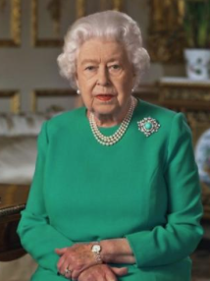
This Moment
"I hope in the years to come everyone will be able to take pride in how they responded to this challenge… with self-discipline, quiet good-humored resolve and fellow-feeling…
We join with all nations across the globe in a common endeavour, using the great advances of science and our instinctive compassion to heal. We will succeed - and that success will belong to every one of us."
Queen Elizabeth II
of the United Kingdom

Slide 4
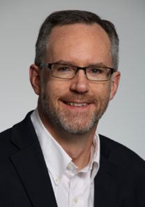
Ted Benson
Education & Research
Biotech & Biopharma
Helping teams succeed for over 25 years

Slide 5
About Corralling Chaos, LLC
We are management consultants.
We equip teams with practical skills and tools to…
Align culture and behavior to mission, vision and values
Increase retention and productivity
Develop potential leaders

Slide 6
Objectives
Objectives
At the conclusion of this webinar, you will:
Understand the motivation and purpose of an interview
Know how to prepare for, conduct and follow-up that conversation
Be aware of at least one thing you will do differently
Notes:
Use active listening skills to identify deeper emotions

Slide 7
Share your thoughts
When you see this red text, please share your thoughts in the chat!

Slide 8
A Blinding Flash of the Obvious
What will you stop or start doing?
Notes:
Oh, the places you’ll go!

Slide 9
Interviews can be bleak interrogations
Interviews can be bleak interrogations…

Slide 10
Or constructive conversations
… or constructive conversations.
You help make the choice.

Slide 11
Why does a manager need to hire?
Pain: The candidate can save the company value
Opportunity: The candidate can create new company value
Bottom line: The manger needs to see your value to the company

Slide 12
So the goal of an interview is …
Please share: What do you think…?

Slide 13
Trust
Elvis Costello: “Trust”

Slide 14
And how do you create trust?
Please share: Your thoughts…?

Slide 15
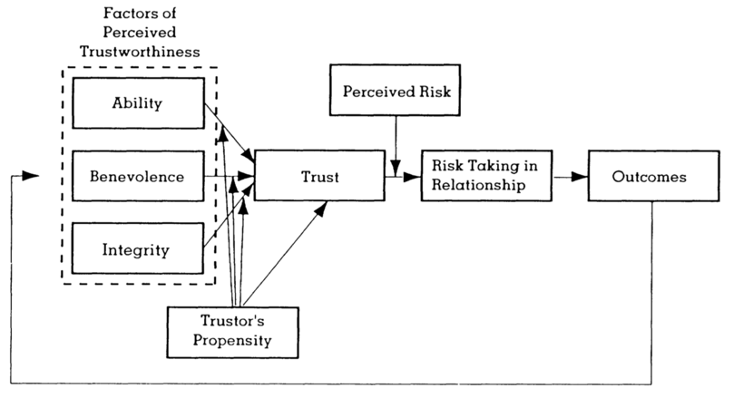
How to create trust: show …
Mayer, Davis, Schoorman 1995

Slide 16
Candidates: Appearance vs Reality
Candidates: Appearance vs Reality
Reality
 | True + | False -
Positive + | TP ++ | FP +-
Negative - | TN -+ | FN --
Appearance
Managers want to hire true positives
… and avoid false positives

Slide 17
Interview Formats
1:1
HR
Team
Please share: Which do you find most challenging?

Slide 18
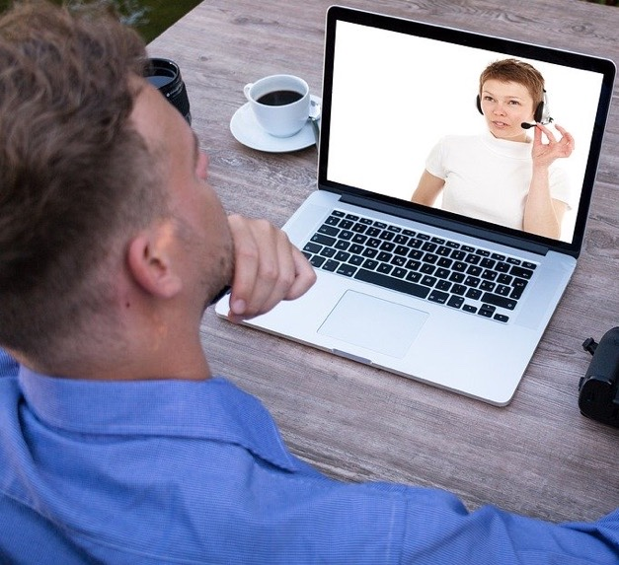
Remote interviews
Video call
Quiet space, no interruptions
Natural lighting on face, calm background
Confirm video and audio set up
Can clearly see and hear each other
Know how to reconnect if needed
Positive visual impact
Business casual clothing, friendly
Smile & look at them!

Slide 19
Key qualities assessed
Key qualities assessed
Skills: What – technical + communication
Ability
Behavior: How – “Tell me about a time you...“
STAR: Situation, Task, Action, Result
Adaptability, problem-solving
Benevolence/good intent
”Tell me about your most significant accomplishment”
Cultural: Why – values/qualities
Demeanor: calm, enthusiastic, serious, fun... Integrity

Slide 20
A-player attributes
A-player attributes
Appearance: Professional dress, open body language, eye contact
Ability: Qualified, credible, responsible, results
Authenticity: Integrity, benevolence, trustworthiness
Awareness: Company mission, values, needs
Please share: Which of these is the trickiest to demonstrate?

Slide 21
Your needs, your fit
Your needs, your fit
Interview to find a good fit – for you!
What you want to ask
What you want to do
Your strengths/areas for growth
Reaction: how the manager responded
Structured vs unstructured interview
Please share: Have you said “no thanks”?

Slide 22
Two action items
Two action items
1. Define 4 STAR stories, write each on a 3x5 index card
2. PRACTICE!

Slide 23
Summary
Summary
Why: VALUE
How: TRUST
Types & components
The 4 A’s:
Appearance
Ability
Authenticity
Awareness
Your needs
Tell them you’re interested

Slide 24
It all adds up...
Good fit for you
Good fit for employer
Good outcome for others

Slide 25
A Blinding Flash of the Obvious
What will you stop or start doing?
Notes:
Oh, the places you’ll go!

Slide 26
Questions?

Slide 27
Goodbye
https://www.linkedin.com/in/tedbenson/
Free content: www.corrallingchaos.com
All text and logo Copyright 2020 by Corralling Chaos, LLC

