Slide 1
Slides and presentation notes for Metrics Manual Training
The National Institute of Environmental Health Sciences (NIEHS) has developed online training materials to help grantees and others learn about developing logic models and evaluation metrics for activities conducted in the Partnerships for Environmental Public Health program (http://www.niehs.nih.gov/pephmetrics).
These materials are available to all who wish to download them. This set of slides and presentation notes can be used verbatim during the workshop, or you can tailor them as you wish.
Additional materials developed include an Instructor Guidance document (http://go.usa.gov/YckR) and Participant Handouts (http://go.usa.gov/YckW) for the workshop.
Notes:
See instructor handouts for details about what to bring, how to set up the room, how to prepare, etc.
These slides provide cues about distributing materials, etc.

Slide 2

PEPH Evaluation Metrics Manual Training Workshop
Welcome!
Please take Handout A and the Self-Evaluation form.
Fill out the top part of the Self-Evaluation.
Notes:
You can show this slide on the screen as participants are entering the room as a reminder to do the initial tasks
Have Handout A and the Self-Evaluation forms at the registration desk.

Slide 3

PEPH Evaluation Metrics Manual
Training Workshop
Christie Drew, Ph.D.
National Institute of Environmental Health Sciences (NIEHS)
Kristi Pettibone, Ph.D.
National Institute of Environmental Health Sciences (NIEHS)
This training was developed by the NIEHS as a companion to the PEPH Evaluation Metrics Manual.
Last updated: August 29, 2012
Notes:
Feel free to add your name(s) here; adapted by… etc.

Slide 4
Schedule
Note to Presenter: Edit this slide with real times for your workshop! For the 90-minute session, we recommend:
Introduction and Overview of Logic Models – 15 minutes
Introduction to Case Study – 10 minutes
Developing Logic Models / Small Groups – 20 minutes
Developing Metrics / Working with a Partner – 25 minutes
Discussion: Metrics and Data – 10 minutes
Wrap-up/Questions – 10 minutes
Notes:
This slide set was designed with a 90 minute training session in mind. However, with more time for discussion, this could easily be adapted to a 3 hour training session.
For the 90 min session, we recommend:
Introduction and Overview of Logic Model – 15 min
Introduction to Case Study – 10 min
Developing Logic Models/small groups – 20 min
Developing Metrics/ work with a partner – 25 min
Discussion: Metrics and Data – 10
Wrap Up/Questions – 10 min

Slide 5
Introductions
Show of hands:
Academic partners?
Community partners?
Evaluators?
Previous experience with the Manual?
Previous experience with logic models?
Notes:
Welcome everyone.
Make sure everyone has the evaluation form and Handout A.
Ask for a show of hands around these questions so you can get a sense of who you are talking to.

Slide 6
Purpose of Training Workshop
  Disclaimer: This workshop provides hands-on training with Evaluation Metrics Manual tools. It is not intended as a full evaluation course.
  Introduce Evaluation Metrics Manual
  Provide hands-on experience with Manual tools
  Demonstrate the utility of Manual tools
  Get feedback on training tools
Notes:
Review the purpose of the workshop. Add personal context if relevant.

Slide 7

National Institute of Environmental Health Sciences
NIEHS Mission: understand how the environment influences the development and progression of human disease
The Division of Extramural Research and Training (DERT) funds a broad portfolio of research across the country and abroad.
The Program Analysis Branch (PAB):
  Evaluation, Tools, Communication
  NIEHS Website: http://www.niehs.nih.gov/
Notes:
Introduce NIEHS. We are one of the 27 Institutes and Centers that make up the National Institutes of Health
In addition to the internal research conducted at NIEHS, the Institute funds external researchers through its Division of Extramural Research and Training (DERT). Within DERT, the Program Analysis Branch provides independent evaluation and analysis of programs within DERT as well as categorizing and coding grants and applications.
The PEPH Manual was developed in DERT under the leadership of the Program Analysis Branch.

Slide 8
Partnerships for Environmental
Public Health (PEPH)
The PEPH network promotes interaction among grantees doing community-based work.
    -Partnerships, Communication, Capacity Building
Program “re-created” in 2008
    -Building upon a long history
Grantees asked for help showing progress
    -Lack of published papers
Notes:
Introduce the PEPH Program… Ask participants if they know about the PEPH program. Depending on their familiarity and the time available, spend more/ less time on this slide.
PEPH program was created in 2008 to promote greater interaction amongst grantees with an environmental public health focus
PEPH program brings together scientists, community members, educators, health care providers, public health officials and policy makers in the shared goal of enhancing the impact of environmental public health research at all levels
Grantees reported challenges in evaluating and documenting achievements related to building community partnerships and to other translation and outreach components of their programs
The PEPH Evaluation Metrics Manual was developed in response to help grantees think about developing evaluation metrics. Discussed further on the next slide.

Slide 9

Evaluation Metrics Manual Purpose
  Demonstrate how a systematic analysis of program activities, outputs, and impacts can lead to meaningful evaluation metrics
  Establish a common language for evaluation
  Make evaluation more accessible
  Intended audience:
    PEPH grantees and program staff
    Groups interested in measuring
    environmental public health activities
http://www.niehs.nih.gov/pephmetrics/
Notes:
Introduce the PEPH Evaluation Metrics Manual:
Key Messages:
Provides approaches for grantees to measure their success.
Provides models and real-world examples.
Is specifically tailored for environmental public health research.

Slide 10
Themes Addressed in the Manual
  Partnerships
  Leveraging
  Products and Dissemination
  Education and Training
  Capacity Building
How do you measure progress or achievement in these areas?
Our approach: Goal-based Logic Models
Notes:
We gathered information for this manual by reviewing grantee materials and websites together with PEPH program documents, and published literature. We also conducted interviews with grantees and consulted program staff and other experts in the field of evaluation and environmental public health. Through these activities we identified five cross-cutting program areas and dedicated one chapter to each area: Partnerships, Leveraging, Products and Dissemination, Education and Training, and Capacity Building. In addition to a sample logic model, each chapter includes examples of Metrics in Action that illustrate real-world PEPH programs. There is also a chapter on Evaluation for those who want to learn more, as well as Appendices that contain the methodology, more resources, and a complete bibliography.
We have said that it can be difficult to measure achievements in these areas using traditional bibliometrics. Our approach is to use Goal-based Logic Models. Using the goals of your project as the basis for development of your logic model will allow you to better understand how the parts of your project fit together toward achieving those goals.

Slide 11
Why evaluate?
Notes:
Transition slide… opportunity to ask participants why they have evaluated projects in the past… or why they might want to evaluate now.

Slide 12
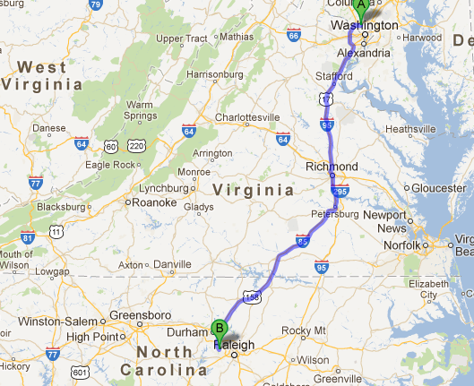
Why evaluate?
Better project design
Improved outcomes
Stronger partnerships
More effective data collection
Continuous improvement loop
Ability to replicate programs
You have to know where you are going before you figure out how to get there!
Notes:
Creating a program logic model and evaluation metrics before you begin a project can serve as a map for the research. It will help you maximize your resources and more efficiently obtain the results you’re after. Again, goal-based logic models and metrics.

Slide 13
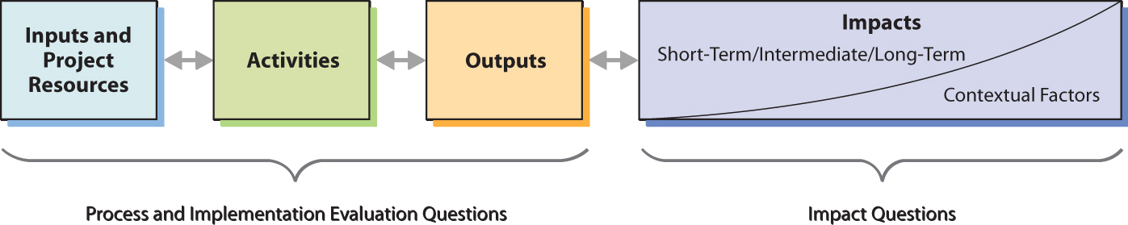
Logic Models
Logic Model – organized, project-specific, informs metrics
  Inputs – resources available
  Activities – actions that use available resources
  Outputs – direct products of activities
  Impacts – benefits or changes resulting from activities, outputs
Notes:
In order to evaluate a program, it is helpful to understand the expected goals and the activities that will help achieve those goals. Developing program logic models is one way to illustrate systematically how the parts of a program interact to achieve program goals or impacts.
Activities are verbs – they are the actions you take to get to your goals.
Outputs are nouns – they are tangible products you create through your activities.
Impacts are nouns – they are benefits or behavior changes resulting from activities or outputs. Impacts may be short, medium, or long term.

Slide 14
Logic Models (continued)
Generally, logic models include inputs, context, etc.
Relationships can exist among all components (arrows).
Manual’s logic models are linear (for simplicity).
Lots of ways to draw them – no right graphic.
Notes:
The Manual doesn’t include inputs in the example logic models for simplicity and because inputs tend to be consistent across programs.
Every aspect of a logic model is measurable.
Each of the 5 themes in the Manual (partnerships, leveraging, products and dissemination, education and training, and capacity building) has its own logic model. All the logic models from the Manual are provided in Handout A.
Detail: In general, the logic models used in the Manual show an increasing level of maturity from left to right and from top to bottom. This design should ensure that all grantees, regardless of experience or capacity, can find activities, outputs, or impacts relevant to their program. Grantees should also keep in mind that the actual implementation of a project may affect the implementation of activities that occur later in the project.

Slide 15
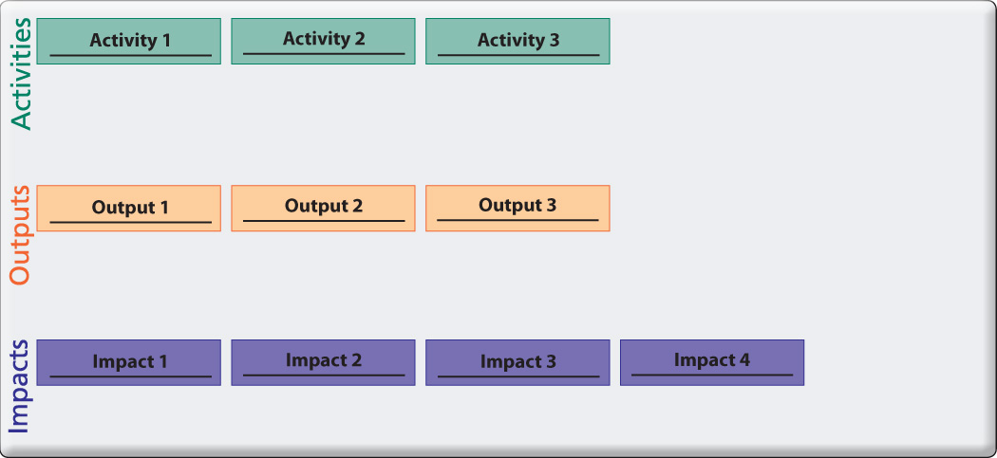
Logic Model Template
Notes:
This is the basic template that we use for a logic model in the manual.
Although we don’t include arrows and contextual factors here, you will want to make sure that you and your partners discuss them.
It’s important that you and your partners agree about the logic model you create; try not to get caught up in whether what you put in each box matches what is in our template. You and your partners need to focus on what is useful to you.
There are multiple ways to fill in the boxes of the logic model. You don’t always have to start with activities. Many people prefer to start with the impacts they want to achieve and work backwards from there. Do what works best for you.

Slide 16
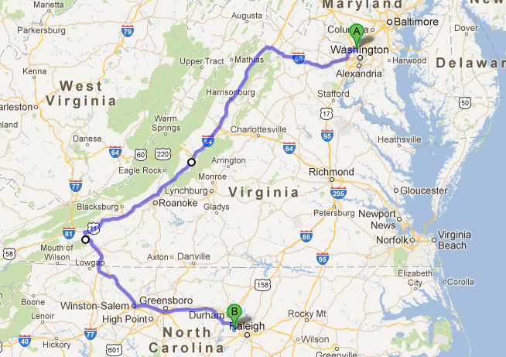
Lots of different ways to get to an impact and contextual factors will impact your route!
Notes:
Good logic models are dynamic. You should periodically revisit them to update based on the progress you’ve made. Often impacts will feed back into new activities, etc. Revisiting them can also help you to keep from taking your project in an unproductive direction.

Slide 17
Questions
Questions about logic models or the manual?
Handout A contains the Manual logic models, as well as the template for your reference.

Slide 18
Click on a Case Study to view:
Goods Movement
Encuentros Network
Cincinnati Anti-Idling Campaign
Notes:
In the next part of this discussion, we will be working in small groups with ideas from a case study to create logic model components and metrics. So we want to spend a little time providing background on this case. Much of this is repetitive of what is in Handout A. We’ve provided this as additional reference for you.
NIEHS created three case studies that we could use for this workshop… we’ll be focused on… CLICK YOUR CHOICE -
Presenter: You can leave all three case studies here - each one has all the remaining slides in it for the presentation. Or you can remove the links and slides for the case studies that you do not want to highlight here.

Slide 19
Goods Movement Case Intro
Goods – commercial products or raw materials transported globally in pursuit of trade/commerce
Goods Movement –the flow of global trade goods through ports, trucks, trains, warehouses and stores
40% of imported goods flow into the United States through ports in Los Angeles and Long Beach, California
  Case Study Acknowledgement: University of Southern California Environmental Health Sciences Core Center, Community Outreach and Engagement Core
  Photo credit: Andrea Hricko, Port of Los Angeles
Notes:
Go over these slides quickly – letting the participants know that all this material is covered in Handout A and you will answer questions after the overview.
Acknowledgement goes to Ms. Andrea Hricko for her assistance in developing the Case Study. Participants should be aware that this project is “real”. It emerged from activities in the Environmental Health Services Core Center at University of Southern California. We do not include all the details of the program here because it is long and complex. But we have highlighted real details in our efforts to provide enough background to illustrate the principles of the Manual that we hope to teach you today.
“Goods” are commercial products, raw materials, etc. that are transported globally in pursuit of trade/commerce.
The goods movement has greatly impacted the communities in Southern California due to the two large ports there.

Slide 20
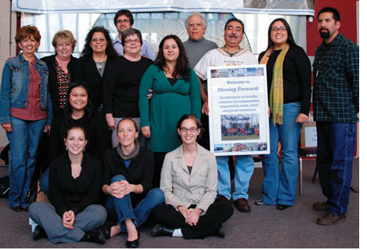
Goods Case Partners:
THE Impact Project
Since 2001, several partnerships have formed in Southern California.
In 2006, six partners formed a formal collaborative – the Trade, Health and Environment (THE) Impact Project.
The collaborative uses scientific information to inform public policy.
THE Impact Project Team
Photo Credit: Allison Cook
Notes:
This collaborative is a region-wide, community-academic partnership of six groups that have been using scientific information to inform public policy decision-making for the health of communities impacted by the goods movement for the past five years.
These partnerships were particularly successful with sharing information and resources. The community groups were able to express their needs and convey the goods movement’s impacts to their daily lives to the policy makers and scientists. The university partners were adept at arming the community members with the scientific, economic, and policy foundation they needed to advocate for themselves and mobilize other members of the community.
The picture is THE Impact Project team in December 2007 (clockwise from bottom middle): Carla Truax, USC; Elina Green, LBACA; Alena Groopman, USC; Helen Tol, USC; Sofia Carillo, EYCEJ; Penny Newman,CCAEJ; Rachel Lopez, CCAEJ; Mark Valliantos, UEPI; Andrea Hricko, USC; Cynthia Romo, LBACA; Robert Gottlieb, UEPI; Jesse N. Marquez, CFASE; Sylvia Betancourt, CCAEJ; Angelo Logan, EYCEJ

Slide 21

Community Concerns
Photo Credit: Andrea Hricko
Pollution (air, light and noise) and traffic
Not enough focus on EH impacts of ports
Facilities close to homes and schools
Notes:
Review the main community concerns.
In Southern California, there is around-the-clock traffic and warehouse operations that create noise, air, and light pollution. Since the highways, warehouses, and rail yards are so close to the homes and schools, this is a serious problems for people living in these communities. Much of the public focus on the ports in the early 2000s centered around the business/labor/economic benefits. The groups involved with THE Impact Project have been actively working to change that focus to look at the environmental health impacts of the ports and to take a larger focus on the region as a whole.
The picture shows how close the population lives to major transportation hubs. You can see how close the rail yard is to the home pictured.

Slide 22
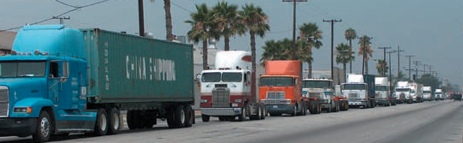
THE Impact Project Goals
Reduce exposure to air pollution and ensure other EH concerns considered in port-related policy
Enhance the community-driven focus for the University of Southern California (USC) Community Outreach and Engagement Core (COEC)
Share scientific findings with community members and legislators
Give voice to community concerns
Increase funding to sustain project activities (leveraging)
Photo credit: Angelo Logan
Notes:
Review the goals.

Slide 23

Activity: Logic Model
Goal: Practice creating your own logic model components
  Form groups of 3-5 individuals
  Pick one of the goals discussed in the case study (Handout A – Page 4)
  Identify one potential activity, output and impact associated with the goal (See definitions on Page 1 of Handout A)
  Post on the wall; discuss in plenary
10 minutes to discuss in small group
Notes:
Goal for exercise: practice creating logic model (LM) components = 20 minutes for the entire exercise
Group exercise: create elements of a LM based on one of the goals of the Goods case as a group
Process:
Step 1 – choose a goal from Handout A page 4.
Step 2 – Work with your group to create an activity (action/verb), an output (tangible product), and an impact (benefits or changes) for this goal.
Write answers on the colored paper (Activity = Green, Output = Yellow; Impacts = Purple)
After 10 minutes, have everyone stand up and gather around the wall where you’ll post the LM elements. Each group should elect a person to post their LM elements on the wall and present their findings.
After the exercise is over, distribute Handout B. If time, discuss the differences between the LM elements the group created and those of the Goods case.

Slide 24
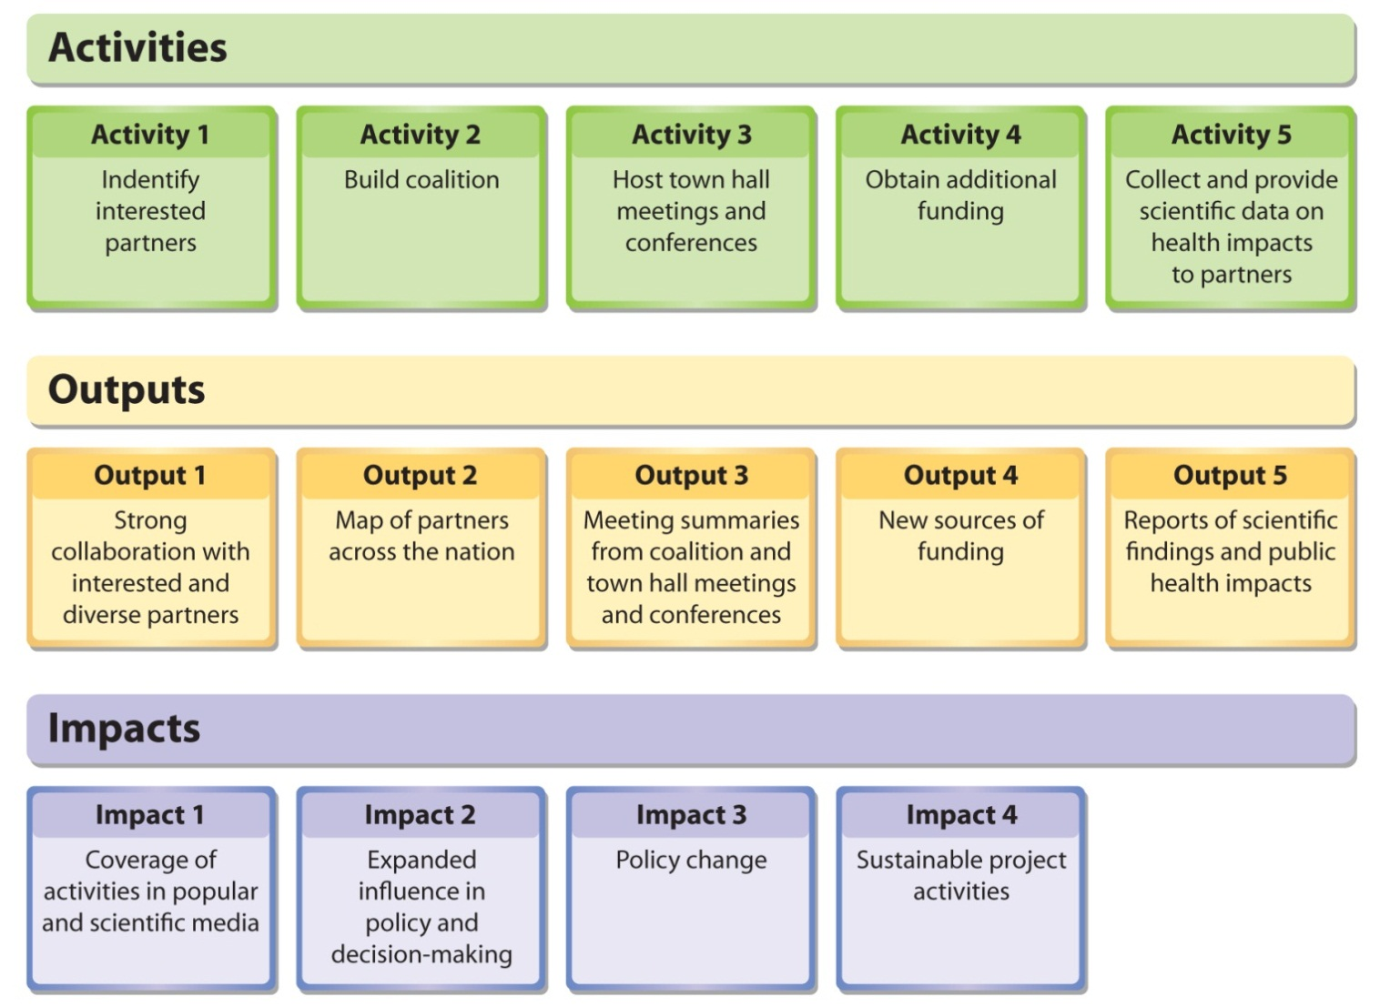
Logic Model from Goods Movement Case
Notes:
Don’t need to spend a lot of time on this slide – just let them know it’s available so they can look at it. It’s also on Handout B.

Slide 25
Key Points for Logic Modeling
No “right” answer for a logic model.
Important to get it down on paper together. Different people bring different perspectives and expectations.
Who do you involve in this process when you’re working in a community?
Logic models can be very iterative - review periodically to see progress and change!
Notes:
Remember that there is no one “right” LM. There are many possibilities, and the important thing is to think about what is important to you in achieving your goals.
3rd bullet point: Which stakeholders should you involve? When should you involve them. Again, no single answer; for some communities, you’re going to want to come in with a straw man, and for other communities, they’re going to want to be part of the development process from the beginning. You may just have to try it and see.
4th bullet point: Review periodically to see how you have progressed, or how your goals have changed due to contextual factors, etc.

Slide 26
How Do We Get to Metrics?
A logic model provides a framework so you can understand how your project goals connect to your activities and outcomes.
Knowing the framework helps clarify what is important to the project partners with measuring every aspect of the project.
Measure what is important to you and your partners (these are your metrics!).
Notes:
This slide serves to provide the connection between logic models and metrics – details on metrics are on the next slide

Slide 27
Metrics
Measures of a characteristic or aspect of the program
For example: size, capacity, description, quality, quantity, duration frequency
Qualitative or quantitative
Reportable and systematic descriptions of desired/actual performance or achievement
It is more difficult to measure a “partnership” than “length”
            Strategy: Build metrics from the nouns, verbs, adjectives and adverbs in your logic model
Notes:
[proposed script] So here we are at the primary goal of our entire Evaluation Metrics Manual. Now that we have a logic model … how do we get to metrics?
First, what is a metric: basically it is any characteristic/aspect of the program you are interested in. Examples include size, capacity, quantity, duration, frequency.
I want to emphasize these can be either qualitative or quantitative – and the Manual has lots of examples of each. Mainly they will be descriptive, it’s not often that higher order statistics are possible on data relating to projects like this. Metrics tend to be more narrative because there is no standard framework with which to measure them. For instance, if you were to measure a length, you would use a ruler or yardstick or some other standardized reference. A lot of times we just have narrative frameworks to measure. For example, there is a description in the Manual of how one of our Superfund centers used Arnstein’s ladder of participation to measure the perceived level of participation for a project in Peducah, Kentucky.
Our recommended strategy here is to key into the nouns, verbs, adjectives, and adverbs in your logic models. Questions that might help you get to metrics include “What would that look like in practice?” or “How would we recognize this when we see it?” Sometimes it will be vague, but usually people have some picture in their minds that can be articulated. After you start talking about metrics, sometimes you go back and change the logic model components.

Slide 28
Example Metrics: Goods Case
Activity 3: Host town hall meetings and conferences
Each meeting/conference grew in number of attendees and states represented by attendees: the 2010 meeting had over 600 attendees representing 18 states and 5 countries. (The 2001 meeting had over 300 attendees, and the 2005 meeting had over 400 attendees.)
Output 1: Strong coalition with interested and diverse partners
Communication strategy developed by partners over past six years
Impact 3: Policy change
The work of the project partners contributed towards the formation of the historic agreement called the San Pedro Bay Ports Clean Air Action Plan that was signed in 2006. This plan stated that the Ports of Los Angeles and Long Beach would reduce air pollution by 45% by 2011.
Notes:
Briefly discuss a few examples of metrics from the actual case logic model and metrics.

Slide 29

Activity: Metrics
What is Important?
Discuss Metrics Questions with a neighbor (See Page 4 of Handout B).
Talk with neighbor to create metrics based on one component of the logic model.
Discuss as a group.
5 minutes
Notes:
Process:
Refer them to logic model in Handout B (or A for all the models).
As a group, pick at least one each of the activities, outputs, and impacts and come up with one or two metrics for how you would measure that component.
Have a volunteer from each group choose one metric to share and discuss – or put up on the wall if there is time.

Slide 30
Handout C
Photo Credit: Jesse N. Marquez
Distribute Handout C.
Review metrics from Goods Movement case.
Notes:
Post some of the metrics to the wall logic model, or on a flip chart – or just discuss them as a group.
Discussion Questions:
What was challenging?
What was most helpful?

Slide 31
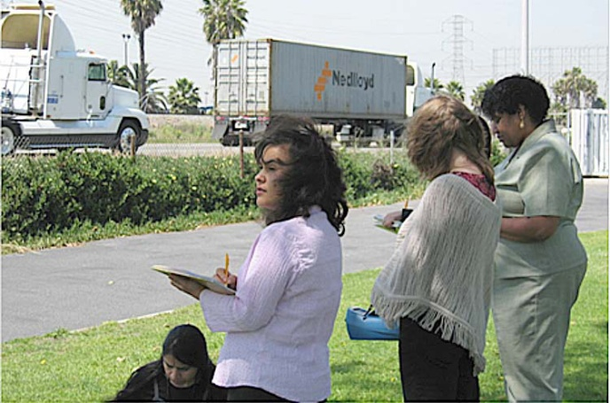
Data Collection
Plan but be open to new ideas
Think about data early and
often
Qualitative and quantitative
Consider:
  How many people will be needed?
  Will special equipment be required?
  How much training will be involved?
  How will data be stored (security issues, ownership, and backups)?
  Photo Credit: Andrea Hricko
Notes:
Discussing metrics can help drive the development of processes and protocols to collect data. When working with partners, it’s important to think about who will own the data and who will store it. What best serves the partnership?
The logic model framework can help you with data organization and analysis.
The photo shows members of THE Impact Project team collecting data that was used in discussions of policies related to ports.
Discussion questions:
How do you decide who owns the data in collaborative projects?
What have been your data challenges in past projects?

Slide 32
Evaluating Metrics
How do I know whether my metric is any good?
Notes:
Lead in to smart metric discussion on next slide – this is our final topic of the day. We are usually running out of time at this point… so you can just review briefly – the material is included in handout C.

Slide 33
SMART Metrics
SMART metrics are criteria that assist in the development of metrics. The 5 criteria that make up SMART metrics are:
  Specific – detail the milestones you expect to achieve, who will achieve them and how
  Measurable – define exactly what level of change you expect to achieve
  Attainable – create a metric that your group or organization can actually achieve
  Relevant – ensure your metric is connected to your goal
  Timely – limit your metrics to those measures that you can reasonably collect within the time frame of the project
Notes:
Specific – detail the milestones you expect to achieve, who will achieve them and how. If your program is addressing exposure to pesticides, a specific measure provides details about what types of pesticides, whom you are trying to target, what level of reduction in exposure you expect to achieve and how you will achieve that reduction.
Measurable – define exactly what level of change you expect to achieve. For example, rather than say that relationships among partners will improve, a measurable statement might propose that partners will participate in four discussions per year, during which they will identify two areas of conflict or potential conflict and map out at least one strategy for dealing with the conflict.
Attainable – create a metric that your group or organization can actually achieve. Rather than working towards a goal of eliminating all environmental health risks in a community, an attainable goal might be working with partners and community members to identify one environmental health risk and to make the community aware of steps it can take to reduce risk.
Relevant – ensure that your metric is connected to your goal. If your goal is to improve air quality around schools’ bus areas, then a relevant metric might measure partnership activities with schools and school-bus companies, school-bus idling times or air quality. A metric related to the number of schoolbus drivers with CPR training is not relevant because it does not relate to air quality.
Timely – limit your metrics to those measures that you can reasonably collect within the time frame of the project. If your project deals with reducing blood lead levels in young children, you might want to measure blood lead levels at six months, one year and two years post intervention. Although you may be interested in blood lead levels ten years from the intervention, it is not likely that you will be able to follow your participants that long.
Once you have some metrics identified, it can be helpful to look at them realistically in the context of your program. Do they make sense? Do you have the resources to collect, store, and analyze them? Will they really describe the most important aspect of your project’s achievement? The “SMART” metric rubric can help you think critically about your metrics. No metric will be perfect, but given project realities, it can be helpful to weigh pros and cons for each metric to choose the most useful set for your goals and situation.

Slide 34

Discussion
Do you have any questions?
How will you use logic models in your program?
Notes:
Get people to think about how they’ll apply these tools to their projects.
Ask them to fill out the bottom part of the feedback form.

Slide 35

Summary
Why should we evaluate projects?
How does a logic model help you think about evaluation?
How do you identify metrics once you have a logic model?
Notes:
Possible answers if no one supplies them.
Evaluation helps you determine what is working and what isn’t so you can adjust your project if necessary.
A logic model helps you plan your project and determine if elements of the proposed plan fit in toward achieving your goals.
To identify metrics, you look at each aspect of your logic model and ask “what would that look like in practice?” and “how would we recognize that when we see it?” If you can’t find a way to measure an element of the logic model, you might need to reconsider that element.

Slide 36

Acknowledgements
The PEPH Manual was created by a team led by the NIEHS Division of Extramural Research and Training. Many staff members from across the Division participated, including Christie Drew, Kristi Pettibone, Liam O’Fallon, Beth Anderson, Sharon Beard, Helena Davis, and Caroline Dilworth.
More importantly, the manual relies on expertise and input from a wide range of grantees and partners involved in the PEPH program.
This work was also supported by tasks and contracts with the Science and Technology Institute; MDB, Inc.; and Image Associates.
The training was developed primarily by Christie Drew and Kristi Pettibone, with input for case studies from Andrea Hricko, John Sullivan, Juan and Bryan Parras, Sharon Croissant, Patrick Ryan, Cyntia Eghbalnia, and Bono Sen. The set of final training materials was developed by MDB, Inc.

Slide 37

Contacts
Christie Drew
Program Analysis Branch, NIEHS
E-mail: drewc@niehs.nih.gov
Phone: 919 541-3319
Kristi Pettibone
Program Analysis Branch, NIEHS
E-mail: pettibonekg@niehs.nih.gov
Phone: 919 541-7752
PAB Website: http://www.niehs.nih.gov/research/supported/dert/pab/index.cfm
Notes:
If you have any questions about the PEPH metrics manual or this training in general, feel free to contact “The Christis” at NIEHS

Slide 38
Click on a Case Study to view:
Goods Movement
Encuentros Network
Cincinnati Anti-Idling Campaign
Notes:
In the next part of this discussion, we will be working in small groups with ideas from a case study to create logic model components and metrics. So we want to spend a little time providing background on this case. Much of this is repetitive of what is in Handout A. We’ve provided this as additional reference for you.
NIEHS created three case studies that we could use for this workshop… we’ll be focused on… CLICK YOUR CHOICE -
Presenter: You can leave all three case studies here - each one has all the remaining slides in it for the presentation. Or you can remove the links and slides for the case studies that you do not want to highlight here.

Slide 39
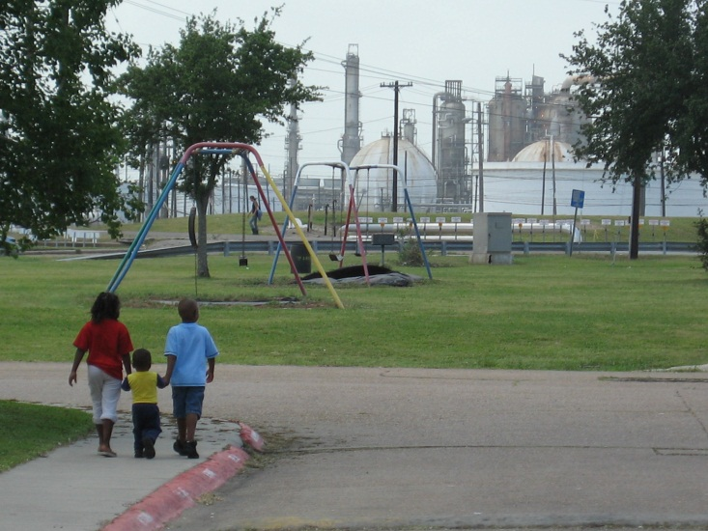
Encuentros Network
Goal - to understand the interplay and effects of multiple stressors on human health, build community resilience, and address environmental health concerns
“Encuentro”:
engagement and discovery
community members, researchers, policy makers, and others
facilitated small group setting
discuss and collectively address issues
  Carver Terrace Projects Playground, Port Arthur, TX
  Photo Credit: John Sullivan
Notes:
Introduce the Encuentros Network… goals and key concepts.
Acknowledgement goes to John Sullivan, Juan and Bryan Parras, and Sharon Croissant for their assistance in developing the Case Study. Participants should be aware that this project is “real”. It emerged from activities of the University of Texas Medical Branch. We do not include all the details of the program here because it is long and complex. But we have highlighted real details in our efforts to provide enough background to illustrate the principles of the Manual that we hope to teach you today.

Slide 40
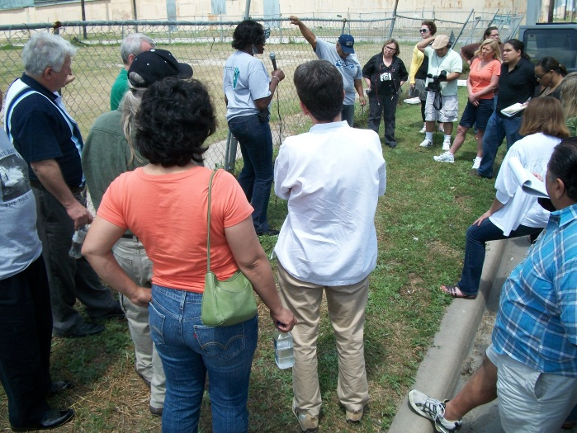
Partners
T.e.j.a.s. (Texas Environmental Justice Advocacy Services)
NIEHS CET-COEC (@ UTMB)
GHASP / Air Alliance Houston (Houston, TX)
Southwest Workers Union (San Antonio, TX)
De Madres a Madres (Houston, TX)
Texans Together (Houston Branch)
Down-Winders @ Risk (Midlothian, TX)
St. Vincent’s House (Galveston, TX)
Louisiana Bucket Brigade (New Orleans, LA)
Community In-Power & Development Association (Port Arthur, TX)
Citizens for Environmental Justice (Corpus Christi, TX)
Citizens League for Environmental Action Now (Houston, TX)
Mothers for Clean Air / 5 Ward Chapter (Houston, TX)
Galveston Baykeeper (La Porte-Shore Acres, TX)
Bayou Interfaith Shared Community Organizing (Thibodaux, LA)
Louisiana Environmental Action Network (Baton Rouge, LA)
Photo Credit: John Sullivan. Post-Ike Toxic Tour in Galveston TX. Doris Bagsby (St.
Vincent's) & Dr. Croisant talk about toxics found in storm surge sediment on this site
- the former Las Palmas public housing project.
Notes:
[proposed script] The University of Texas Medical Branch at Galveston (UTMB) has established relationships with the coastal communities because of their involvement in the recovery efforts after Hurricanes Katrina, Rita, and Ike.
Early partners in the Encuentros / Community Science Workshops are listed on this slide. I don’t intend to read them all, but want to give you a sense of the number and different types of organizations that have been involved. You can see that many geographic areas are represented.

Slide 41
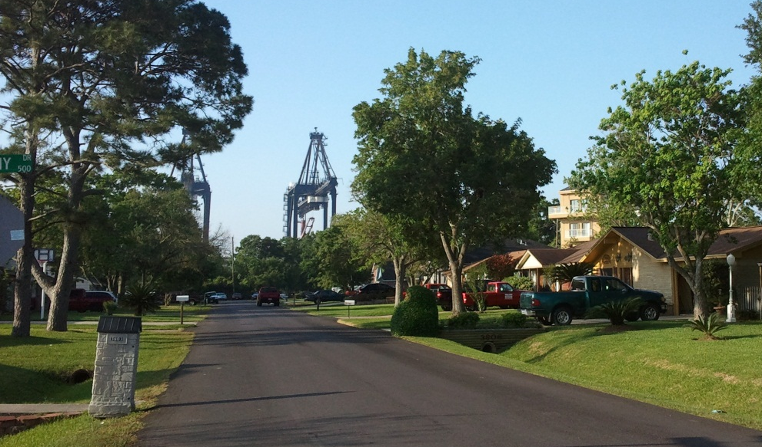
Community Concerns
Health effects of chronic low-level
ambient exposures to known carcinogens
associated with petroleum industry
Multiple chemical exposures / density of facilities
Upsets-spills-fires-explosions-excessive flaring from proximate facilities
Disaster preparedness: shelter-in-place & evacuation
Diesel traffic / diesel particulate exposure
Perceived high incidence of various cancers
High incidence of respiratory problems including asthma, chronic bronchitis
Photo Credit: John Sullivan. Bayport container gantries located directly next to a
neighborhood in La Porte TX. Concerns include: noise, diesel / VOC emissions,
light pollution from 24/7 operation.
Notes:
Community concerns identified by the encuentro process are listed here.
Over a number of years, community members have identified additional concerns including: industrial noise, blowing dust, possible metals exposure pathway, the high density of rail lines carrying hazardous stock chemicals, and legacy pollution from previous casting, smelting, processing industrial operations.

Slide 42
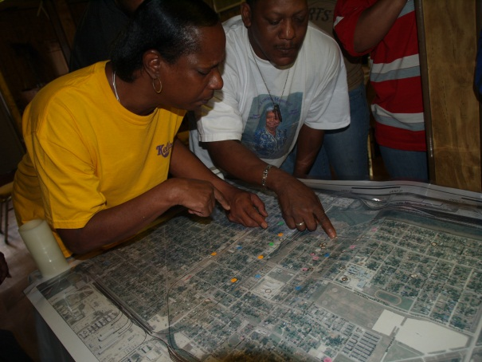
Encuentro Goals
Facilitate community ownership in identifying
solutions to environmental health concerns
Build and strengthen relationships between community partners and researchers
Identify parameters that help or hinder community response to natural and man-made disasters that impact the Gulf Coast
Help communities improve resilience to future disasters
Disseminate scientific findings to community stakeholders
Photo Credit: John Sullivan. Pre-Encuentro community mapping workshop
facilitated by the Pacific Institute community leadership development team
Catalina Garzon & Eli Moore
Notes:
The specific project goals that are the focus of this case study are listed here.

Slide 43
Activity: Logic Model
Goal: Practice creating your own logic model components
  Form groups of 3-5 individuals
  Pick one of the goals discussed in the case study (Handout A – Page 4)
  Identify one potential activity, output and impact associated with the goal (See definitions on Page 1 of Handout A)
  Post on the Wall; discuss in plenary
10 minutes to discuss in small group
Notes:
Goal for exercise: practice creating logic model (LM) components = 20 minutes for the entire exercise
Group exercise: create elements of a LM based on one of the goals of the Goods case as a group
Process:
Step 1 – choose a goal from Handout A page 4.
Step 2 – Work with your group to create an activity (action/verb), an output (tangible product), and an impact (benefits or changes) for this goal.
Write answers on the colored paper (Activity = Green, Output = Yellow; Impacts = Purple)
After 10 minutes, have everyone stand up and gather around the wall where you’ll post the LM elements. Each group should elect a person to post their LM elements on the wall and present their findings.
After the exercise is over, distribute Handout B. If time, discuss the differences between the LM elements the group created and those of the Goods case.

Slide 44
Encuentros Logic Model
ACTIVITIES
Conduct community forums and listening groups
Identify partners to assist in research
Host annual Encuentro meetings
Facilitate community partners expanding leadership roles in Encuentro meetings
Build a consortium
Conduct community needs assessment to drive future research, outreach & education activities
Illustrate environmental health concerns and solutions using Community Environmental Forum Theater
OUTPUTS
Directory of community contacts
Community Science Workshops
Training workshops to bring community partners up to speed on research process and study design
Innovative tools for dissemination of information like live videos and interviews with community groups and leaders
Tox, Risk and Stress community environmental forum theater curriculum
Air quality data provided support for connections between childhood cancers and air pollution
IMPACTS
Strengthened partnerships between research community and community organizations and members
Empowered partners aware of the long-term ecosystem and human health impacts of natural and man-made disasters
Educated community members able to advocate for necessary changes in health and policy
Resilient communities better equipped to deal with future disasters
Data from the Texas Air Quality Study led to the Houston mayor creating a city-wide bureau to monitor and enforce air quality standards
Notes:
Don’t need to spend a lot of time on this slide – just let them know it’s available so they can look at it. It’s also on Handout B.

Slide 45
Key Points for Logic Modeling
No “right” answer for a logic model.
Important to get it down on paper together. Different people bring different perspectives and expectations.
Who do you involve in this process when you’re working in a community?
Logic models can be very iterative - review periodically to see progress and change!
Notes:
Remember that there is no one “right” LM. There are many possibilities, and the important thing is to think about what is important to you in achieving your goals.
3rd bullet point: Which stakeholders should you involve? When should you involve them. Again, no single answer; for some communities, you’re going to want to come in with a straw man, and for other communities, they’re going to want to be part of the development process from the beginning. You may just have to try it and see.
4th bullet point: Review periodically to see how you have progressed, or how your goals have changed due to contextual factors, etc.

Slide 46
How Do We Get to Metrics?
A logic model provides a framework so you can understand how your project goals connect to your activities and outcomes.
Knowing the framework helps clarify what is important to the project partners with measuring every aspect of the project.
Measure what is important to you and your partners (these are your metrics!).
Notes:
This slide serves to provide the connection between logic models and metrics – details on metrics are on the next slide

Slide 47
Metrics
Measures of a characteristic or aspect of the program
For example: size, capacity, description, quality, quantity, duration, frequency
Qualitative or quantitative
Reportable and systematic descriptions of desired/actual performance or achievement
It is more difficult to measure a “partnership” than “length”
            Strategy: Build metrics from the nouns, verbs, adjectives and adverbs in your logic model
Notes:
[proposed script:] So here we are at the primary goal of our entire Evaluation Metrics Manual. Now that we have a logic model … how do we get to metrics?
So first, what is a metric: basically it is any characteristic/aspect of the program you are interested in. Examples include size, capacity, quantity, duration, frequency.
I want to emphasize these can be either qualitative or quantitative – and the Manual has lots of examples of each. Mainly they will be descriptive, its not often that higher order statistics are possible on data relating to projects like this. Metrics tend to be more narrative because there is no standard framework with which to measure them. For instance, if you were to measure an length, you would use a ruler or yardstick or some other standardized reference. A lot of times we just have narrative frameworks to measure. For example, there is a description in the manual of how one of our Superfund centers used Arnstein’s ladder of participation to measure the perceived level of participation for a project in Peducah, Kentucky.
Our recommended strategy here is to key into the nouns, verbs, adjectives and adverbs in your logic models. Questions that might help you get to metrics include “What would that look like in practice?” or “How would we recognize this when we see it?” Sometimes it will be vague, but usually people have some picture in their mind that can be articulated. After you start talking about metrics, sometimes you go back and change the logic model components.

Slide 48
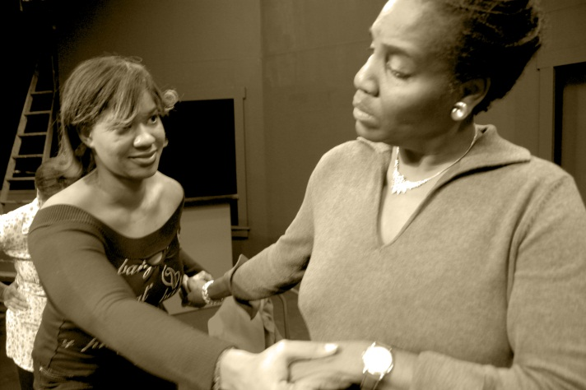
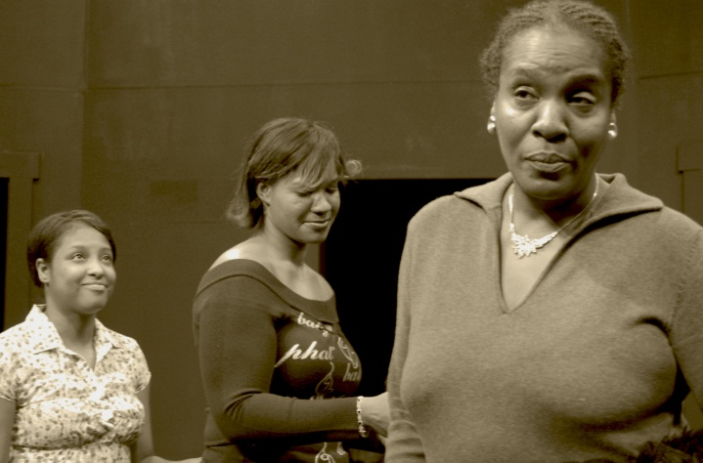
Encuentros Case Study
Community members participating in the Community Environmental Theatre Forum in Buffalo, NY act out the progression from engagement to rejection of collaboration in response to power imbalances between community & university participants.
(Photo Credits: John Sullivan)
Notes:
One of the most interesting pieces of the Encuentros network is the Teatro – the Theatre of the Oppressed. These pictures are in tended to show the a measureable difference in how people are interacting… the people on the left are engaged – how do you know??
Touching, eye contact, facial expressions…compare that to a figure on the right…

Slide 49
Example Metrics:
Build and Strengthen Relationships
Activity: Create and Perform “Theater of the Oppressed”
Number of theater forums conducted
Description of curriculum/content of theater forums
Number & description of participants in theater forums
Description of topics and issues raised during the session
Output: Theater of the Oppressed Curriculum
Description of curricula for conducting Tox, Risk, and Stress community environmental forums
Impact: Strengthened partnerships
Researchers change how they think about EHS concerns – better implementation of CBPR principles
Notes:
Briefly discuss a few examples of metrics from the actual case logic model and metrics.
Re: Impact: The Teatro provides researchers a unique view of how the community feels about the issues, their relationship to the social power dynamic in the larger metro area, and their relationship to research (especially their ambivalence toward any research that doesn't translate very quickly into something actionable).

Slide 50
Activity: Metrics
What is Important?
Discuss Metrics Questions with a neighbor (See Page 3-4 of Handout B)
Talk with neighbor to create metrics based on one component of the logic model
Discuss as a group
5 minutes
Notes:
Process:
Refer them to logic model in Handout B (or A for all the models).
As a group, pick at least one each of the activities, outputs and impacts and come up with one or two metrics for how you would measure that component.
Have a volunteer from each group choose one metric to share and discuss – or put up if there is time.

Slide 51
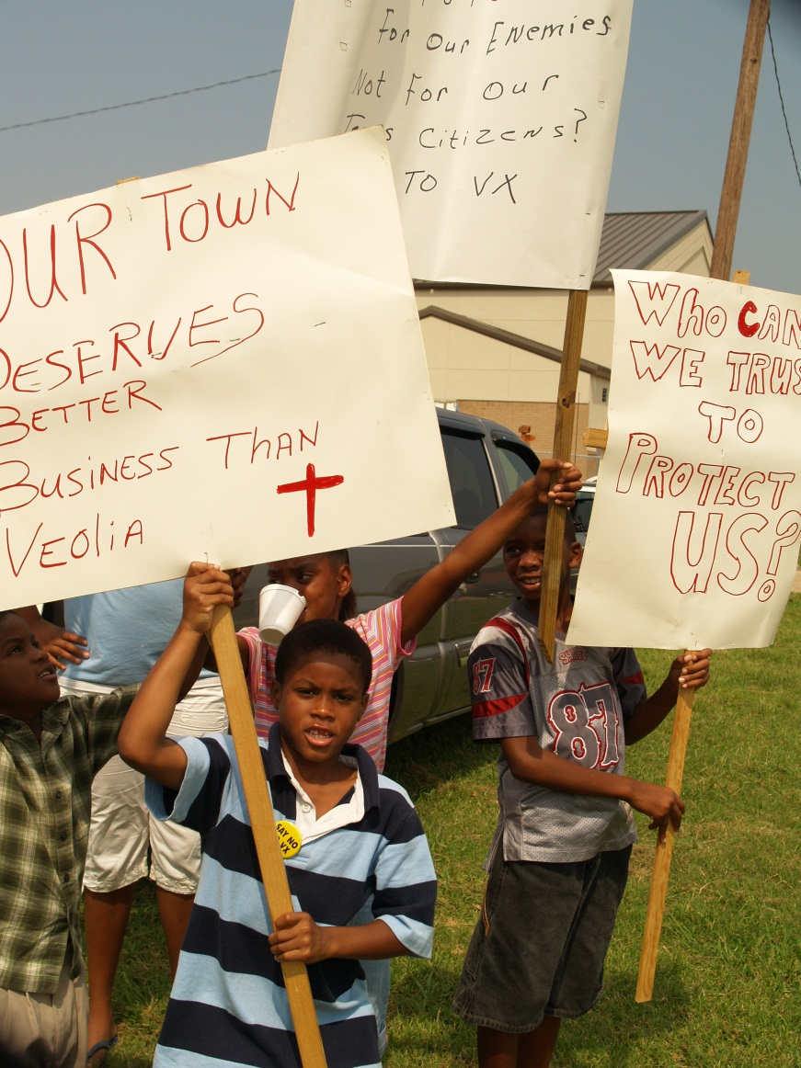
Handout C
Distribute Handout C
Review example metrics from case study
Photo Credit: John Sullivan. EJ activities in Port Arthur - sponsored by Encuentro Network partner, CIDA (Community In-Power and Development Association)
Notes:
Post some of the metrics to the wall logic model, or on a flip chart – or just discuss them as a group.
Discussion Questions:
What was challenging?
What was most helpful?

Slide 52
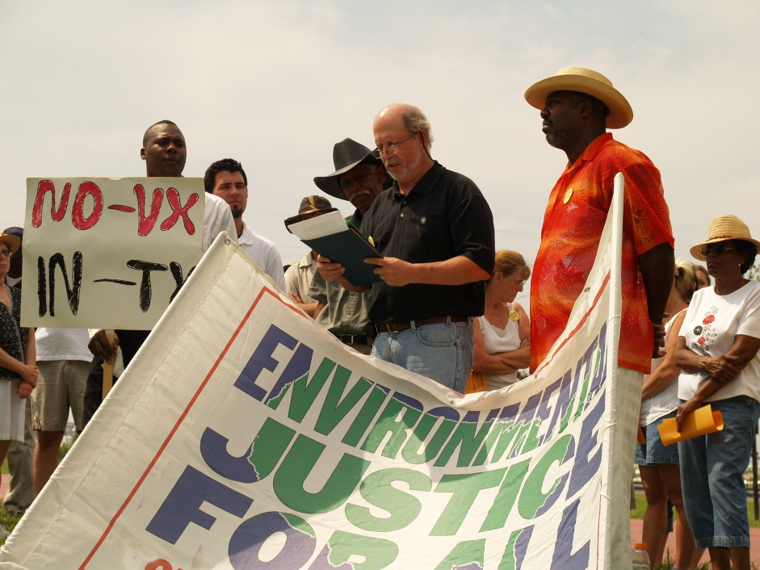
Data Collection
Plan, but be open to new ideas
Think about data early and
often
Qualitative and quantitative
Consider:
  How many people will be needed?
  Will special equipment be required?
  How much training will be involved?
  How will data be stored (security issues, ownership and backups)?
Photo Credit: John Sullivan. EJ activities in Port Arthur - sponsored by Encuentro
Network partner, CIDA (Community In-Power and Development Association)
Notes:
Discussing metrics can help drive the development of processes and protocols to collect data. When working with partners, it’s important to think about who will own the data and who will store it. What best serves the partnership?
The logic model framework can help you with data organization and analysis.
Discussion questions:
How do you decide who owns the data in collaborative projects?
What have been your data challenges in past projects?

Slide 53
Evaluating Metrics
How do I know whether my metric is any good?
Notes:
Lead in to smart metric discussion on next slide – this is our final topic of the day. We are usually running out of time at this point… so you can just review briefly – the material is included in handout C.

Slide 54
SMART Metrics
SMART metrics are criteria that assist in the development of metrics. The 5 criteria that make up SMART metrics are:
  Specific – detail the milestones you expect to achieve, who will achieve them and how
  Measurable – define exactly what level of change you expect to achieve
  Attainable – create a metric that your group or organization can actually achieve
  Relevant – ensure your metric is connected to your goal
  Timely – limit your metrics to those measures that you can reasonably collect within the time frame of the project
Notes:
Specific – detail the milestones you expect to achieve, who will achieve them and how. If your program is addressing exposure to pesticides, a specific measure provides details about what types of pesticides, whom you are trying to target, what level of reduction in exposure you expect to achieve and how you will achieve that reduction.
Measurable – define exactly what level of change you expect to achieve. For example, rather than say that relationships among partners will improve, a measurable statement might propose that partners will participate in four discussions per year, during which they will identify two areas of conflict or potential conflict and map out at least one strategy for dealing with the conflict.
Attainable – create a metric that your group or organization can actually achieve. Rather than working towards a goal of eliminating all environmental health risks in a community, an attainable goal might be working with partners and community members to identify one environmental health risk and to make the community aware of steps it can take to reduce risk.
Relevant – ensure that your metric is connected to your goal. If your goal is to improve air quality around schools’ bus areas, then a relevant metric might measure partnership activities with schools and school-bus companies, school-bus idling times or air quality. A metric related to the number of schoolbus drivers with CPR training is not relevant because it does not relate to air quality.
Timely – limit your metrics to those measures that you can reasonably collect within the time frame of the project. If your project deals with reducing blood lead levels in young children, you might want to measure blood lead levels at six months, one year and two years post intervention. Although you may be interested in blood lead levels ten years from the intervention, it is not likely that you will be able to follow your participants that long.
Once you have some metrics identified, it can be helpful to look at them realistically in the context of your program. Do they make sense? Do you have the resources to collect, store and analyze them? Will they really describe the most important aspect of your project’s achievement? The “SMART” metric rubric can help you think critically about your metrics. No metric will be perfect, but given project realities it can be helpful to weigh pros and cons for each metric to choose the most useful set for your goals and situation.

Slide 55
Discussion
Do you have any questions?
How will you use logic models in your program?
Notes:
Get people to think about how they’ll apply these tools to their projects.
Ask them to fill out the bottom part of the feedback form.

Slide 56
Summary
Why should we evaluate projects?
How does a logic model help you think about evaluation?
How do you identify metrics once you have a logic model?
Notes:
Possible answers if no one supplies them.
Evaluation helps you determine what is working and what isn’t so you can adjust your project if necessary.
A logic model helps you plan your project and determine if elements of the proposed plan fit in toward achieving your goals.
To identify metrics, you look at each aspect of your logic model and ask “what would that look like in practice?” and “how would we recognize that when we see it?” If you can’t find a way to measure an element of the logic model, you might need to reconsider that element.

Slide 57
Acknowledgements
The PEPH Manual was created by a team led by the NIEHS Division of Extramural Research and Training. Many staff from across the Division participated, including Christie Drew, Kristi Pettibone, Liam O’Fallon, Beth Anderson, Sharon Beard, Helena Davis, and Caroline Dilworth.
More importantly, the manual relies on expertise and input from a wide range of grantees and partners involved in the PEPH program.
This work was also supported by tasks and contracts with the Science and Technology Institute; MDB, Inc.; and Image Associates.
The training was developed primarily by Christie Drew and Kristi Pettibone, with input for case studies from Andrea Hricko, John Sullivan, Juan and Bryan Parras, Sharon Croissant, Patrick Ryan, Cyntia Eghbalnia, and Bono Sen. The set of final training materials were developed by MDB, Inc.

Slide 58
Contacts
Christie Drew
Program Analysis Branch, NIEHS
E-mail: drewc@niehs.nih.gov
Phone: 919 541-3319
Kristi Pettibone
Program Analysis Branch, NIEHS
E-mail: pettibonekg@niehs.nih.gov
Phone: 919 541-7752
PAB Website: http://www.niehs.nih.gov/research/supported/dert/pab/index.cfm
Notes:
If you have any questions about the PEPH metrics manual or this training in general, feel free to contact “The Christis” at NIEHS.

Slide 59
Click on a Case Study to view:
Goods Movement
Encuentros Network
Cincinnati Anti-Idling Campaign
Notes:
In the next part of this discussion, we will be working in small groups with ideas from a case study to create logic model components and metrics. So we want to spend a little time providing background on this case. Much of this is repetitive of what is in Handout A. We’ve provided this as additional reference for you.
NIEHS created three case studies that we could use for this workshop… we’ll be focused on… CLICK YOUR CHOICE -
Presenter: You can leave all three case studies here - each one has all the remaining slides in it for the presentation. Or you can remove the links and slides for the case studies that you do not want to highlight here.

Slide 60

Anti-Idling Campaign Introduction
Children spend roughly 35 hours a week at school.
School children face traffic-related air pollution from idling buses and vehicles.
Asthma symptoms are exacerbated by exposure to air pollution.
Case Study Acknowledgement: University of Cincinnati
Stock Photo
Notes:
Introduces the Anti-Idling Campaign project.
Acknowledgement goes to Patrick Ryan and Cynthia Eghbalnia for their assistance in developing the Case Study. Participants should be aware that this project is “real”. It emerged from activities of the University of Cincinnati. We do not include all the details of the program here. But we have highlighted real details in our efforts to provide enough background to illustrate the principles of the Manual that we hope to teach you today.

Slide 61
Anti-Idling Campaign Partners:
3 main partners:
University of Cincinnati
Cincinnati Public Schools
Cincinnati Health Department
Partners met before project was funded to discuss collaboration opportunities.
Partners collaborated well, each bringing its expertise to bear on the campaign.
The collaborative used scientific information to inform public policy.
Graphic by: Kavan Eghbalnia, CPS
Notes:
These partners had met and discussed collaboration possibilities before this project was funded. These early meetings helped the partners to mobilize quickly once funding was in place.

Slide 62

Community Concerns
                Prevalence of childhood asthma has doubled in the last two decades.
                Asthma accounts for 12.8 million missed school days each year.
                Urban populations have the highest increase in asthma prevalence and severity.
CPS Air Quality Assembly
Photo Credit: Cynthia Eghbalnia, CPS
Notes:
Childhood asthma is on the rise and is worse in urban populations. Children with asthma often have more absences, which can affect school performance.

Slide 63
Anti-Idling Campaign Goals
Determine whether children are exposed to
increased traffic-related air pollution (TRAP) at
schools
Develop and implement a community-driven
anti-idling campaign
Measure the impact of an anti-idling campaign on:
  Children’s exposure to TRAP at schools
  Idling practices of vehicles and busses
Determine the impacts of an anti-idling campaign on asthma morbidity
Graphic by: Hamilton County Department of Environmental Sciences
Notes:
The specific project goals that are the focus of this case study are listed here.

Slide 64
Activity: Logic Model
Goal: Practice creating your own logic model components
  Form groups of 3-5 individuals
  Pick one of the goals discussed in the case study (Handout A – Page 3)
  Identify one potential activity, output and impact associated with the goal (See definitions on Page 1 of Handout A)
  Post on the Wall; discuss in plenary
10 minutes to discuss in small group
Notes:
Goal for exercise: practice creating logic model (LM) components = 20 minutes for the entire exercise
Group exercise: create elements of a LM based on one of the goals of the Goods case as a group
Process:
Step 1 – choose a goal from Handout A page 3.
Step 2 – Work with your group to create an activity (action/verb), an output (tangible product), and an impact (benefits or changes) for this goal.
Write answers on the colored paper (Activity = Green, Output = Yellow; Impacts = Purple)
After 10 minutes, have everyone stand up and gather around the wall where you’ll post the LM elements. Each group should elect a person to post their LM elements on the wall and present their findings.
After the exercise is over, distribute Handout B. If time, discuss the differences between the LM elements the group created and those of the Goods case.

Slide 65
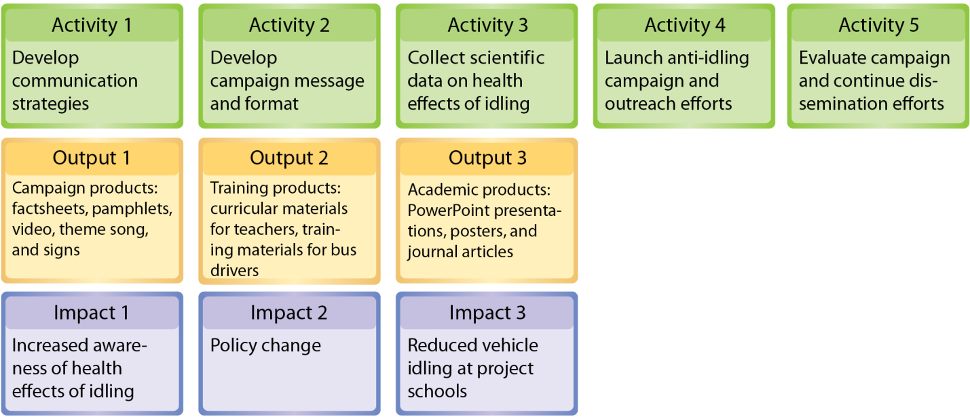
Anti-Idling Campaign Logic Model
Notes:
Don’t need to spend a lot of time on this slide – just let them know it’s available so they can look at it. It’s also on Handout B.

Slide 66
Key Points for Logic Modeling
No “right” answer for a logic model.
Important to get it down on paper together. Different people bring different perspectives and expectations.
Who do you involve in this process when you’re working in a community?
Logic models can be very iterative - review periodically to see progress and change!
Notes:
Remember that there is no one “right” LM. There are many possibilities, and the important thing is to think about what is important to you in achieving your goals.
3rd bullet point: Which stakeholders should you involve? When should you involve them. Again, no single answer; for some communities, you’re going to want to come in with a straw man, and for other communities, they’re going to want to be part of the development process from the beginning. You may just have to try it and see.
4th bullet point: Review periodically to see how you have progressed, or how your goals have changed due to contextual factors, etc.

Slide 67
How Do We Get to Metrics?
A logic model provides a framework so you can understand how your project goals connect to your activities and outcomes.
Knowing the framework helps clarify what is important to the project partners with measuring every aspect of the project.
Measure what is important to you and your partners (these are your metrics!).
Notes:
This slide serves to provide the connection between logic models and metrics – details on metrics are on the next slide

Slide 68
Metrics
Measures of a characteristic or aspect of the program
For example: size, capacity, description, quality, quantity, duration, frequency
Qualitative or quantitative
Reportable and systematic descriptions of desired/actual performance or achievement
It is more difficult to measure a “partnership” than “length”
            Strategy: Build metrics from the nouns, verbs, adjectives and adverbs in your logic model
Notes:
[proposed script:] So here we are at the primary goal of our entire Evaluation Metrics Manual. Now that we have a logic model … how do we get to metrics?
So first, what is a metric: basically it is any characteristic/aspect of the program you are interested in. Examples include size, capacity, quantity, duration, frequency.
I want to emphasize these can be either qualitative or quantitative – and the Manual has lots of examples of each. Mainly they will be descriptive, its not often that higher order statistics are possible on data relating to projects like this. Metrics tend to be more narrative because there is no standard framework with which to measure them. For instance, if you were to measure an length, you would use a ruler or yardstick or some other standardized reference. A lot of times we just have narrative frameworks to measure. For example, there is a description in the manual of how one of our Superfund centers used Arnstein’s ladder of participation to measure the perceived level of participation for a project in Peducah, Kentucky.
Our recommended strategy here is to key into the nouns, verbs, adjectives and adverbs in your logic models. Questions that might help you get to metrics include “What would that look like in practice?” or “How would we recognize this when we see it?” Sometimes it will be vague, but usually people have some picture in their mind that can be articulated. After you start talking about metrics, sometimes you go back and change the logic model components.

Slide 69
Example Metrics: Anti-Idling Case
Activity 4: Launch anti-idling campaign and outreach efforts
More than 15 products were distributed
Output 2: Training products: curricular materials for teachers, training materials for bus drivers
397 school bus drivers in the Cincinnati Public School system attended the anti-idling training session.
Impact 3: Reduced vehicle idling at project schools
Post-campaign, bus idling times decreased 60% at student drop-off in the morning and 80% at afternoon pickup
Notes:
Briefly discuss a few examples of metrics from the actual case logic model and metrics.

Slide 70
Activity: Metrics
What is Important?
Discuss Metrics Questions with a neighbor (See Page 4-5 of Handout B)
Talk with neighbor to create metrics based on one component of the logic model
Discuss as a group
5 minutes
Notes:
Process:
Refer them to logic model in Handout B (or A for all the models) .
As a group, pick at least one each of the activities, outputs and impacts and come up with one or two metrics for how you would measure that component.
Have a volunteer from each group choose one metric to share and discuss – or put up if there is time

Slide 71

Handout C
Distribute Handout C
Review example metrics from case study
Photo Credit: Cynthia Eghbalnia, CPS
Notes:
Post some of the metrics to the wall logic model, or on a flip chart – or just discuss them as a group.
Discussion Questions:
What was challenging?
What was most helpful?

Slide 72

Data Collection
Plan, but be open to new ideas
Think about data early and
often
Qualitative and quantitative
Consider:
How many people will be needed?
  Will special equipment be required?
  How much training will be involved?
  How will data be stored (security issues, ownership and backups)?
Student collecting air quality data
Photo Credit: Cynthia Eghbalnia, CPS
Notes:
Discussing metrics can help drive the development of processes and protocols to collect data. When working with partners, it’s important to think about who will own the data and who will store it. What best serves the partnership?
The logic model framework can help you with data organization and analysis.
The photo shows a student collecting air quality data.
Discussion questions:
How do you decide who owns the data in collaborative projects?
What have been your data challenges in past projects?

Slide 73
Evaluating Metrics
How do I know whether my metric is any good?
Notes:
Lead in to smart metric discussion on next slide – this is our final topic of the day. We are usually running out of time at this point… so you can just review briefly – the material is included in handout C.

Slide 74
SMART Metrics
SMART metrics are criteria that assist in the development of metrics. The 5 criteria that make up SMART metrics are:
  Specific – detail the milestones you expect to achieve, who will achieve them and how
  Measurable – define exactly what level of change you expect to achieve
  Attainable – create a metric that your group or organization can actually achieve
  Relevant – ensure your metric is connected to your goal
  Timely – limit your metrics to those measures that you can reasonably collect within the time frame of the project
Notes:
Specific – detail the milestones you expect to achieve, who will achieve them and how. If your program is addressing exposure to pesticides, a specific measure provides details about what types of pesticides, whom you are trying to target, what level of reduction in exposure you expect to achieve and how you will achieve that reduction.
Measurable – define exactly what level of change you expect to achieve. For example, rather than say that relationships among partners will improve, a measurable statement might propose that partners will participate in four discussions per year, during which they will identify two areas of conflict or potential conflict and map out at least one strategy for dealing with the conflict.
Attainable – create a metric that your group or organization can actually achieve. Rather than working towards a goal of eliminating all environmental health risks in a community, an attainable goal might be working with partners and community members to identify one environmental health risk and to make the community aware of steps it can take to reduce risk.
Relevant – ensure that your metric is connected to your goal. If your goal is to improve air quality around schools’ bus areas, then a relevant metric might measure partnership activities with schools and school-bus companies, school-bus idling times or air quality. A metric related to the number of schoolbus drivers with CPR training is not relevant because it does not relate to air quality.
Timely – limit your metrics to those measures that you can reasonably collect within the time frame of the project. If your project deals with reducing blood lead levels in young children, you might want to measure blood lead levels at six months, one year and two years post intervention. Although you may be interested in blood lead levels ten years from the intervention, it is not likely that you will be able to follow your participants that long.
Once you have some metrics identified, it can be helpful to look at them realistically in the context of your program. Do they make sense? Do you have the resources to collect, store and analyze them? Will they really describe the most important aspect of your project’s achievement? The “SMART” metric rubric can help you think critically about your metrics. No metric will be perfect, but given project realities it can be helpful to weigh pros and cons for each metric to choose the most useful set for your goals and situation.

Slide 75
Discussion
Do you have any questions?
How will you use logic models in your program?
Notes:
Get people to think about how they’ll apply these tools to their projects.
Ask them to fill out the bottom part of the feedback form.

Slide 76
Summary
Why should we evaluate projects?
How does a logic model help you think about evaluation?
How do you identify metrics once you have a logic model?
Notes:
Possible answers if no one supplies them.
Evaluation helps you determine what is working and what isn’t so you can adjust your project if necessary.
A logic model helps you plan your project and determine if elements of the proposed plan fit in toward achieving your goals.
To identify metrics, you look at each aspect of your logic model and ask “what would that look like in practice?” and “how would we recognize that when we see it?” If you can’t find a way to measure an element of the logic model, you might need to reconsider that element.

Slide 77
Acknowledgements
The PEPH Manual was created by a team led by the NIEHS Division of Extramural Research and Training. Many staff from across the Division participated, including Christie Drew, Kristi Pettibone, Liam O’Fallon, Beth Anderson, Sharon Beard, Helena Davis, and Caroline Dilworth.
More importantly, the manual relies on expertise and input from a wide range of grantees and partners involved in the PEPH program.
This work was also supported by tasks and contracts with the Science and Technology Institute; MDB, Inc.; and Image Associates.
The training was developed primarily by Christie Drew and Kristi Pettibone, with input for case studies from Andrea Hricko, John Sullivan, Juan and Bryan Parras, Sharon Croissant, Patrick Ryan, Cyntia Eghbalnia, and Bono Sen. The set of final training materials were developed by MDB, Inc.

Slide 78
Contacts
Christie Drew
Program Analysis Branch, NIEHS
E-mail: drewc@niehs.nih.gov
Phone: 919 541-3319
Kristi Pettibone
Program Analysis Branch, NIEHS
E-mail: pettibonekg@niehs.nih.gov
Phone: 919 541-7752
PAB Website: http://www.niehs.nih.gov/research/supported/dert/pab/index.cfm
Notes:
If you have any questions about the PEPH metrics manual or this training in general, feel free to contact “The Christis” at NIEHS.

Slide 79
Click on a Case Study to view:
Goods Movement
Encuentros Network
Cincinnati Anti-Idling Campaign
Notes:
In the next part of this discussion, we will be working in small groups with ideas from a case study to create logic model components and metrics. So we want to spend a little time providing background on this case. Much of this is repetitive of what is in Handout A. We’ve provided this as additional reference for you.
NIEHS created three case studies that we could use for this workshop… we’ll be focused on… CLICK YOUR CHOICE.
Presenter: You can leave all three case studies here - each one has all the remaining slides in it for the presentation. Or you can remove the links and slides for the case studies that you do not want to highlight here.

