Slide 1
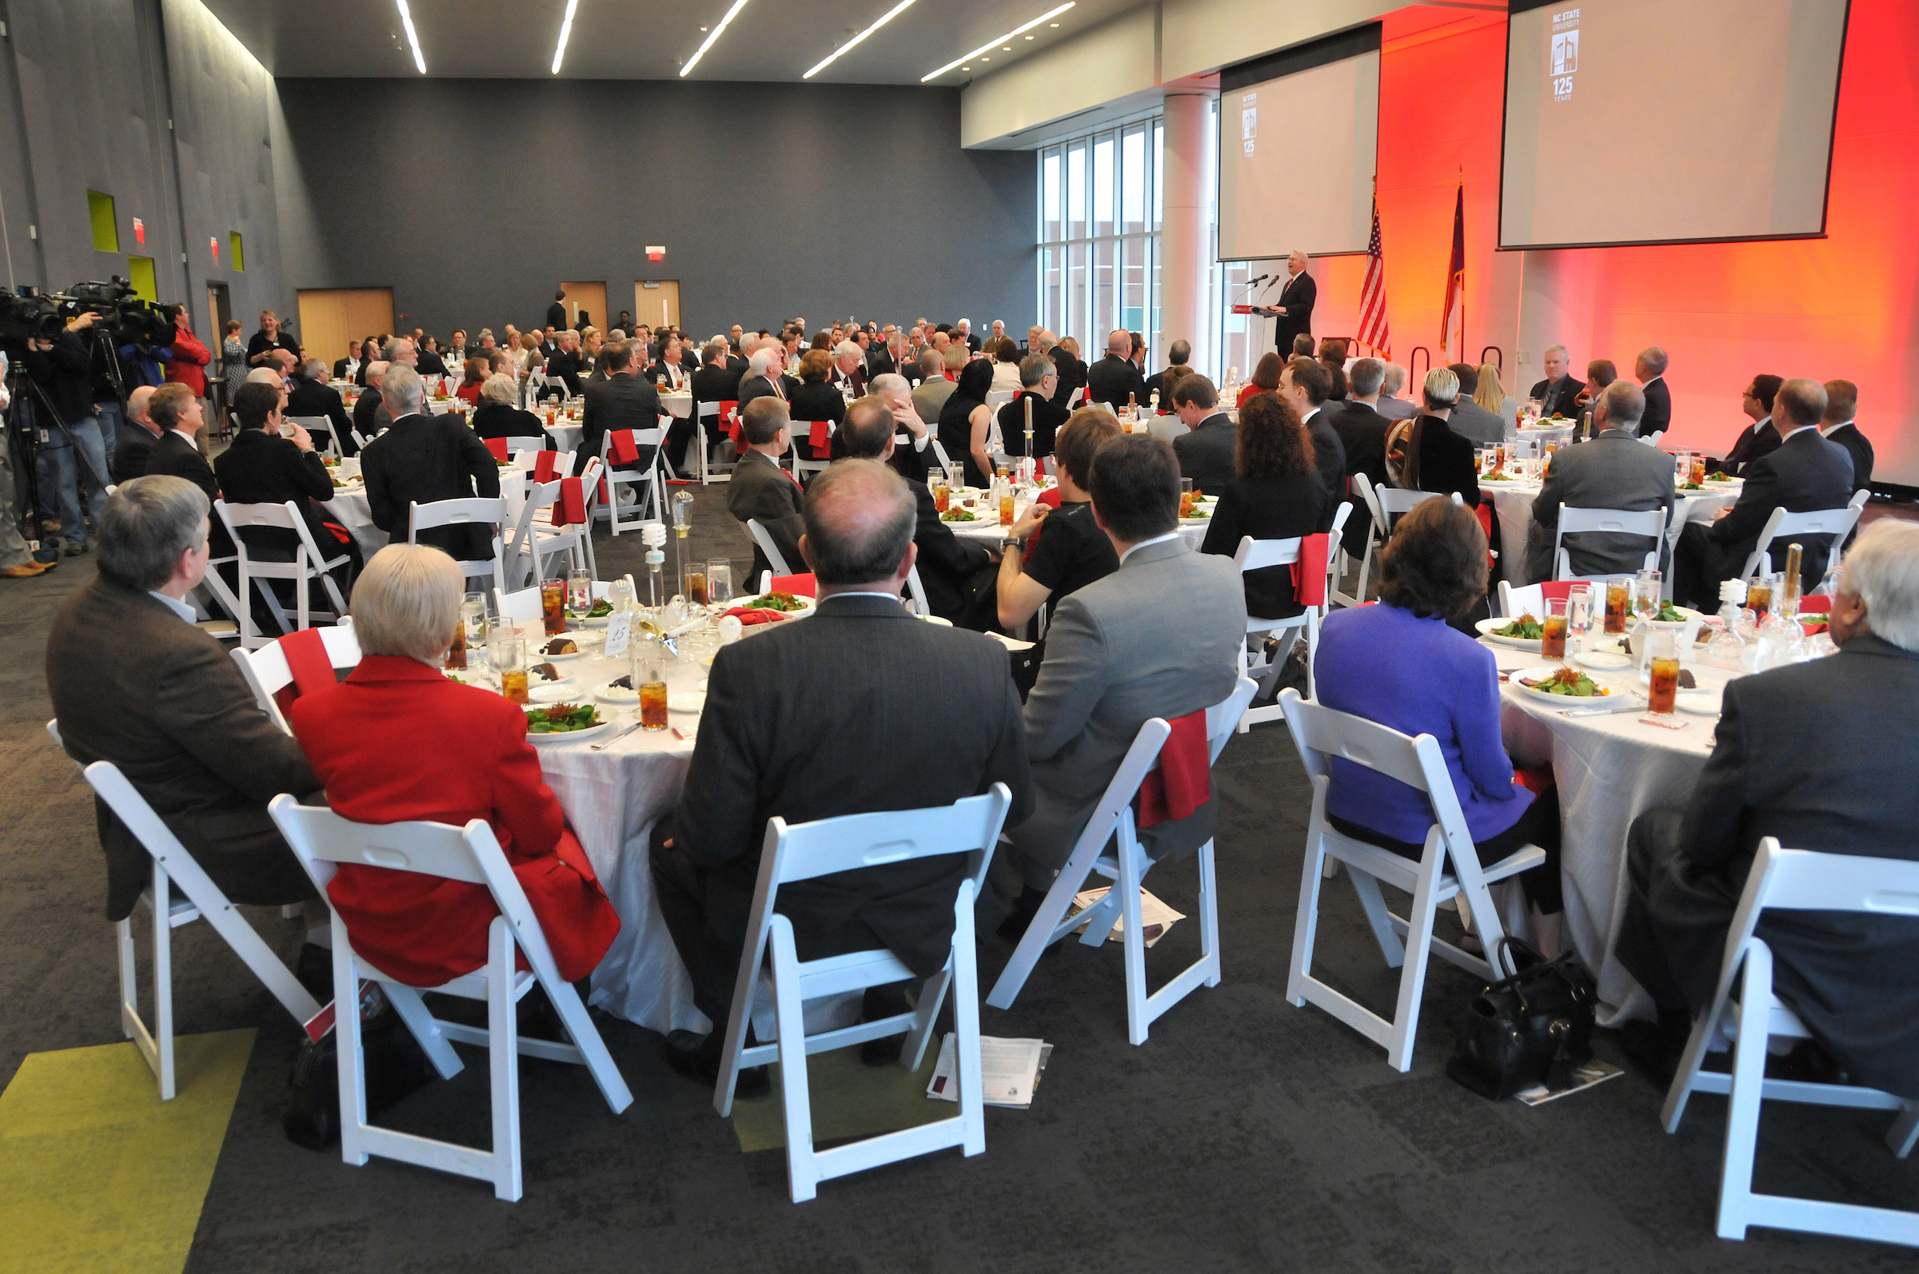
Conflict and Negotiation Leadership
Roy Baroff
NC State Faculty & Staff Ombuds
November 17, 2017
Roy Baroff, MA, JD
Certified Organizational
Ombuds Practitioner
Mediator Attorney
NC State Faculty &
Staff Ombuds
NIH Program
July 24, 2020
Notes:
How you deal with conflict are leadership skills !!

Slide 2
Program Agenda
  Intro and Warm Up
  Ombuds Role
  Conflict Leadership
  - Engaging / dealing with conflicts – conflict styles
  - Ombuds meeting ideas
  Negotiation Leadership
Questions and Wrap Up
Notes:
----- Meeting Notes (4/7/20 15:18) -----
Invite you to stand up at 30 minutes for about 10 - 20 seconds. It's the Cheveron way.
We'll use random breakout rooms for a couple of the exercises.
Ask questions by Chat as they come to you, we’ll collect them, and address them at the end with a Q & Session

Slide 3

Program Goal
Take home one or two ideas !!

Slide 4
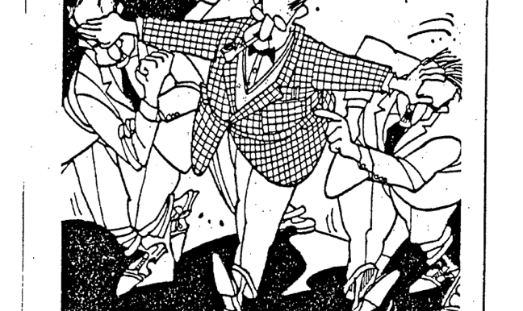
Conflict Engagement Professional – Roy Baroff
Mediator Attorney Educator
NC State Faculty & Staff Ombuds
Notes:
----- Meeting Notes (4/7/20 15:35) -----
Opened Faculty ombuds office in spring 2015 and added staff services in January 2017. In the conflict engagement field for 38 years.

Slide 5

  Warm Up - Conflict Defined
Notes:
----- Meeting Notes (4/7/20 15:18) -----
Use the Chat box.
1. Last time you, a family member or colleague was in a conflict - how did it feel?
2. Now give me one word definitions of "conflict"
Pause - let's think about 1 and 2 - what does it say about how we feel and think about conflict?
3. Now give me one word definitions of conflict that are positive, constructive.

Slide 6
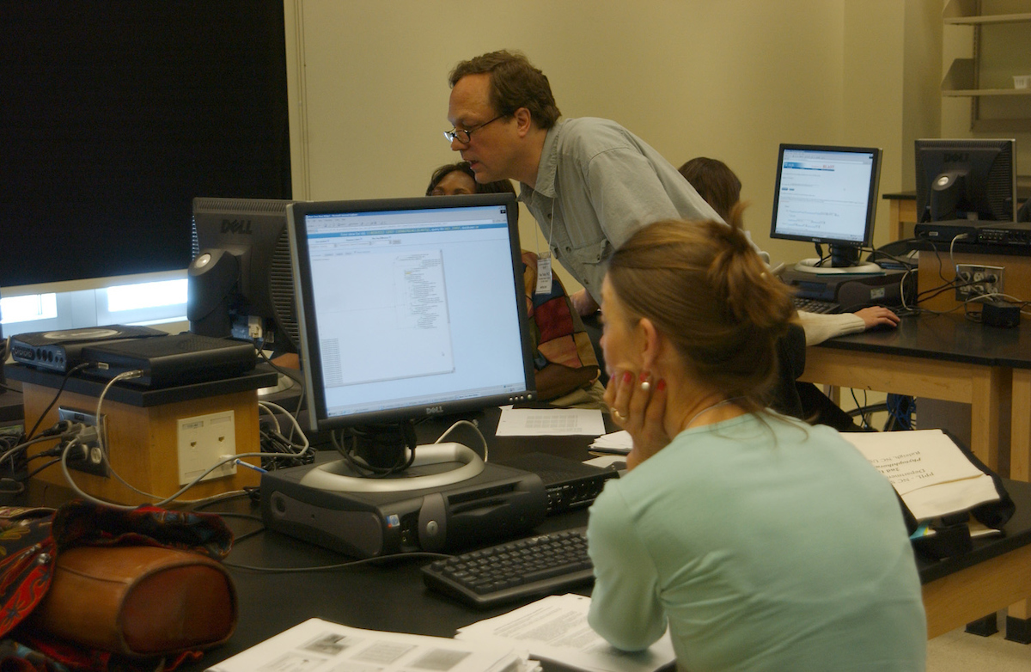
Bonus item !!! Email and listserve ??!!!###$$%%%
Bill Eddy
(High Conflict Institute - San Diego)
Ever receive “hostile” email?
First - Do you need to respond?
If no – don’t !!
If yes – BIFF it
    Brief
      Informative
        Friendly
        Firm

Slide 7


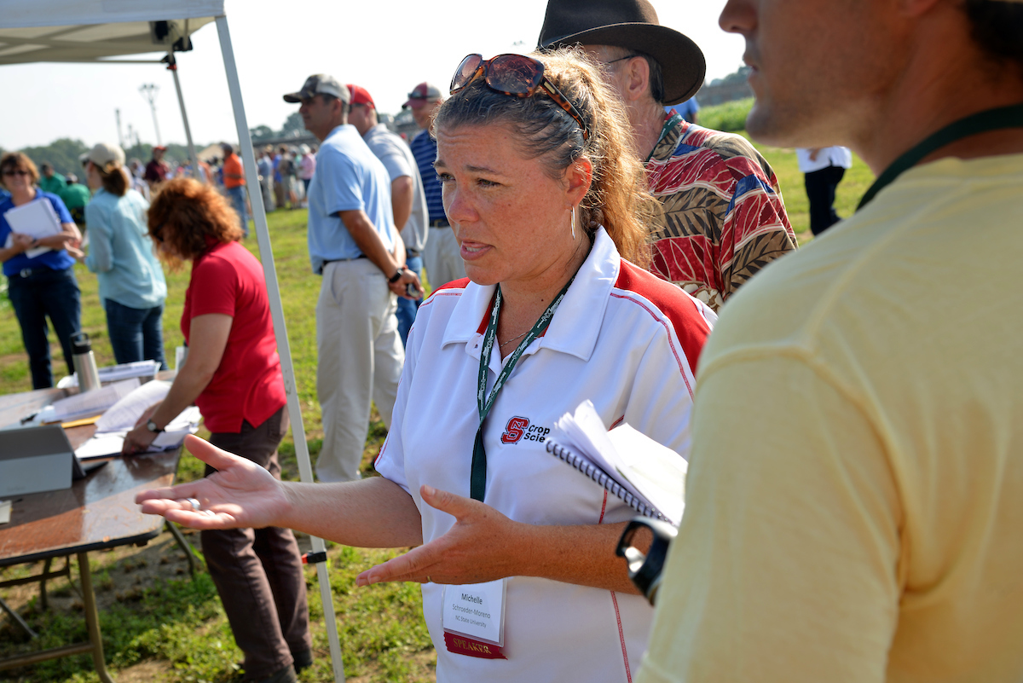

What is an ombuds?
What is an ombuds?

Slide 8
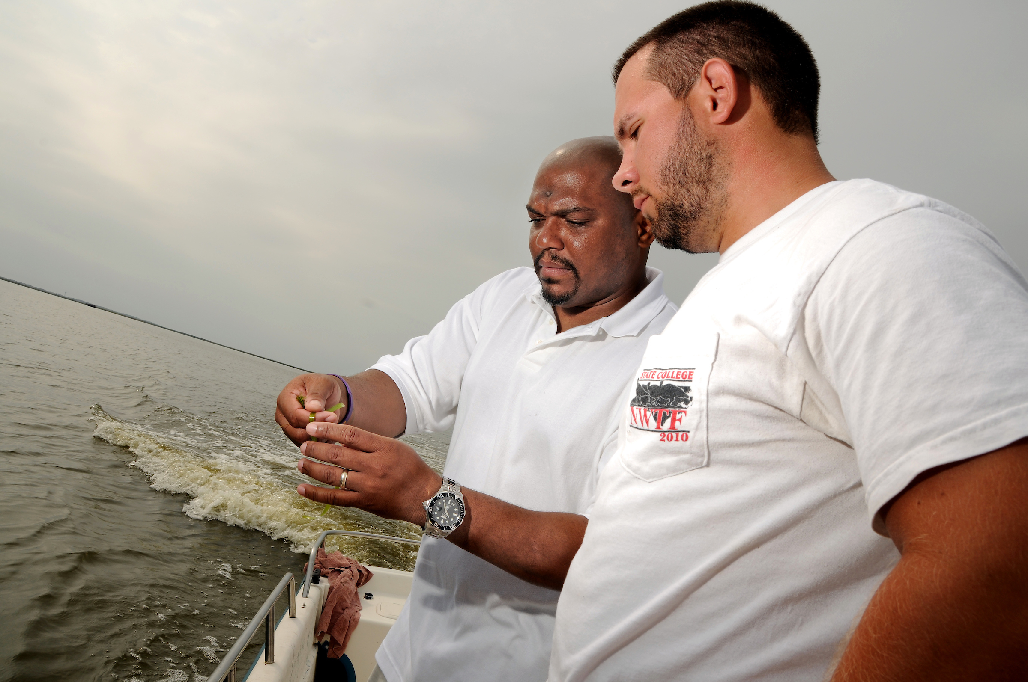
NC State Faculty & Staff Ombuds Office
International Ombuds Association Standards
Independent
Confidential
Informal
Impartial
Navigate
Empower
Connect
Coach

Slide 9
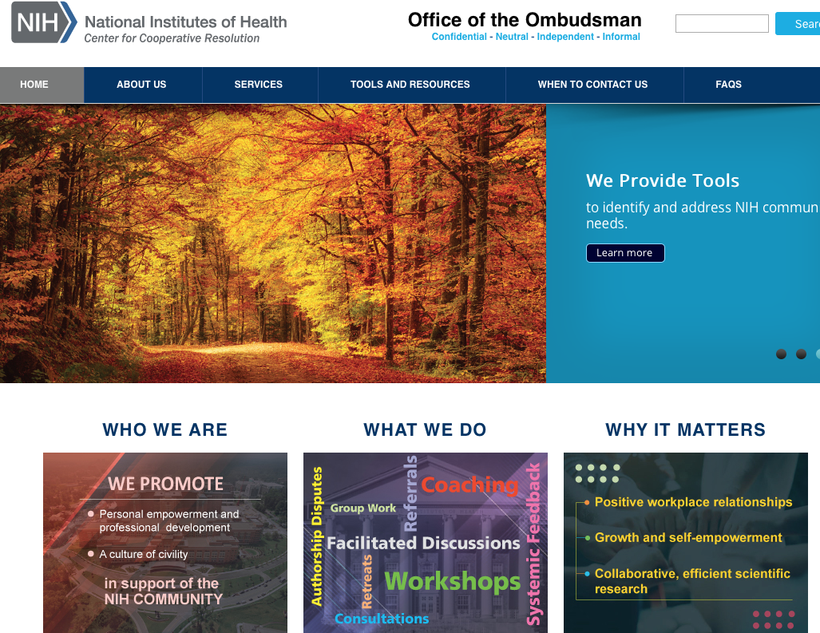
NIH Office of the Ombudsman

Slide 10

Conflict Leadership – Choose Your Style !

Slide 11
Conflict Styles
Avoid
Accommodate / Harmonize
Compromise / Distributive
Compete / Dominate / Direct
Collaborate / Cooperate
(based on Ken Thomas - Ralph Kilmann Conflict Mode
Instrument – TKI and Ron Kraybill – Style Matters)

Slide 12

Avoid - - - What conflict??
It’s a good choice when:
Issue is trivial
You have time
Need cooling off
What we do:
Flee, ignore, withdraw
Put it off to the last
Give it to someone else
Hope it goes away
Notes:
----- Meeting Notes (4/7/20 15:35) -----
It's a bad choice when - use the Chat box to respond.
Usually not so good in the workplace. Things don't seem to go away!!

Slide 13

Accommodate / Harmonize - - - Whatever you want is ok
It’s a good choice when:
Issue is not important to you
You are in a weak position
You believe you may be wrong
What we do:
Quick agreement
Appease, flatter
Soft on the people (except yourself !)
Notes:
----- Meeting Notes (4/7/20 15:35) -----
When is accomondate not a good idea? Use chat box.
Often used in the workplace until overuse leads to strong emotions that impact ability to work with others.

Slide 14
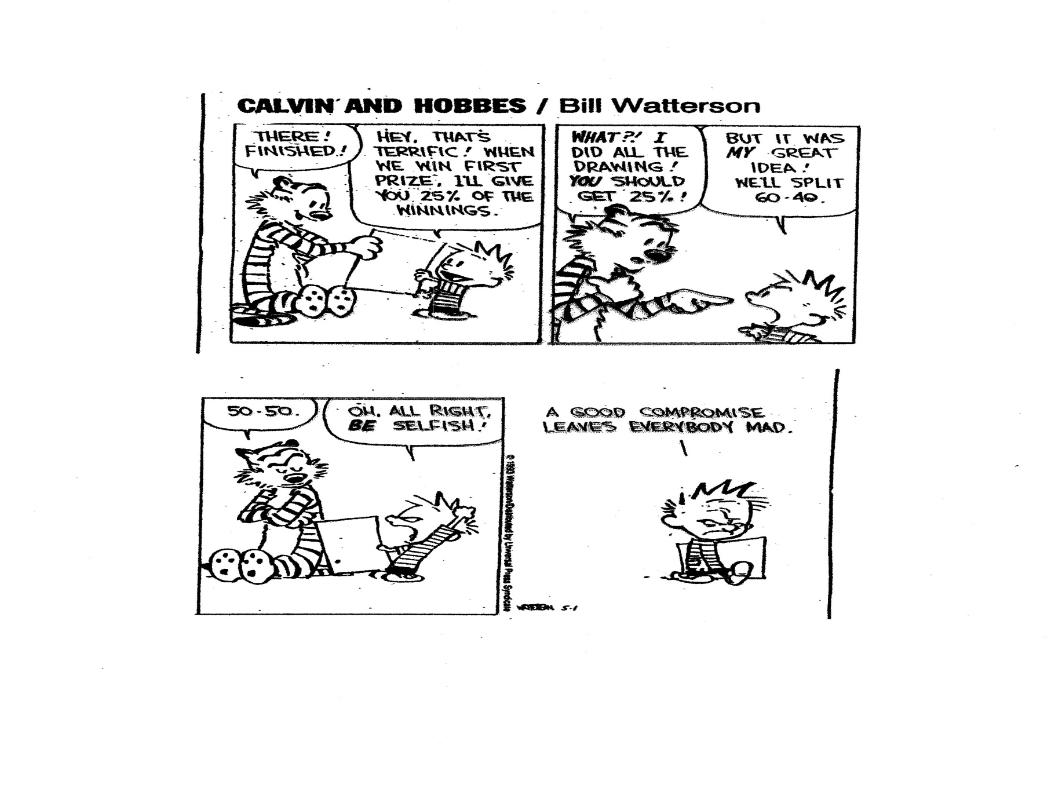
Compromise / Distributive - - - gain some, lose some
It’s the right choice when:
Finding solution better than nothing
Cooperation important, but time limited
What we do:
Active bargaining over fixed resource
Give some to get some
Reactive
Split the difference
Notes:
----- Meeting Notes (4/7/20 15:35) -----
When is compromise not a good idea - use chat box.
We can miss out on creative solutions that provide mutual gain. It keeps us in a zero sum framework that shows up as you vs. me.

Slide 15
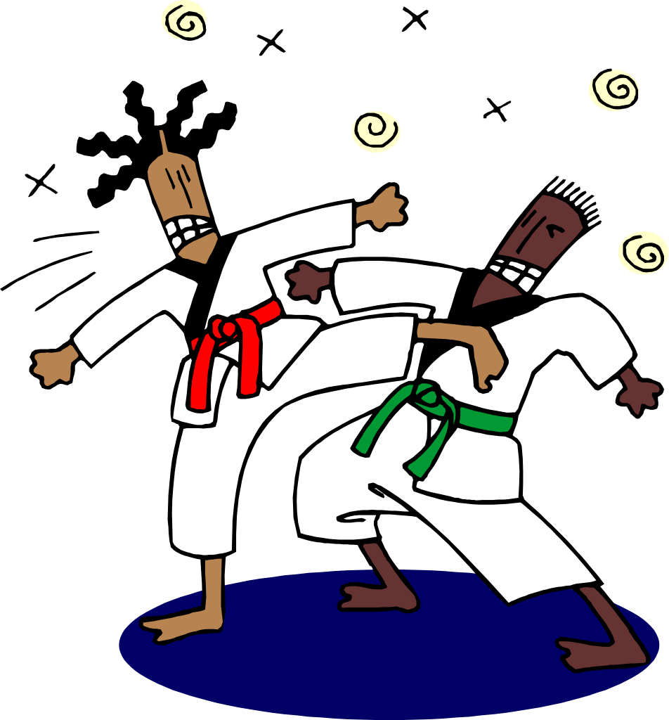
Compete / Dominate / Direct - - - Fight to win!
It’s a good choice when:
Issue is trivial
Time is of the essence
Don’t care about relationships
Others don’t care about outcome
What we do:
Use power of position
High/low initial proposals
Make small concessions
Threat, accuse, exaggerate
Seek to dominate and control, hard on the people and the problem
Notes:
----- Meeting Notes (4/7/20 15:35) -----
When is this choice not so good? - use chat box
This is often a "go to" response based on positional hierachy - just "do it because I'm your boss" - does not build loyalty or willingness to go the extra mile.

Slide 16

Collaborate / Cooperate - - - work together for mutual gain
It’s the right choice when:
Issues & relationships important
Issues complex
Seek to address all aspects
Need help from others to solve
What we do:
Use rational logical persuasion
Develop relationships
Make unilateral steps
Focus on fairness
Notes:
----- Meeting Notes (4/7/20 15:35) -----
When is collaborating not a good idea? Use chat box
This can often be the go to for teams and work groups, yet the facilitative/collaborative skill set is not always in place. How can you get more out of your team? We'll talk about this in the next section after we go to a breakout session.

Slide 17
Think of the different styles –
What would you do?
You’ve just been offered a new job!!! The offer includes a decent salary and benefits package. Do you ask for a higher salary?
Think of other conflicts that you have and consider which style/approach makes sense.
Notes:
----- Meeting Notes (4/7/20 15:35) -----
We are now going to randomly put you into breakout rooms. Zoom should do this automatically and you should be able to see and hear and chat with the people in your room. If you don't get put in a room you'll be in the main room and we will move you manually. If you have an issue in your breakout room - call us for help. You'll have 12 minutes to talk about the two scenarios and when we come back, we'll ask for a few folks to report back and for you to post to chat your ideas. Okay, here we go!!

Slide 18

Negotiation Leadership

Slide 19
Getting to Yes (Principled)
Roger Fisher and Bill Ury
Separate people from the problem/conflict - be hard on the problem and soft on the people
Focus on interests not positions
Generate a range of options for mutual gain
Base choices on some objective or mutually agreeable criteria or standard

Slide 20
Negotiation Model - Interest Based
Win – Win (All Win)
Interests
Positions

Slide 21

BIG PICTURE - Build Relationships

Slide 22

Make a Plan (build in flexibility)

Slide 23
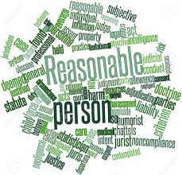
Be Reasonable !

Slide 24
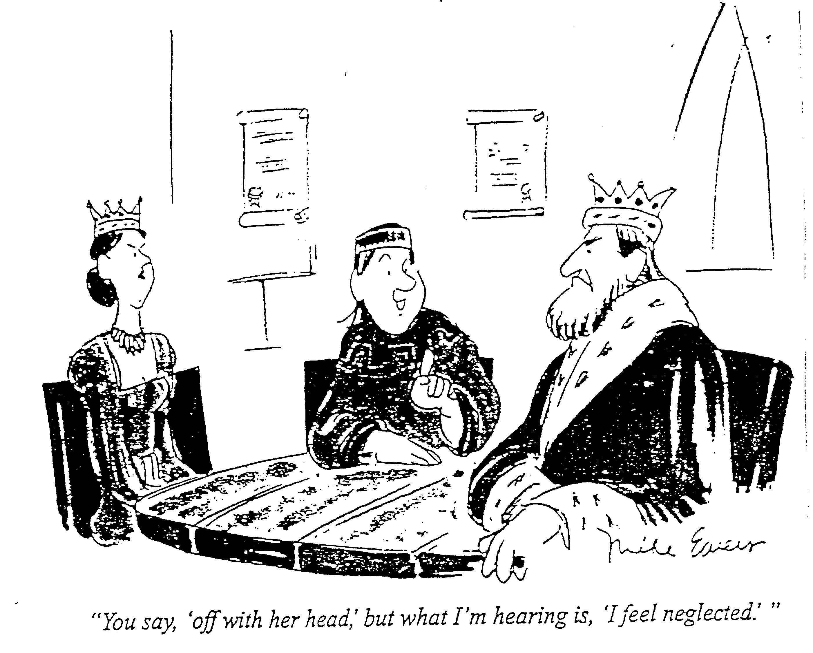
Questions?
Questions?

