Slide 1
2020 NIEHS Biomedical Career Symposium: Applying for Government Jobs
July 24, 2020

Slide 2
Overview
Overview
Federalizing Your Resume
Apply to Positions on USAJOBS
Qualifying for the Job You Want
2

Slide 3
Federalizing Your Resume
Federalizing Your Resume
Federal Resumes Require More Detail Than Standard Resumes
3

Slide 4
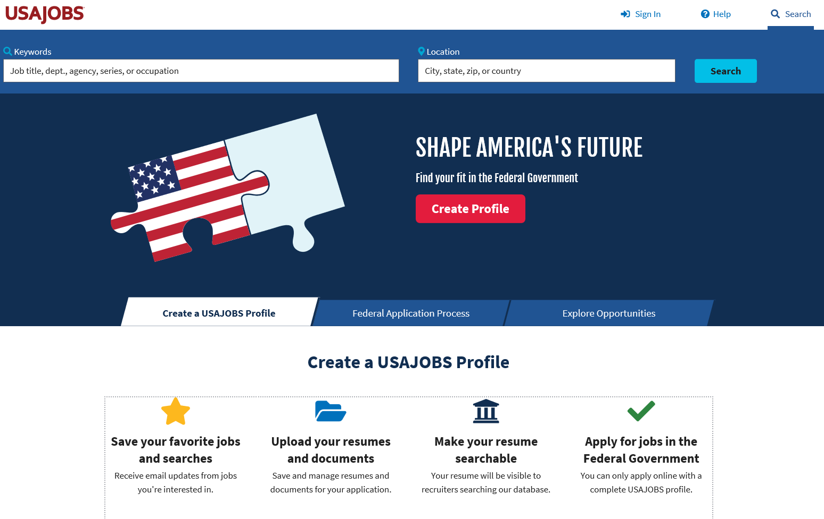
USAJOBS
4

Slide 5
Building Your Online resume
Building Your Online Resume
Personal Information
Name
Address
Phone Number
Email Address
High Career Level Achieved
Getting Started: Universal Format for the Entire Federal Government
5

Slide 6
Building Your Online Resume
Building Your Online Resume
Hiring Eligibility
Citizenship-Only US or Naturalized citizens
Selective Service Status-Males are required by law to register
Veterans’ Status
Federal Status
Special Hiring Options
Competitive vs. Non-competitive Eligibility
6

Slide 7
Building Your Online Resume
Building Your Online Resume
Preferences
Travel
Type of Work
Type of Schedule
Work Location(s)
Demographics
Account Information
Increase the Relevance of Your Search
7

Slide 8
Building your online resume
Building Your Online Resume
Work Experience
Employer Information
Start/End Date- DD/MM/YYYY format
Average Hours-per week
Duties, Accomplishments and Related Skills
Experience: What Set’s You Apart From Every Other Candidate
8

Slide 9
Building your online resume
Building Your Online Resume
Education
School or Program
Location
Degree/Level Attained
Dates-Degree conferred
Major/Minor/GPA
Relevant Coursework, Licensures, Certifications
9

Slide 10
Building your online resume
Building Your Online Resume
Other
Job Related Training
Language Skills
Organizations/Affiliations
Professional Publications
Additional Information
References
10

Slide 11
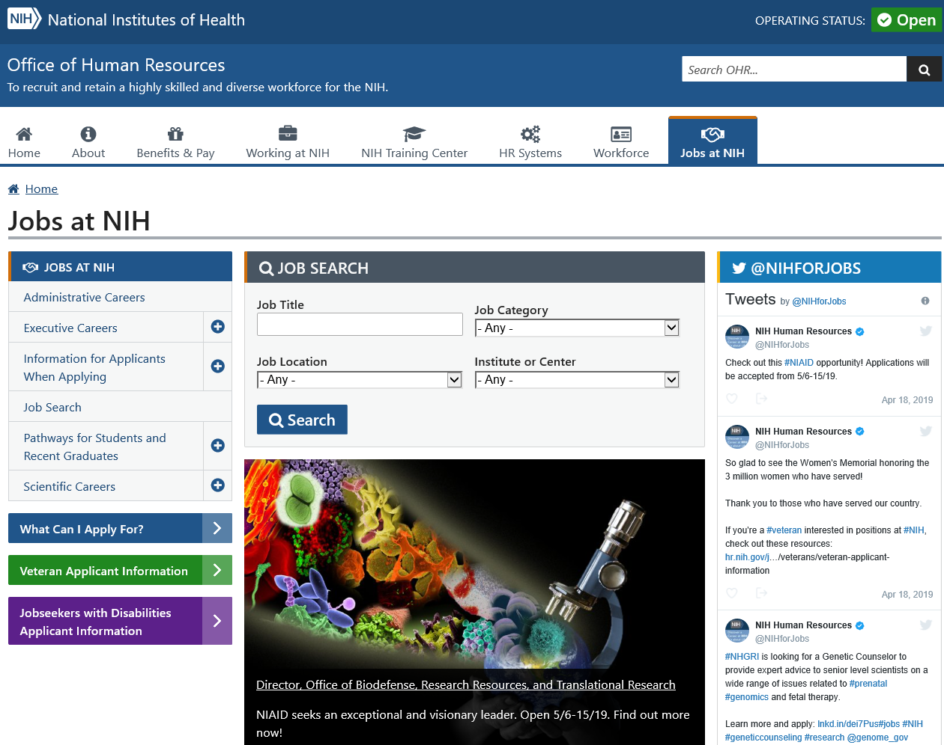
Online Resources
Online Resources
Jobs @ NIH – official web page
http://www.jobs.nih.gov/
11

Slide 12
USAJOBS Announcements
USAJOBS Announcements
12

Slide 13
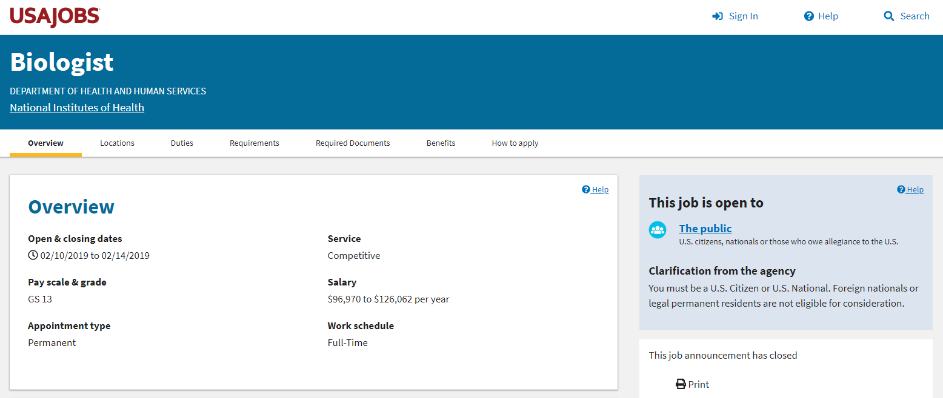
USAJOBS Announcements
USAJOBS Announcements cont.
13

Slide 14
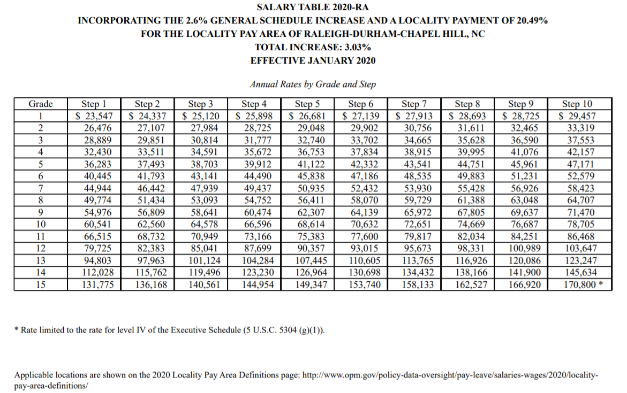
General Schedule Grades and Steps
General Schedule Grades and Steps
14

Slide 15
USAJOBS Announcements
USAJOBS Announcements cont.
15

Slide 16
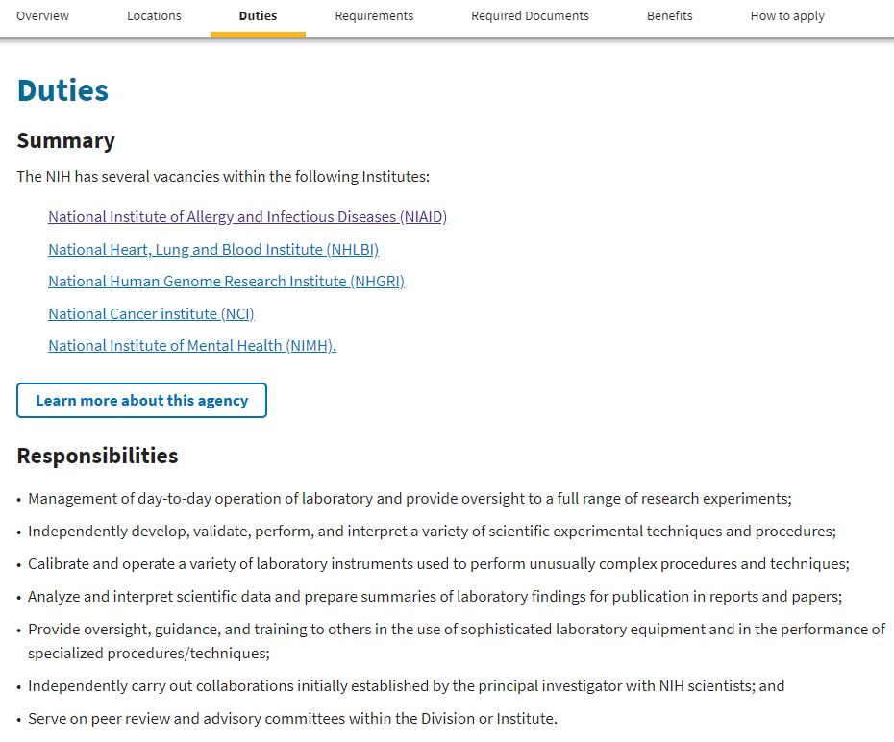
USAJOBS Announcements
USAJOBS Announcements cont.
16

Slide 17
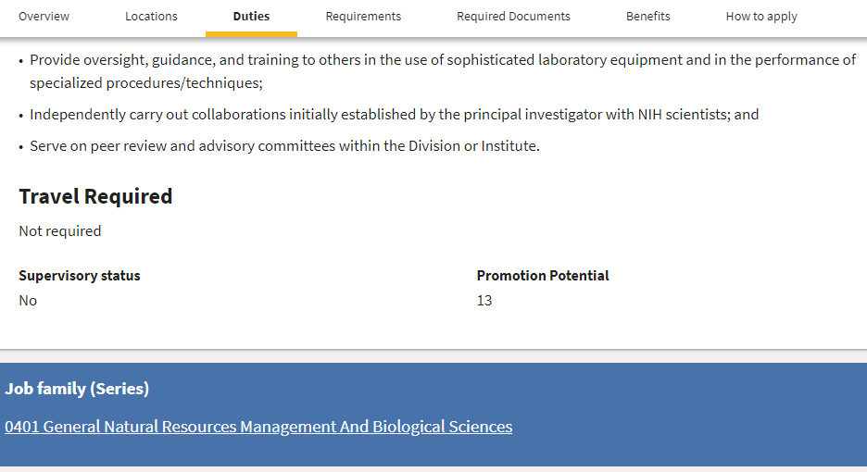
USAJOBS Announcements
USAJOBS Announcements cont.
17

Slide 18
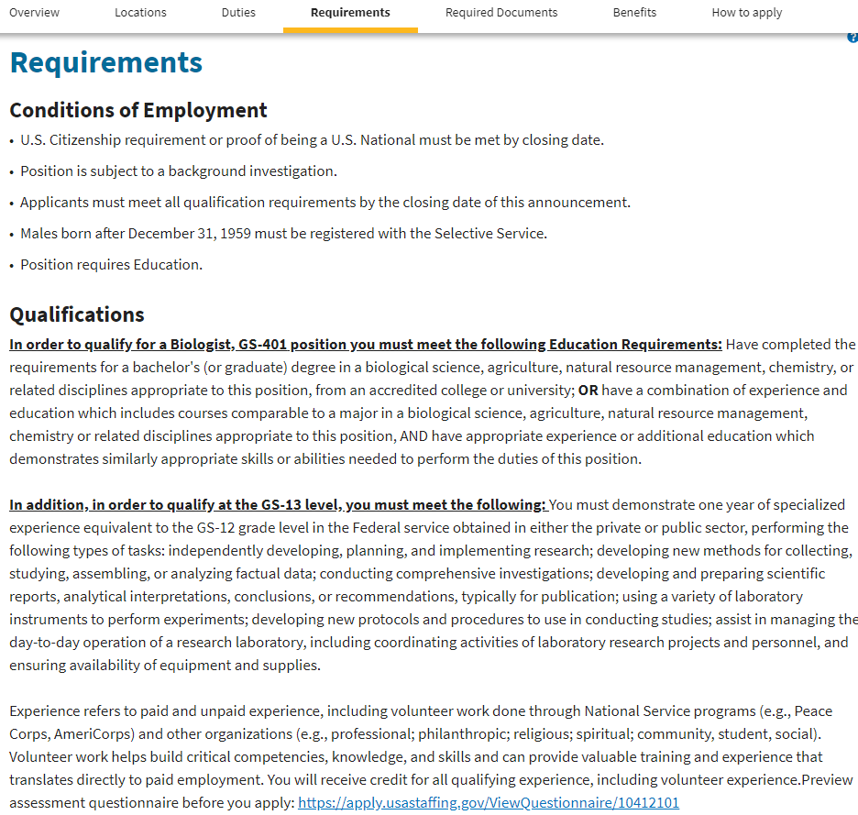
USAJOBS Announcements
USAJOBS Announcements cont.
18

Slide 19
What is specialized experience?
What is Specialized Experience?
Experience related to the position
One year at the next lower grade level
19

Slide 20
Specialized Experience
Specialized Experience
In addition, in order to qualify at the GS-13 level, you must meet the following: You must demonstrate one year of specialized experience equivalent to the GS-12 grade level in the Federal service obtained in either the private or public sector, performing the following types of tasks: independently developing, planning, and implementing research; developing new methods for collecting, studying, assembling, or analyzing factual data; conducting comprehensive investigations; developing and preparing scientific reports, analytical interpretations, conclusions, or recommendations, typically for publication; using a variety of laboratory instruments to perform experiments; developing new protocols and procedures to use in conducting studies; assist in managing the day-to-day operation of a research laboratory, including coordinating activities of laboratory research projects and personnel, and ensuring availability of equipment and supplies.
20

Slide 21
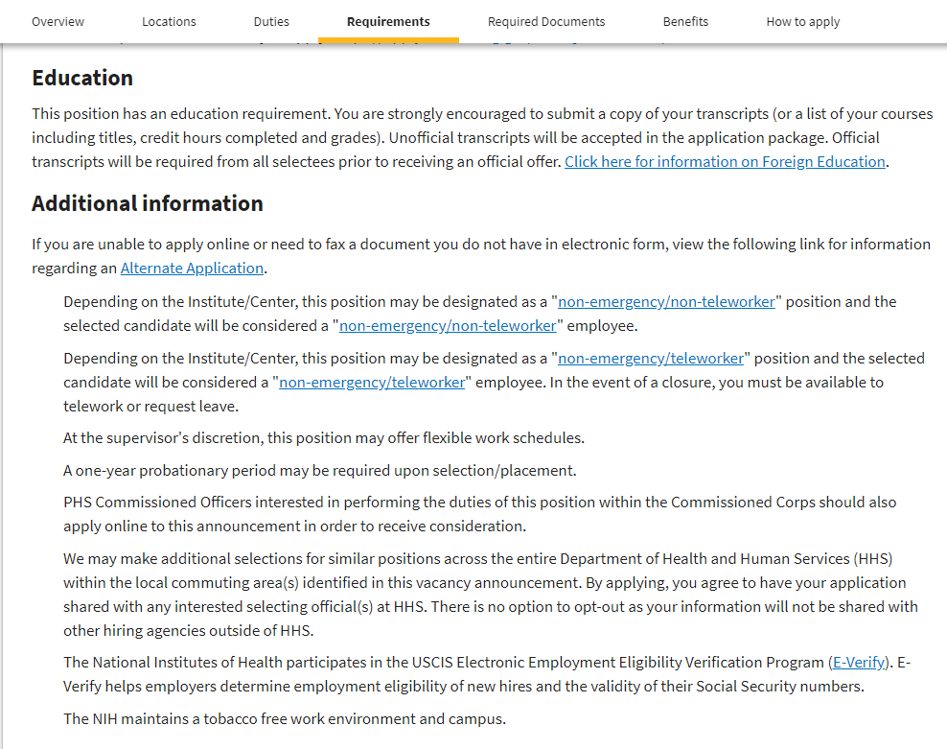
USAJOBS Announcements
USAJOBS Announcements cont.
21

Slide 22
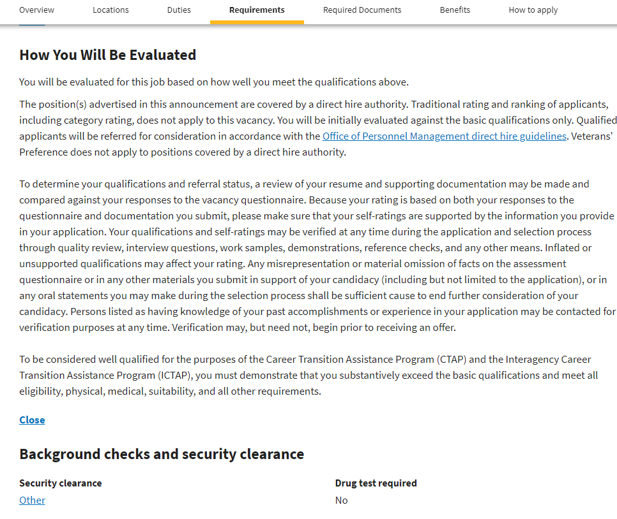
USAJOBS Announcements
USAJOBS Announcements cont.
22

Slide 23
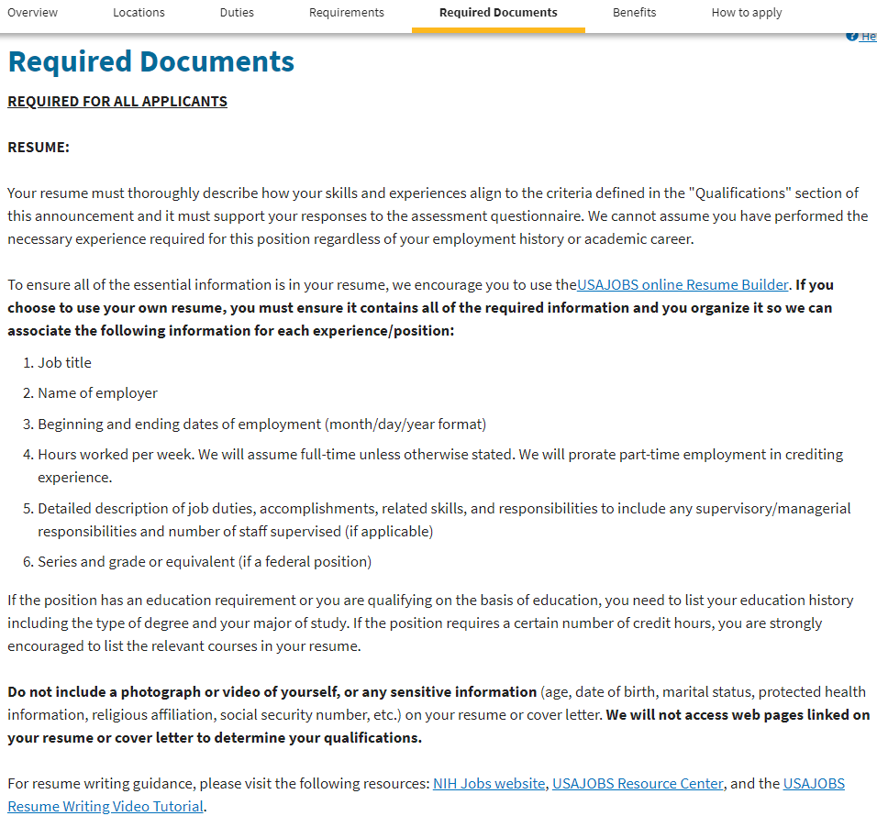
USAJOBS Announcements
USAJOBS Announcements cont.
23

Slide 24
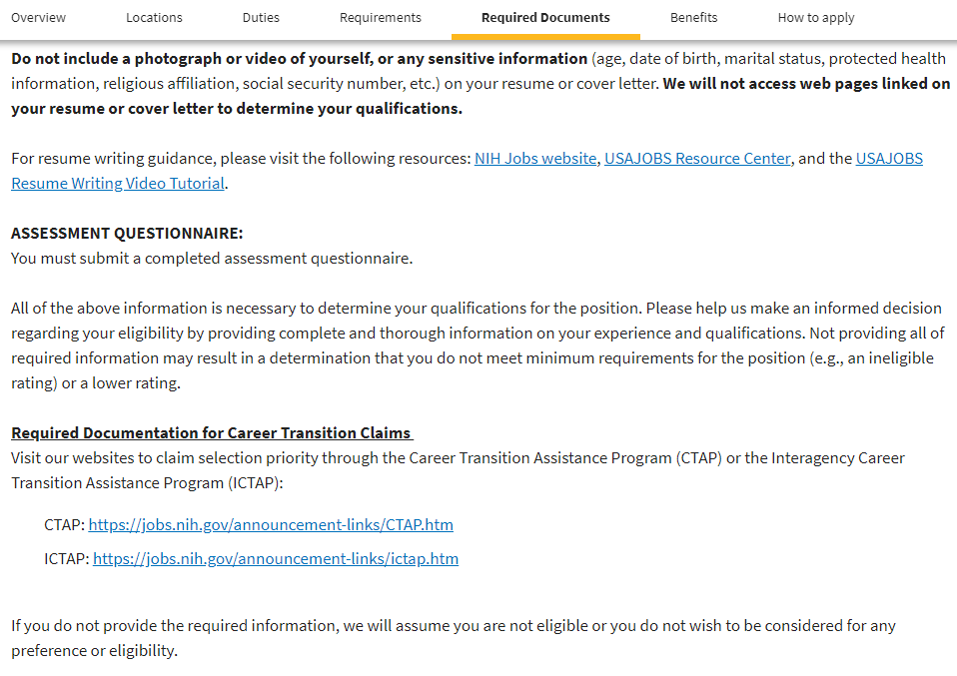
USAJOBS Announcements
USAJOBS Announcements cont.
24

Slide 25
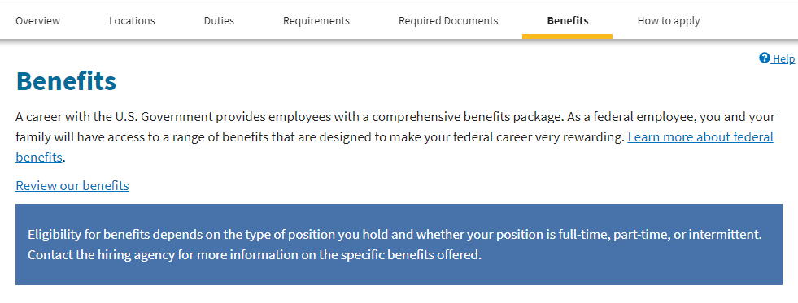
USAJOBS Announcements
USAJOBS Announcements cont.
25

Slide 26
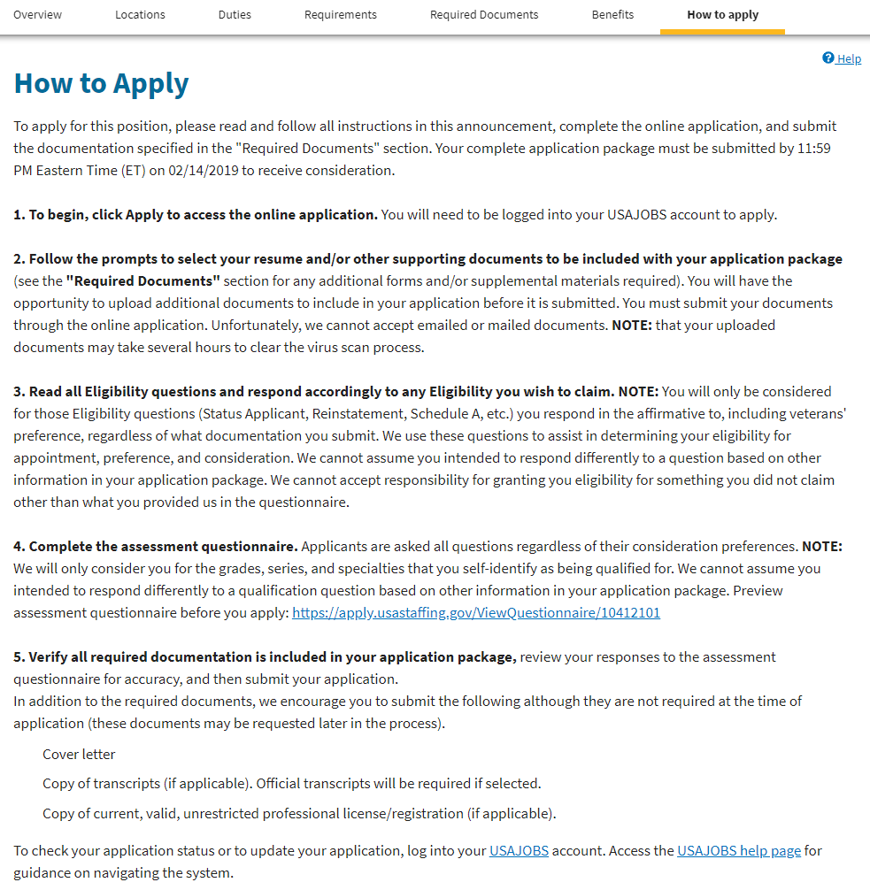
USAJOBS Announcements
USAJOBS Announcements cont.
26

Slide 27
Resources
Resources
NIH Jobs Website (Federal Resume Tips) - http://www.jobs.nih.gov/jobsearch/FederalResume.htm
Federal Agency Core Competencies - www.vetfedjobs.org/competencies.doc
USAJOBS Resource Center - https://help.usajobs.gov/index.php/Main_Page
Qualification Standards by Series - http://www.opm.gov/qualifications/standards/indexes/num-ndx.asp
Subscribe to an OPM List - http://apps.opm.gov/Listserv_Apps/list-sub.cfm
Ten Steps to a Federal Job (Kathryn Troutman) - http://www.resume-place.com/
Emotional Intelligence (Daniel Goleman) - http://danielgoleman.info/topics/emotional-intelligence/
27

Slide 28
Real-World Application Example Health Scientist: Office of Fellows’ Career Development Tammy R.L. Collins, Ph.D. Director, Office of Fellows’ Career Development

Slide 29
How are government resumes evaluated?
How Are Government Resumes Evaluated?
First screened by human resources
MUST pass this first screen for it to be forwarded to hiring manager
Rated based on how well you can perform the job duties = look at application and answers to the questions
Put into a category based on your rating = EX: Best Qualified, Well-Qualified, Qualified; you want to be in the ‘Best Qualified’ category
Hiring manager receives a ‘Certificate of Eligibles’ in which candidates are rank-ordered

Slide 30
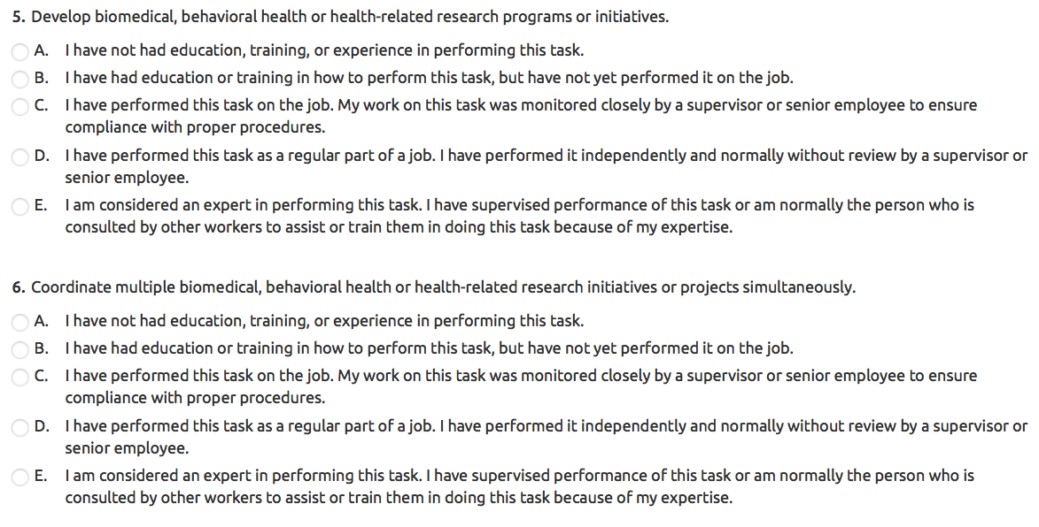
Sample Questions

Slide 31
Key differences of government resume
Key Differences of Government Resumes?
Demonstrate experience in every skill required
No page limit

Slide 32
What additional considerations for government applications?
What Additional Considerations for Government Applications?
Spoon-feed information to HR
Make it easy to determine how you are qualified for the position and can do the job
Ensure you are truly an ‘Expert’ at the questions they ask; don’t be modest
Questions reflected in application
Volunteer experience counts!
Networking!

Slide 33
More tips
More Tips
Upload a nicely formatted PDF RESUME as a separate document and copy/paste info into the USAJOBS resume builder
Upload additional supporting documents (cover letter, references, etc.)
Does your application seem exceedingly long?
You’re doing it right!

Slide 34
Step-by-step approach
Step-by-Step Approach:
1: ID Qualifications
2: Pick Out Keywords & Make Example for Each Qualification
3: Create Summary of Qualifications
4: ID Duties/ Requirements
5: Pick Out Keywords & Make Examples for Each Requirement
9: Layout Resume with Headings, Include Bullets Regarding All Aspects of Job Throughout
6: Create Summary of Accomplishments as it Relates to Duties
7: ID Questions & Make Examples for Each Question
8: Create bullets using STAR technique

Slide 35
Qualifications Example
developing and overseeing scientific research education and mentoring programs;
analyzing the effectiveness of career development programs;
preparing scientific papers, posters and reports for publication in the peer-reviewed scientific literature and for presentation to senior scientific leadership;
organizing scientific workshops or symposia to enhance the scientific skills of trainees;
advising trainees regarding career decisions, grants preparation and submission, stipend and benefits information, and conflict resolution.

Slide 36
Resume sample

Slide 37
Responsibilities/Duties
Design, implement, and evaluate career enhancement programs;
Develop guidance and operational procedures to improve the National Institute of Environmental Health Sciences (NIEHS) training experience;
Provide individualized administrative and scientific guidance to NIEHS trainees and track their progress and career placements;
Keep abreast of national trends in career development;

Slide 38
Responsibilities/Duties, cont’d
Provide scientific, administrative, and management oversight of the NIEHS Summer Internship Program;
Draft and defend an annual budget for the Office of Fellows' Career Development (OFCD);
Provide expert technical advice and policy interpretation to NIEHS Leadership.

Slide 39
Resume sample

Slide 40
Job Question Examples
25. Provide oversight of a scientific program.
Provided oversight of the scientific program for ~40 NIEHS summer interns; supervised a team of 8-10 trainees and employees to develop and teach topics in Global Environmental Health and Exposure Biology
37. Evaluate work performance of subordinate employees.
Evaluated the work performance of four subordinate undergraduate research employees; met weekly and provided oral and written recommendations for developing their critical research, thinking, and writing skills

Slide 41
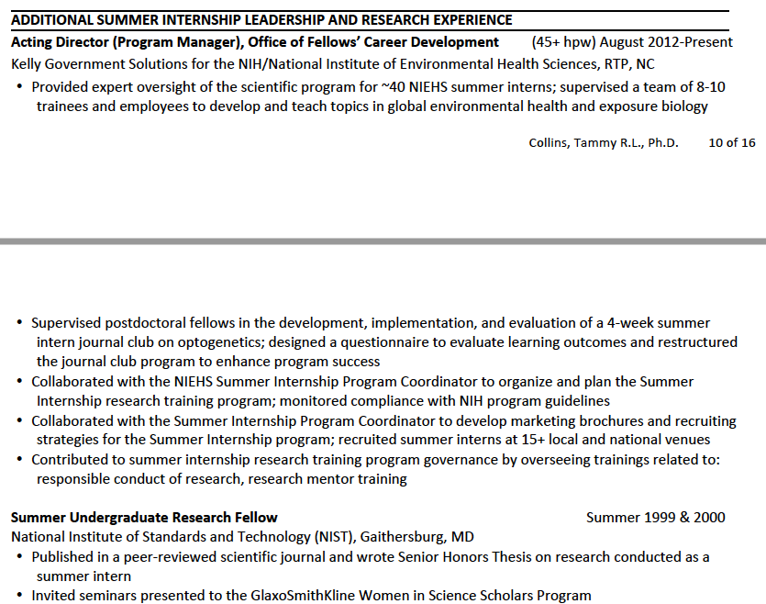
Resume sample

Slide 42
HOW? Articulate Using STAR
Who benefitted and how? What was the impact? What were the key deliverables, measures, or standards? What was your specific contribution?
S
Describe the situation or provide some background on your achievement. Why did you do it? Why is it important? Responding to what problem?
Situation
R
T
Result
Task
In carrying out the tasks, what were some of the specific actions you took? Elaborate on processes, procedures, and methods.
In responding to the situation, what task did you decide to carry out?
Action
A

Slide 43
Thoughts on the STAR technique
Thoughts on the STAR technique...

Slide 44
STAR
As co-chair of a 19-member symposium committee serving ~400 attendees,
thus increasing team motivation as evidenced by reaching planning milestones 3 months ahead of schedule
S
streamlined communication flow amongst the group by
R
T
A
creating online, group accessible & editable documentation; regularly kept the team abreast of planning progress and organized teambuilding activities

Slide 45
Resume Sample

Slide 46
Resume Sample

Slide 47
Resume Sample

Slide 48
Types of Government Jobs
Types of Government Jobs
Principal Investigator: NOT found on USAJOBS, typically found on Institute website. Department-specific searches. (NOTE: NIH-wide Earl Stadtman Search)
Staff Scientist: NOT found on USAJOBS, typically found on Institute website.
Postdoc: NOT found on USAJOBS, typically contact PI directly or search OITE Jobs Boards
Biologist, Chemist, etc.: USAJOBS, GS position
Program Analysts, Administrators, etc.: ex: “Health Scientist Administrator” USAJOBS, GS position
Other Agencies: EPA, NSF, FDA, CDC, DOD, DOE, SI

Slide 49
Postdoctoral Fellow Pay at NIEHS
Postdoctoral Fellow Pay at NIEHS

Slide 50
Working at NIEHS

Slide 51
Search Federal Employee Salaries
Fedsdatacenter.com

Slide 52
Salaries

Slide 53
Step by Step Approach
Step-by-Step Approach:
1: ID Qualifications
2: Pick Out Keywords & Make Example for Each Qualification
3: Create Summary of Qualifications
4: ID Duties/ Requirements
5: Pick Out Keywords & Make Examples for Each Requirement
9: Layout Resume with Headings, Include Bullets Regarding All Aspects of Job Throughout
6: Create Summary of Accomplishments as it Relates to Duties
7: ID Questions & Make Examples for Each Question
8: Create bullets using STAR technique

Slide 54
Using the STAR with resumes
X
Using the STAR with Resumes...
..... SSSS TTTTT AAAAA RRRRRRR .......... ................ .......................... ..... ....... .... ........

Slide 55
Using the STAR with resumes
Using the STAR with Resumes...

Slide 56
Questions?

Slide 57
Extra Slides

Slide 58
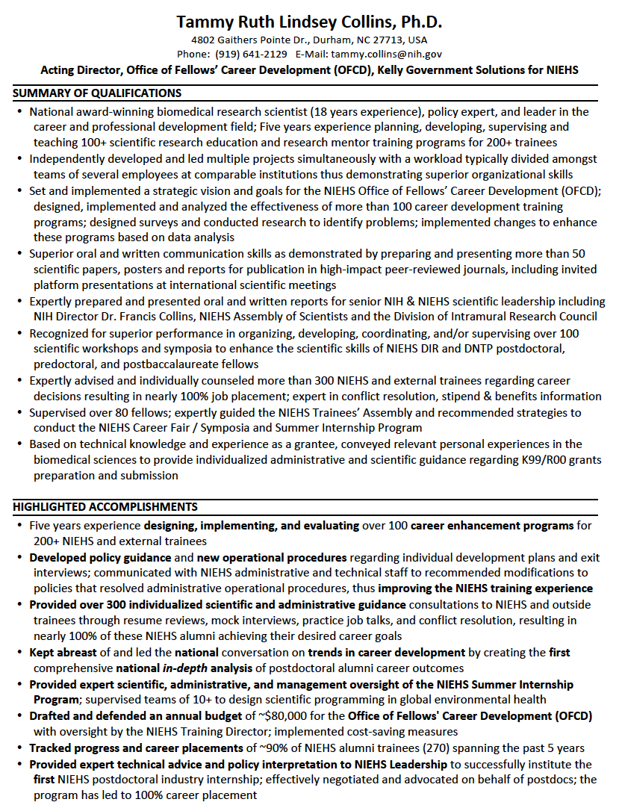
Resume sample

Slide 59
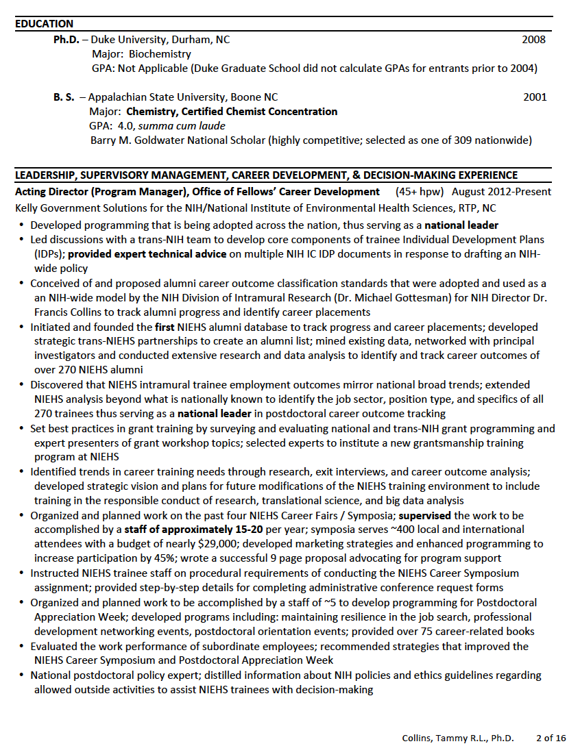
Resume sample

Slide 60
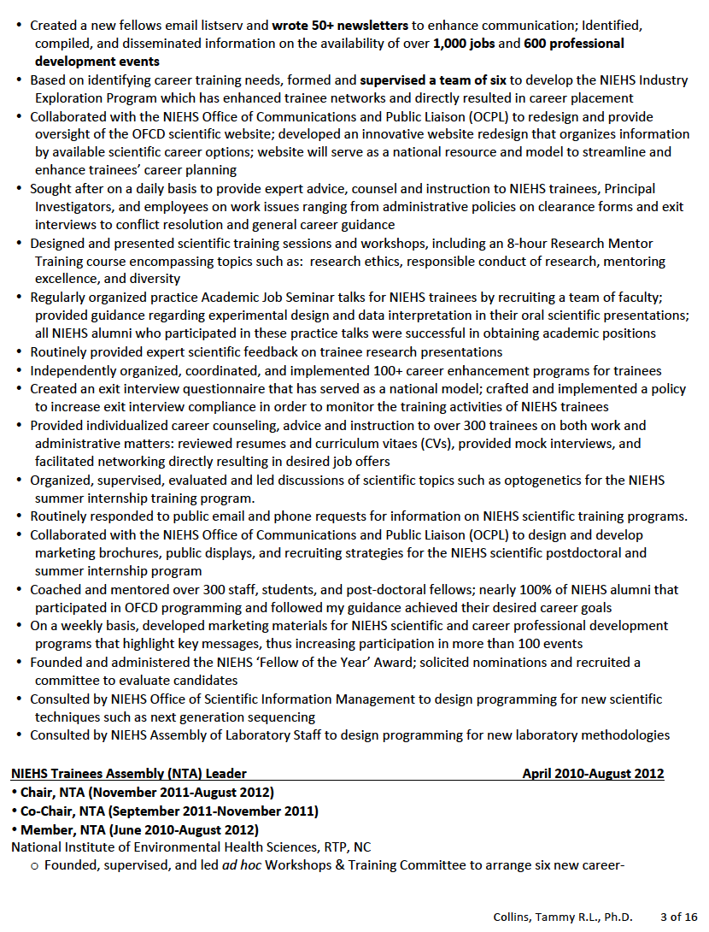
Resume sample

Slide 61
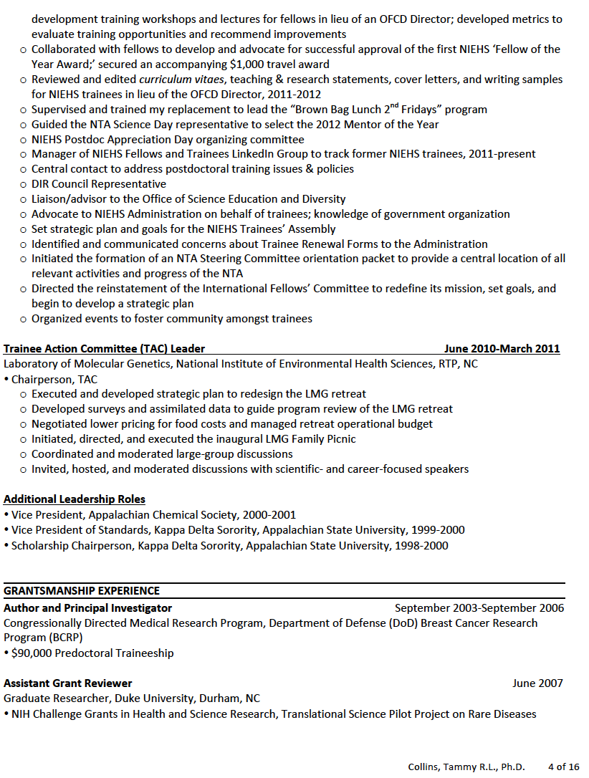
Resume sample

Slide 62
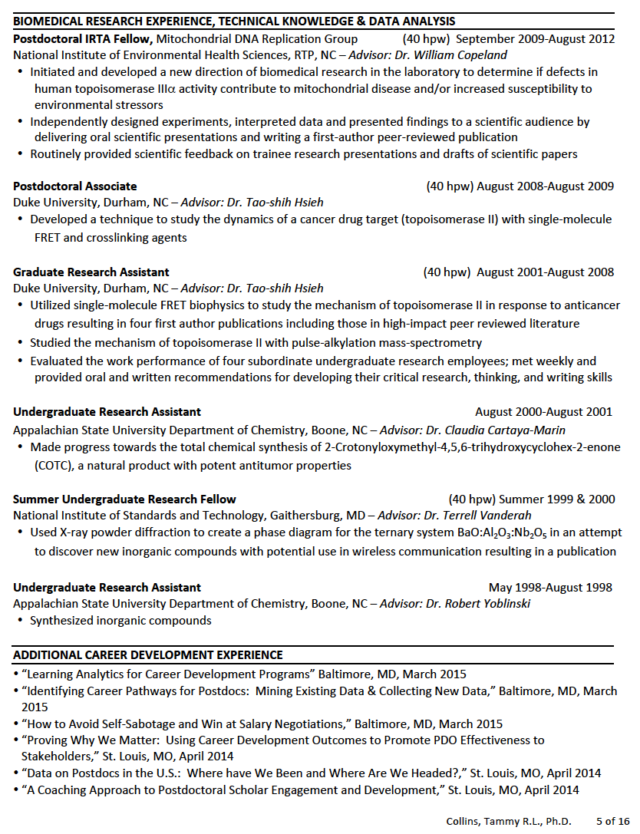
Resume sample

Slide 63
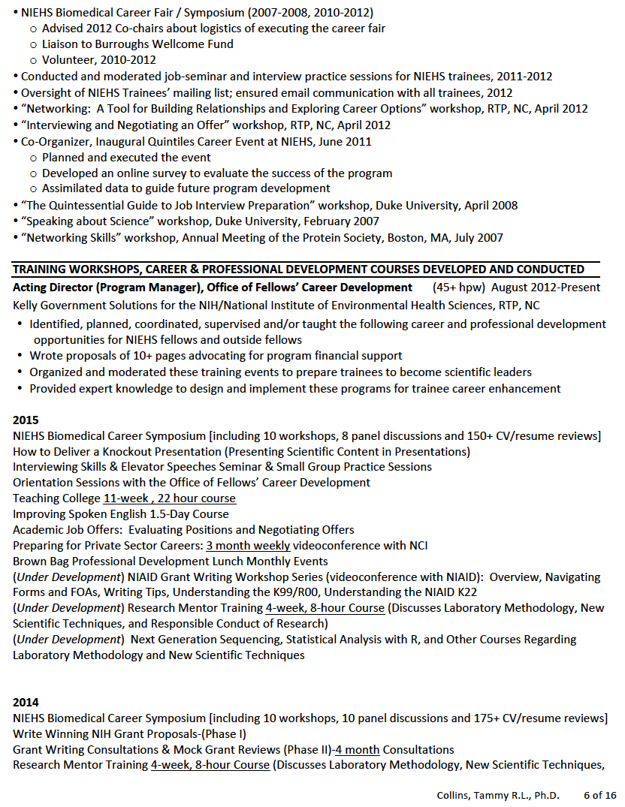
Resume sample

Slide 64
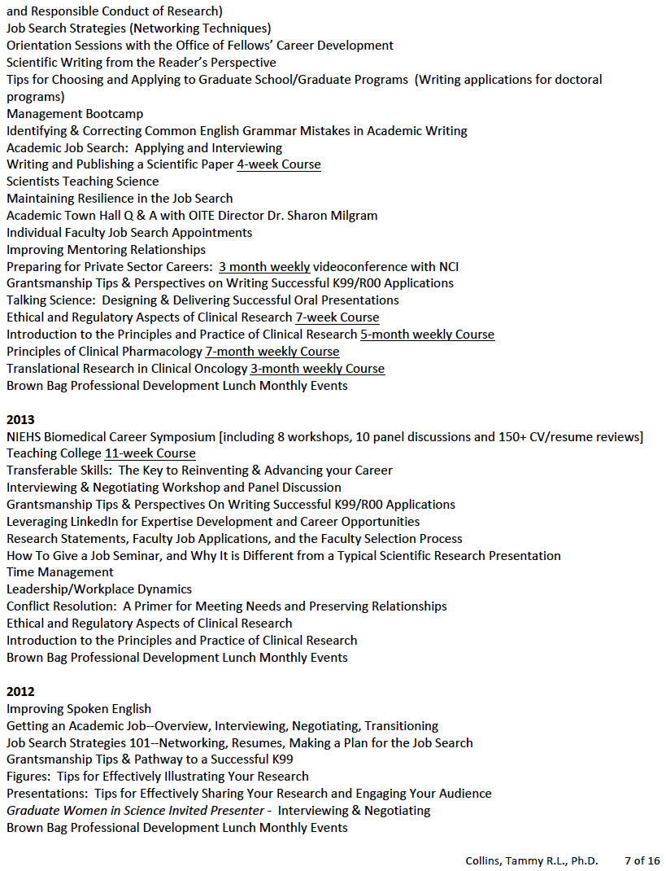
Resume sample

Slide 65
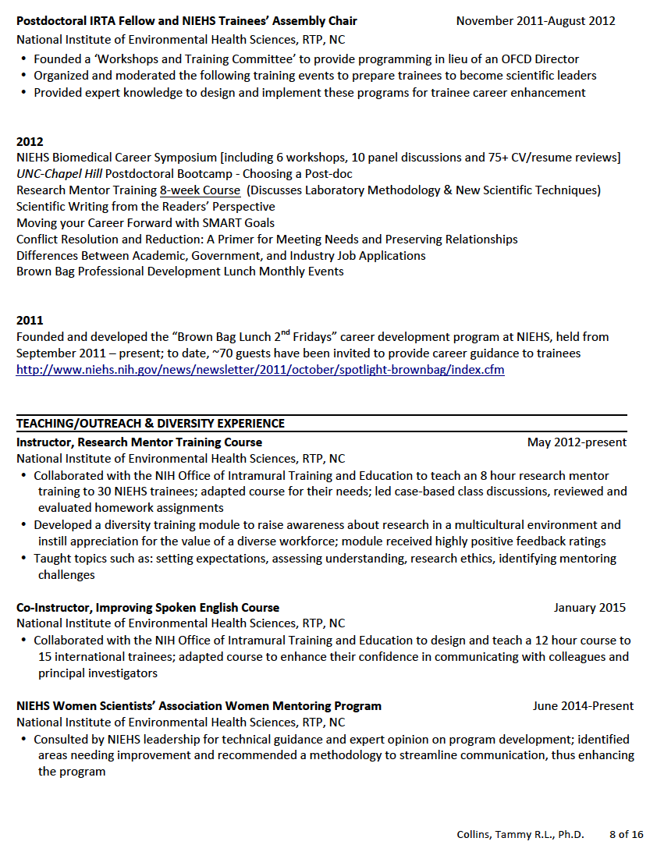
Resume sample

Slide 66
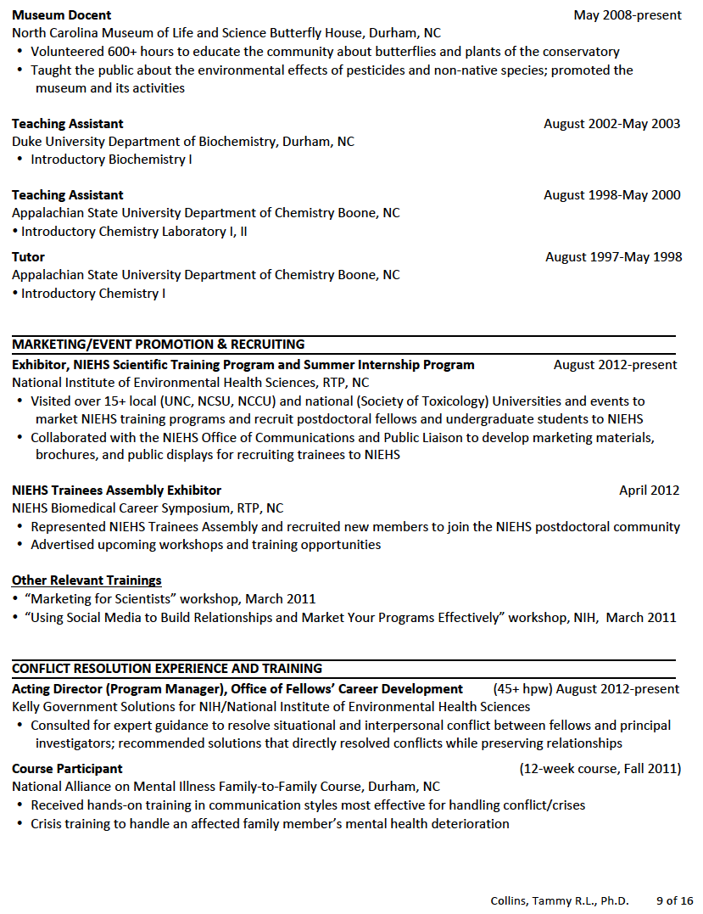
Resume sample

Slide 67
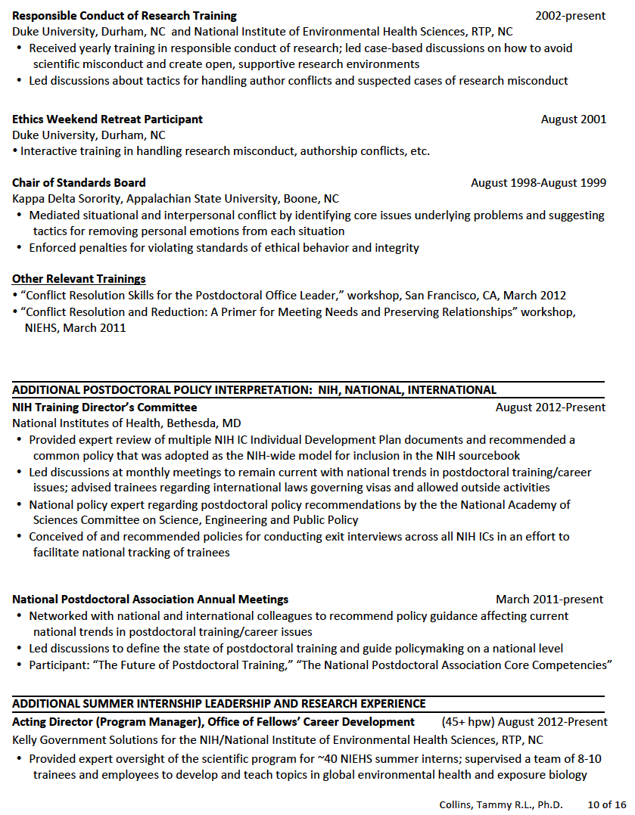
Resume sample

Slide 68
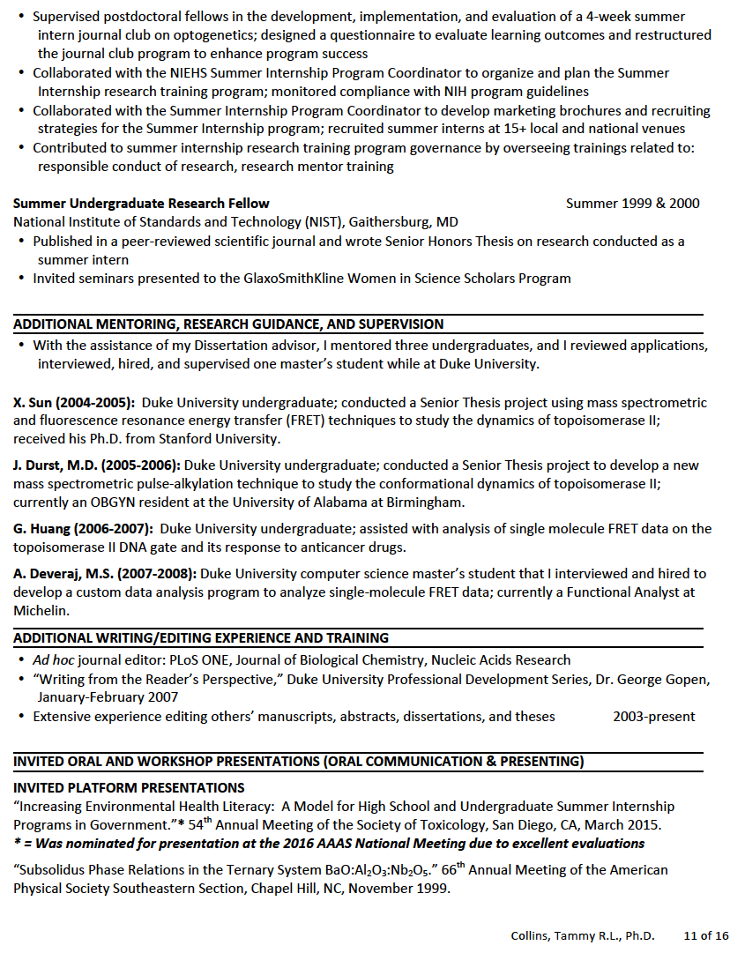
Resume sample

Slide 69
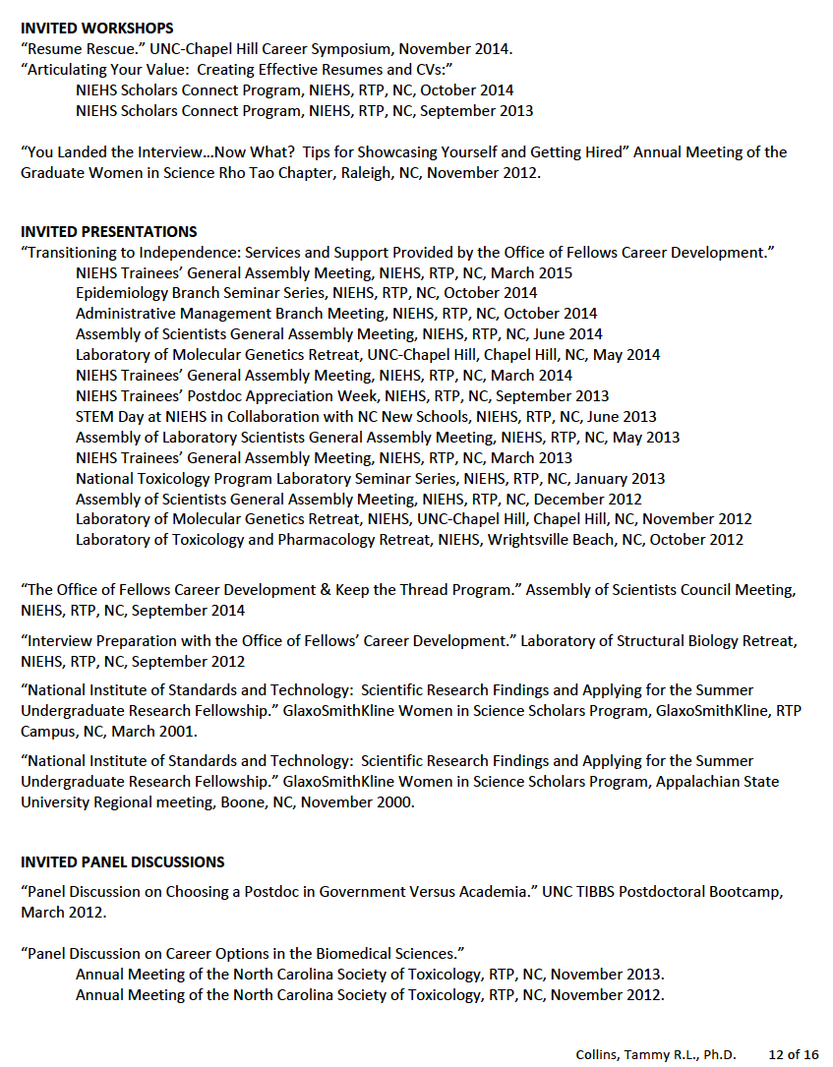
Resume sample

Slide 70
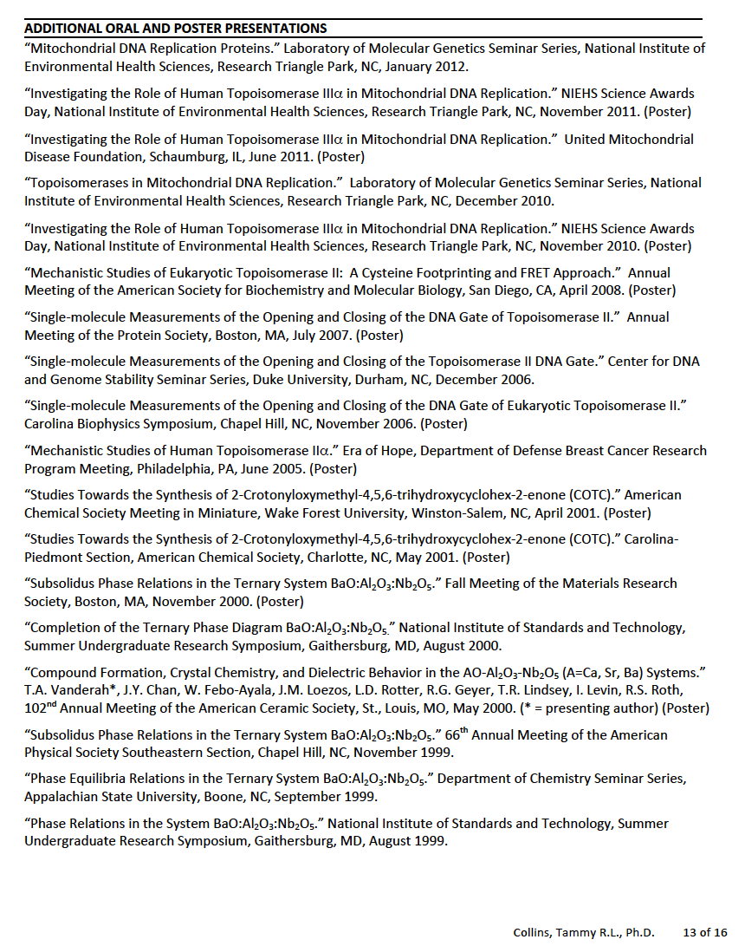
Resume sample

Slide 71
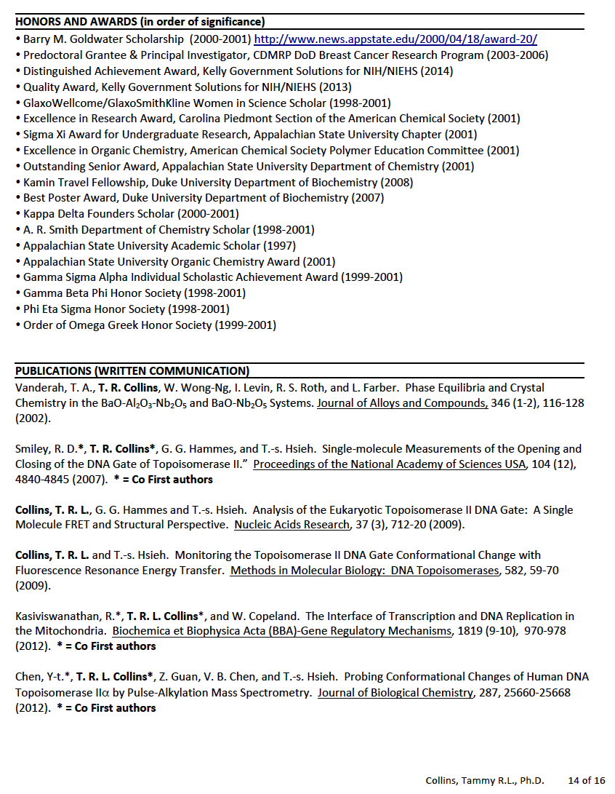
Resume sample

Slide 72
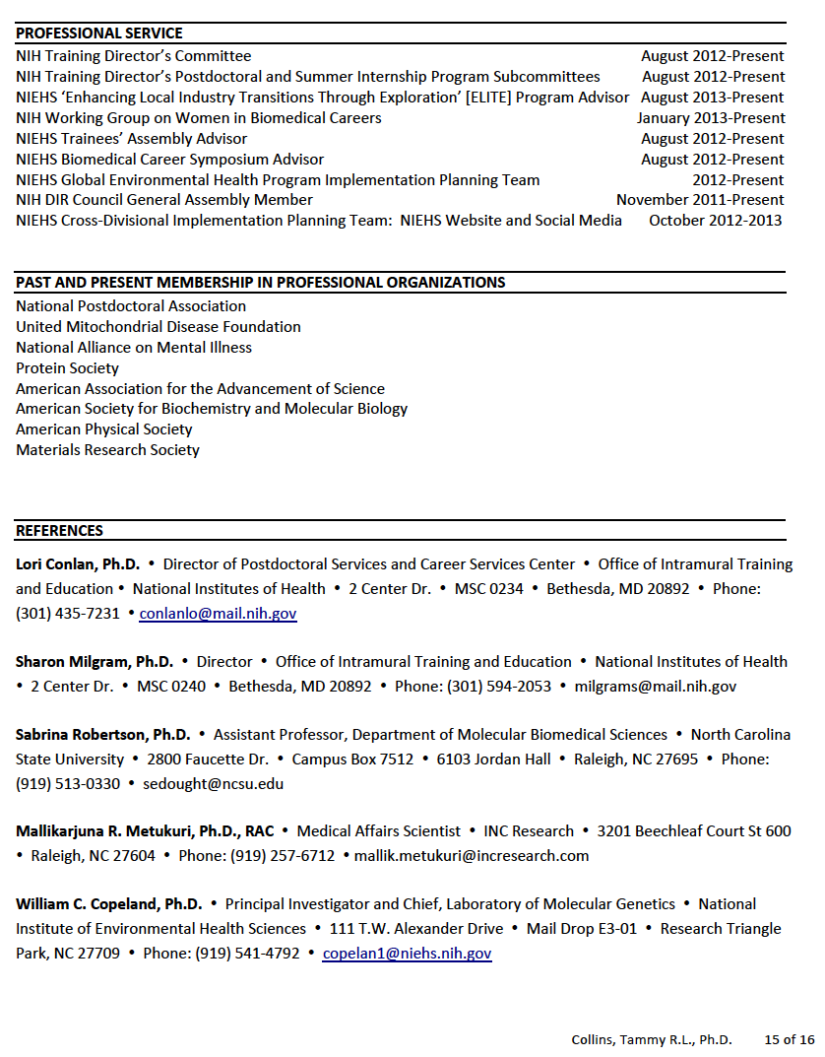
Resume sample

Slide 73
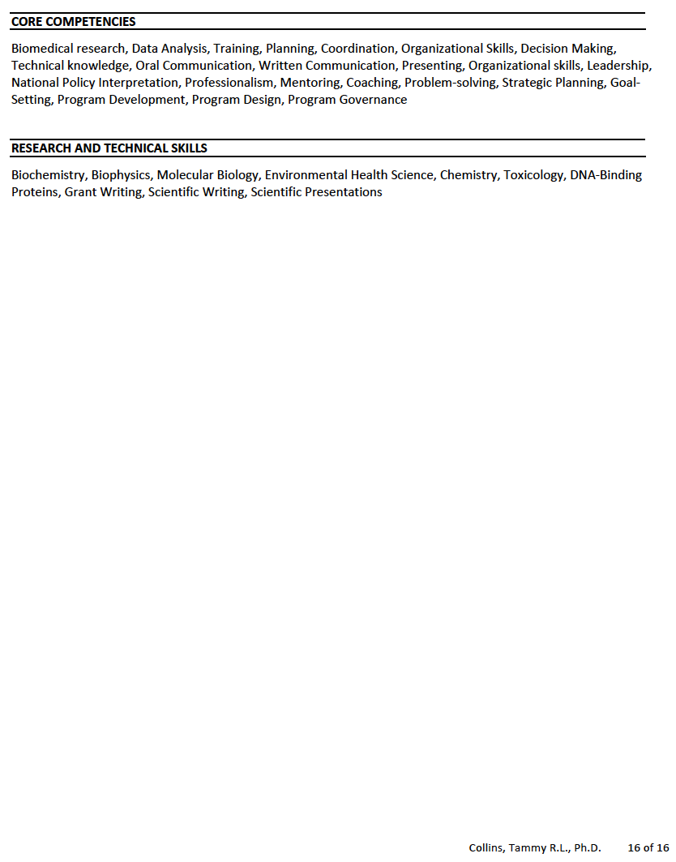
Resume sample

